Slide 1
Final Project
Group 5
Denis Akbari, Javier Gutierrez, & Esdras Solorzano
CIS 4560-01
Professor Jongwook Woo

Slide 2
Our Datasets
The data set, Data science for COVID-19, focuses on datasets based on the Coronavirus in South Korea. We chose this data because of the recent pandemic. The dataset we will be using will be age, gender, provinces, status, etc.
Approximately 10,000 South Koreans have been infected by COVID-19. The KCDC (Korea Centers for Disease Control & Prevention) releases COVID-19 information rapidly and transparently. The data was extracted from research from the KCDC and local governments. Based on KCDC and local government reports, we create a structured dataset. We analyze and visualize the data using data mining and visualization techniques.

Slide 3
Data Source URLs
https://www.kaggle.com/kimjihoo/coronavirusdataset?fbclid=IwAR1V1oLbBY3gako_2s27chpybGrF8l5eH7NWyj685Ol9BKNyqJ0Ym-YCThw
https://www.kaggle.com/datasets/allen-institute-for-ai/CORD-19-research-challenge?select=metadata.csv

Slide 4
Data Specifications
Data Set | Size (10.47 GB)
TimeAge.csv | 27.11 KB
Region.csv | 19.08 KB
Case.csv | 11.71 KB
cord_19_embeddings_2021-05-31.csv | 8.84 GB
metadata.csv | 1.57 GB
PatientInfo.csv | 488.86 KB
Policy.csv | 5.71 KB
SearchTrend.csv | 71.72 KB
SeoulFloating.csv | 49.68 MB
Time.csv | 6.6 KB
TimeGender.csv | 6.97 KB
TimeProvince.csv | 92.03 KB
Weather.csv | 1.5 MB
Each file had already been labeled with its file size to get the Data Specifications.

Slide 5
H/W Experimental Specifications
Cluster Version | Hadoop 3.2.2-amzn-3.1
Cluster Number of Nodes | 2
Memory Size | 33G
CPU Speed | 2399.892 MHz
hadoop version to find cluster version. Our server is using hadoop while running on an amazon instance.
yarn node -list -all to find cluster number of nodes.
free -h to find memory size in human readable format.
lscpu to find CPU speed

Slide 6
How Unique Your Idea
Our dataset is unique as we’re looking into the data of cases of Covid-19 in South Korea.
It's relevant because we need a dataset that can be sent into HDFS and Beeline and finally into a visual representation.
We created visualization on what age groups were infected the most and the amount of people in those age groups that deceased.

Slide 7
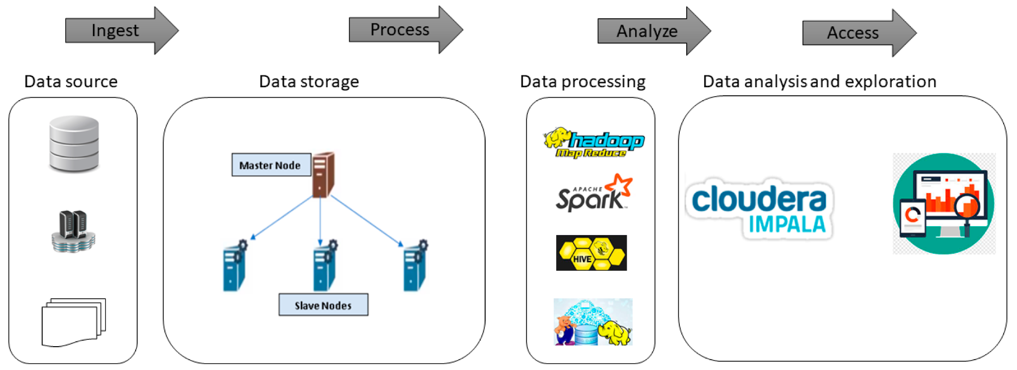



Deliverable: Workflow/Architecture charts - ETL Big Data
We extracted the data from Kaggle, placed all the data in OneDrive and uploaded it to the server and then we created tables on Beeline, and finally, downloaded the file locally and used a Microsoft Excel 3D map.

Slide 8
Implementation Flowchart
Thirteen .csv files are uploaded to HDFS. Next, Beeline is used to create the tables, clean data, sort out the info, and export the results. Finally, once an output file has been downloaded, we can open the file in an Excel 3D map.
Local Server
Hadoop
Raw dataset
Upload dataset to HDFS
Create tables schema
Geo-Spatial Visualization
Clean data
Excel
Bar, line, and pie graphs
Export results
Create summary table

Slide 9
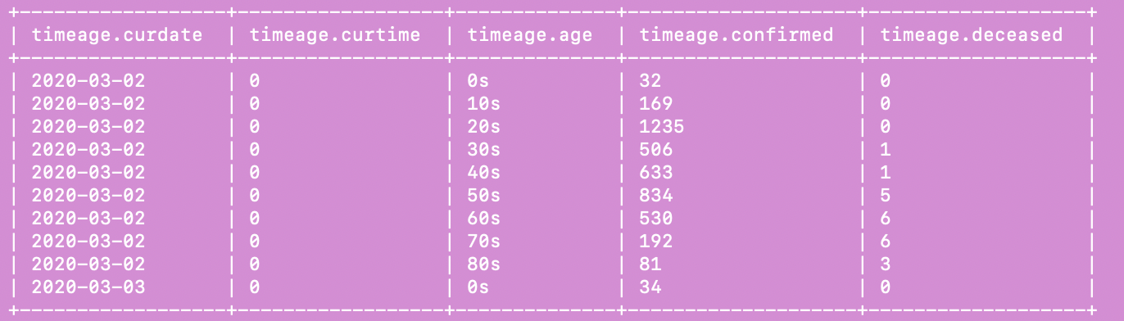
The TimeAge table gives us ‘curdate,’ which is the date the patient got tested. ‘curtime’ provides us with the time based on this formula Time (0 = AM 12:00 / 16 = PM 04:00). ‘Age’ gives the age range of the patient. The ‘confirmed’ column gives us the accumulated confirmed number of infected cases. The ‘deceased’ column gives us an accumulated number of deaths.

Slide 10
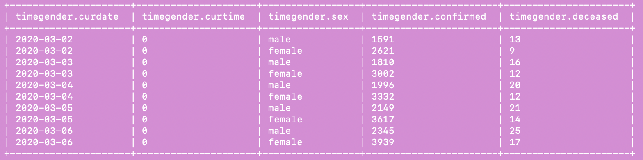
The TimeGender table gives us the ‘curdate’ of when the patient went to get tested. ‘curtime’ column provides us with the time based on this formula Time (0 = AM 12:00 / 16 = PM 04:00). The ‘sex’ column shows us the gender of the patient. ‘confirmed’ column gives us the accumulated confirmed number of cases who are infected. The ‘deceased’ column gives us an accumulated number of deaths.

Slide 11
PatientInfo Table
The PatientInfo table gives us ‘patientId’ to identify patients quickly in a database. ‘sex’ column provides us with the gender of the patient. The ‘age’ column gives the age of the patient. The ‘country’ and 'province' column shows where the patient resides. The ‘city’ column provides us with the city the patient lives in. ‘infection_case’ column gives us the cause of the infection. The ‘infectedby’ column provides us with the ID of who infected the patient. The ‘contact_number’ column provides us with the number of contacts with people. The ‘symptom_onset_date’ column gives us the symptoms the patient was feeling the day of the test. ‘confirmed_date’ shows us the date of being a confirmed case. ‘released_date’ indicates the date of being released. ‘deceased_date’ shows us the date of deceased. ‘state’ shows us the state of being isolated / deceased / released.

Slide 12
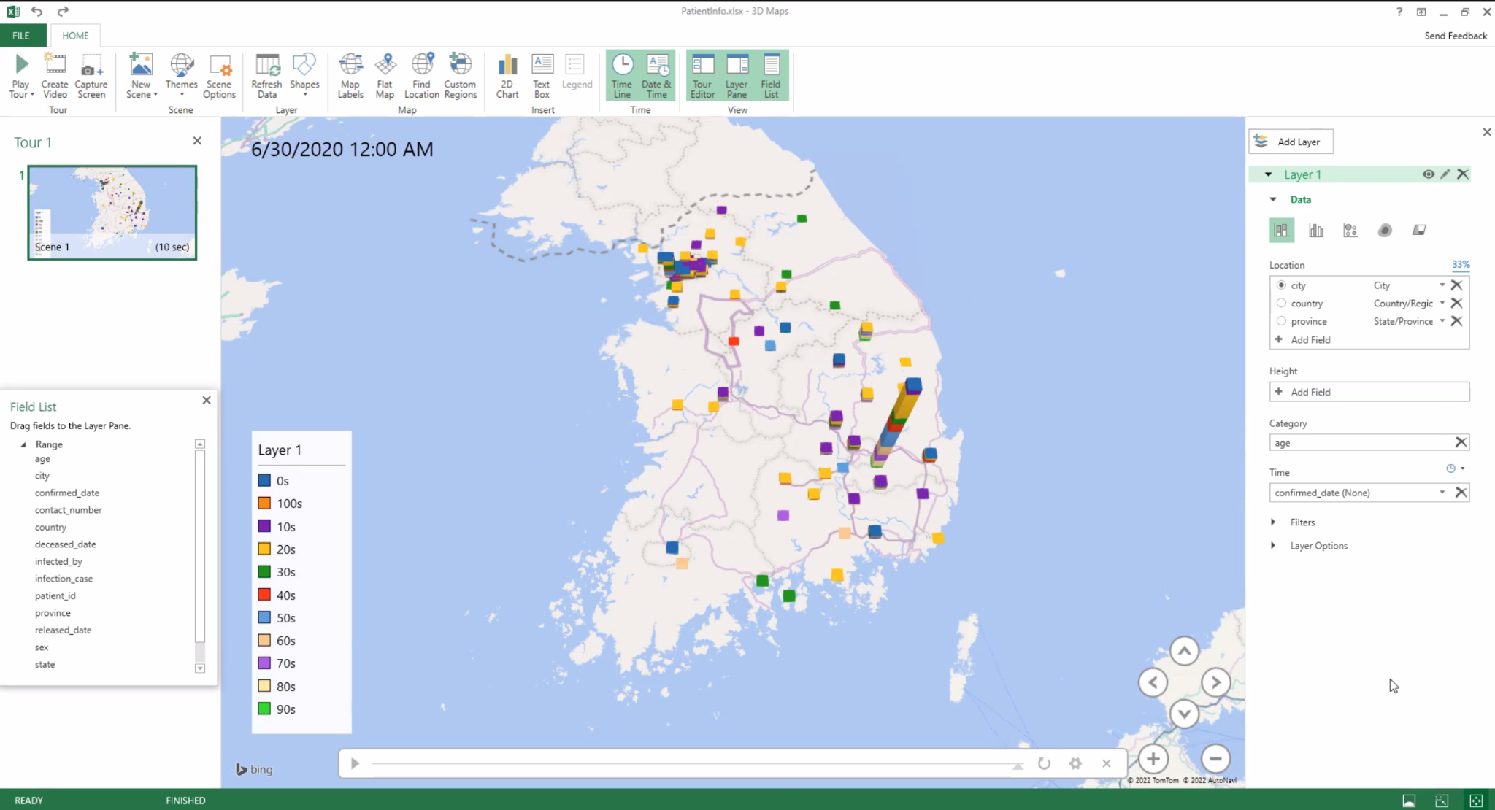
Geo-Spacial Visualization
On this map, we have a location set to ‘city,' a category set to ‘age,’ and time set to ‘confirmed_date.’ This tells us the number of people in their age group who had confirmed cases of coming out positive on their test result of the Coronavirus.

Slide 13
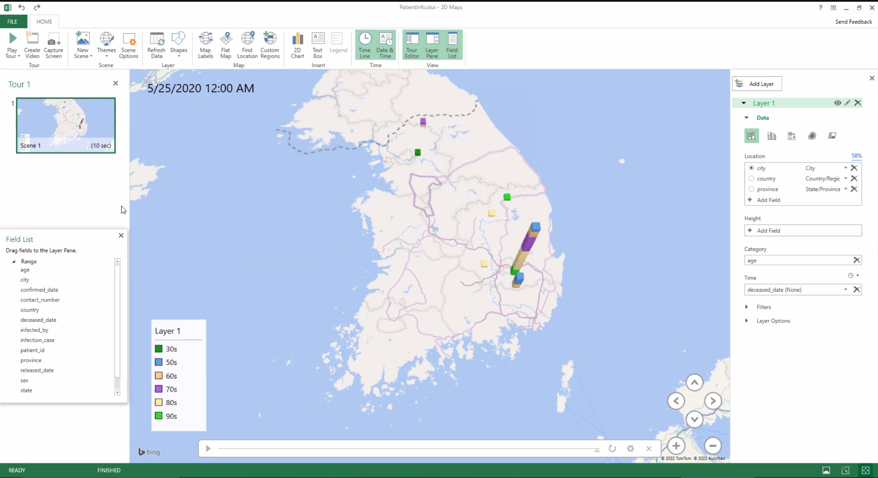
Geo-Spacial Visualization
This map has a location set to ‘city’ category set to ‘age’, and time set to ‘deceased_date.’ This tells us the age group of people that have passed away.

Slide 14
Github link
Codes and documents:
https://github.com/dakbari2/Group5Project

