Slide 1
Qf cAf
cA
cB
A,B,C

Slide 2
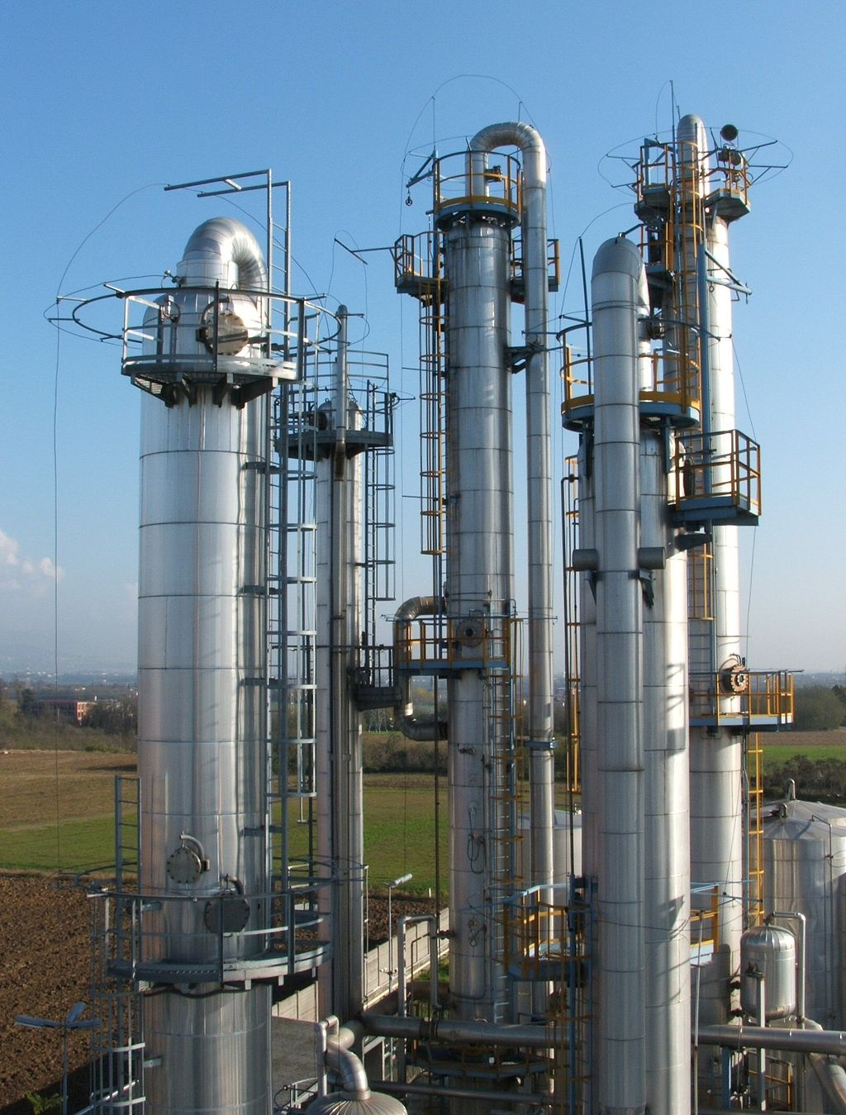
d
u
y
Controller
Feedback

Slide 3




