Slide 1
Time
FailedAuthentication
username | authenticationTimestamp
userA | 13:07
userA | 13:10
3 Record
userA | 13:11
2 Record
(1)
13:16
(2)
13:18
Timeline
Insert query
Authentication failure (invalid password)
Authentication failure (account is locked)
Authentication success

Slide 2
Time
FailedAuthentication
username | authenticationTimestamp
userA | 13:07
userA | 13:10
0 Record
userA | 13:11
Delete
(1)
13:16
Timeline
Insert query
Authentication failure (invalid password)
Authentication success
Deleted
Delete query
Unlock

Slide 3
(2) make PasswordData
(1) prepare PasswordValidator
PasswordData
PasswordValidator
password
(3) validate
Rule
username
Rule
Rule
Reference
Reference
Reference
(3’) get RuleResult
(5) get messages
RuleResult
(4) confirm result

Slide 4
PasswordData
(1) new
password
username
Reference
Reference
・・・
Histories …
PasswordValidator
(2’) reference
Application
(2) validate
Rule
Rule
Rule
(3) new
(4) isValid
RuleResult

Slide 5
(9) Create
Password Reissue Information
(Complete)
(1) Login
(8) Create
Password Reissue Information
(10) Reissue Password
(11) Reissue Password (Complete)
Y
Should the password
be changed?
N
(2) Top
(3) Show Account Information
(5) Change Password
(Complete)
(6) Unlock
(4) Change Password
(7) Unlock
(Complete)
Page
Authenticated
Conditional Branch
Transition
Authorized

Slide 6
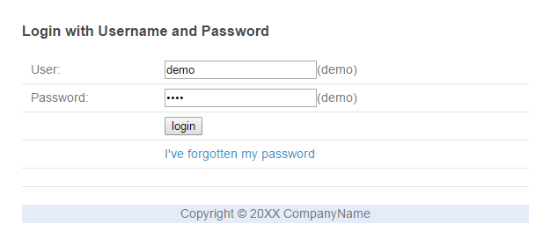
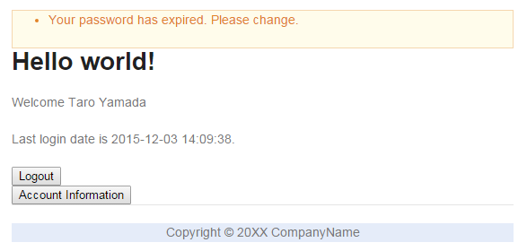
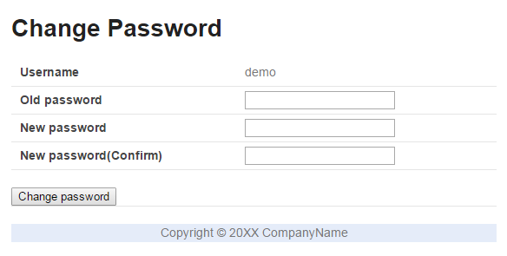
force to
change password
show a message

Slide 7
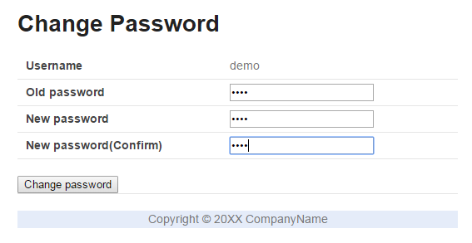
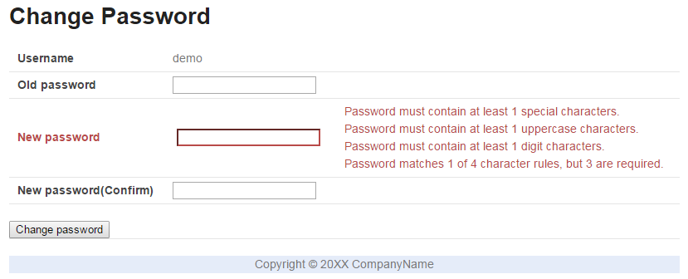
weak password
show messages

Slide 8
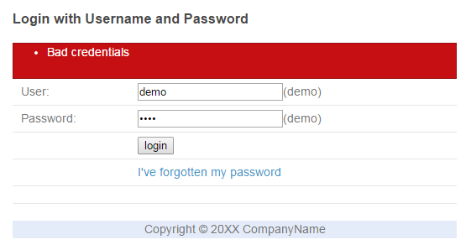
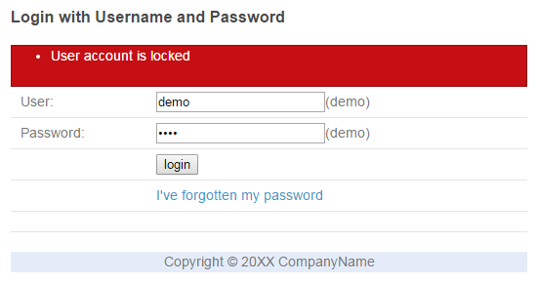
many times
in a short period
account has been locked

Slide 9
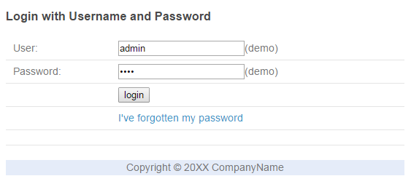
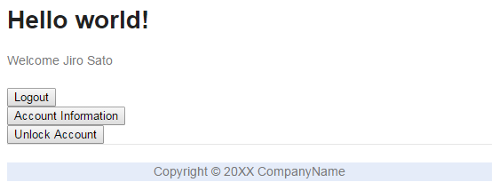
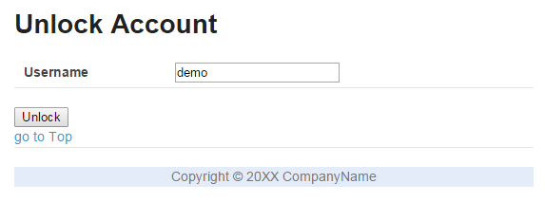
login as administrator

Slide 10
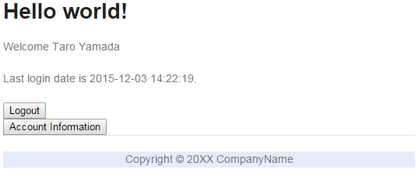
show last login date

Slide 11
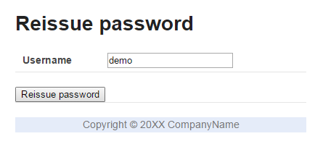
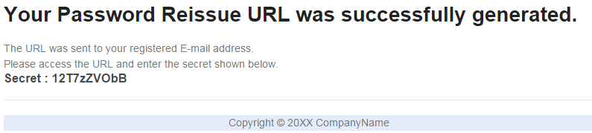
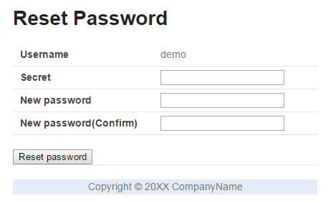
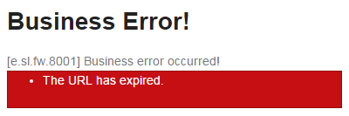
generate token and secret
show the secret
send URL (token is included)
token is valid
token has been expired

Slide 12
generate token and secret
show the secret
send URL (token is included)
token is valid
token has been expired

Slide 13
generate token and secret
show the secret
send URL (token is included)
token is valid
token has been expired

Slide 14
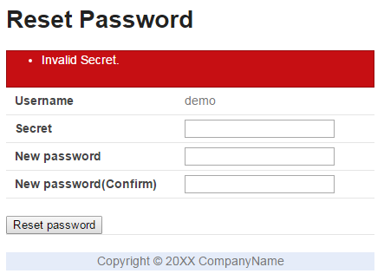
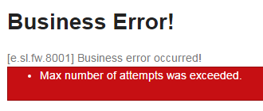
too many times
the URL has been invalidated

