Slide 1

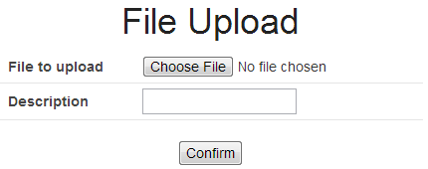
(1)
Upload
File
Temporary directory
for servlet container
<Application Server>
Servlet
Container
Web.xml
Temporary
File
(2)
<Spring Web>
MultipartFilter
(3)
<Spring Web>
StandardServlet
MultipartResolver
(4)
(12)
<Spring MVC>
Dispatcher
Servlet
(5)
(8)
<servlet>
Part
<Spring Web>
MultipartFile
(11)
(6)
(7)
Controller
Upload
File
(9)
Service
(10)
Upload directory
for application
Database

Slide 2
Input
Screen
(3)
Confirm
Screen
(7)
Complete
Screen
Upload
File
(4)
Controller
Controller
(1)
(5)
Service
Move File
Temporary
Upload
Upload Temporary directory
(6)
Upload directory
Upload
File
Upload
File
(2)
or
Database
or
Database

