Slide 1
Authorized Pages
target
Create Account Pages
Update Account Pages
Login Pages
View Item Pages
View Cart Pages
Order Pages
Cart

Slide 2
From View Item pages, …
Update Account Pages
③
④
①
②
Name
E-mail
Birthday
Zip
Address
Card number
Expiration date
Security code
xxx
a@b.com
1990-04-01
1111111
Tokyo
****-****-0000
2020-01
111
Your account has updated
Name
E-mail
Birthday
Zip
Address
Card number
Expiration date
Security code
xxx
a@b.com
1990-04-01
1111111
Tokyo
****-****-0000
2020-01
111
Name
E-mail
Birthday
Zip
Address
Card number
Expiration date
Security code
Next
Back
Confirm
Home
Home
Back
Update
Home
Home
To View Item Pages

Slide 3
From/To Update Account Pages
⑤
⑧
⑦
Welcome xxx
Logout
Update Account
⑨
Welcome xxx
Logout
Update Account
Welcome xxx
Name price Quantity
Book1 \1,000 1
Book2 \2,000 2
Total \5,000
Welcome xxx
Logout
Update Account
Category ▼
Update
Logout
Update Account
Order No. 0000-0000-0000-0000
Order Date 2015/08/01
Name Price Quantity
Book1 \1,000 1
Book2 \2,000 2
Total \5,000
From
Login
Pages
Name Price Quantity
Book1 \1,000
Book2 \2,000
Book3 \1,500
Name Price Quantity Remove
Book1 \1,000 1
Book2 \2,000 2
Total \5,000
Add
Add
Name
E-mail
Zip
Address
Payment
xxx
a@b.com
1111111
Tokyo
Card (card number : ****-****-0000)
Add
<< < 1 2 .. 10 > >>
Remove
View Cart
Confirm Your Order
home
Book1 \1,000 1
Book2 \2,000 2
Total \5,000
ホーム
Order
Back
home
⑥
Welcome xxx
Logout
Update Account
Name Book1
Price \1,000
Description Very funny
quantity
Add
Back
View Cart
Book1 \1,000 1
Book2 \2,000 2
Total \5,000
View Item Pages
View Cart Pages
Order Pages
To Update Account Pages

Slide 4
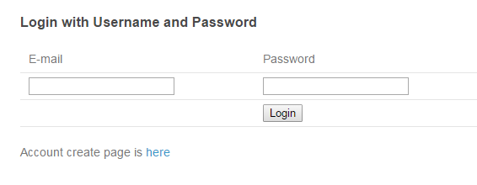

Slide 5
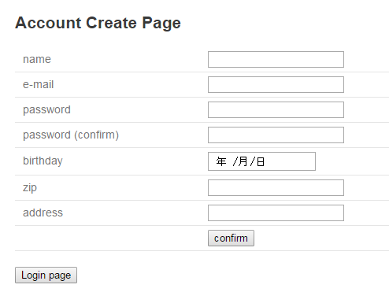
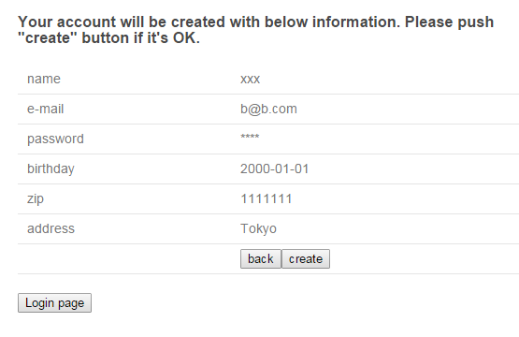
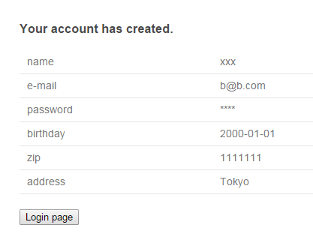

Slide 6
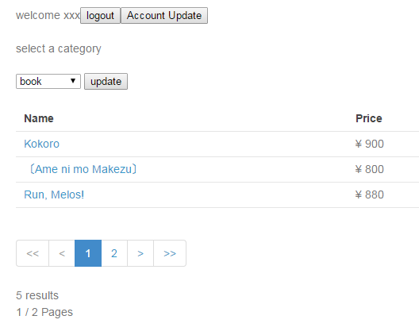
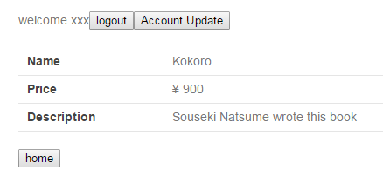

Slide 7
AccountUpdateContoller
Update Account Form1
Update Account Form2
Confirm Account
Finish Update
Input data
GoodsContoller
CartContoller
OrderContoller
Show Goods
Show Cart
Confirm Order
Finish Order
Show Goods’ Details
Cart

