Slide 1
Chest X-ray image
指導教授：陳素雲
學生：吳岱錡

Slide 2
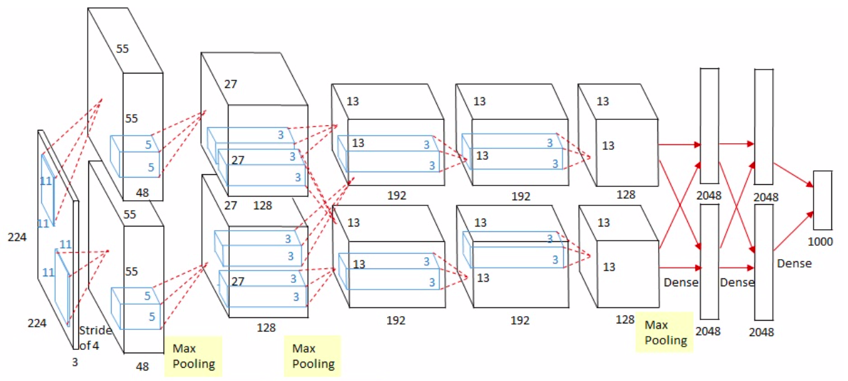
Alexnet(2012)

Slide 3
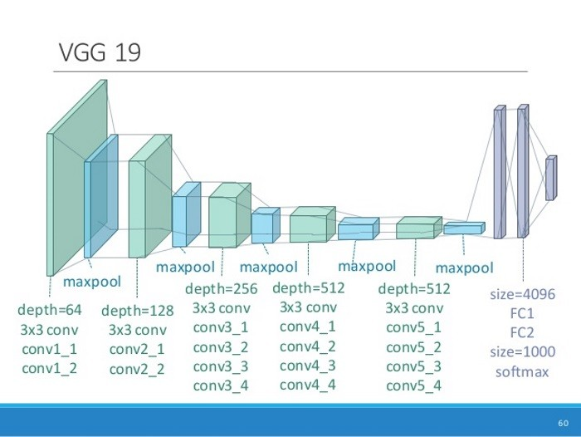
VGG19(2014)

Slide 4
Model changes
AlexNet：optimizer SGD → Adam → batch-size from 64 to 32
VGG19 ：optimizer RMSprop → Adam → batch-size from 64 to 32
SGD
RMSprop
Adam

Slide 5
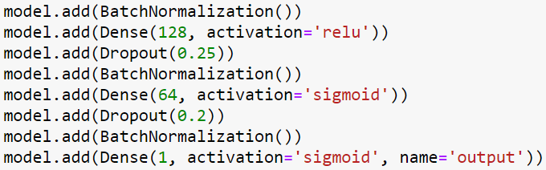
Model changes - Alexnet

Slide 6
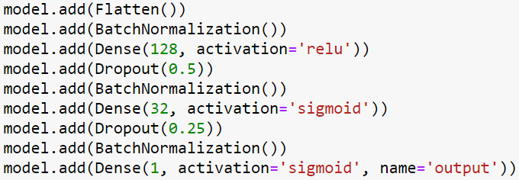
Model changes – VGG19

Slide 7
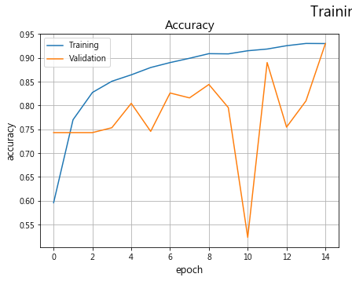
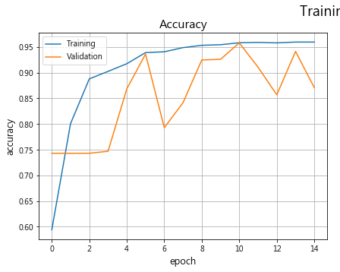
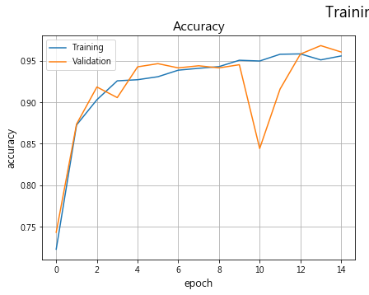
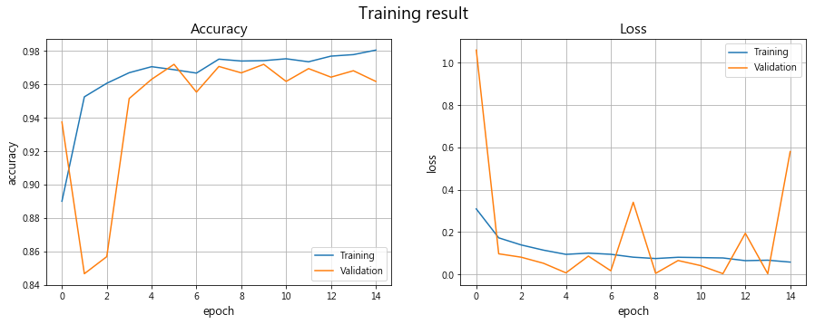
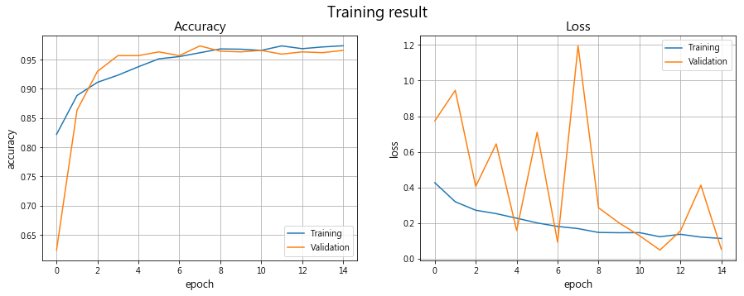
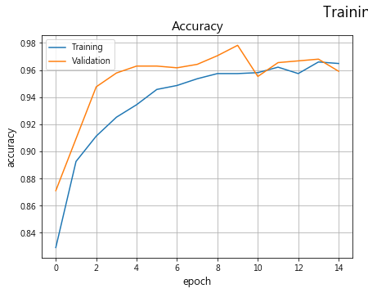
Results
AlexNet
AlexNet
AlexNet
Vgg19
Vgg19
Vgg19

Slide 8
Test-set result
 | Alexnet-SGD | Alexnet-Adam | Alexnet_32
Accuracy | 0.798077 | 0.923077 | 0.850962
Recall | 0.989700 | 0.930800 | 0.997400
Precision | 0.478600 | 0.910300 | 0.606800
F1-score | 0.645200 | 0.920400 | 0.754500
 | Vgg19-RSMprop | Vgg19-Adam | Vgg19_32
Accuracy | 0.894231 | 0.884615 | 0.900641
Recall | 0.979500 | 0.984600 | 0.987200
Precision | 0.752100 | 0.717900 | 0.756400
F1-score | 0.850900 | 0.830400 | 0.856500

