Slide 1
I Smite You!
Christina Fontana, Srinidhi Venkatesan Kalavai,
David Kirk, Jillian Yong

Slide 2
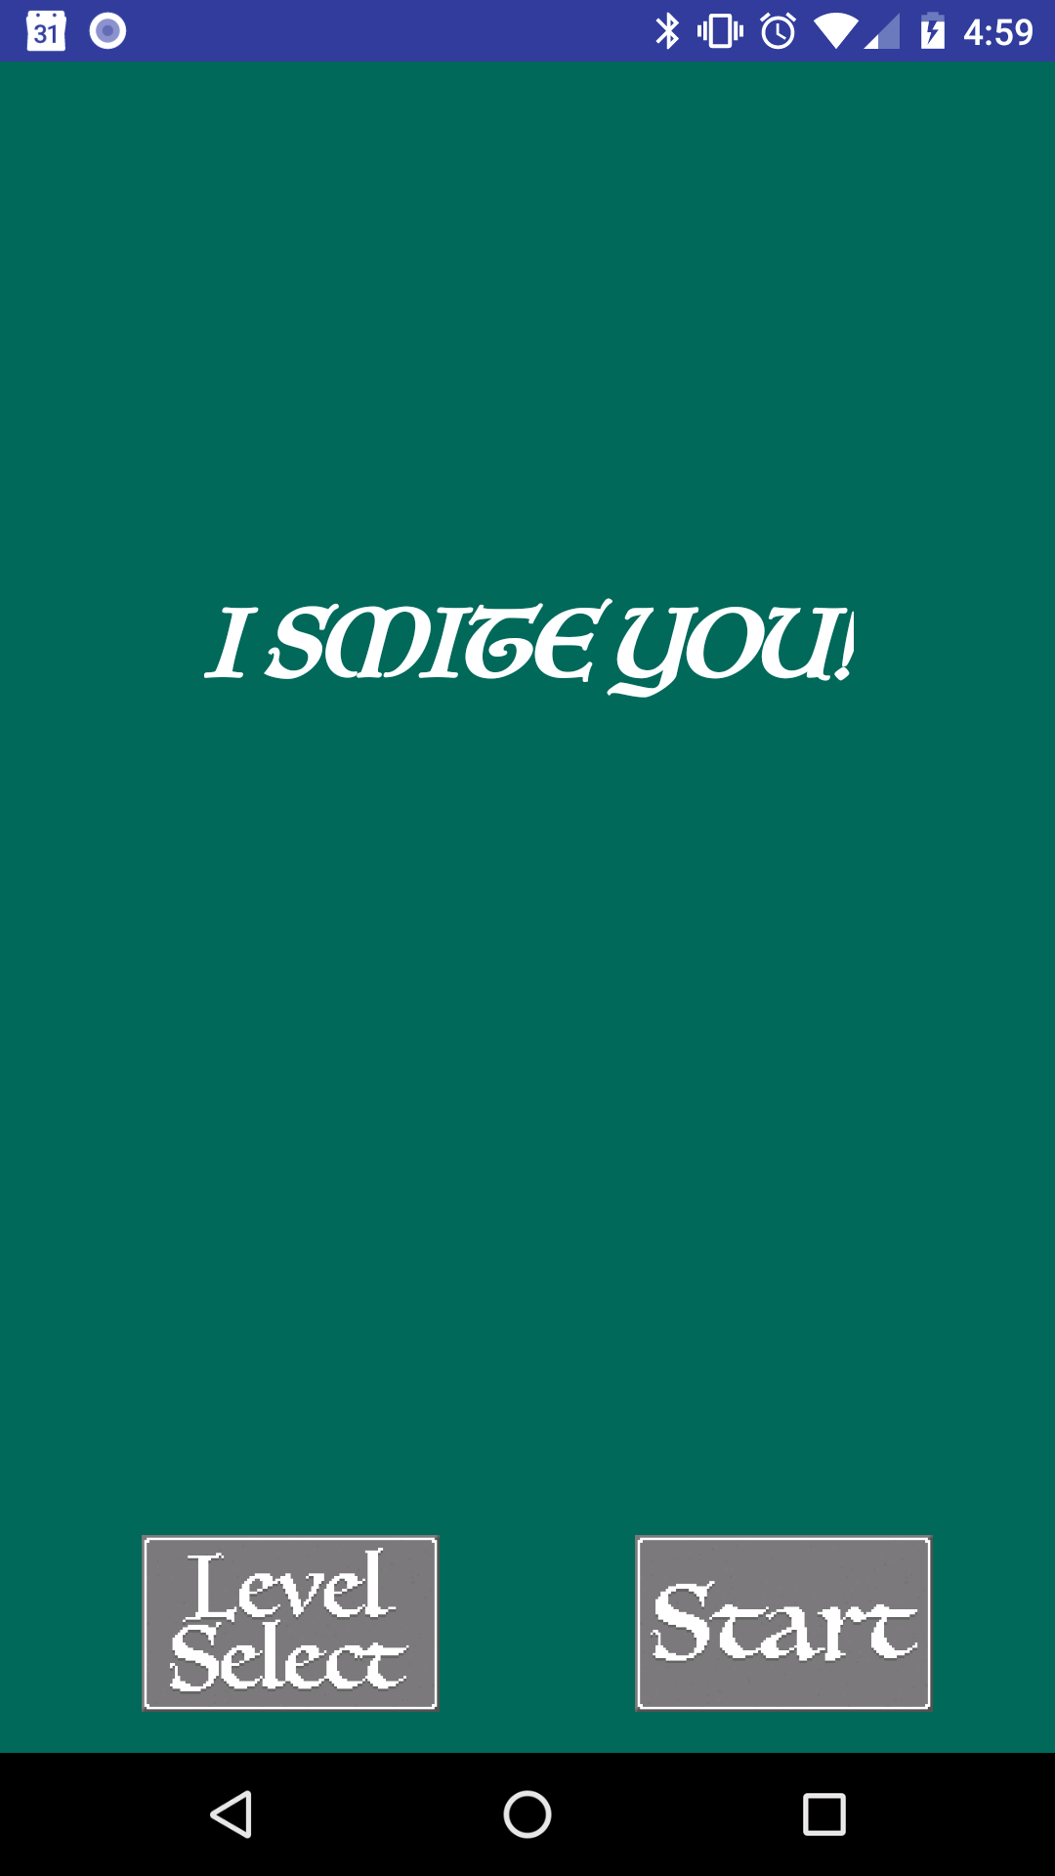
The Game
I SMITE YOU! is a tile-switching turn-based game about a wizard defending against orcs
The home screen shows the title of the app, a button to start the game (START) and a button to select which level to play (LEVEL SELECT)
Pressing the Start button will take the user to the Introduction page and then to Level 1

Slide 3
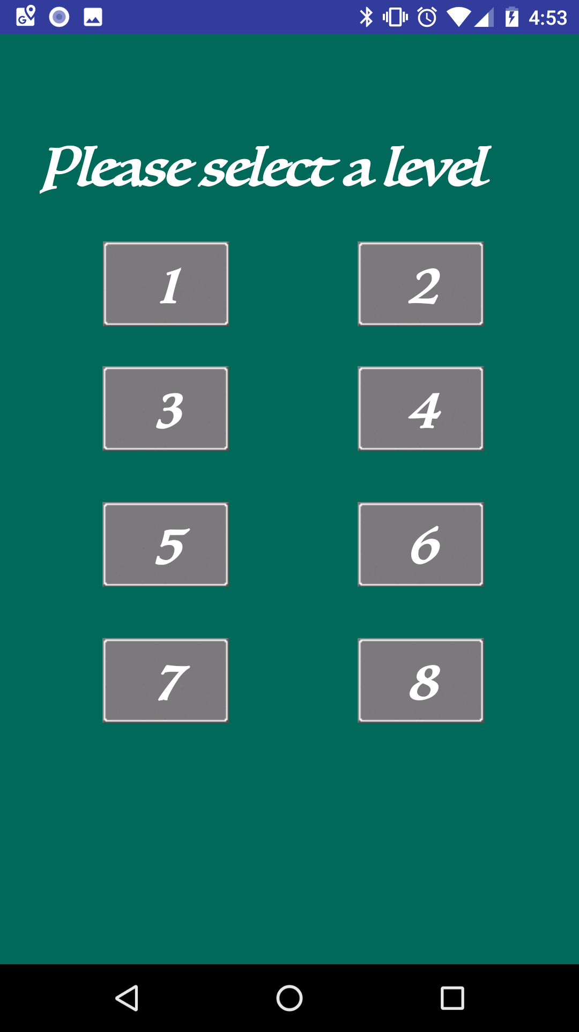
Level Select Screen
The level select screen allows the user to select which level they want to play
There are 8 levels in total, with each level increasing in difficulty and complexity

Slide 4
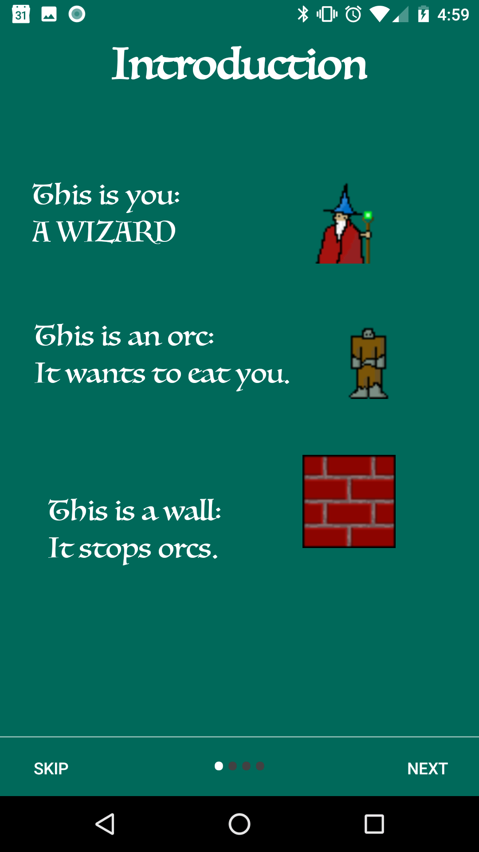
Introduction (Main objects)
The introduction slides explain the objects that will be in the game
The user will play as the wizard
The orcs will try to eat the wizard
Dumb orcs can be stopped by walls
The user must stop all orcs in order to win

Slide 5
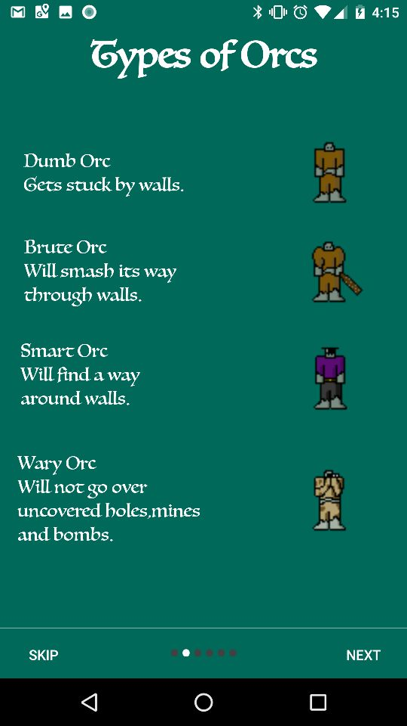
Introduction (Types of Orcs)
There are 4 kinds of orcs:
Dumb orcs: Poor pathfinding, get stuck by walls
Brute orcs: Poor pathfinding, but can smash walls
Smart orcs: Good pathfinding, and can avoid walls
Wary orcs: Good pathfinding and can avoid most
obstacles

Slide 6
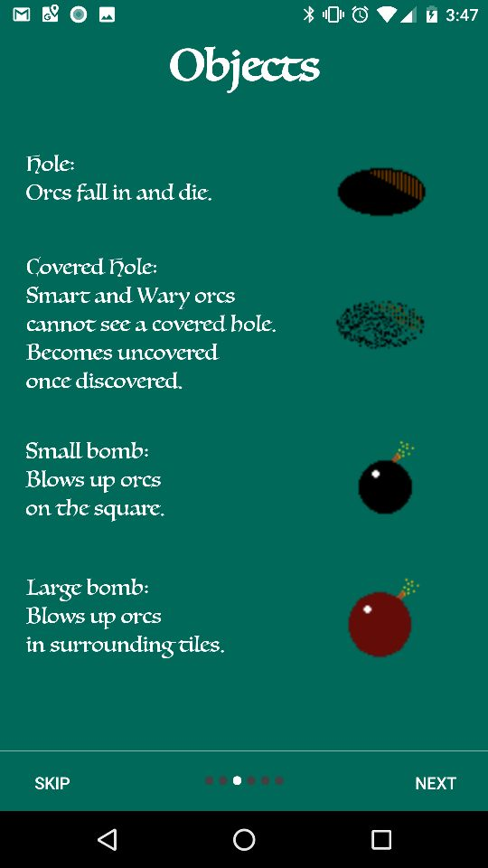
Introduction (Obstacles)
4 Additional Obstacles
Holes: Orcs fall into holes
Covered Holes: Invisible to Smart and Wary orcs,
and become uncovered once an orc falls in
Small bomb: Orc lands on it and blows up one
Square
Large bomb: Orc lands on it and blows up
surrounding tiles

Slide 7
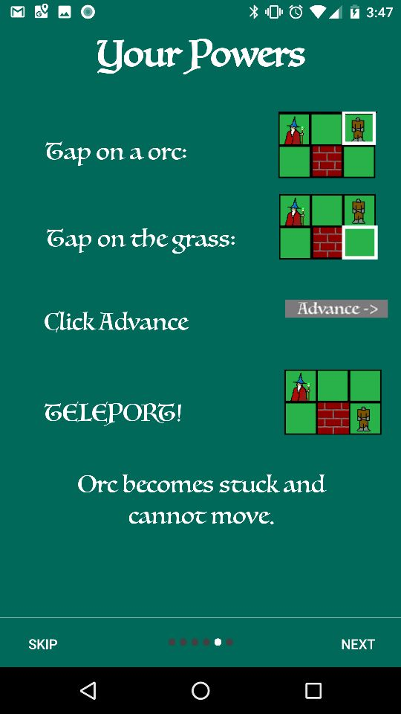
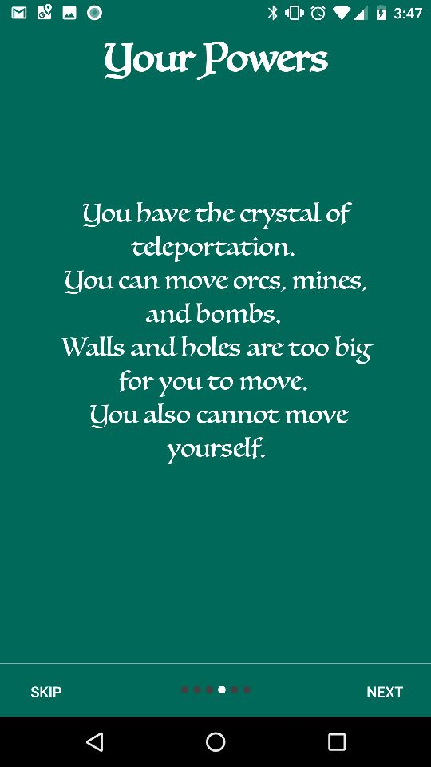
Introduction
The user will have to switch tiles containing objects in order to play the game
The user will be able to switch tiles that contain orcs
The user will not be able to switch tiles that contain walls, holes, or the wizard

Slide 8
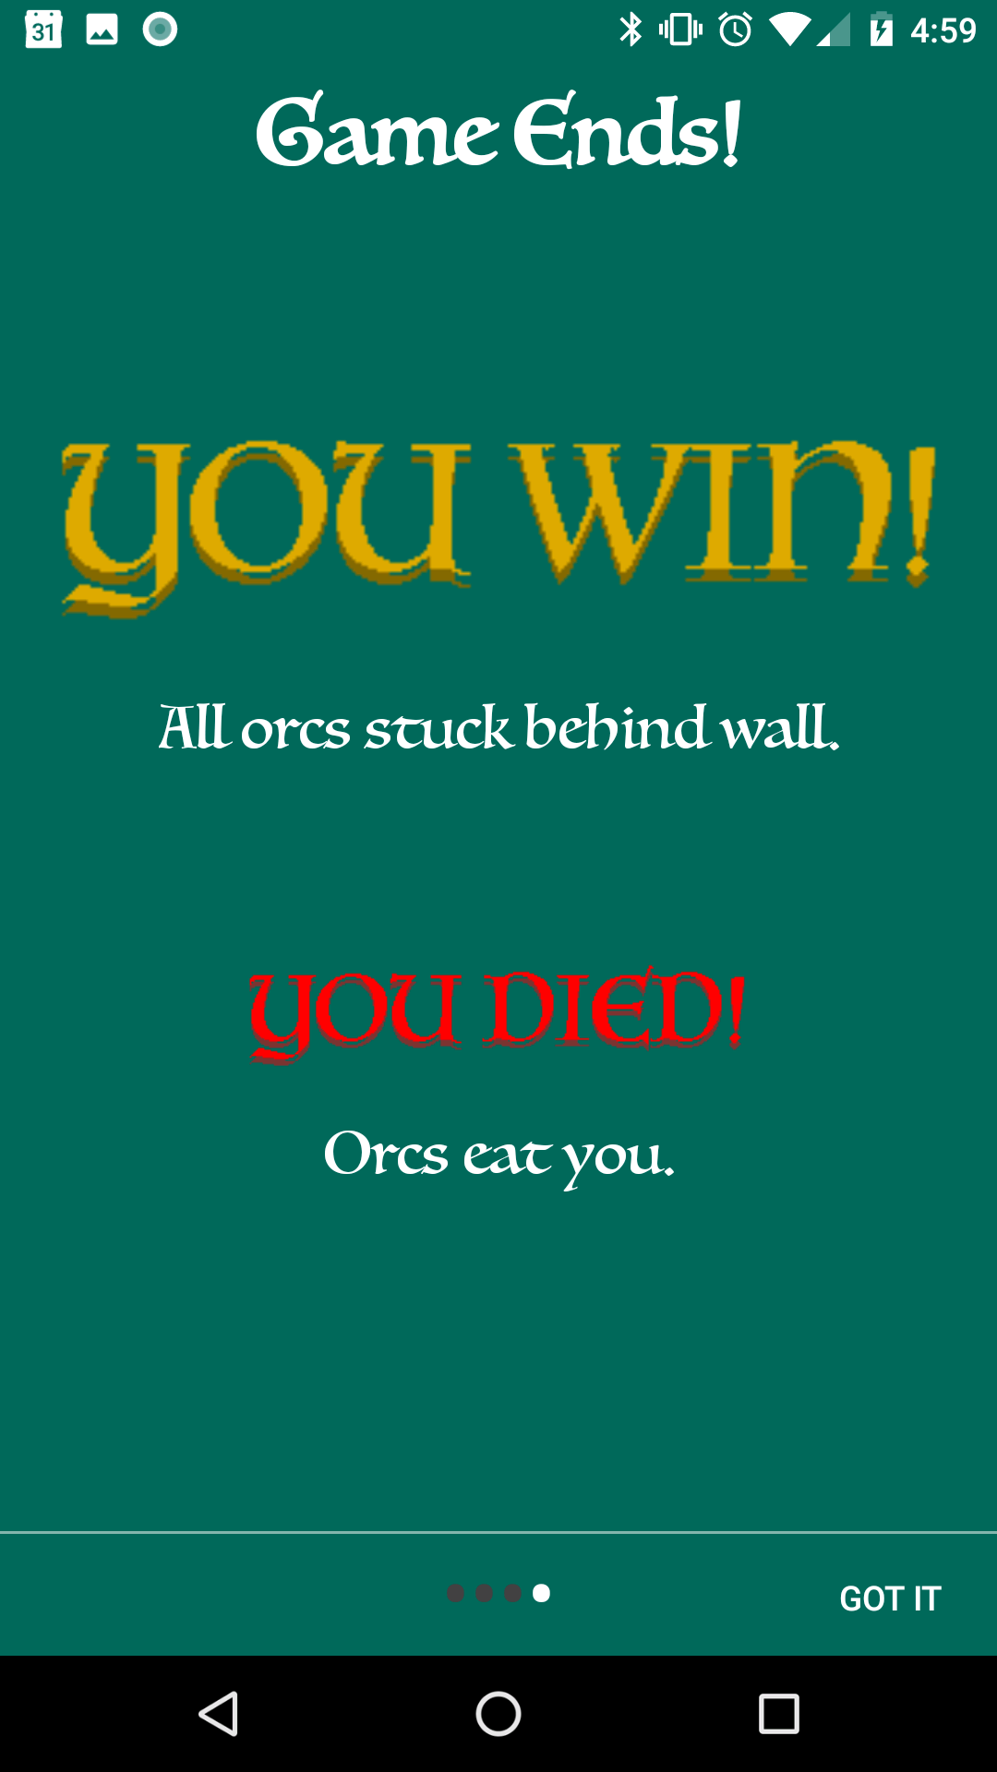
Introduction
The user wins once all the orcs are stuck behind a wall
The user loses if an orc reaches the wizard and eats it

Slide 9
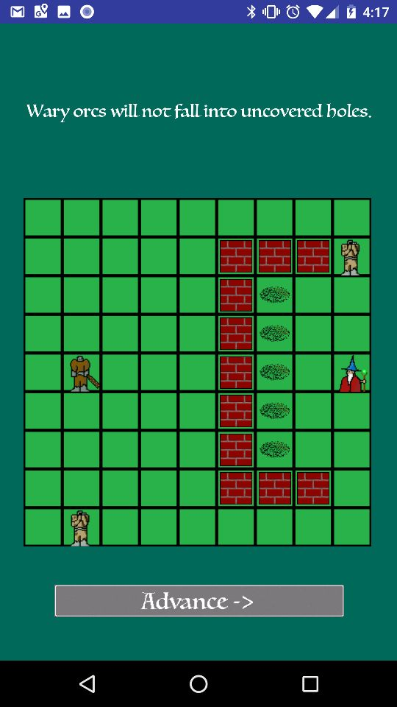
Level Example
Levels start out with a wizard, some orcs of varying intellect, and various obstacles
Orcs move via a pathfinding algorithm in the back end that lets them move in the direction closest to the wizard
Orcs only move one tile at a time

Slide 10
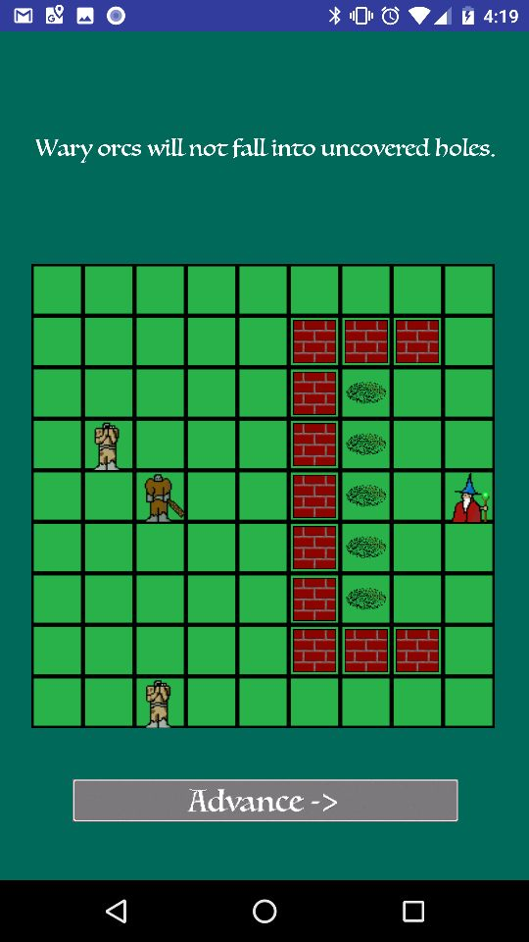
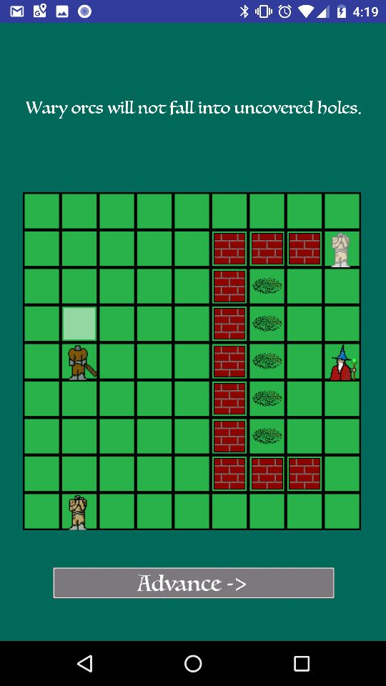
Advancing
When the user selects a tile to be switched, that tile or the object on the tile gets highlighted
Once two tiles are selected, the user must press the “Advance” Button in order to switch the two tiles
After the user’s turn, all the orcs advance one tile closer to the wizard

Slide 11
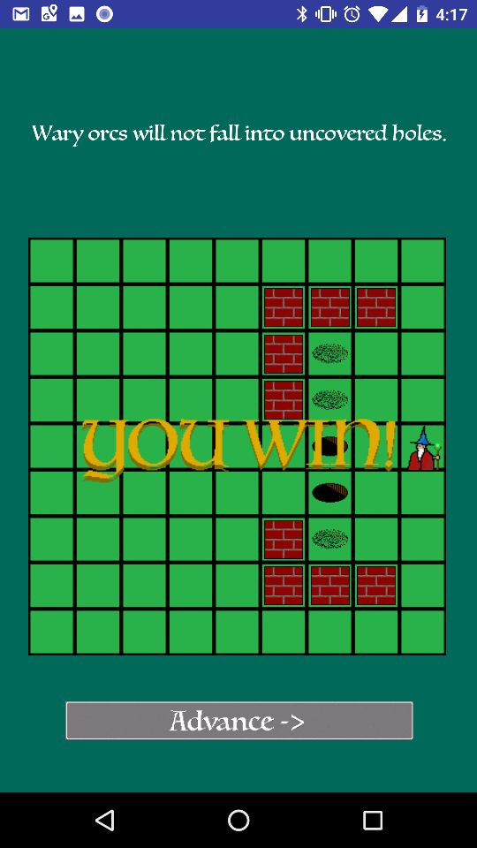
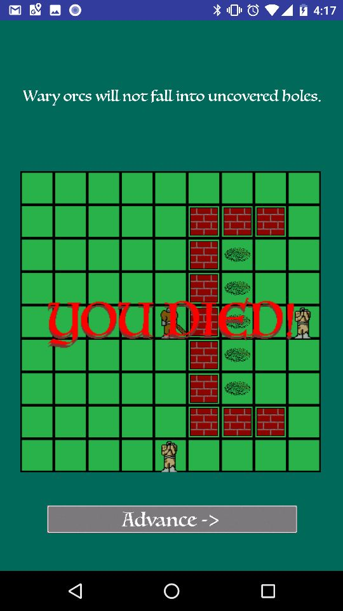
Winning/Losing
The user wins when all orcs are stuck behind a wall or in a hole
The user loses when an orc reaches the wizard and eats it, taking over its tile

