Slide 1

Improving Information Retention and Learner Self-Efficacy through a Coding Workshop Micro-credential
Dani Kirsch, Ph.D.
Research Data Services Librarian, Oklahoma State University
Jaina Agan, Ph.D.
Assistant Professor of Biology, University of Central Oklahoma

Slide 2
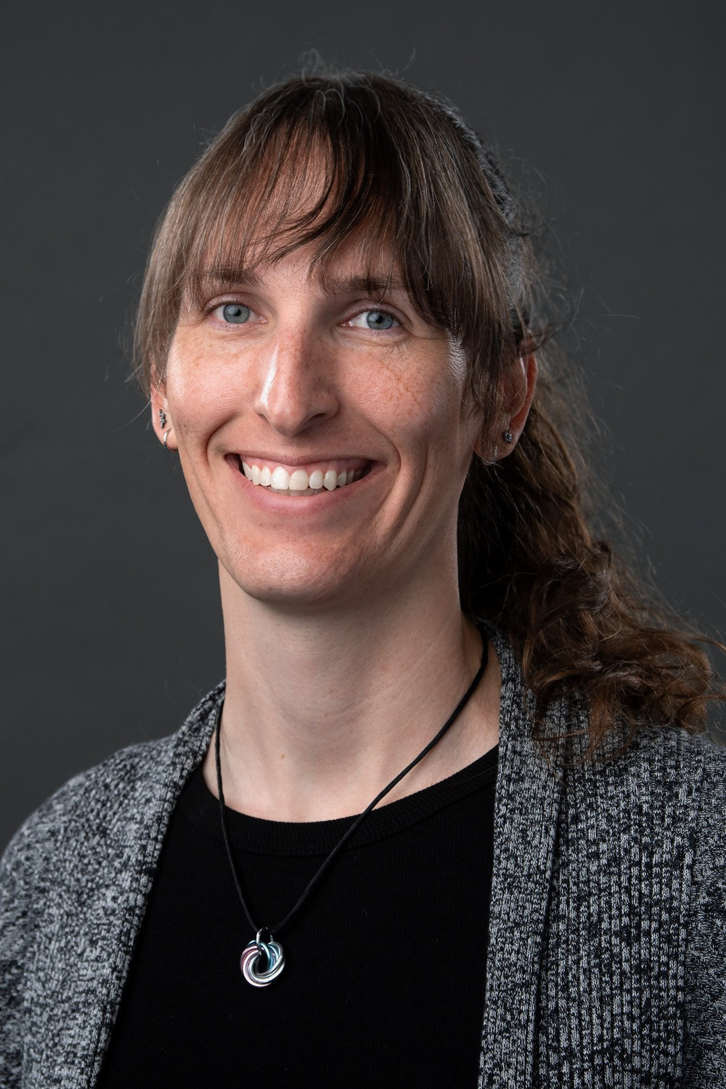
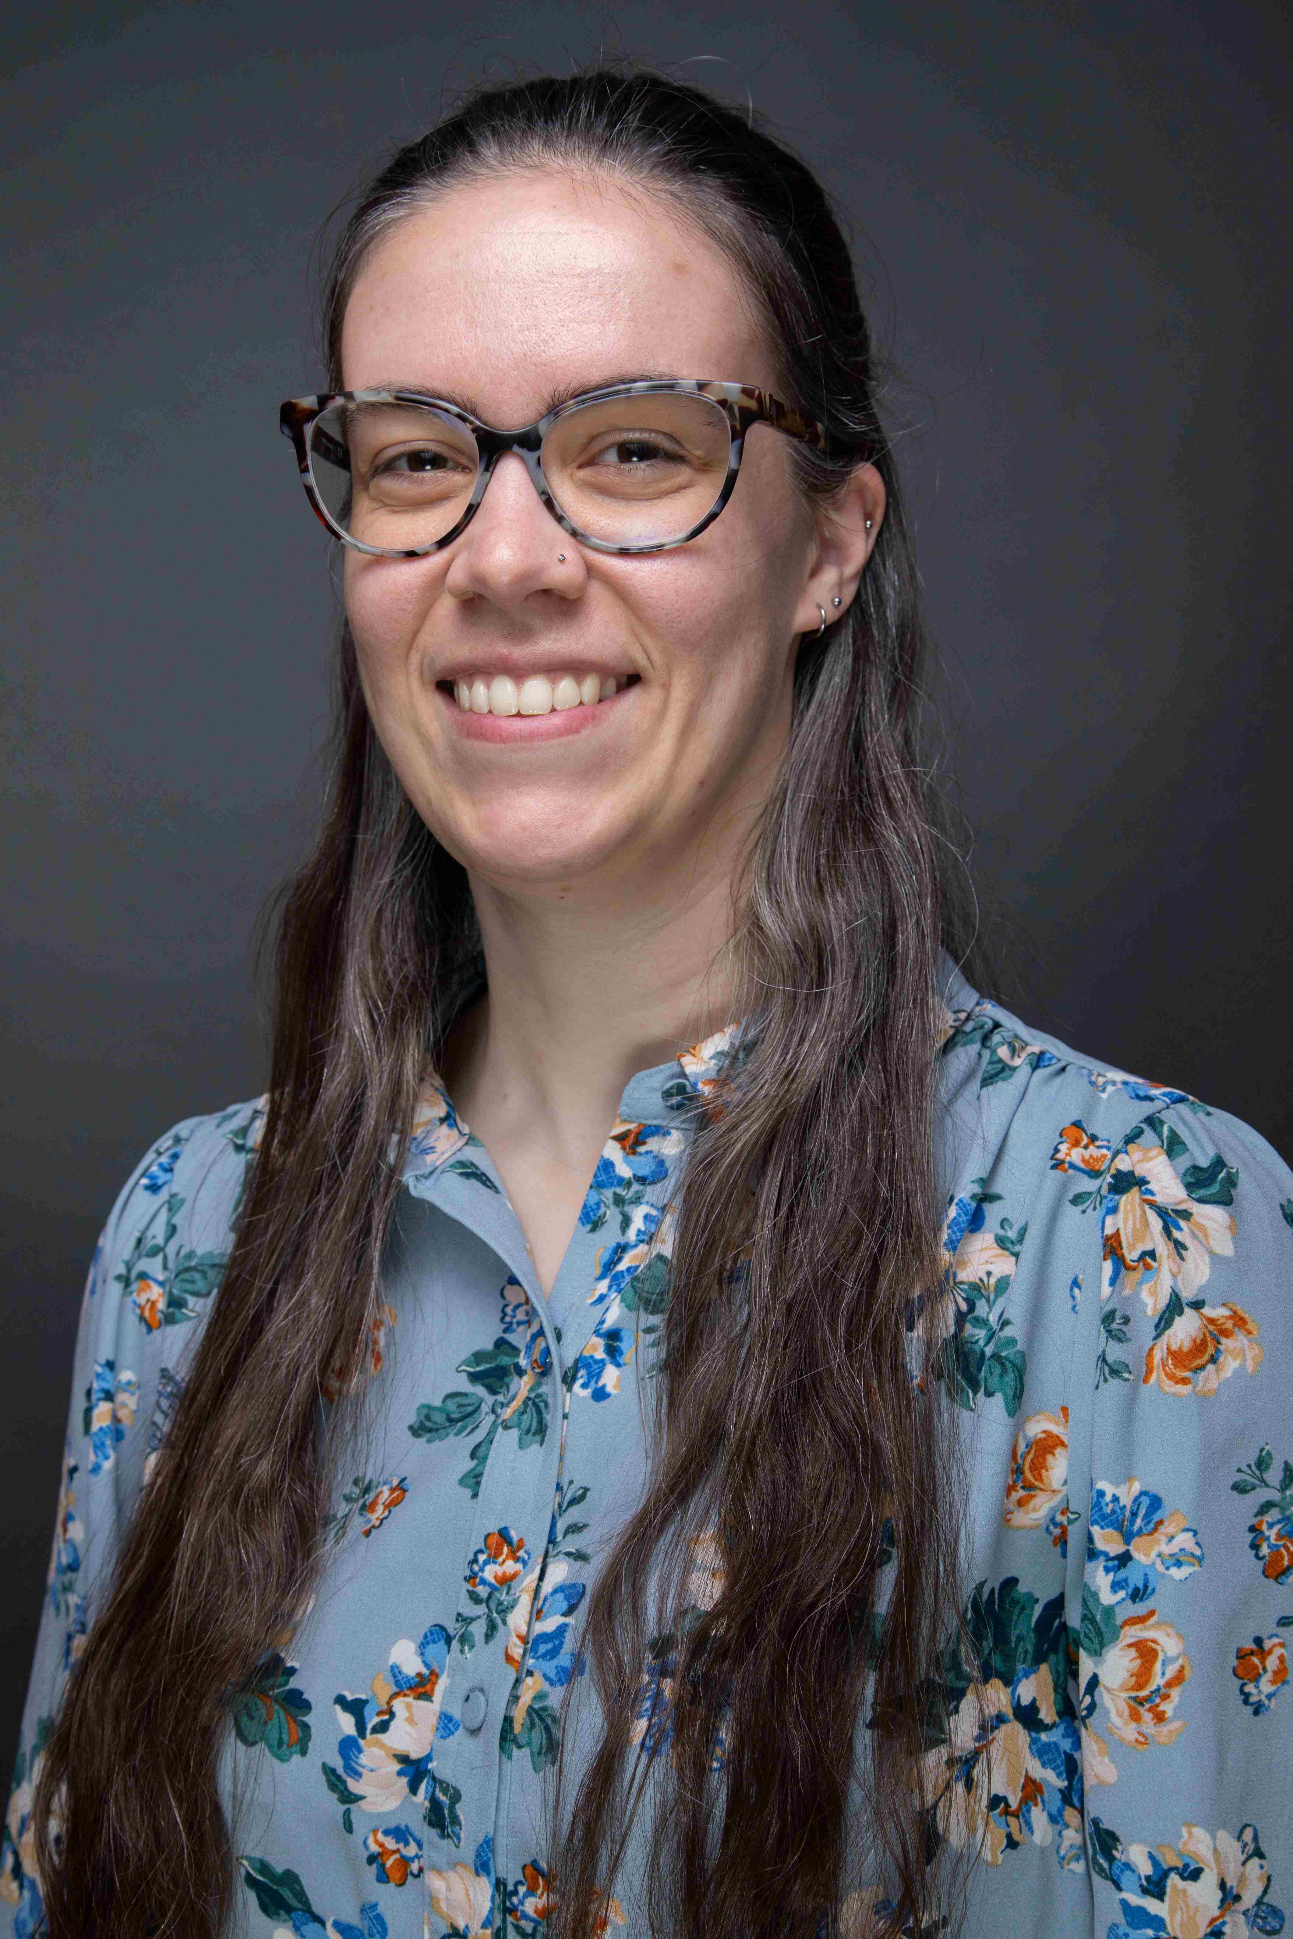
Who Are We?
Dr. Jaina Agan
Dr. Dani Kirsch
University of Central Oklahoma (UCO)
Teach introductory biology classes, ecology, and animal behavior
Teaching R coding workshops since 2023
Certified Carpentries Instructor since 2023
Oklahoma State University (OSU)
Instruct and support researchers on data management and sharing
Teaching R coding workshops since 2021
Certified Carpentries Instructor since 2022
Notes:
Jaina and Dani

Slide 3

Agenda
Do we need this slide?
Brief workshop context
Why a micro-credential?
Creating the micro-credential
Perspectives on micro-credential integration
Photo by Kimberly Farmer on Unsplash

Slide 4

Our Instructional Context
Carpentries Workshops
Notes:
Dani

Slide 5

Global, non-profit organization
Train people in software development and data science skills for more effective work and career development
Build community and local capacity for teaching and learning these skills and perspectives
Offer training that is accessible, approachable, and applicable
Committees & task forces
Carpentries lesson development & maintenance
Local Carpentries Community Workshop helpers, instructors, workshop organizing committee
Learn more on the About Us page for The Carpentries
Notes:
Dani

Slide 6

The Carpentries develops & maintains free, openly-available lessons
4 major lesson programs, covering topics such as Python, R, and the Unix Shell/Bash while also incorporating OpenRefine, SQL, and Git
Volunteer instructors trained in pedagogy
Lessons developed & maintained by volunteers
Lesson materials openly and freely available on Carpentries website
Find out more about The Carpentries Curricula
Notes:
Dani

Slide 7
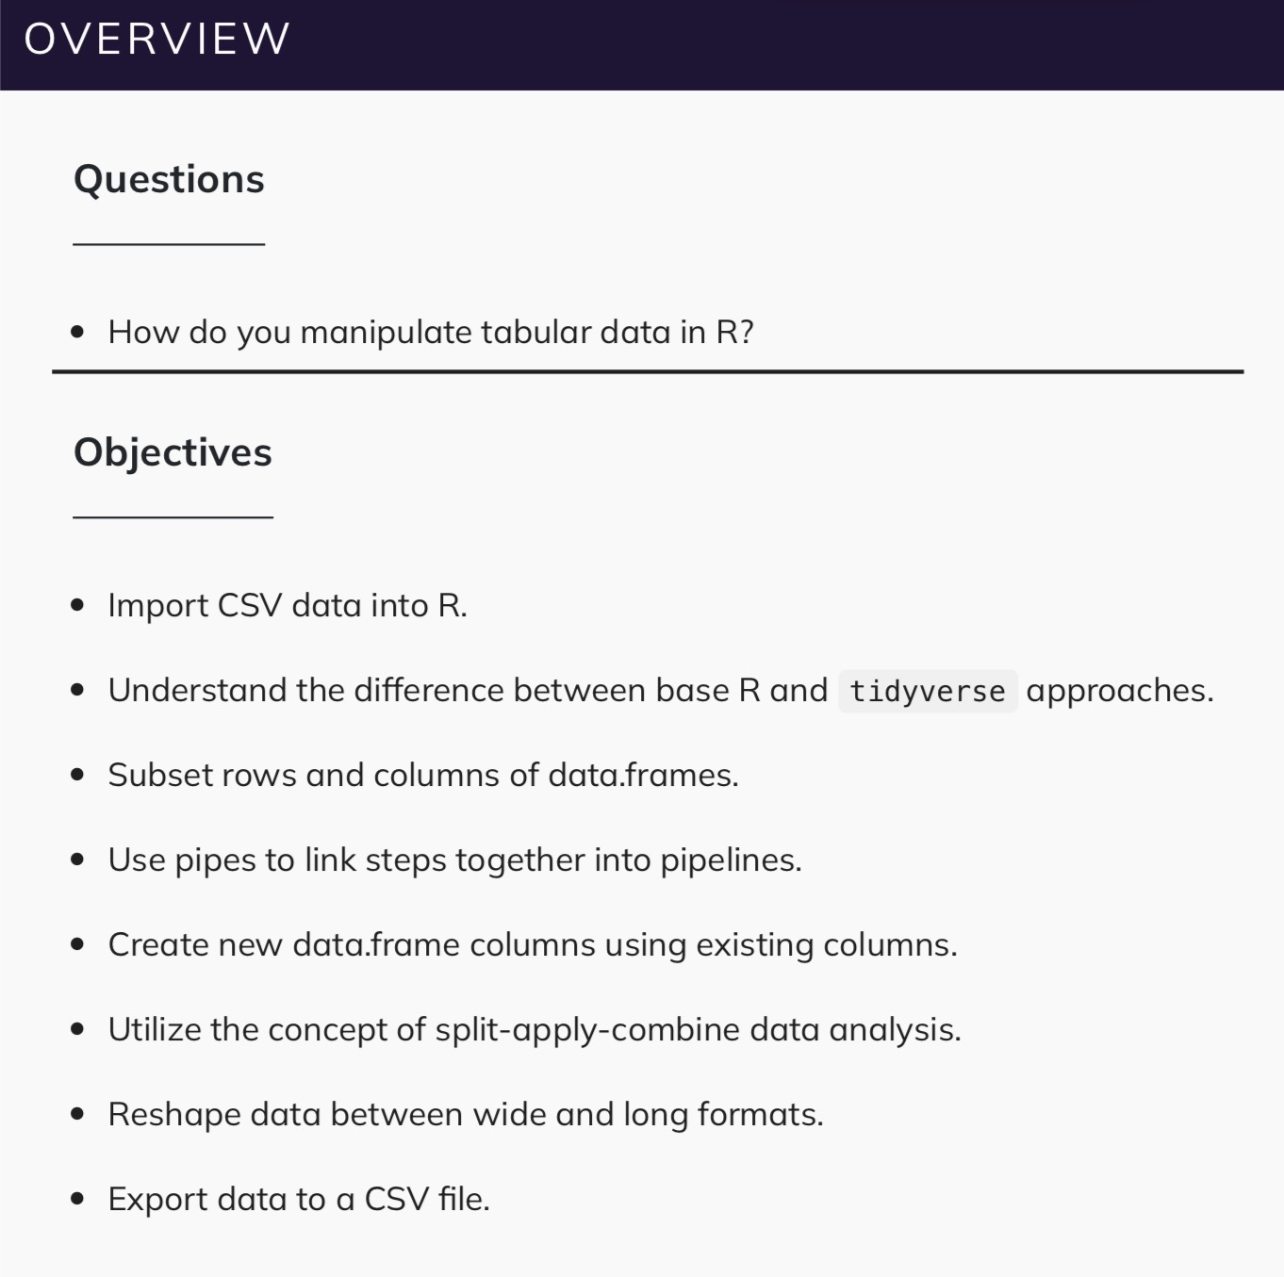
Learn by Doing
Lessons have clearly stated learning objectives
Workshop lessons assume that participants have NO previous coding experience
Learners follow along with live coding on their own device
Challenge exercises during sessions allow learners to apply what they learn
From Data Analysis & Visualization in R for Ecologists
Notes:
Dani

Slide 8

Local Carpentries Community
2015: Oklahoma State University (OSU) starts offering Carpentries workshops
2017: OSU becomes Carpentries member institution
2020: OSU begins working with instructors from other nearby institutions—including UCO—to offer workshops more consistently and to a broader audience
2022: OSU and UCO initiate collaboration
    28 workshop series, consisting of 73 individual sessions
    500+ attendees, mostly from OSU & UCO
Photo by Tim Mossholder on Unsplash; modified for presentation
Notes:
Dani – tallies count through Git/GitHub workshop in October 2026

Slide 9
Identifying an Opportunity
Enhancing the “Introduction to R and RStudio” workshop series
Notes:
Jaina

Slide 10
What challenges were we confronting?
Engagement and attendance in Carpentries workshop series usually starts strong, but decreases with subsequent sessions
Learners began requesting practice problems to work on between sessions so they could apply what they learned and reinforce new concepts
And so…we started thinking about solutions
Notes:
Jaina

Slide 11

Why a micro-credential?
Create opportunities for learners to engage with and apply workshop content between sessions (independent practice)
  Selected workshop series with larger instructor pool that is consistently offered each semester
Reward extra effort by connecting workshop participation and independent practice to create a micro-credential
  Attendance at all 3 workshop sessions + submission of 3 sets of practice problems and reflections = micro-credential badge
Learners can use micro-credential badge to convey they have gained basic knowledge in R and RStudio
Basics of R & RStudio Credly Badge
Notes:
Jaina

Slide 12
Creating the Micro-Credential
Application, Effort, and Evaluation
Notes:
Dani

Slide 13
R Markdown as the Tool
Computational notebook that combines narrative text and code into a single file, exportable as HTML, PDF, etc.
Rendering options for code chunks enable flexibility to show or hide code and results (such as figures) from final output
  Helpful for easily producing practice problems and answer keys
Markdown formatting for headings, lists, and URLs helped make documents accessible
  Also possible to include fig.alt as a code chunk option to embed alt text

Slide 14
Our reservations and considerations
Amount of extra work for learners
Amount of extra work for instructors
Workshop content + assessment pieces = relevant and meaningful experience for learners
Notes:
Dani

Slide 15

A Brief AI Interlude:
Initial Concerns
Wanted micro-credential to represent actual learner effort and not AI-generated code
Uncertain how to flag potential AI use in practice problems
  Distinguishing between using AI to learn VS as an answer generator
Carpentries lesson includes brief discussion of generative AI help
  Emphasis on importance of errors and troubleshooting as learning opportunities
  Foundational knowledge essential to evaluate code from other sources
Notes:
Jaina

Slide 16

A Brief AI Interlude:
AI and Assessment
Scrutinizing submitted responses would not necessarily reveal generative AI use
  Often multiple ways to code to reach the same solution
  Time intensive and unreliable to flag potential AI use
Realized that objectives for micro-credential were not precision use of R, but application of lesson material in new contexts & continued use of R
Our job as instructors is to provide the tools and environment to learn
  Learners themselves decide to what extent they commit to learning
Notes:
Jaina

Slide 17
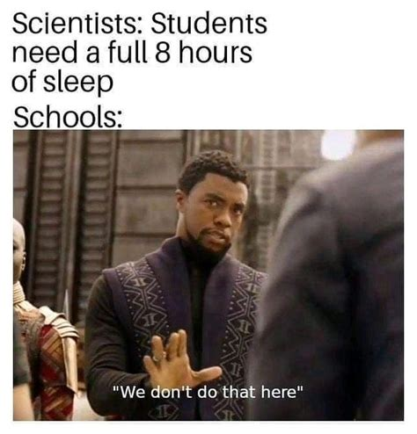
Outcomes: Learner Workload
Initial Reservations
Decisions and Solutions
9-hour commitment for just in-person instruction
Need enough to test understanding without being burdensome
Small, targeted set of practice problems
focused on major topics from the session
Given 1 week to complete each problem set
Practice problems + reflections assess skill application and encourage them to think about their learning process
Provided an answer key after submission deadline
Notes:
Dani

Slide 18
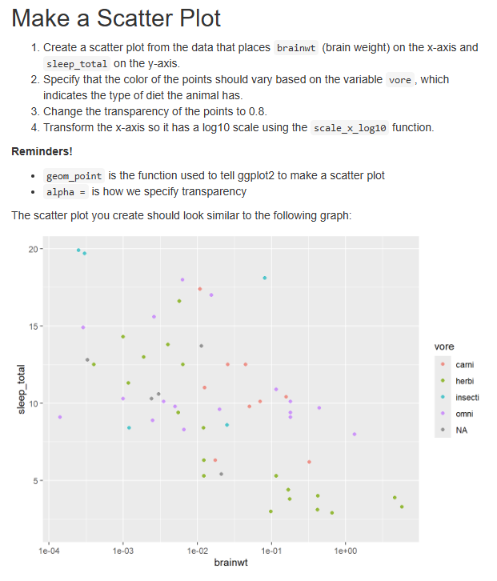

Example: Week 1 Practice Problems & Reflections
Week 1 Practice Problems & Reflections
Notes:
Dani

Slide 19
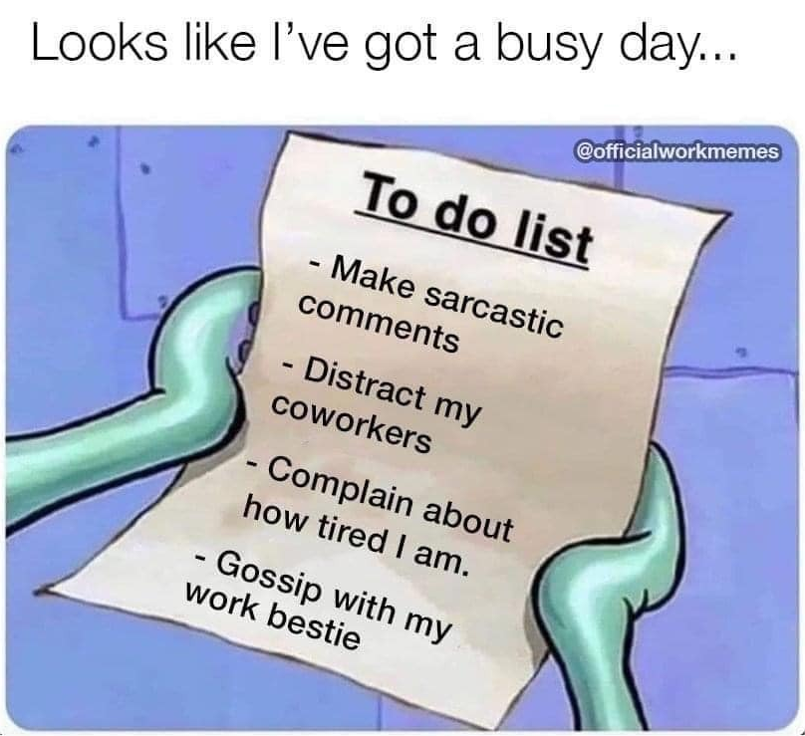
Outcomes: Instructor Workload
Initial Reservations
Decisions and Solutions
What is being assessed and how?
Create assessment pieces that require minimal modification from semester to semester
Time needed to process micro-credential submissions
Broad application of
knowledge, rather than
assessment of specific functions
Incorporate reflection questions to prompt learners to think about their learning experience
Updates to assessment pieces minimal from
one semester to the next
Answer keys streamlined checking code submissions
Focus of assessment was application of content, not correctness
Notes:
Jaina

Slide 20
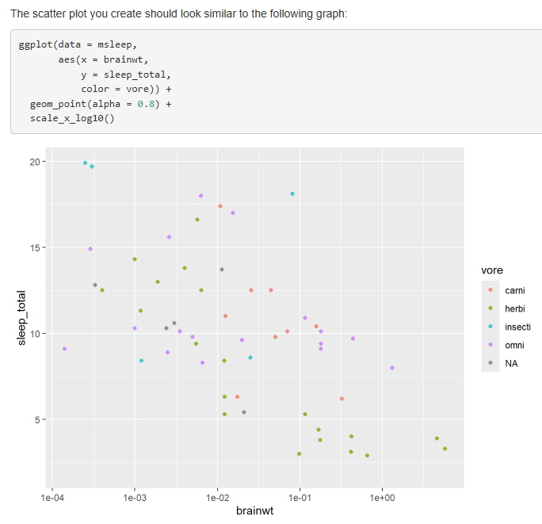

Example: Week 1 Answer Key
Week 1 Answer Key
Notes:
Jaina

Slide 21
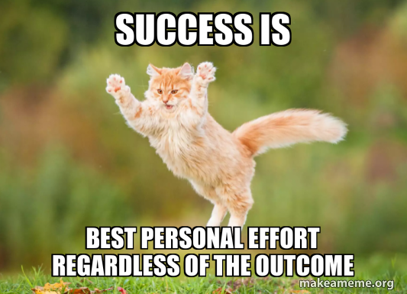
Outcomes: Micro-Credential Impact
Initial Reservations
Decisions and Solutions
Micro-credential badge feels earned
Consider learners may use AI to complete assessment pieces
Application of cumulative learned material to new datasets
Reflections focused on overcoming challenges, rewarding moments, and what they were excited to try next
Emphasis on learning and application, not policing potential
AI use
Notes:
Dani

Slide 22

Learner Reflections: Most Challenging
“The most challenging aspect of this week's workshop was understanding the syntax of plotting with ggplot so that I could apply it to other contexts, but I am overcoming it with the practice that I got during the workshop and from these practice problems.”
“The most challenging aspect of the workshop was memorizing the individual codes to improve and design the plot. I overcame this by seeking to understand the purpose of the code as opposed to just memorizing. I asked myself, what do I need and what am I formatting and worked from there step by step.”
“The most challenging aspect of this week’s workshop was understanding the concept of factors. Initially, I did not fully comprehend the meaning of the term or what it accomplished. Thankfully, the lesson manual given on GitHub assisted with explaining this notion, and so I was able to eventually understand. The practice questions in the homework assignment also helped me to grasp the concept.”
Notes:
Dani

Slide 23

Learner Reflections: Most Rewarding
“The most rewarding part of this so far has been the homework lesson. I dreaded it for days, but found that it was very easy when I used my previous code and just modified it.”
“This workshop helped me feel more comfortable working with datasets and showed me that I am gradually becoming more confident in using R.”
“It is always fun when you’ve entered the syntax properly and clicking “Ctrl + Enter” suddenly makes a graph pop up that makes sense and looks like what you were expecting.”
“The most rewarding aspect of the workshop is being able to do the practice problems independently. This reflected my understanding of the workshop.”
“The most rewarding aspect was getting the graphs in the Week 1 Practice Problems to look similar to the examples because for these I was on my own in troubleshooting the syntax, geom order, within which set of parentheses to place things, etc. Completing it on my own helped most to reinforce the syntax and grammar of graphics we went over during the workshop”
“While completing the practice problems and the challenges, I actually understood what it was asking and how to code it.”
Notes:
Jaina

Slide 24

Learner Reflections: Excited to Try Next
“I am interested in learning how to automate parts of the analysis process and improve my efficiency when working with data in R.”
“I am most excited to try working with my own dataset in R next, maybe with creating graphs and plots in this controlled environment rather than in Excel.”
“I think I am most excited to use this information to start analyzing my own data sets. I plan on using R next time I run a study and definitely to make my next graph.”
“I’m most excited to try making more advanced graphs and learning how to customize them more in ggplot.”
“I think I am most excited to continue implementing custom graphs. I want to use R to perform statistics on data and then make customized graphs out of that data.”
“I’m most excited to try some data analysis in R for future classes. Also, it would be fun to make graphs in R.”
Notes:
Dani

Slide 25
Final Thoughts
Challenges and Perspectives
Notes:
Dani

Slide 26

Our Challenges with
Micro-Credential Integration
Did not account for accommodations for in-person absences
  Enabling online participation
  Requesting submission of coding scripts for that session’s content
Met with accessibility challenges when trying to provide practice problems
  Limitations with exporting PDF files containing images tagged with alt text
  HTML export from R Markdown worked much better in this regard
Notes:
Dani

Slide 27
Our Perspectives on
Micro-Credential Integration
Attendance remained strong throughout series when we piloted the micro-credential
Micro-credential assessment pieces provided an avenue for learner engagement outside of workshop sessions
Learners who completed the first micro-credential assignment seemed to maintain that engagement throughout the series and obtain the micro-credential
Notes:
Jaina

Slide 28





Acknowledgments
UCO Carpentries Committee
  Nicole Sump-Crethar
  Karl Siewert
  Ryan Maher, Buddy
  Casey Lowry
  Juliet Alavicheh
  Stephanie Loria
  Jesse Kern
  Daniel Raudabaugh
LX Studio
  Cami Cooper
  Alyssa Provencio-Ciszewicz
  Trevor Cox
R and RStudio workshop co-instructors and helpers
  Simon Ringsmuth, co-instructor
  Nguvan Agaigbe, co-instructor
  Rebekah Silverstein, co-instructor
  Evan Linde, TIGER
  Jess Warre
  Cameron Cardona
Notes:
Jaina and Dani

Slide 29

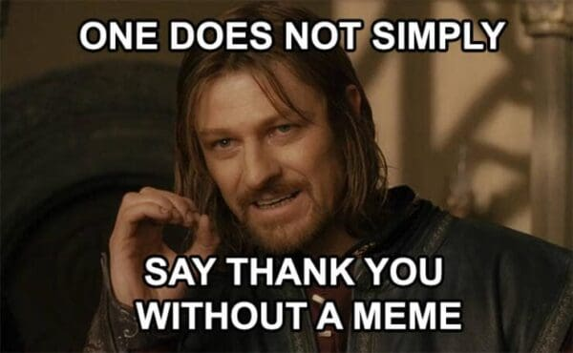
Thank you! Any questions?
tinyurl.com/sedls26-micro
Notes:
Dani

