Slide 1
A very short introduction to
Modeling in Landscape Archaeology
Daniel Knitter

Slide 2
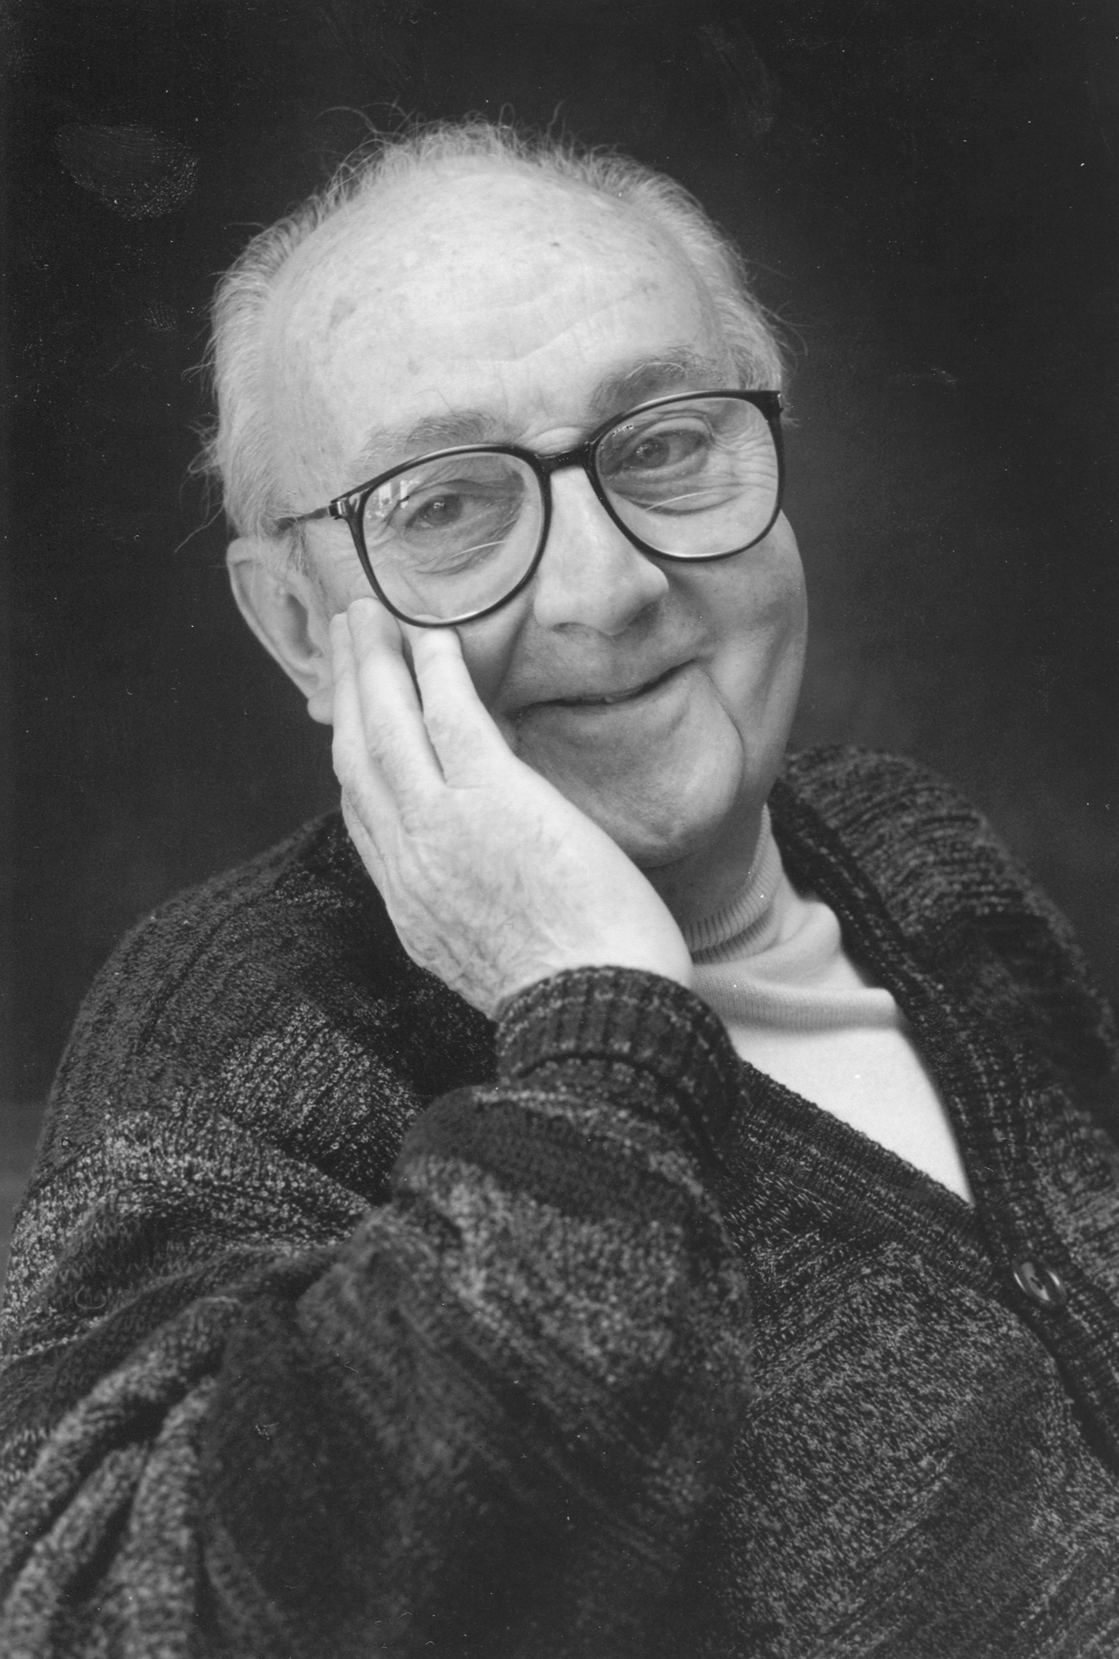
"Since all models are wrong
the scientist cannot obtain a 'correct' one
by excessive elaboration.
On the contrary following William of Occam
[s]he should seek an economical description
of natural phenomena.
Just as the ability to devise simple but evocative
models is the signature of the great scientist
so overelaboration and overparameterization
is often the mark of mediocrity" (Box 1976, 792).
By DavidMCEddy at en.wikipedia, CC BY-SA 3.0,
https://commons.wikimedia.org/w/index.php?curid=14941622

Slide 3
Content
Modeling and processes
Why space matters: Potentials and Pitfalls of Spatial Data
Point Pattern Analyses: What processes might have caused the distribution of findings?
  First order processes (density based approaches)
  Second order processes (distance based approaches)
From single attributes to continuous surfaces: geostatistics
Geomorphometry: What is the character of the landscape?
Outlook

Slide 4
Content
Modeling and processes
Why space matters: Potentials and Pitfalls of Spatial Data
Point Pattern Analyses: What processes might have caused the distribution of findings?
  First order processes (density based approaches)
  Second order processes (distance based approaches)
From single attributes to continuous surfaces: geostatistics
Geomorphometry: What is the character of the landscape?
Outlook

Slide 5

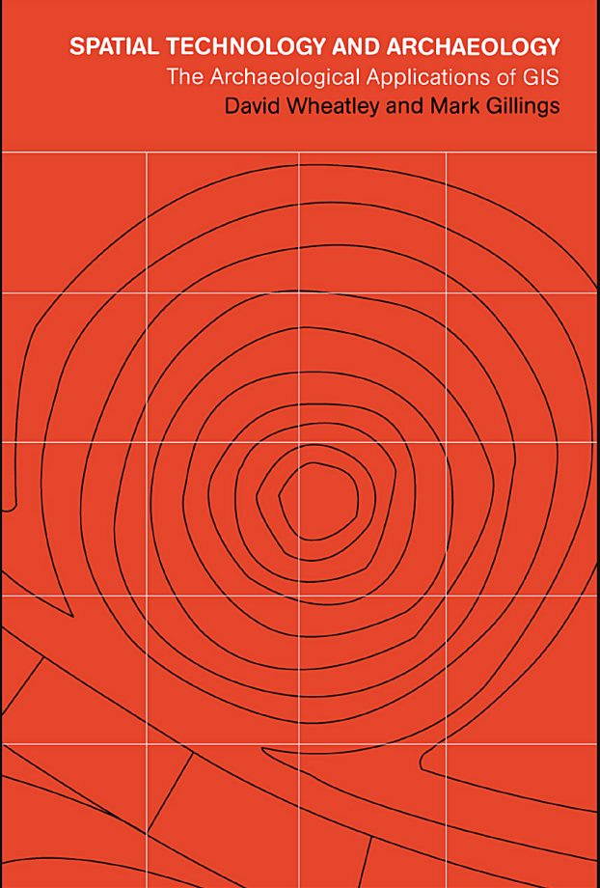




Modeling in (Landscape) Archaeology

Slide 6
Modeling in Landscape Archaeology
What to read?
Where to start?
A slightly different selection...

Slide 7
Modeling in Landscape Archaeology
Theory
Application
What to read?
Where to start?
A slightly different selection...
Basics

Slide 8

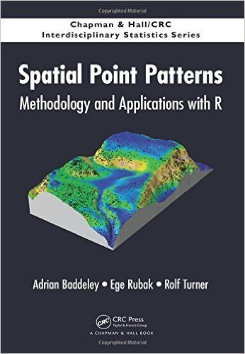
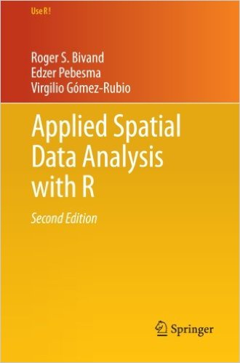

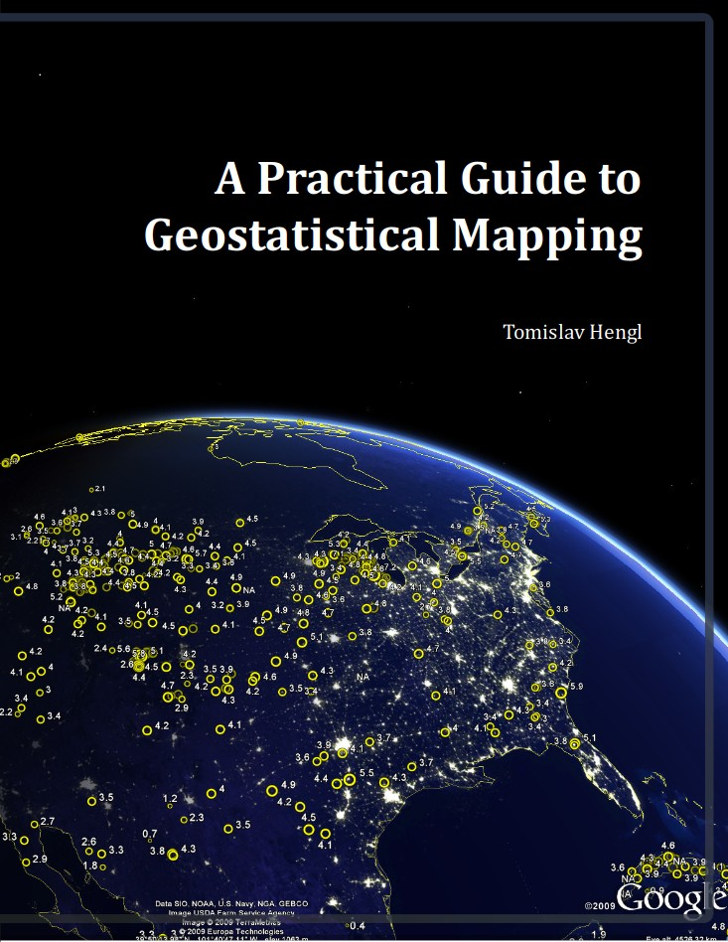

Modeling in Landscape Archaeology
Theory
Application
Basics

Slide 9
Modeling in Landscape Archaeology
Spatial phenomena are the result of processes
Modeling = (re-)construction of these processes

Slide 10
Modeling in Landscape Archaeology
Spatial phenomena are the result of processes
Modeling = (re-)construction of these processes
Artifacts
(pottery, metals, bricks, ...)
Spatial process
Site and pattern of sites
Spatial process
Settlement and settlement pattern

Slide 11
Modeling in Landscape Archaeology
Spatial phenomena are the result of processes
Modeling = (re-)construction of these processes
Artifacts
(pottery, metals, bricks, ...)
Spatial process
Site and pattern of sites
Spatial process
Spatial process
Environment
(natural/social)
Spatial process
Settlement and settlement pattern

Slide 12
Modeling in Landscape Archaeology
Spatial
Phenomena
Process
Spatial
Phenomena

Slide 13
Modeling in Landscape Archaeology
Modeling as a recursive activity.
Spatial
Phenomena
Process
Spatial
Phenomena

Slide 14
Content
Modeling and processes
Why space matters: Potentials and Pitfalls of Spatial Data
Point Pattern Analyses: What processes might have caused the distribution of findings?
  First order processes (density based approaches)
  Second order processes (distance based approaches)
From single attributes to continuous surfaces: geostatistics
Geomorphometry: What is the character of the landscape?
Outlook

Slide 15
Spatial data are special
Pitfalls of spatial data:
→ spatial autocorrelation
→ modifiable areal unit problem
→ scale
→ ecological fallacy
→ non-uniformity of space
→ edge effects

Slide 16
Spatial autocorrelation
Pitfalls of spatial data
The Earth is not an isotropic plate
Spatial data are not random
Data from locations near to each other are usually
more similar than data far away from each other
Space and location are important because of
Spatial autocorrelation.
Without spatial autocorrelation, spatial analyses would be pointless

Slide 17
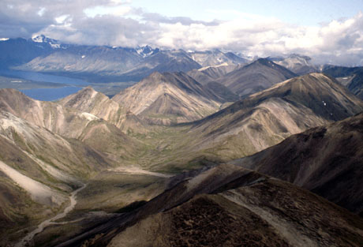

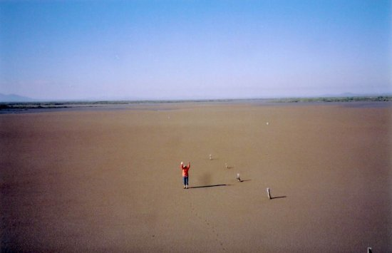
Spatial autocorrelation
Pitfalls of spatial data
Low
High
Maximum
www.geog.ucsb.edu/~kclarke/G176B/Lecture12.ppt

Slide 18
Modifiable Areal Unit Problem (MAUP)
Pitfalls of spatial data
- aggregation units used are arbitrary with respect to the phenomena under investigation
- If spatial units are specified differently, one might get very different patterns
→ Openshaw, Stan (1984): The modifiable areal unit problem

Slide 19
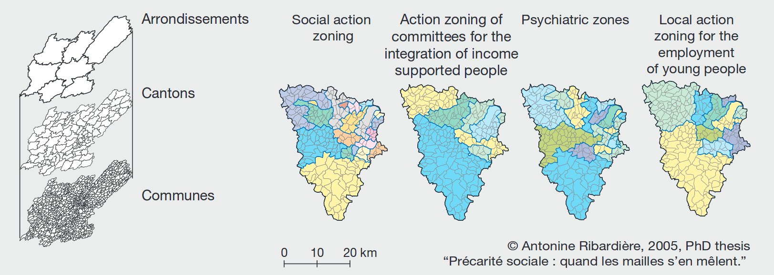
Modifiable Areal Unit Problem (MAUP)
Pitfalls of spatial data
http://www.bbsr.bund.de/BBSR/DE/Veroeffentlichungen/IzR/2009/10_11/Inhalt/DL_Madelin_ua.pdf?__blob=publicationFile&v=2

Slide 20
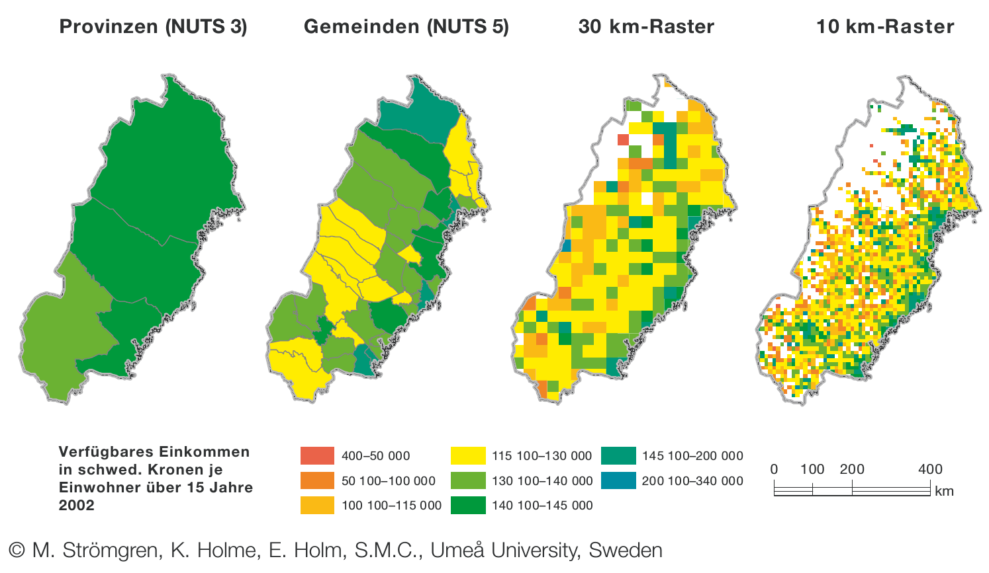
Modifiable Areal Unit Problem (MAUP)
Pitfalls of spatial data
http://www.bbsr.bund.de/BBSR/DE/Veroeffentlichungen/IzR/2009/10_11/Inhalt/DL_Madelin_ua.pdf?__blob=publicationFile&v=2

Slide 21
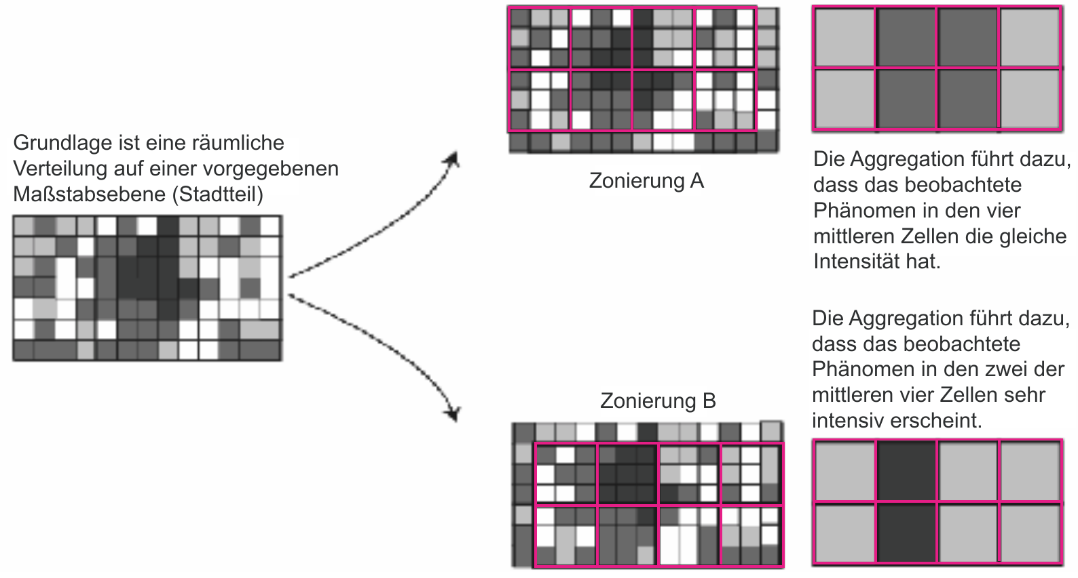
Modifiable Areal Unit Problem (MAUP)
Pitfalls of spatial data
Zone A
Mean of zones
Zone B
Mean of zones
http://www.bbsr.bund.de/BBSR/DE/Veroeffentlichungen/IzR/2009/10_11/Inhalt/DL_Madelin_ua.pdf?__blob=publicationFile&v=2

Slide 22
Scale effects
Pitfalls of spatial data
- Scale affects results and representativity of data
- e.g. cities may be represented as points or polygons
- results depend on the scale of analysis, e.g. province or county → MAUP
Individuals
Clustered in cities
Cities dispersed in space

Slide 23
Scale effects
Pitfalls of spatial data
- Scale affects results and representativity of data
- e.g. cities may be represented as points or polygons
- results depend on the scale of analysis, e.g. province or county → MAUP
A river on different scales
1:1,000
1:1,000,000

Slide 24
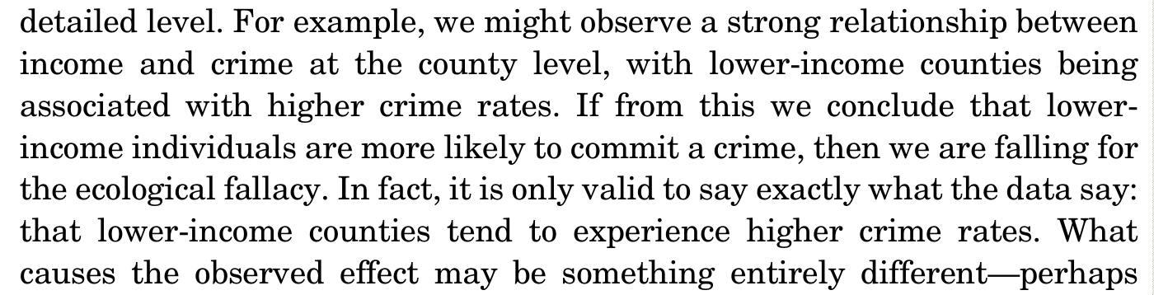
Ecological fallacy
Pitfalls of spatial data
correlation IS NOT causation
Arises when:
- Statistical relationship at one level of aggregation...
- ...is assumed to hold true because it holds at a more detailed level
(O’Sullivan & Unwin, 2010)

Slide 25
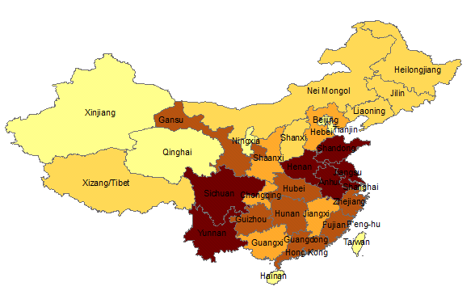
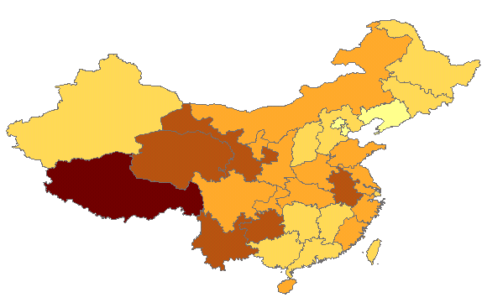
Non-uniformity of space
Pitfalls of spatial data
Bank robberies are clustered
→ because banks are clustered
Diseases due to bad air are clustered
→ because factories are clustered
Illiteracy in China
absolute
as ratio of population
www.utdallas.edu/~briggs/henan/2spatanal.ppt

Slide 26
Edge effects
Pitfalls of spatial data
- unless you study the entire world: Every study region has a boundary
- You do not have data outside your study region
- But: the “outside” data may/do affect the data of your study region (if there is spatial autocorrelation...)

Slide 27
Spatial data are special
Pitfalls of spatial data:
→ spatial autocorrelation
→ modifiable areal unit problem
→ scale
→ ecological fallacy
→ non-uniformity of space
→ edge effects
Potentials of spatial data:
→ distance
→ adjacency
→ interaction
→ neighborhood

Slide 28
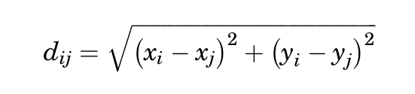
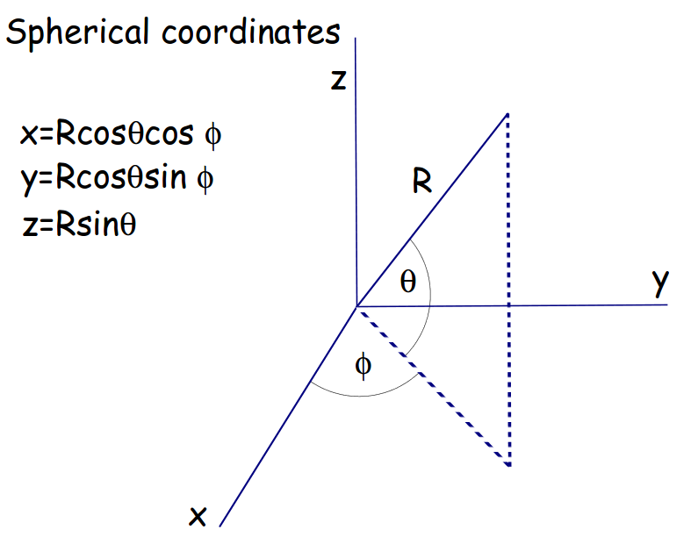
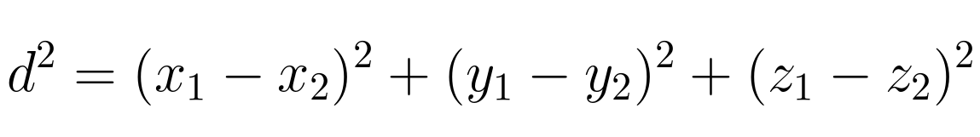
Distance
Potential of spatial data
Euclidean distance as calculated using
Pythagoras' formula
→ for projected data on the local/regional scale
Spherical distance via spherical coordinates
and a 3D version of Pythagoras' formula
→ for unprojected data on a global scale
R = radius of earth, ca. 6378 km
https://www.math.ksu.edu/~dbski/writings/haversine.pdf

Slide 29
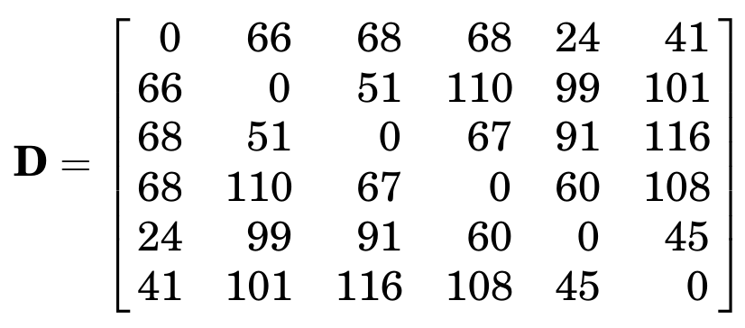
Distance – Adjacency – Interaction - Neighborhood
Potential of spatial data
(O’Sullivan & Unwin, 2010)

Slide 30
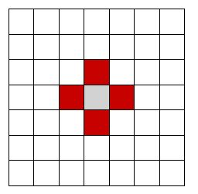
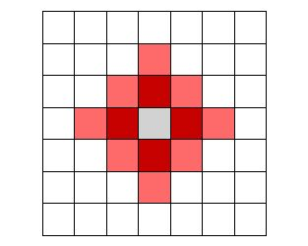
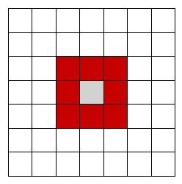
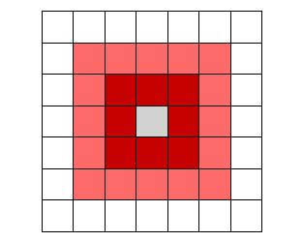
Adjacency
Potential of spatial data
Binary
→ things are adjacent or not
Rook case
→ sharing a boundary
Queen case
→ sharing a boundary or point
1st order neighbor
2nd order neighbor
and also...distance based neighbors...
www.utdallas.edu/~briggs/henan/2spatanal.ppt

Slide 31
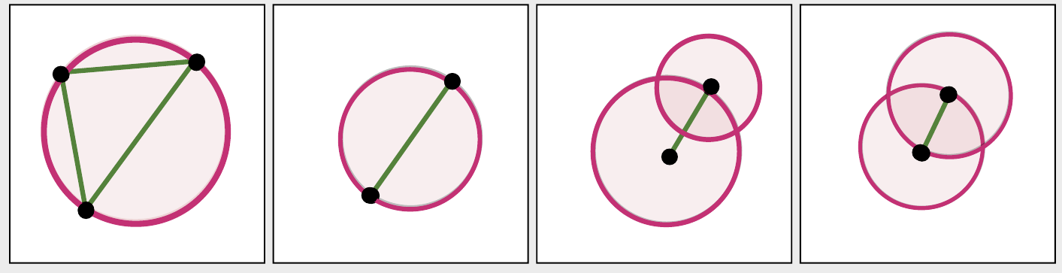
Adjacency
Potential of spatial data
...or graph based neighbors.
Sphere of
influence
Relative
neighbor
Delaunay
Gabriel
Neighbor
Edge between neighbor
Space without points
(Nakoinz & Knitter 2016)

Slide 32
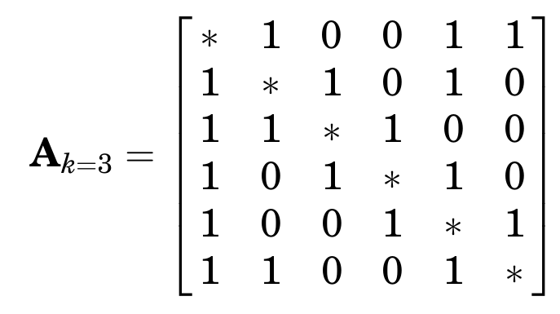
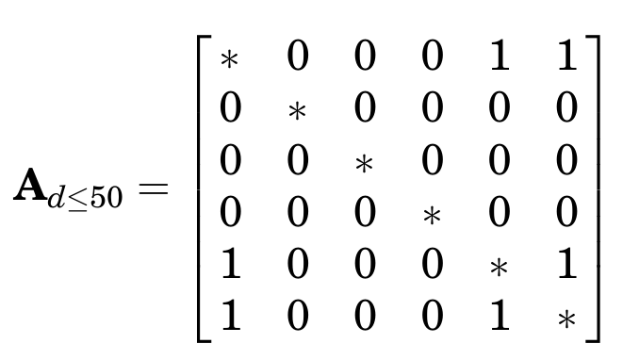
Distance – Adjacency – Interaction - Neighborhood
Potential of spatial data
(O’Sullivan & Unwin, 2010)

Slide 33
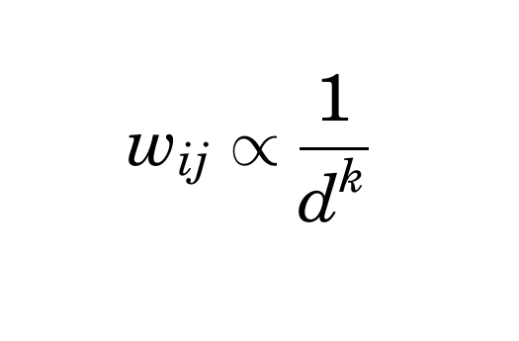
Interaction
Potential of spatial data
- A combination of distance and adjacency
- related to Tobler's first law of geography:
“(...) everything is related to everything else,
but near things are more related
than distant things” (Tobler 1970, 236)
rate of decline
interaction weight
between i and j
distance between i and j
...strength of interaction between i and j is proportional to their inverse distance

Slide 34
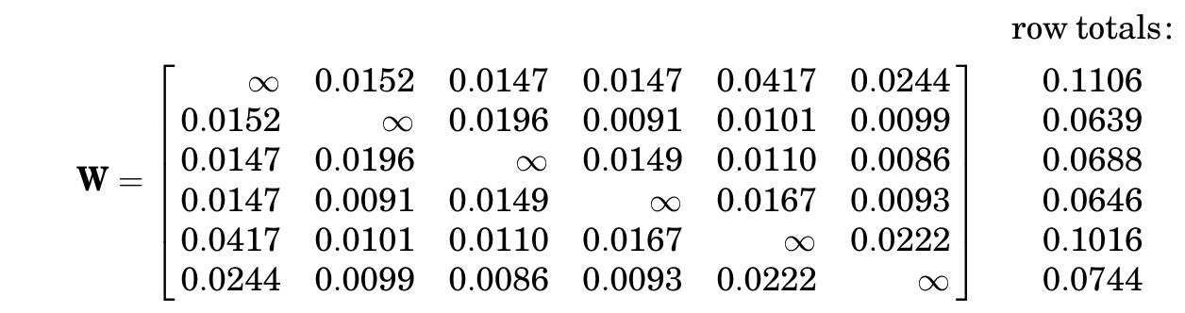
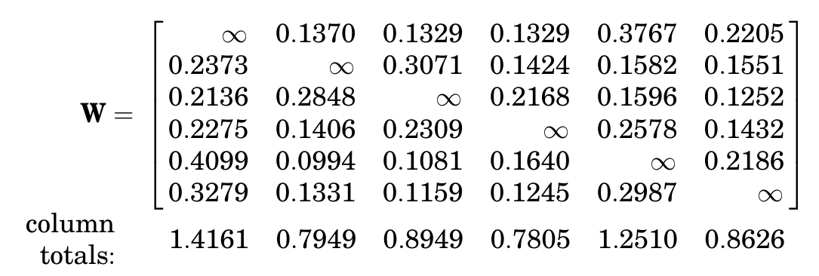
Distance – Adjacency – Interaction - Neighborhood
Potential of spatial data
W[1,2] = W[1,] / sum(W[1,])
...
Influence of element A on all other elements
(O’Sullivan & Unwin, 2010)

Slide 35
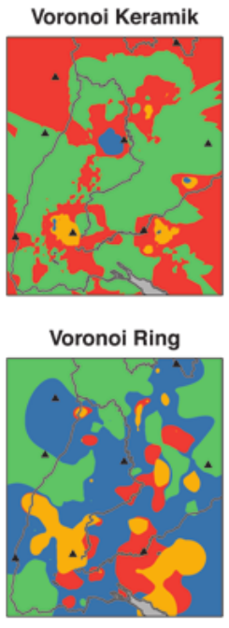
Neighborhood
Potential of spatial data
Neighborhood of X is:
- the set of adjacent cells/areas
- the set of points/cells/areas within a certain distance
- the set of points/cells/areas that share some specific attribute or that are alike
(Nakoinz 2013)

Slide 36
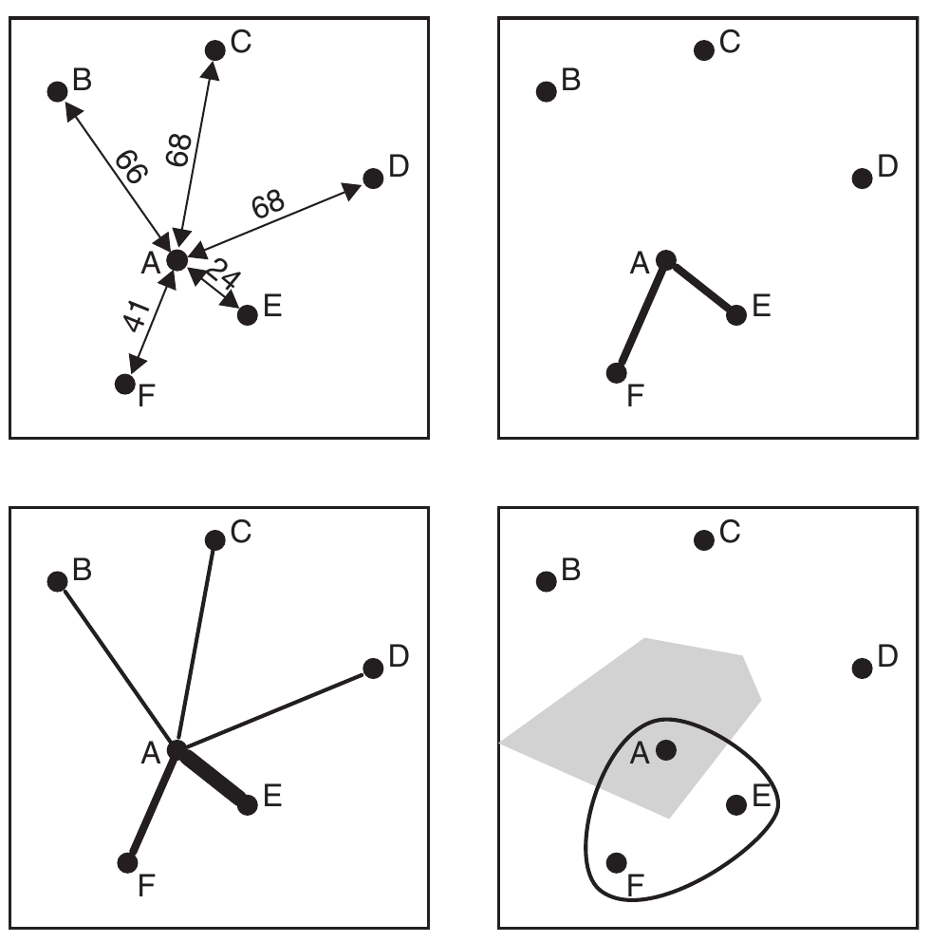
Distance – Adjacency – Interaction - Neighborhood
Potential of spatial data
(O’Sullivan & Unwin, 2010)

Slide 37
Spatial data are special
Pitfalls of spatial data:
→ spatial autocorrelation
→ modifiable areal unit problem
→ scale
→ ecological fallacy
→ non-uniformity of space
→ edge effects
Potentials of spatial data:
→ distance
→ adjacency
→ interaction
→ neighborhood

Slide 38
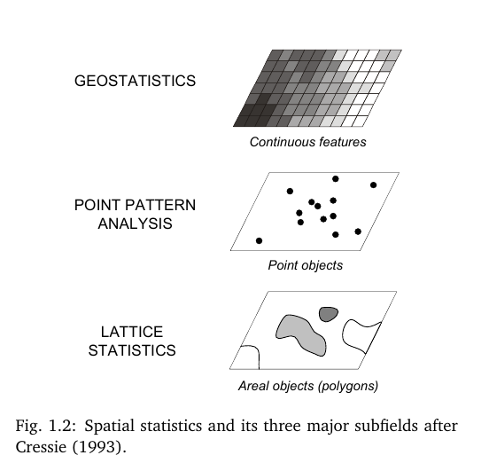
...it's all about processes
However you call it and focus on...
everything is about processes...
Because they cause spatial patterning, autocorrelation, ...
(Hengl, 2009)

Slide 39
Content
Modeling and processes
Why space matters: Potentials and Pitfalls of Spatial Data
Point Pattern Analyses: What processes might have caused the distribution of findings?
  First order processes (density based approaches)
  Second order processes (distance based approaches)
From single attributes to continuous surfaces: geostatistics
Geomorphometry: What is the character of the landscape?
Outlook

Slide 40
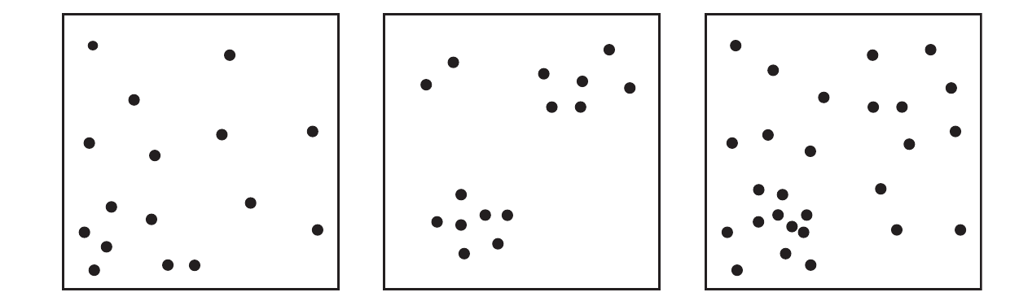
Point Pattern
What caused these patterns? First- or Second order effects?
Point pattern analysis aims to distinguish between both effects
– helping you to understand the genuine process creating the pattern –
(O’Sullivan & Unwin, 2010)

Slide 41
Point Pattern
region
event
pattern
What caused these patterns? First- or Second order effects?
i(x,y)
j(x,y)
Point pattern analysis aims to distinguish between both effects
– helping you to understand the genuine process creating the pattern –
(O’Sullivan & Unwin, 2010)

Slide 42
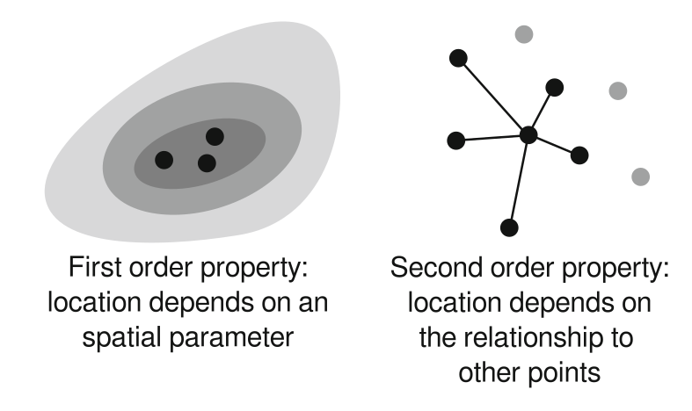
Point Pattern
What caused these patterns? First- or Second order effects?
e.g. mining sites and resources
e.g. graveyard and settlement
(Nakoinz & Knitter 2016)

Slide 43
Point Pattern
What caused these patterns? First- or Second order effects?
e.g. mining sites and resources
e.g. graveyard and settlement
(Nakoinz & Knitter 2016)

Slide 44
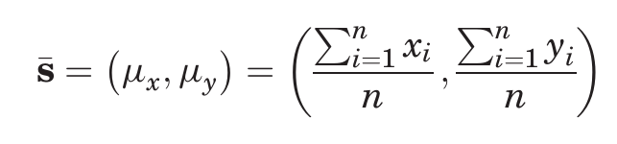
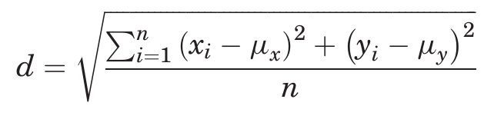
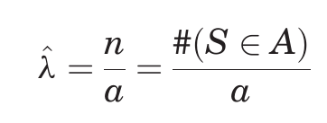
Point Pattern
Simple measures:
- mean center
- standard distance
- intensity of a pattern
Number of events in the
pattern found in study region
Area of study region

Slide 45
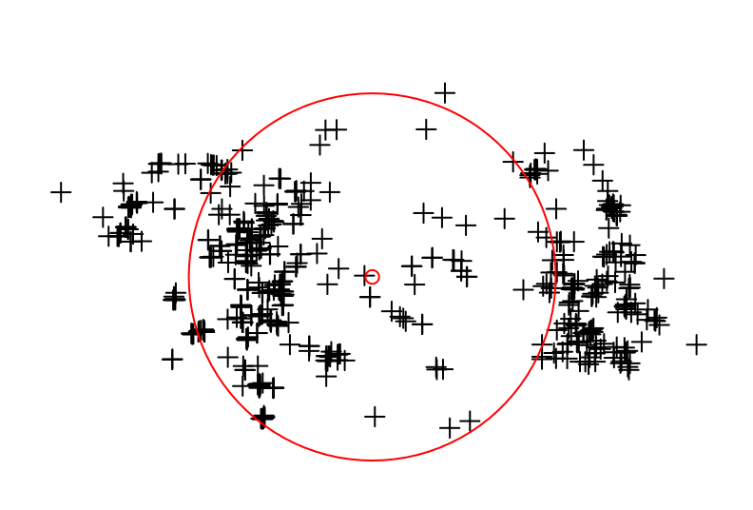
Point Pattern
Simple measures:
- mean center
- standard distance
- intensity of a pattern
0.015 sites/sqkm
Sensitive...what is the area?

Slide 46
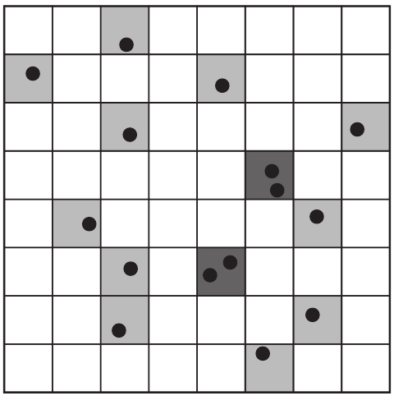
Point Pattern – first order effects
Intensity – more advanced
Independent Random Process (IRP)
= Complete Spatial Randomness (CSR)
→ any event has equal probability to be located
in a quadrant
→ the occurrence of points is independent of the
Positioning of other events
P (event in a quadrant) = 1/64
(O’Sullivan & Unwin, 2010)

Slide 47
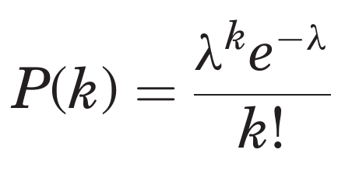
Point Pattern – first order effects
Intensity – more advanced
Independent Random Process (IRP)
= Complete Spatial Randomness (CSR)
Probability of k events in a quadrant is calculated with
Poisson distribution
intensity
Base of natural logarithm (2.78...)
(O’Sullivan & Unwin, 2010)

Slide 48
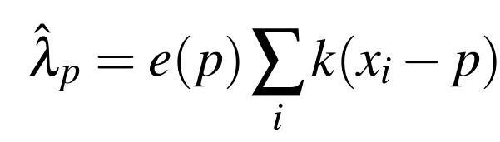
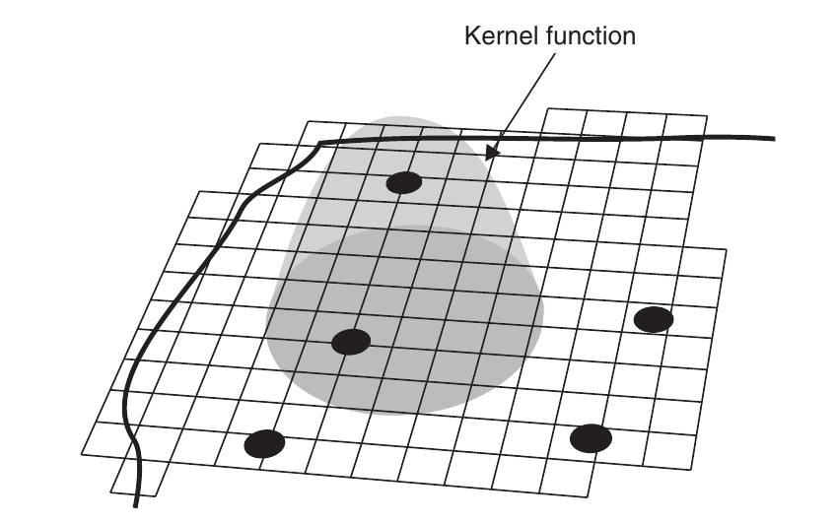
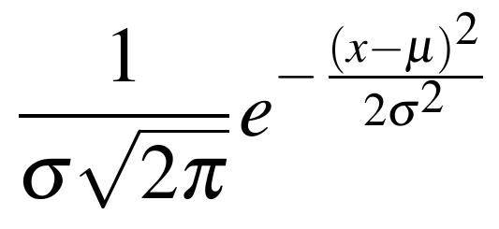
Point Pattern – first order effects
Intensity – more advanced
Edge correction
kernel location
Kernel density estimation (KDE)
(Gaussian) Kernel function
mean
Standard deviation
(Knitter & Nakoinz (in press); (O’Sullivan & Unwin, 2010)

Slide 49
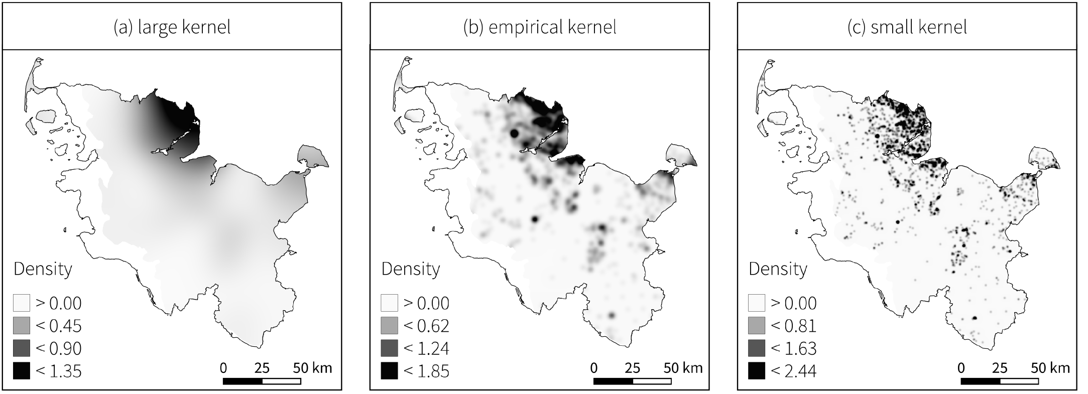
Point Pattern – first order effects
Sigma large
Sigma small
General trend
Local trend
Knitter & Nakoinz (in press)

Slide 50
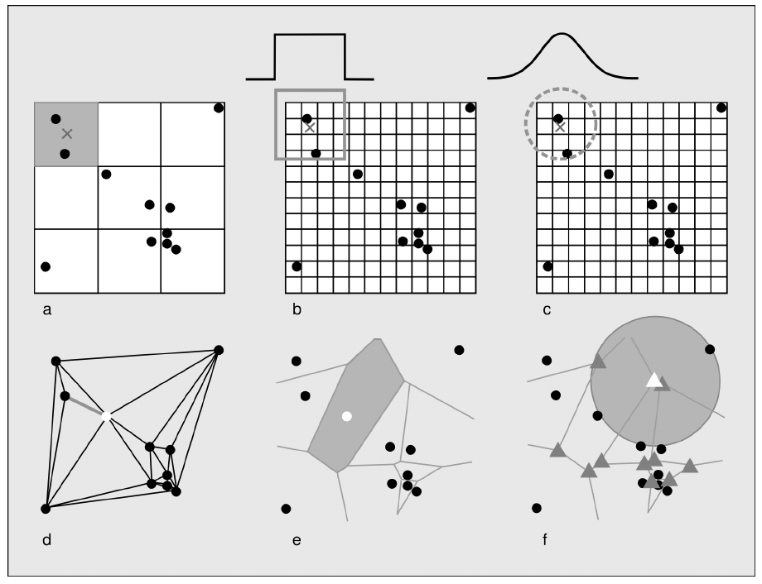
Point Pattern – first order effects
Intensity – possibilities to calculate
(Nakoinz & Knitter 2016)

Slide 51
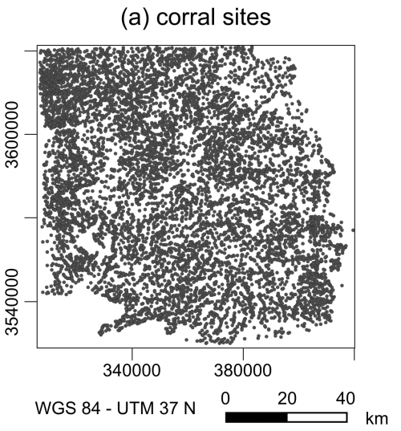
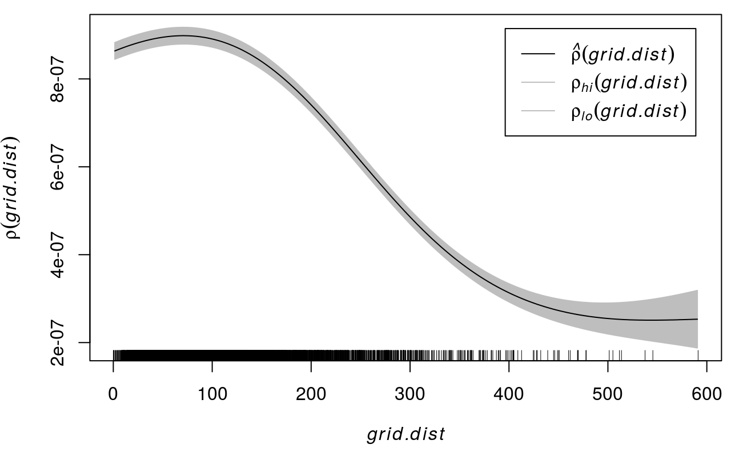
Point Pattern – first order effects
Intensity as tool to investigate dependence on covariates
(Meister et al. forthcoming)

Slide 52
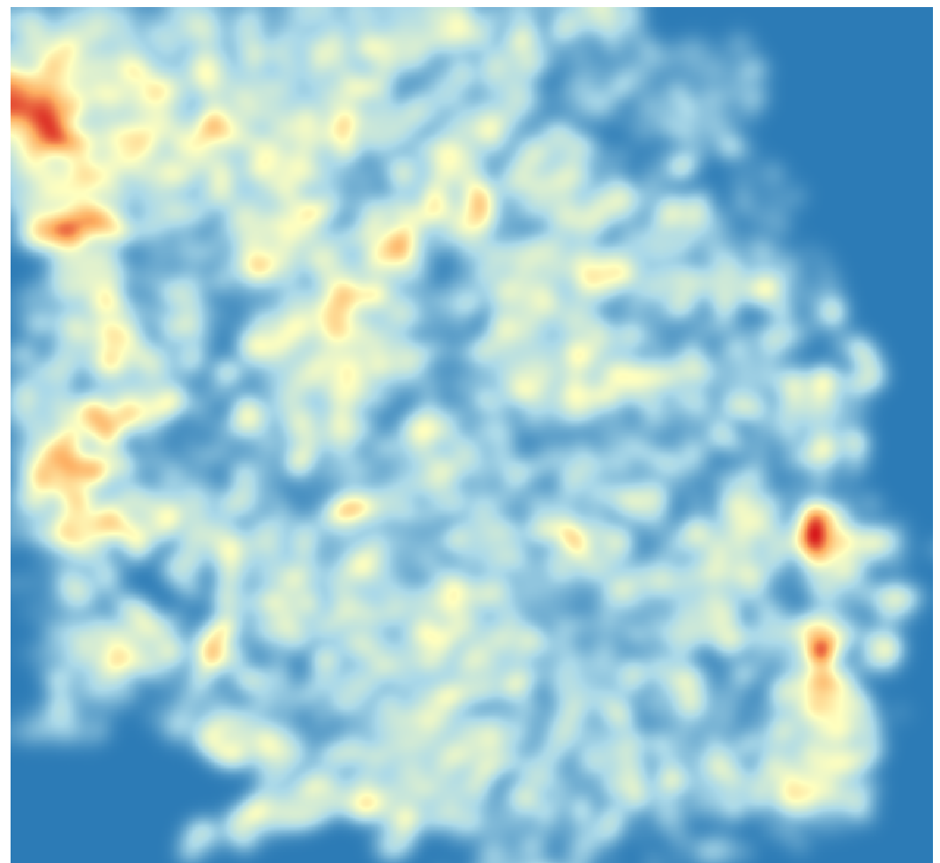
Point Pattern – first order effects
Intensity as tool to investigate dependence on covariates
(Meister et al. forthcoming)

Slide 53
Point Pattern – second order effects

Slide 54
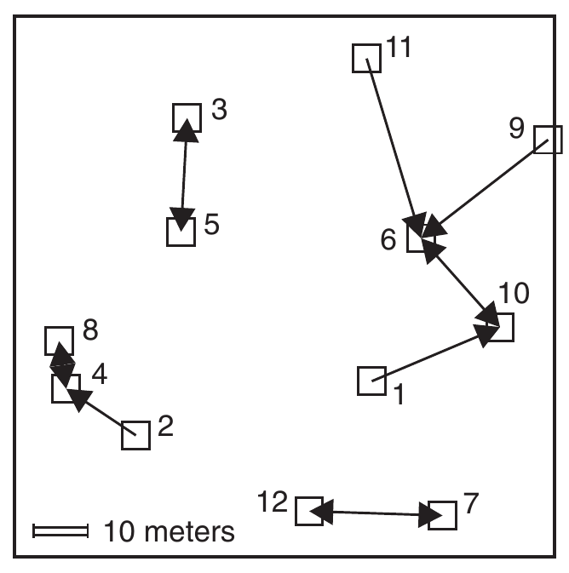
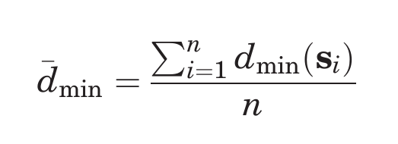
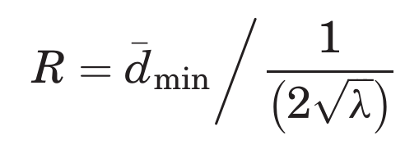
Point Pattern – second order effects
Point patterns described by distance measures
- nearest-neighbor distance → euclidean distance
mean nearest-neighbor distance
Are the points clustered or dispersed?
Use Clark and Evan's R statistic of nearest neighbor distances
expected
nearest-neighbor
distance
R < 1: more clustered
R > 1: more evenly spaced
(O’Sullivan & Unwin, 2010)

Slide 55
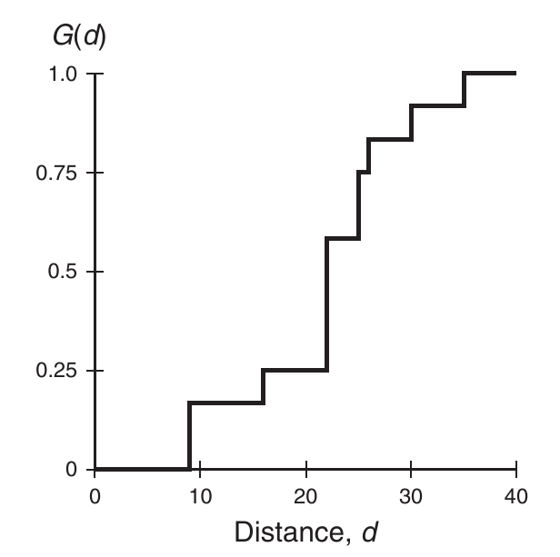

Point Pattern – second order effects
Point patterns described by distance measures
→ cumulative frequency distribution of the nearest-neighbor distances = G(d)
→ G(d) tells us what fraction of all n-n distances is less than d
(O’Sullivan & Unwin, 2010)

Slide 56


Point Pattern – second order effects
Point patterns described by distance measures
→ cumulative frequency distribution of the nearest-neighbor distances of arbitrary events to known events = F(d)
minimum distance from random point pi to an event
set of randomly
selected locations
(O’Sullivan & Unwin, 2010)

Slide 57

Point Pattern – second order effects
(O’Sullivan & Unwin, 2010)

Slide 58


Point Pattern – second order effects
To get rid of the nearest-neighbor limitation:
use the K Function
Events in circle radius d centered at s
Event density in the study area/region
(O’Sullivan & Unwin, 2010)

Slide 59

Point Pattern – second order effects
To get rid of the nearest-neighbor limitation:
use the K Function
Events in circle radius d centered at s
Event density in the study area/region
(O’Sullivan & Unwin, 2010)

Slide 60

Point Pattern Analyses
Help to distinguish between first and second order
effects that caused your spatial pattern at hand
→ you gain insights in the underlying processes

Slide 61
Content
Modeling and processes
Why space matters: Potentials and Pitfalls of Spatial Data
Point Pattern Analyses: What processes might have caused the distribution of findings?
  First order processes (density based approaches)
  Second order processes (distance based approaches)
From single attributes to continuous surfaces: geostatistics
Geomorphometry: What is the character of the landscape?
Outlook

Slide 62
Interpolation
We start with points
But wait…
Why are the methods of point patterns not used??
Because point data is not necessarily a point pattern
e.g. sampling locations of soil samples to analyze phosphorous (=points)
are artificial and irrelevant to the study of phosphorous distribution
→ such points do not reflect a process.

Slide 63

Interpolation
Aim: get a continuous representation of attribute information.

Slide 64

Interpolation
Aim: get a continuous representation of attribute information.
Hoelzmann & Knitter forthcoming

Slide 65


Interpolation
Aim: get a continuous representation of settlement density.
Mission accomplished…!?

Slide 66

Interpolation
Aim: get a continuous representation of attribute information.
Nakoinz & Knitter 2016

Slide 67


Interpolation
Inverse Distance Weighting
Control points i in neighborhood m
Estimate at j
(O’Sullivan & Unwin, 2010)

Slide 68

Interpolation
Kriging
1. Describing spatial variation
Square root differences cloud
(O’Sullivan & Unwin, 2010)

Slide 69

Interpolation
Kriging
1. Describing spatial variation
Square root differences cloud
Distance classes → lags
and summary statistics
(O’Sullivan & Unwin, 2010)

Slide 70

Interpolation
Kriging
1. Describing spatial variation
Square differences, i.e. semivariogram cloud
(O’Sullivan & Unwin, 2010)

Slide 71


Interpolation
Kriging
1. Describing spatial variation
Square differences, i.e. semivariogram cloud
Distance classes → lags
and summary statistics
→ experimental semivariogram
[or short variogram]
Semivariance
= mean of sum of squared differences at distance d
(O’Sullivan & Unwin, 2010)

Slide 72

Interpolation
Kriging
1. Describing spatial variation
Square differences, i.e. semivariogram cloud
Distance classes → lags
and summary statistics
→ experimental semivariogram
[or short variogram]
Semivariance
= mean of sum of squared differences at distance lags
(O’Sullivan & Unwin, 2010)

Slide 73

Interpolation
Kriging
2. Summarizing spatial variation
Fitting a function to the experimental estimates from the semivariogram
Any function? No. Function has to be authorized, i.e.
→ function can only be positive
→ intercept at zero
(O’Sullivan & Unwin, 2010)

Slide 74

Interpolation
Kriging
2. Summarizing spatial variation
Fitting a function to the experimental estimates from the semivariogram
Exemplary functions to fit
(O’Sullivan & Unwin, 2010)

Slide 75
Interpolation
Aim: get a continuous representation of settlement density.
Mission accomplished…!?
Kriging
Inverse Distance weighting

Slide 76
Content
Modeling and processes
Why space matters: Potentials and Pitfalls of Spatial Data
Point Pattern Analyses: What processes might have caused the distribution of findings?
  First order processes (density based approaches)
  Second order processes (distance based approaches)
From single attributes to continuous surfaces: geostatistics
Geomorphometry: What is the character of the landscape?
Outlook

Slide 77
Terrain analyses
Geomorphometry: the science of the quantitative representation of the Earth’s surface
A great starting point:
Tomislav Hengl and Hannes I. Reuter (eds):
Geomorphometry Concepts, Software, Applications.
Developments in Soil Science, Volume 33, Pages 1-765 (2009)

Slide 78

Terrain analyses
Geomorphometry: the science of the quantitative representation of the Earth’s surface
Everything starts with a DEM...

Slide 79



Terrain analyses
Slope = difference length/difference height

Slide 80

Terrain analyses – what was perceivable?

Slide 81

Terrain analyses – what was perceivable?

Slide 82

Terrain analyses – what was perceivable?

Slide 83

Terrain analyses – what was perceivable?

Slide 84

Terrain analyses – what was perceivable?

Slide 85

Terrain analyses – what was perceivable?
Popa & Knitter 2015

Slide 86
Terrain analyses – what was perceivable?
Where is the transition?
Popa & Knitter 2015

Slide 87

Crisp vs. fuzzy boundaries
openclipart.org

Slide 88


Crisp vs. fuzzy boundaries
warm :)
cold :(
openclipart.org

Slide 89
Crisp vs. fuzzy boundaries
flat.
steep?
flat?
steep?
flat?
steep?
flat?
steep.

Slide 90
Crisp vs. fuzzy boundaries
Flatness = 100%
Steepness = 0%
Steepness = 10%
Flatness = 80%
Steepness = 40%
Flatness = 20%
Steepness = 80%
Flatness = 10%
Flatness = 0%
Steepness = 100%

Slide 91

Crisp vs. fuzzy boundaries
Demicco 2004

Slide 92

Crisp vs. fuzzy boundaries
Nakoinz 2012

Slide 93
Terrain analyses – what was perceivable?
Slope = difference length/difference height

Slide 94

Terrain analyses – what was perceivable?
Popa & Knitter 2015

Slide 95

Terrain analyses – what was perceivable?
Popa & Knitter 2015

Slide 96

Terrain analyses – what was perceivable?
Popa & Knitter 2015

Slide 97

Terrain analyses – what was perceivable?
Popa & Knitter 2015

Slide 98
Terrain analyses – what was perceivable?
If “they” preferred certain areas, how would a resulting interaction network look like?

Slide 99
Terrain analyses – what was perceivable?
If “they” preferred certain areas, how would a resulting interaction network look like?
Workflow:
- fuzzy terrain

Slide 100

Terrain analyses – what was perceivable?
If “they” preferred certain areas, how would a resulting interaction network look like?
Workflow:
- fuzzy terrain
- point pattern analyses

Slide 101

Terrain analyses – what was perceivable?
If “they” preferred certain areas, how would a resulting interaction network look like?
Workflow:
- fuzzy terrain
- point pattern analyses
- cost-surface creation
- pseudo-random walk
(the smaller the cost, the higher the probability)
- sum of all random walks

Slide 102
Content
Modeling and processes
Why space matters: Potentials and Pitfalls of Spatial Data
Point Pattern Analyses: What processes might have caused the distribution of findings?
  First order processes (density based approaches)
  Second order processes (distance based approaches)
From single attributes to continuous surfaces: geostatistics
Geomorphometry: What is the character of the landscape?
Outlook

Slide 103




Outlook: personal advices
use open-source software, i.e. free software published under terms of GNU GENERAL PUBLIC LICENSE
Why?
- They grow. Fast. So you can work at the bleeding edge
- YOU can contribute
- others can contribute so YOU can profit from their methods and tools
- you can investigate how methods are implemented.
Publish open access. www.sci-hub.io is/was no alternative and science needs to be free.
Share your code. It is easy: github.com or better gitlab.com

Slide 104
Thank you very much for your attention.

Slide 105

Entity-Attribute Spatial Data Types
Processes caused the spatial occurrence of different entities
Ceramic types
Territories
Site types
Hierarchy
Site size
Population density
(O’Sullivan & Unwin, 2010)

Slide 106

Entity-Attribute Spatial Data Types
Processes define the transformation of spatial data
territories
Population
density
junction
City center
territories
(O’Sullivan & Unwin, 2010)

Slide 107

Spatial Autocorrelation – Moran's I
Weight from spatial
weight matrix
Covariance term
Division by total data variance
Normalize to total spatial weights
(O’Sullivan & Unwin, 2010)

Slide 108

Point Pattern – second order effects
Shows the point pattern clustering/dispersion; does it deviate from CSR?
→ Simulation approach based on
Monte Carlo simulations
Knitter & Nakoinz (in press)

Slide 109



Point Pattern – second order effects
Shows the point pattern clustering/dispersion; does it deviate from CSR?
→ Simulation approach based on
Monte Carlo simulations
Just a
square root transformation of K(d)
Knitter & Nakoinz (in press)

Slide 110

Point Pattern – a look ahead
Knitter & Nakoinz (in press)

Slide 111
Point Pattern – a look ahead
Knitter & Nakoinz (in press)

Slide 112

Interpolation
Kriging
2. Summarizing spatial variation
“Elements” of a semivariogram
Nugget
→ measurement error
→ variation below shortest sampling interval
Sill
→ range of semivariance
Range
→ distance at which semivariance
reaches maximal value
(Nakoinz & Knitter 2016)

