Slide 1
V/S Modellieren in der Landschaftsarchäologie
Freie Universität Berlin
M.Sc. Landschaftsarchäologie
Dr. Daniel Knitter

Slide 2
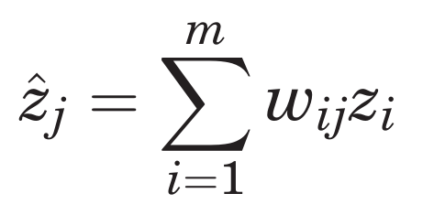
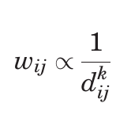
Interpolation
Inverse Distance Weighting
Control points I in neighborhood m
Estimate at j
(O’Sullivan & Unwin, 2010)

Slide 3
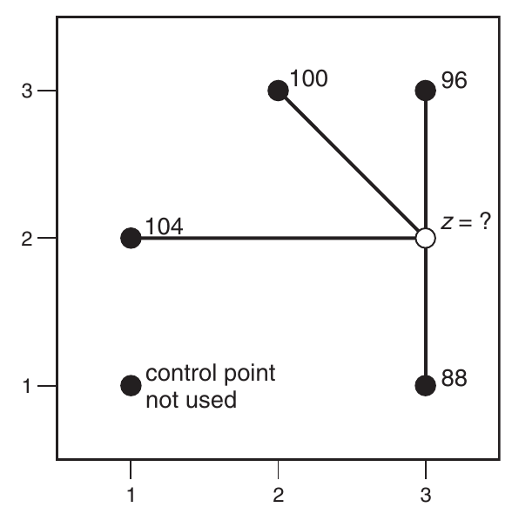
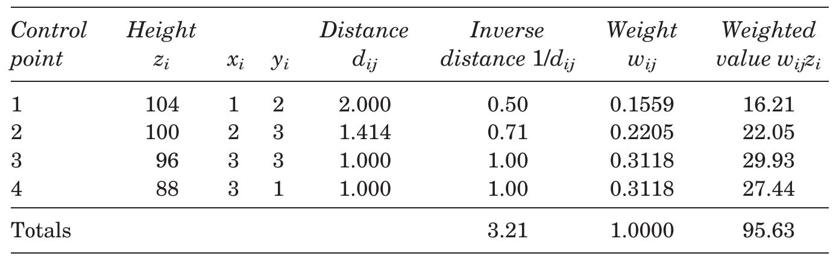
Interpolation
Inverse Distance Weighting
(O’Sullivan & Unwin, 2010)

Slide 4
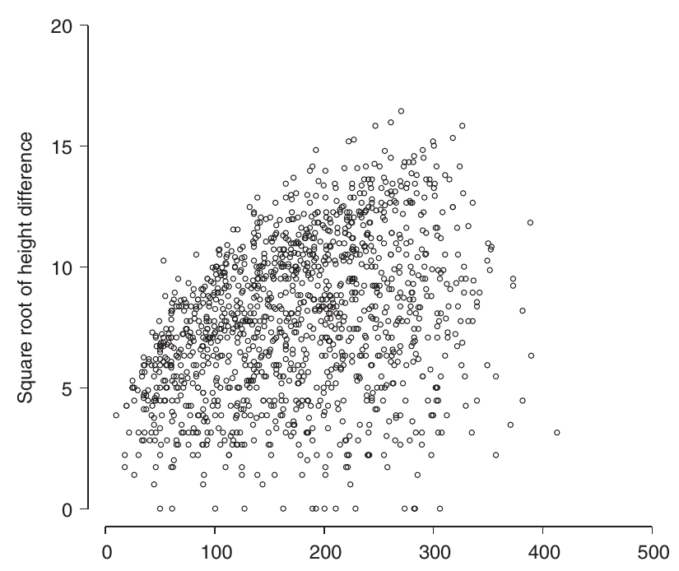
Interpolation
1. Describing spatial variation
Square root differences cloud
(O’Sullivan & Unwin, 2010)

Slide 5
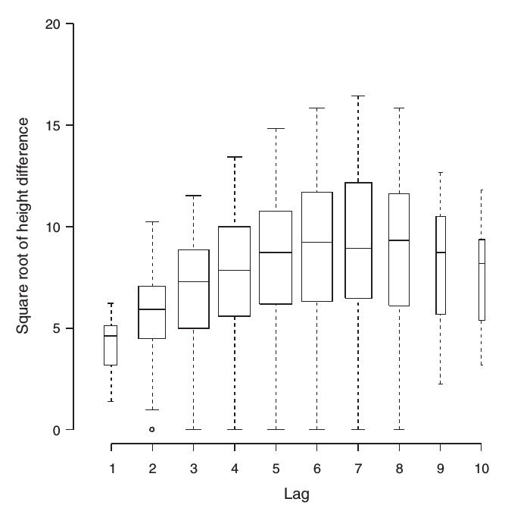
Interpolation
1. Describing spatial variation
Square root differences cloud
Distance classes → lags
and summary statistics
(O’Sullivan & Unwin, 2010)

Slide 6
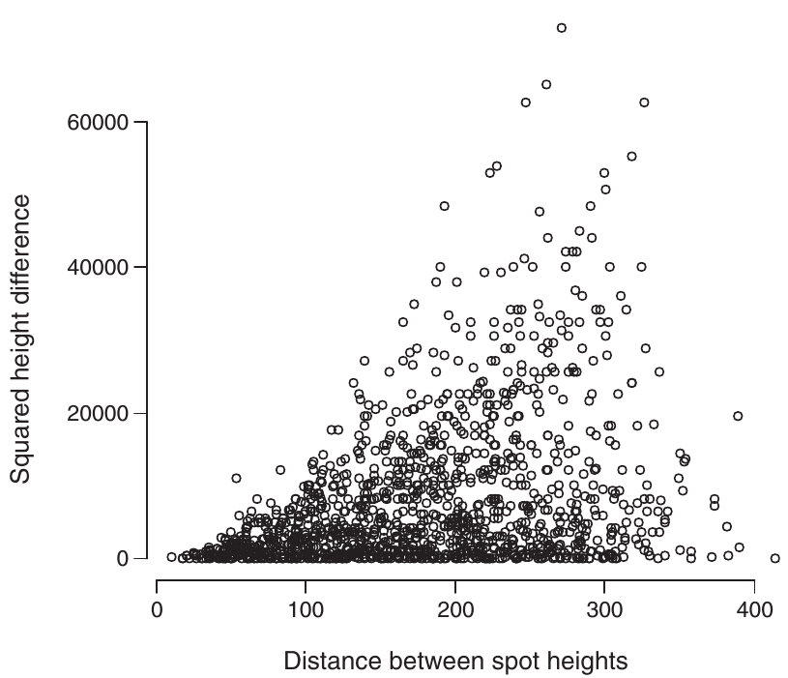
Interpolation
1. Describing spatial variation
Square differences, i.e. semivariogram cloud
(O’Sullivan & Unwin, 2010)

Slide 7
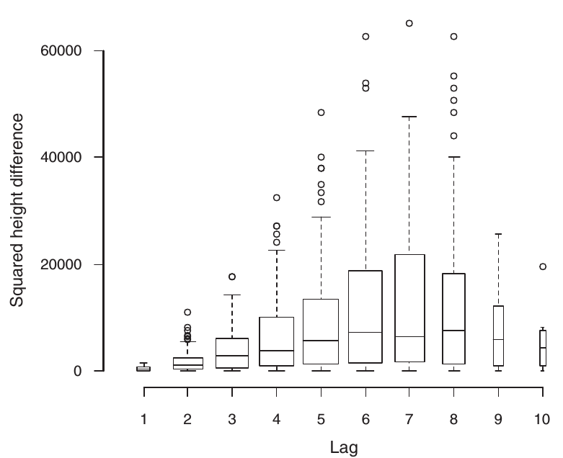
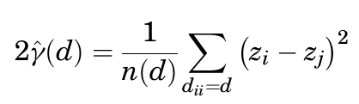
Interpolation
1. Describing spatial variation
Square differences, i.e. semivariogram cloud
Distance classes → lags
and summary statistics
→ experimental semivariogram
[or short variogram]
Semivariance
= mean of sum of squared differences at distance d
(O’Sullivan & Unwin, 2010)

Slide 8
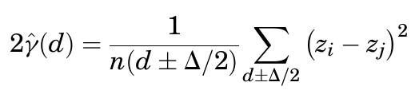
Interpolation
1. Describing spatial variation
Square differences, i.e. semivariogram cloud
Distance classes → lags
and summary statistics
→ experimental semivariogram
[or short variogram]
Semivariance
= mean of sum of squared differences at distance lags
(O’Sullivan & Unwin, 2010)

Slide 9
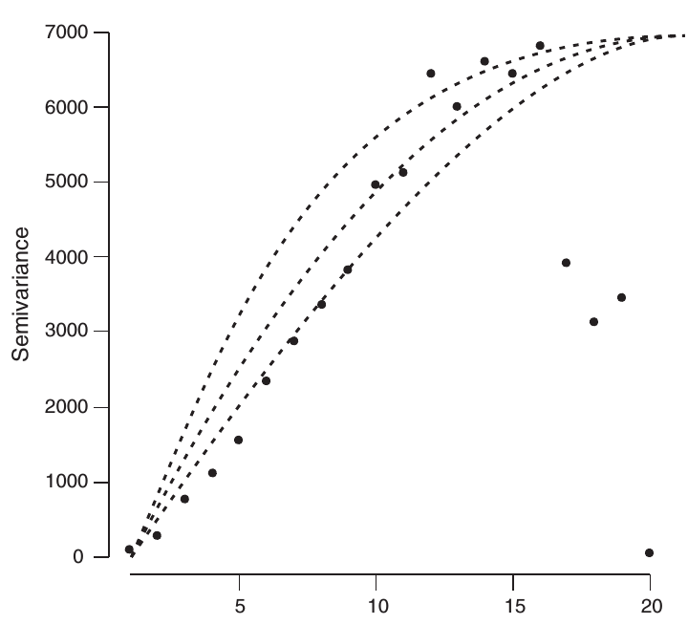
Interpolation
2. Summarizing spatial variation
Fitting a function to the experimental estimates from the semivariogram
Any function? No. Function has to be authorized
→ function can only be positive
→ intercept at zero
(O’Sullivan & Unwin, 2010)

Slide 10
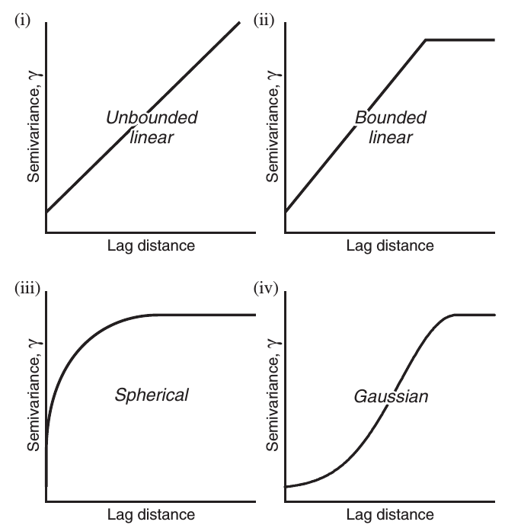
Interpolation
2. Summarizing spatial variation
Fitting a function to the experimental estimates from the semivariogram
Exemplary functions to fit
(O’Sullivan & Unwin, 2010)

Slide 11
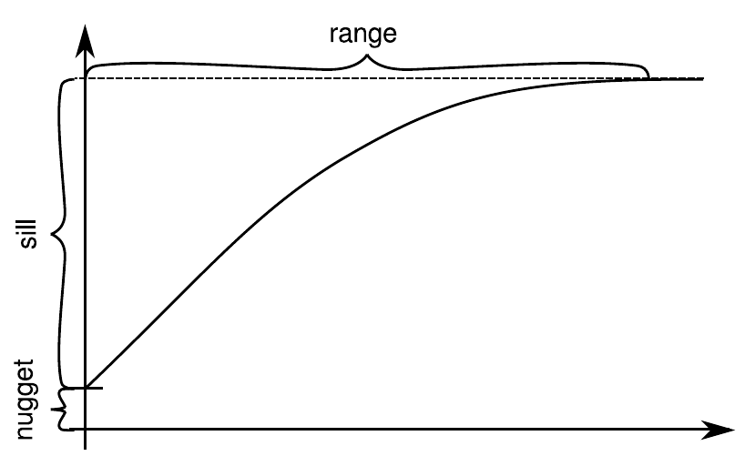
Interpolation
2. Summarizing spatial variation
“Elements” of a semivariogram
Nugget effect
→ measurement error
→ variation below shortest sampling interval
Sill
→ where range of semivariance
Range
→ distance at which semivariance
reaches maximal value
(Nakoinz & Knitter forthcoming)

