Slide 1
V/S Modellieren in der Landschaftsarchäologie
Freie Universität Berlin
M.Sc. Landschaftsarchäologie
Dr. Daniel Knitter

Slide 2
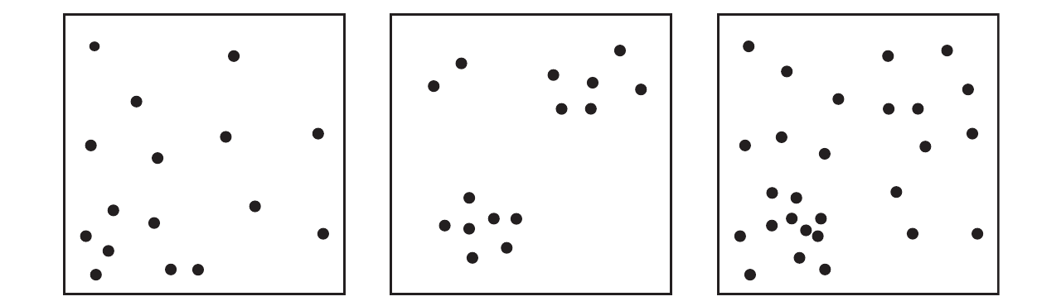
Point Pattern
What caused these patterns? First- or Second order effects?
Point pattern analysis aims to distinguish between both effects
– helping you to understand the genuine process creating the pattern –
(O’Sullivan & Unwin, 2010)

Slide 3
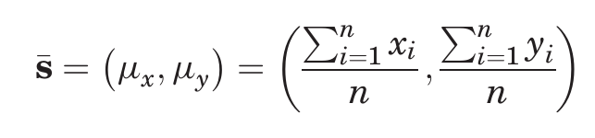
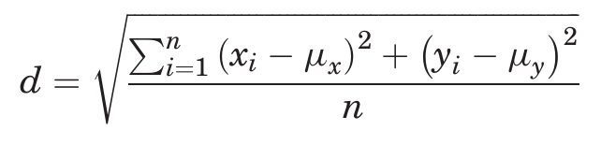
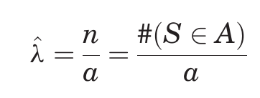
Point Pattern
Simple measures:
- mean center
- standard distance
- intensity of a pattern
Number of events in the
pattern found in study region
Area of study region

Slide 4
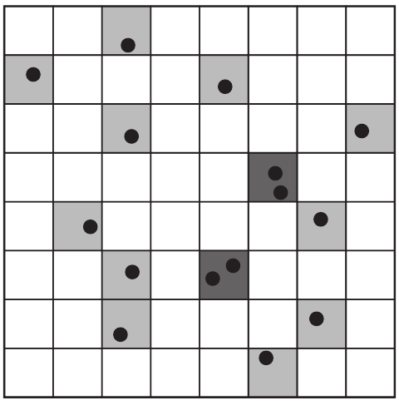
Point Pattern – first order effects
Intensity – more advanced
Independent Random Process (IRP)
= Complete Spatial Randomness (CSR)
→ any event has equal probability to be located
a quadrant
→ the occurrence of points is independent of the
Positioning of other events
P (event in a quadrant) = 1/64
(O’Sullivan & Unwin, 2010)

Slide 5
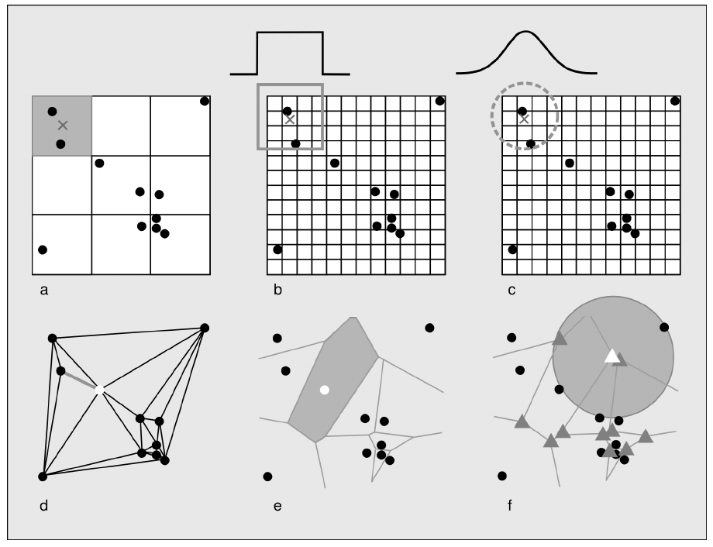
Point Pattern – first order effects
Intensity – possibilities to calculate
(Nakoinz & Knitter forthcoming)

Slide 6
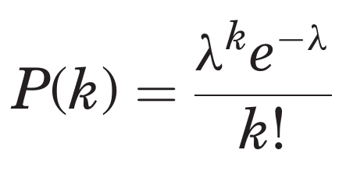
Point Pattern – first order effects
Intensity – more advanced
Independent Random Process (IRP)
= Complete Spatial Randomness (CSR)
Probability of k events in a quadrant is calculated with
Poisson distribution
intensity
Base of natural logarithm (2.78...)
(O’Sullivan & Unwin, 2010)

Slide 7
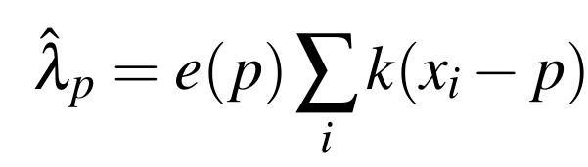
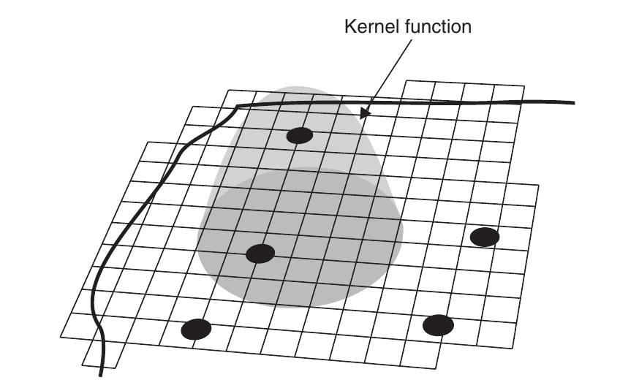
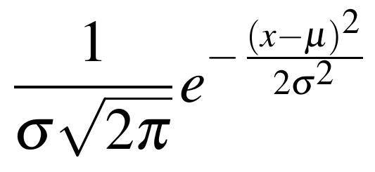
Point Pattern – first order effects
Intensity – more advanced
Edge correction
kernel location
Kernel density estimation (KDE)
(Gaussian) Kernel function
mean
Standard deviation
(Knitter & Nakoinz (submitted); (O’Sullivan & Unwin, 2010)

Slide 8
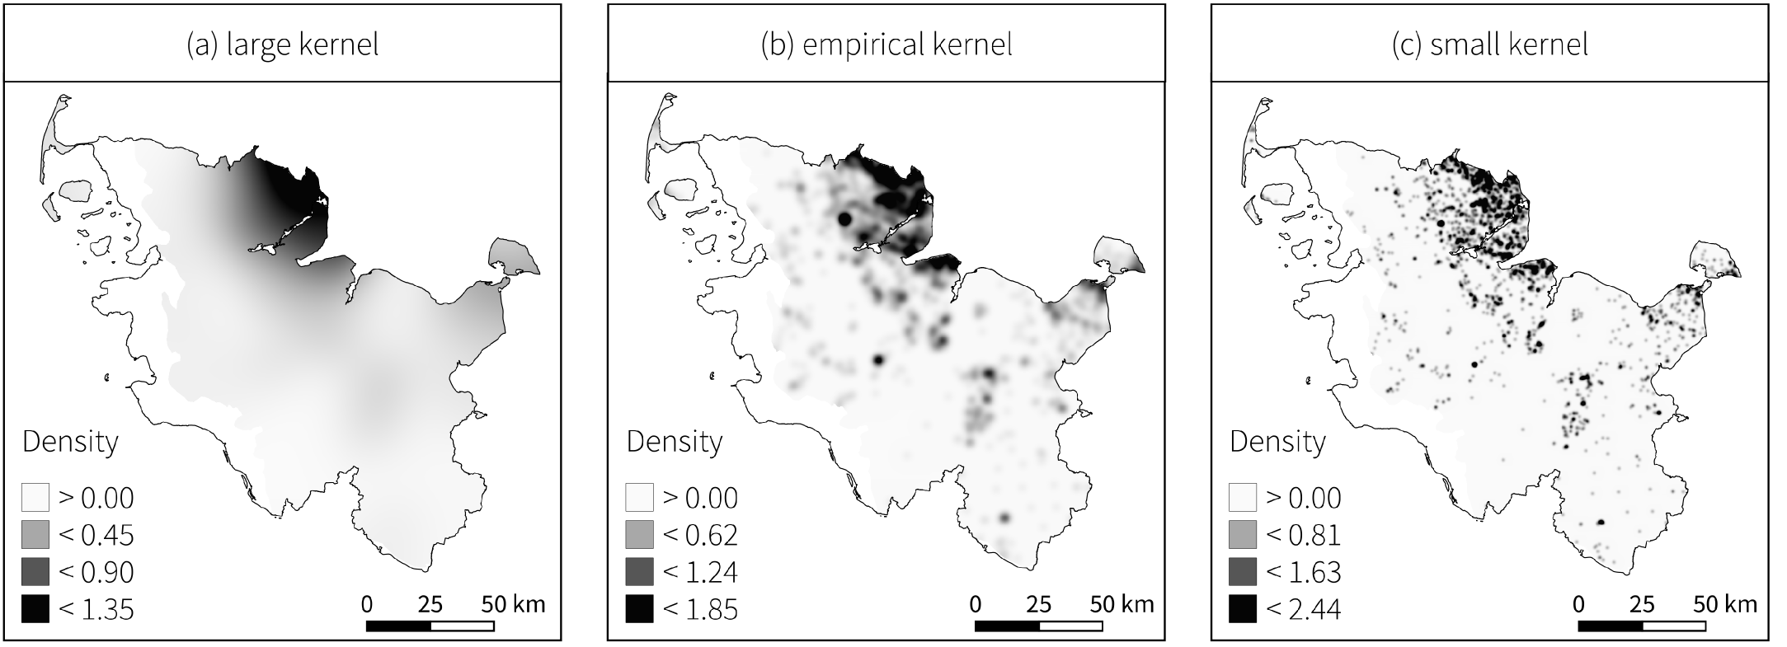
Point Pattern – first order effects
Sigma large
Sigma small
General trend
Local trend
(Knitter & Nakoinz (submitted)

Slide 9
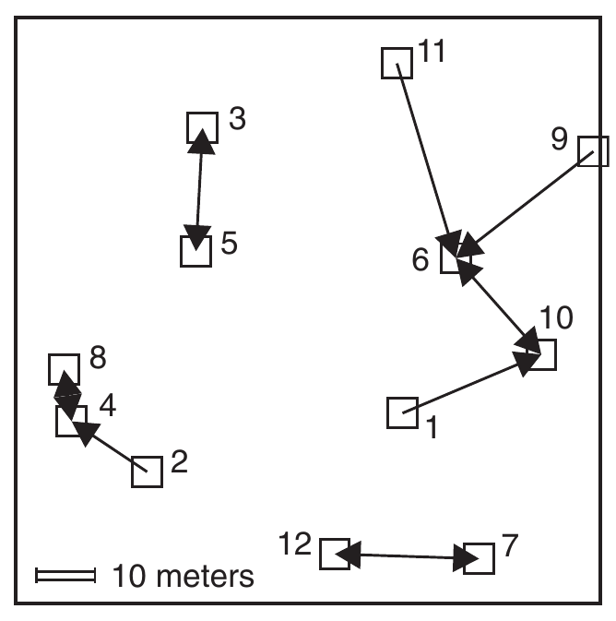
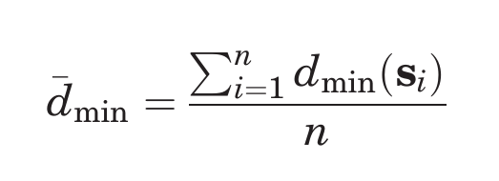
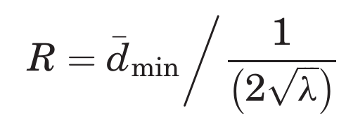
Point Pattern – second order effects
Point patterns described by distance measures
- nearest-neighbor distance → euclidean distance
mean nearest-neighbor distance
Are the points clustered or dispersed?
Use Clark and Evan's R statistic of nearest neighbor distances
more clustered < 1 > more dispersed
(O’Sullivan & Unwin, 2010)

Slide 10
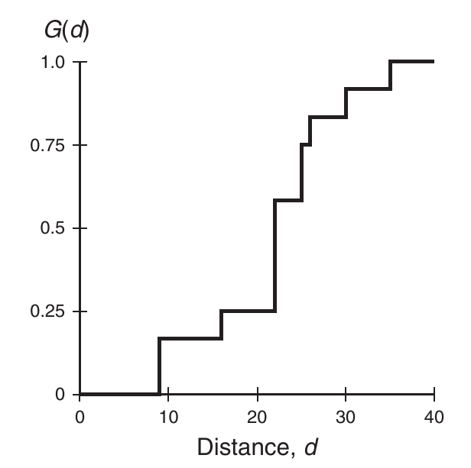
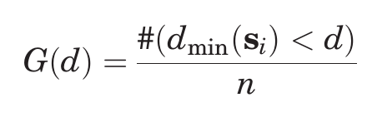
Point Pattern – second order effects
Point patterns described by distance measures
→ cumulative frequency distribution of the nearest-neighbor distances = G(d)
→ G(d) tells us what fraction of all n-n distances is less than d
(O’Sullivan & Unwin, 2010)

Slide 11
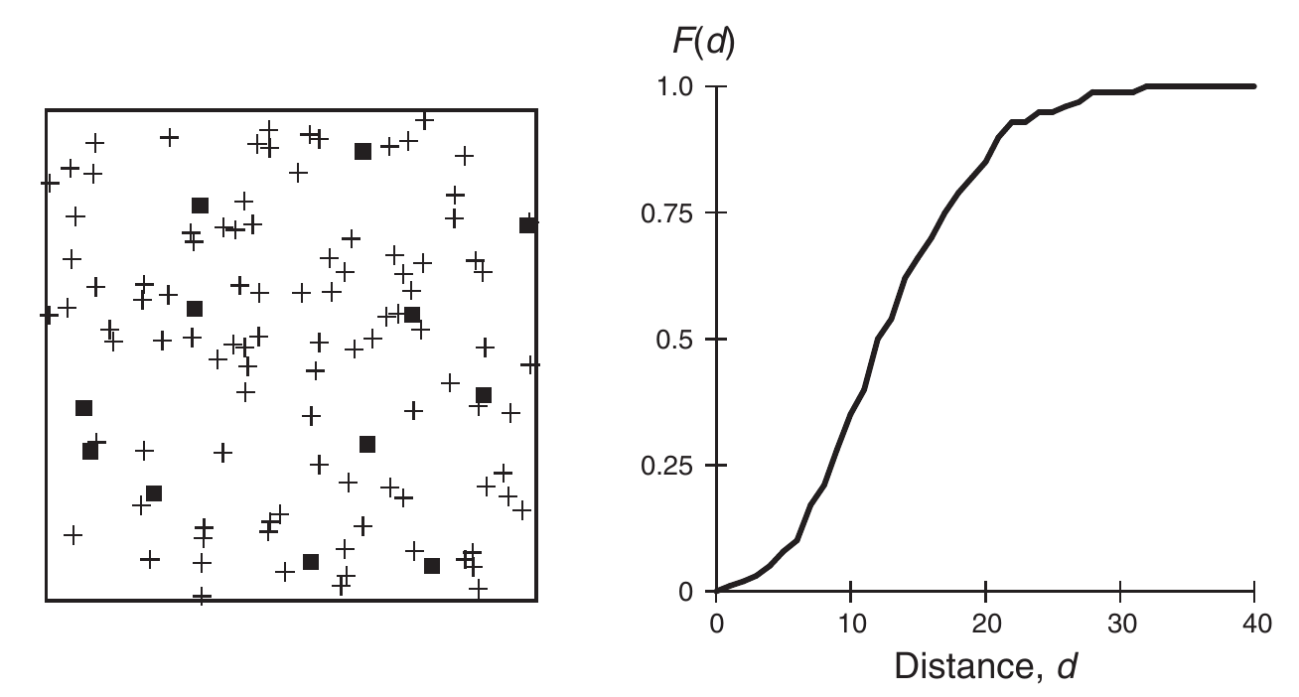
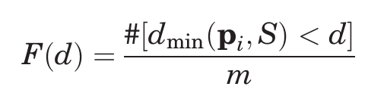
Point Pattern – second order effects
Point patterns described by distance measures
→ cumulative frequency distribution of the nearest-neighbor distances of arbitrary events to known events = F(d)
minimum distance from random point pi to an event
set of randomly selected locations
(O’Sullivan & Unwin, 2010)

Slide 12
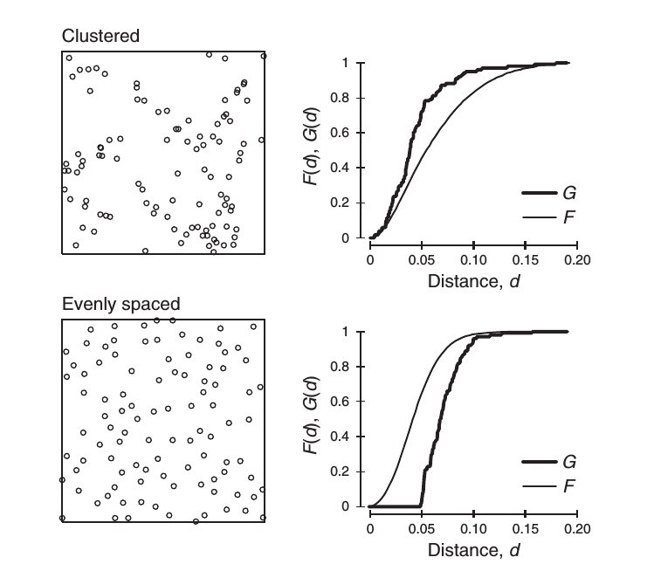
Point Pattern – second order effects
(O’Sullivan & Unwin, 2010)

Slide 13
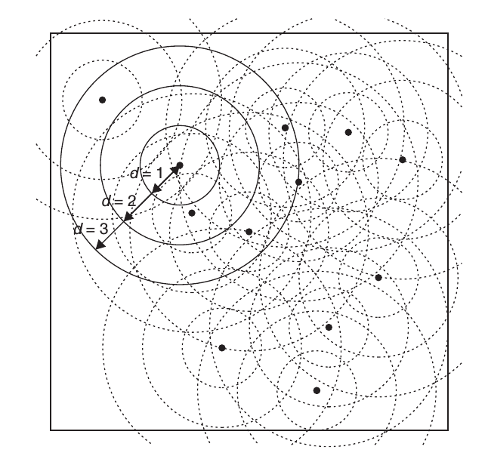
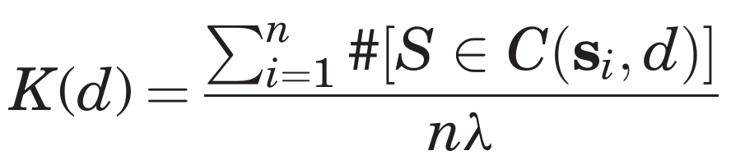
Point Pattern – second order effects
To get rid of the nearest-neighbor limitation:
use the K Function
Events in circle radius d centered at s
Event density in the study area
(O’Sullivan & Unwin, 2010)

Slide 14
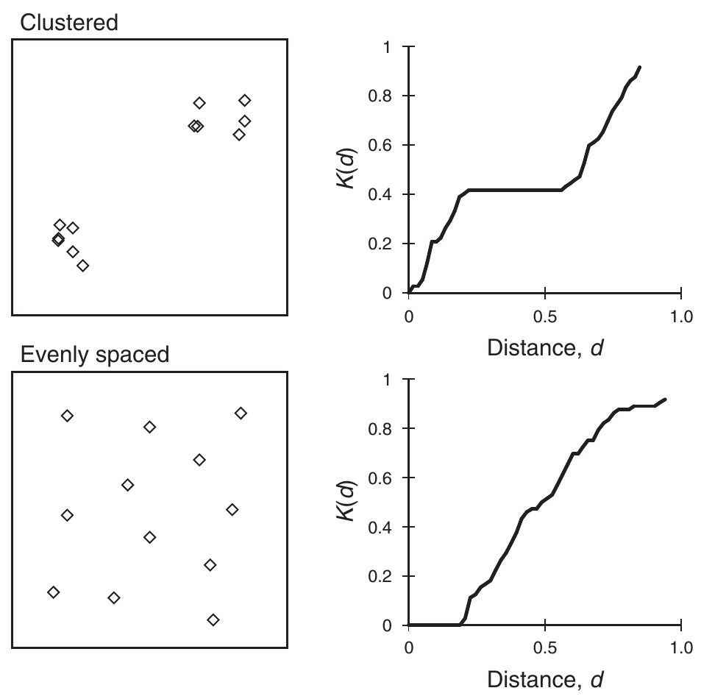
Point Pattern – second order effects
To get rid of the nearest-neighbor limitation:
use the K Function
Events in circle radius d centered at s
Event density in the study area
(O’Sullivan & Unwin, 2010)

Slide 15
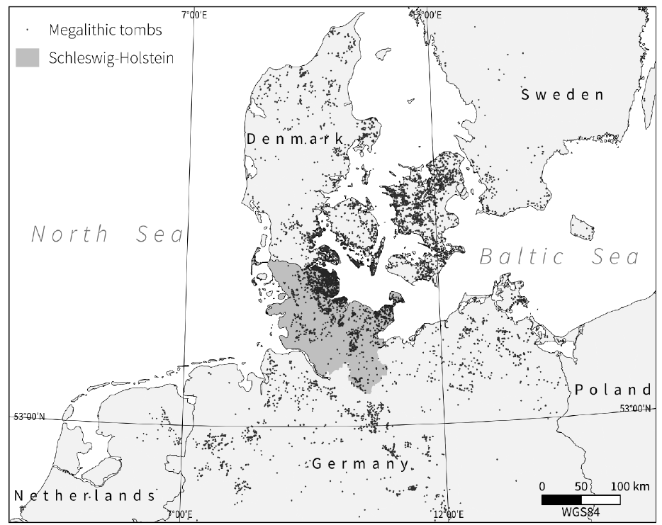
Point Pattern – second order effects
Shows the point pattern clustering/dispersion; does it deviate from CSR?
→ Simulation approach based on
Monte Carlo simulations
(Knitter & Nakoinz (submitted)

Slide 16

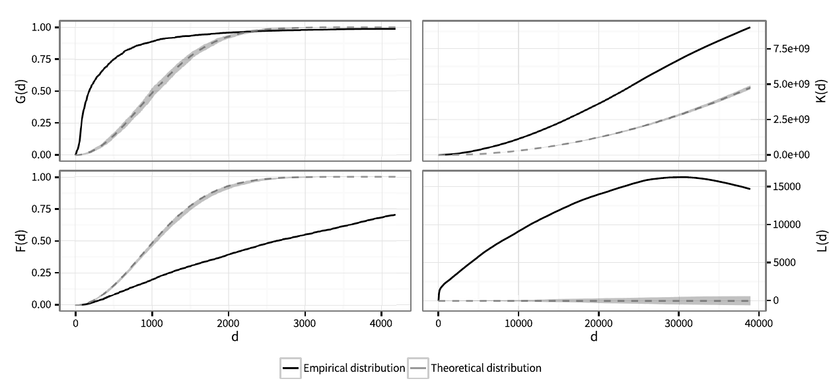
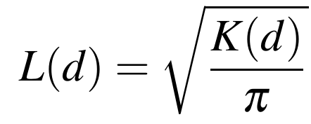
Point Pattern – second order effects
Shows the point pattern clustering/dispersion; does it deviate from CSR?
→ Simulation approach based on
Monte Carlo simulations
Just a
square root transformation of K(d)
(Knitter & Nakoinz (submitted)

Slide 17
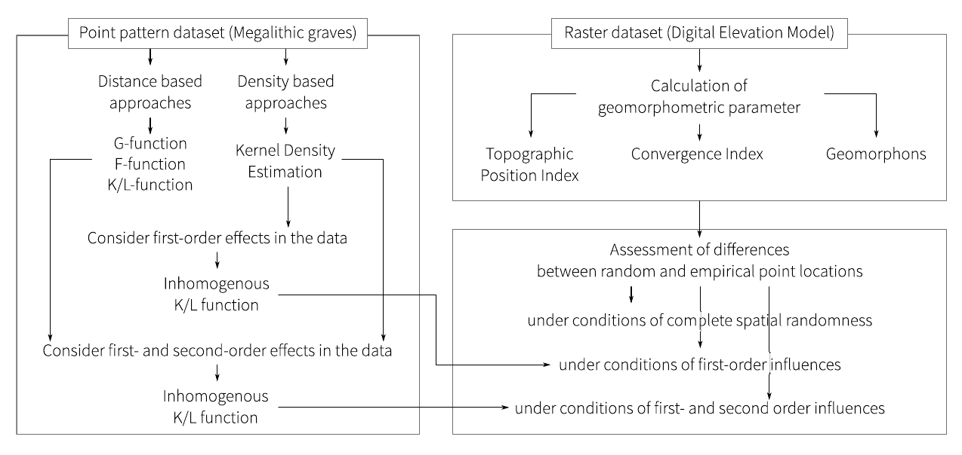
Point Pattern – a look ahead
(Knitter & Nakoinz (submitted)

Slide 18
Point Pattern – a look ahead
(Knitter & Nakoinz (submitted)

