Slide 1
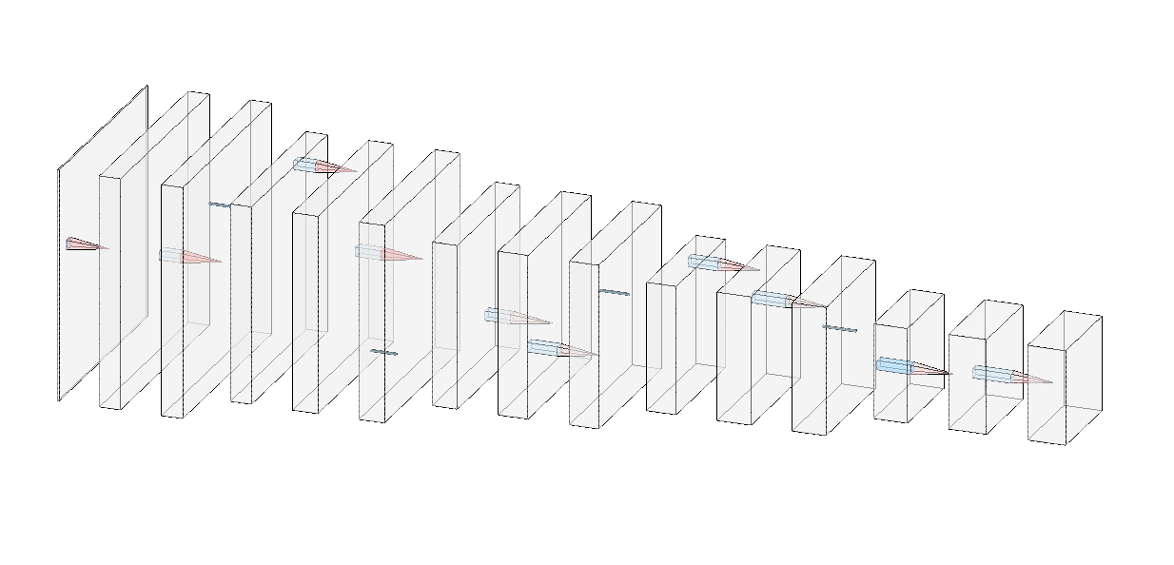
Encoder (compression)

Slide 2
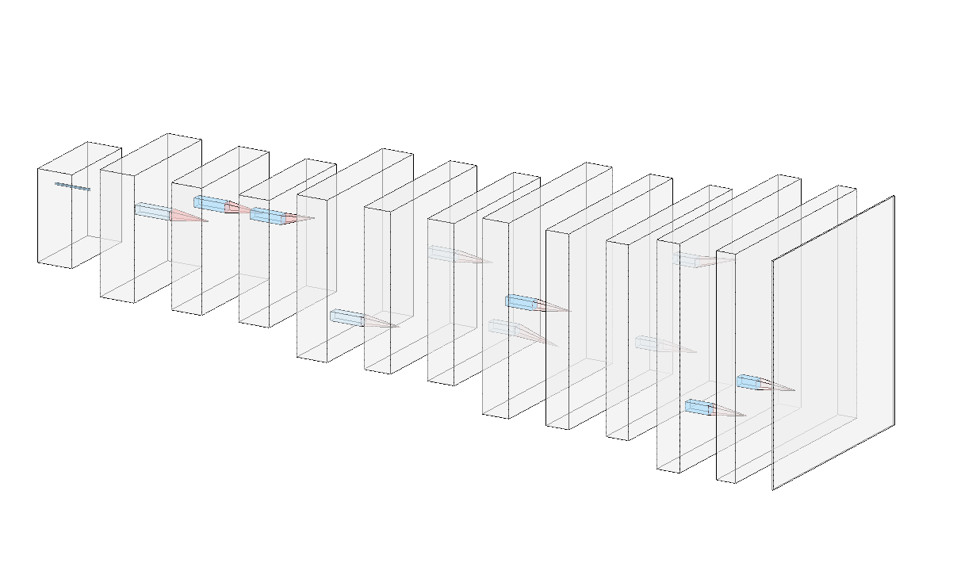
Decoder (decompression)

Slide 3
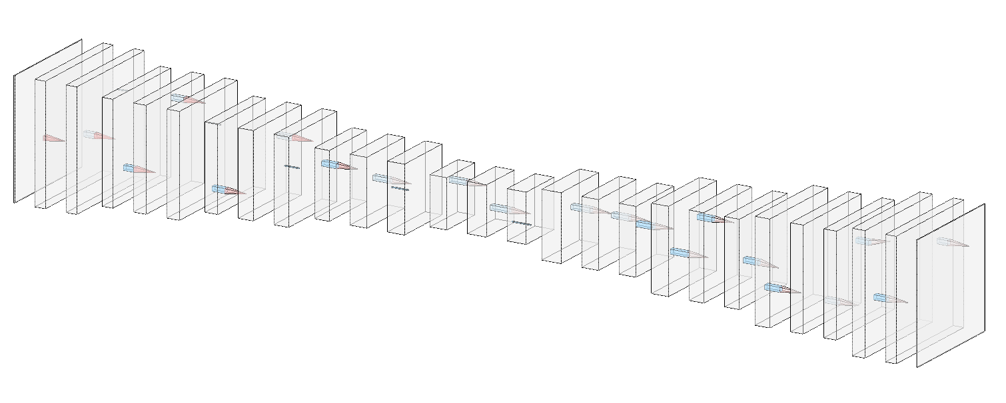
Autoencoder (by stacking convolutional layers)

