Slide 1

Project_2 ETL
Group_3
Dakota/ Joyce/ Sean/ Trevor

Slide 2

Data Source
https://fbref.com/en/comps/12/3239/2019-2020-La-Liga-Stats

Slide 3
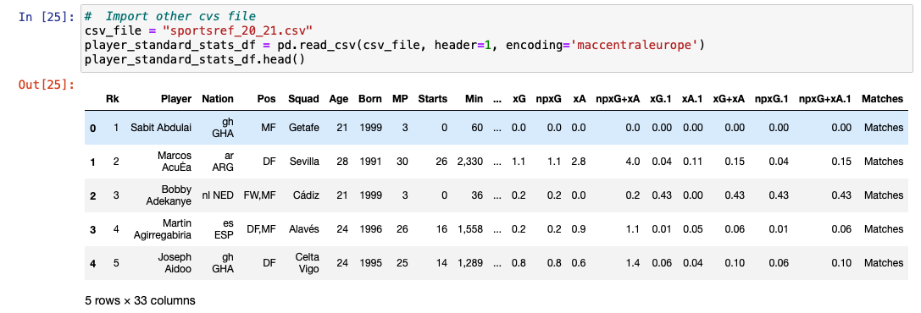
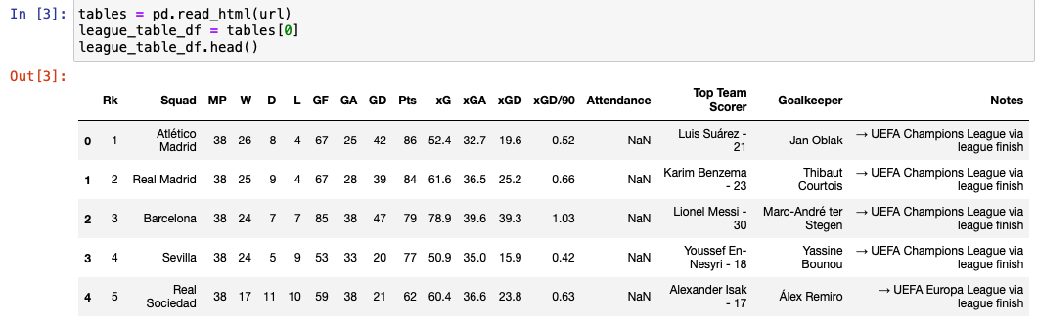
ETL process
Extract (Read the data from multiple)
player_standard_stats_df
league_table_df

Slide 4
ETL process
Transform (Clean and structure data)
Source DB | Source Table | Source column | Source Datatype | Target DB | Target Table | Target column | Target Datatype | Business Rule
Sportsref_20_21.csv | player_standard_stats | Player | string | La_liga_db | player_standard_stats | Player | string | encoding='maccentraleurope'
Sportsref_20_21.csv | player_standard_stats | Nation | string | La_liga_db | player_standard_stats | Nation | string | Split to get last 3 nation abbreviated
Sportsref_20_21.csv | player_standard_stats |  |  | La_liga_db | player_standard_stats |  |  | Dropped columns
Sportsref_20_21.csv | player_standard_stats | Min | string | La_liga_db | player_standard_stats | Min | string | Replace “,” with””
https://fbref.com/en/comps/12/10731/2020-2021-La-Liga-Stats | League_table_df |  |  | La_liga_db | League_table_table |  |  | Dropped columns

Slide 5
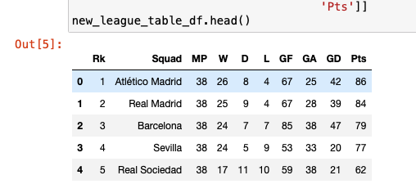
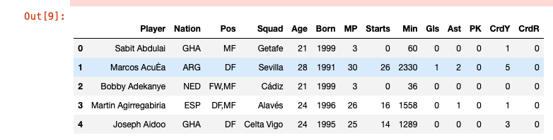
new_league_table_df
new_player_df

Slide 6
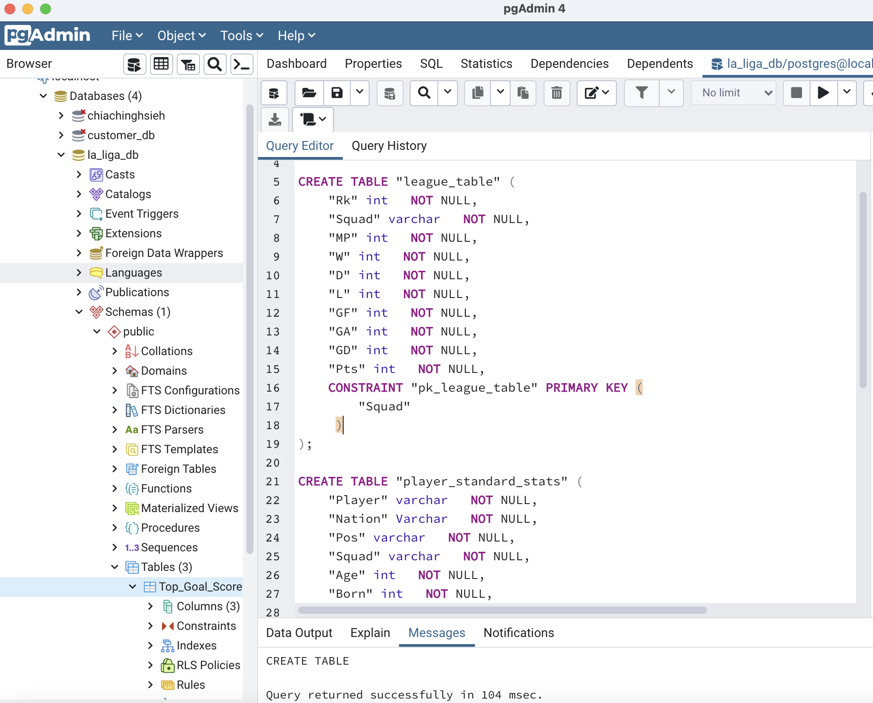
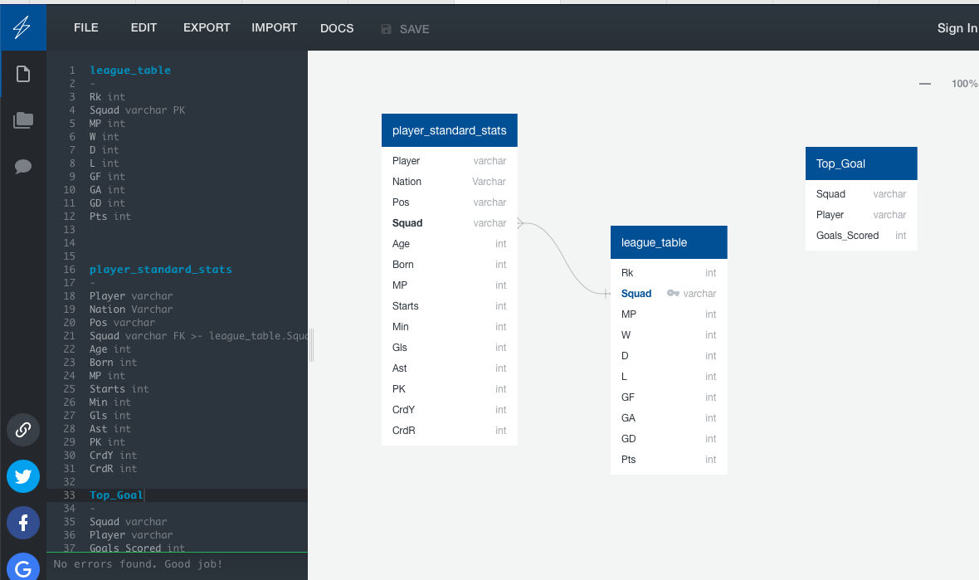
ERD & CREATE DataBase

Slide 7
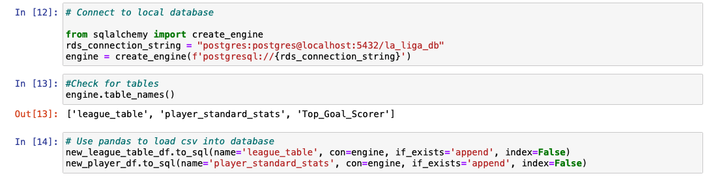
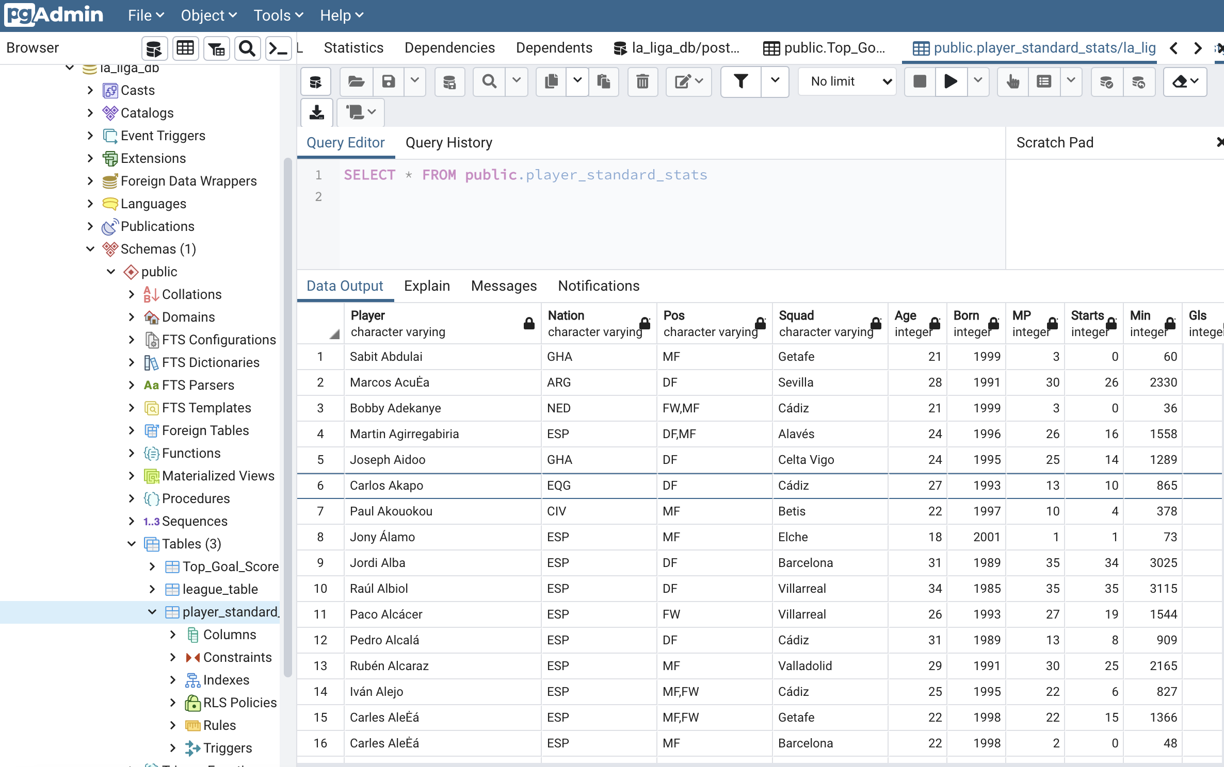
ETL process
Load (Write the data into database for storage)

Slide 8
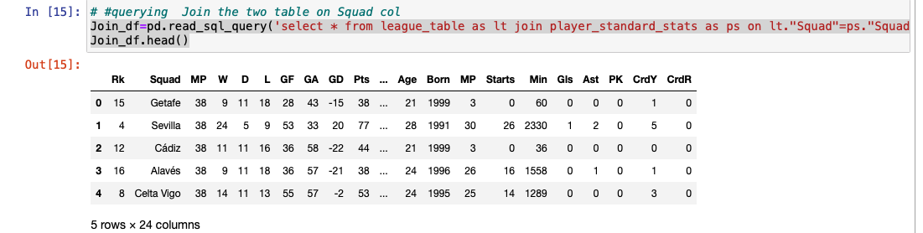
Join Two Table
Join_df=pd.read_sql_query('select * from league_table as lt join player_standard_stats as ps on lt."Squad"=ps."Squad"', con=engine)

Slide 9
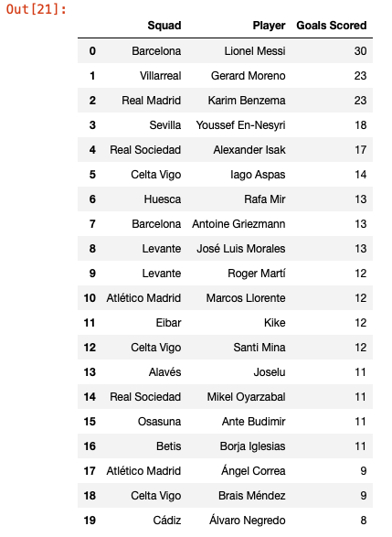
Target Table
Source DB | Source Table | Target DB | Target Table | Business/Target Rule
La_liga_db | player_standard_stats &League_table | La_liga_db | Top_Goal_Scorer | Write to DataBase Groupby: ”Squad” and find max goals scored then sort by max
df2 =Top_player.groupby(['Squad','Player'])['Gls'].agg(['max’])
df2 = df2.sort_values('max', ascending=False)
reset_df=df2.reset_index()
reset_df.drop_duplicates(['Squad'], keep='first’)
TGS_df=reset_df.rename(columns={'max':'Goals Scored’})
#insert new datafrmae into database new table
TGS_df.to_sql(name='Top_Goal_Scorer', con=engine, if_exists='append', index=False)

Slide 10

Thank you

