Slide 1

Project_2 ETL
Group_3
Dakota/ Joyce/ Sean/ Trevor

Slide 2

Data Source
https://fbref.com/en/comps/12/3239/2019-2020-La-Liga-Stats

Slide 3

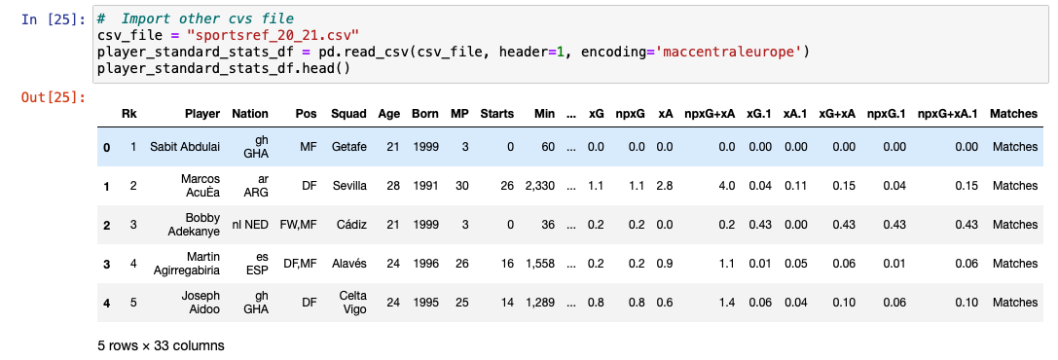
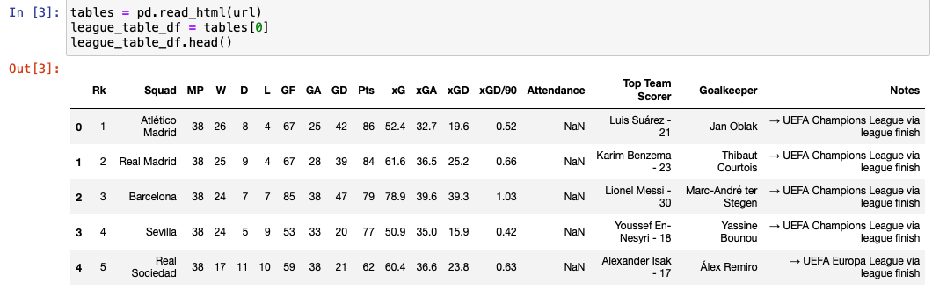
ETL process
Extract (Read the data from multiple)
player_standard_stats_df
league_table_df

Slide 4
ETL process
Transform (Clean and structure data)
Source DB | Source Table | Source column | Source Datatype | Target DB | Target Table | Target column | Target Datatype | Business Rule
Sportsref_20_21.csv | player_standard_stats | Player | string | La_liga_db | player_standard_stats | Player | string | encoding='maccentraleurope'
Sportsref_20_21.csv | player_standard_stats | Nation | string | La_liga_db | player_standard_stats | Nation | string | Split to get last 3 nation abbreviated
Sportsref_20_21.csv | player_standard_stats |  |  | La_liga_db | player_standard_stats |  |  | Dropped columns
Sportsref_20_21.csv | player_standard_stats | Min | string | La_liga_db | player_standard_stats | Min | string | Replace “,” with””
https://fbref.com/en/comps/12/10731/2020-2021-La-Liga-Stats | League_table_df |  |  | La_liga_db | League_table_table |  |  | Dropped columns

Slide 5
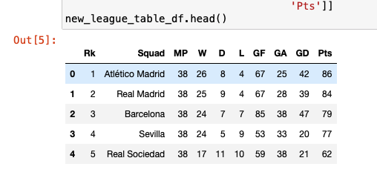
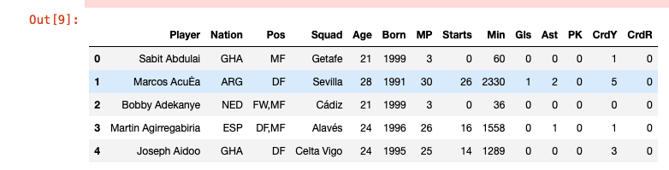
new_league_table_df
new_player_df

Slide 6
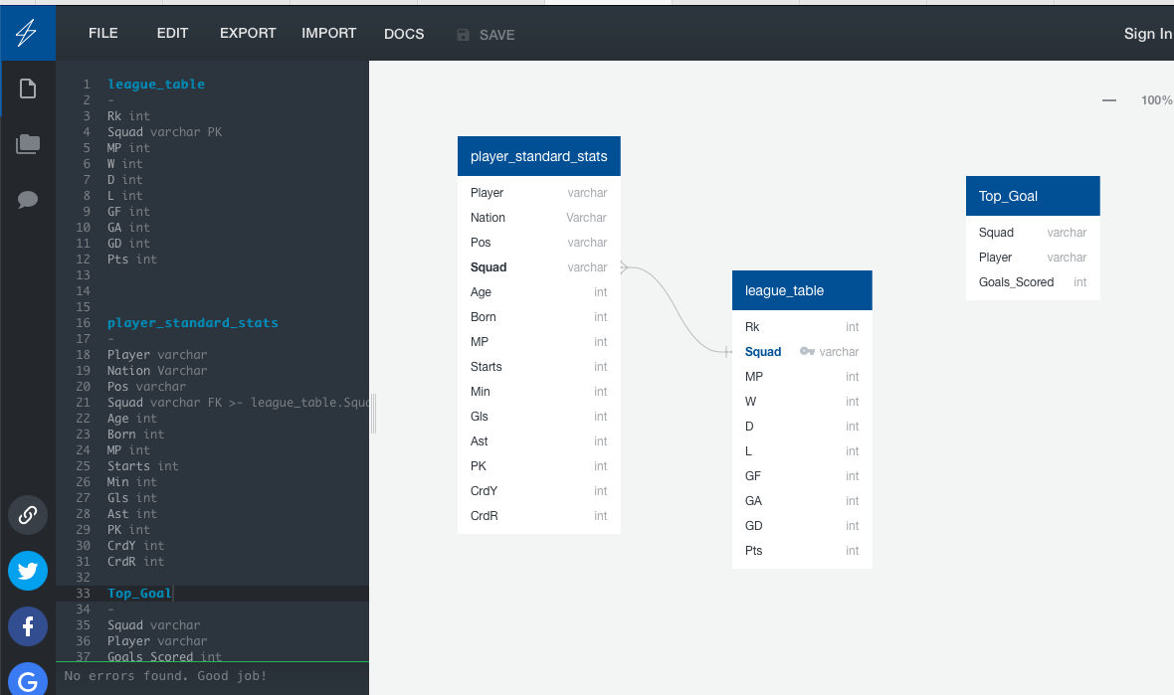
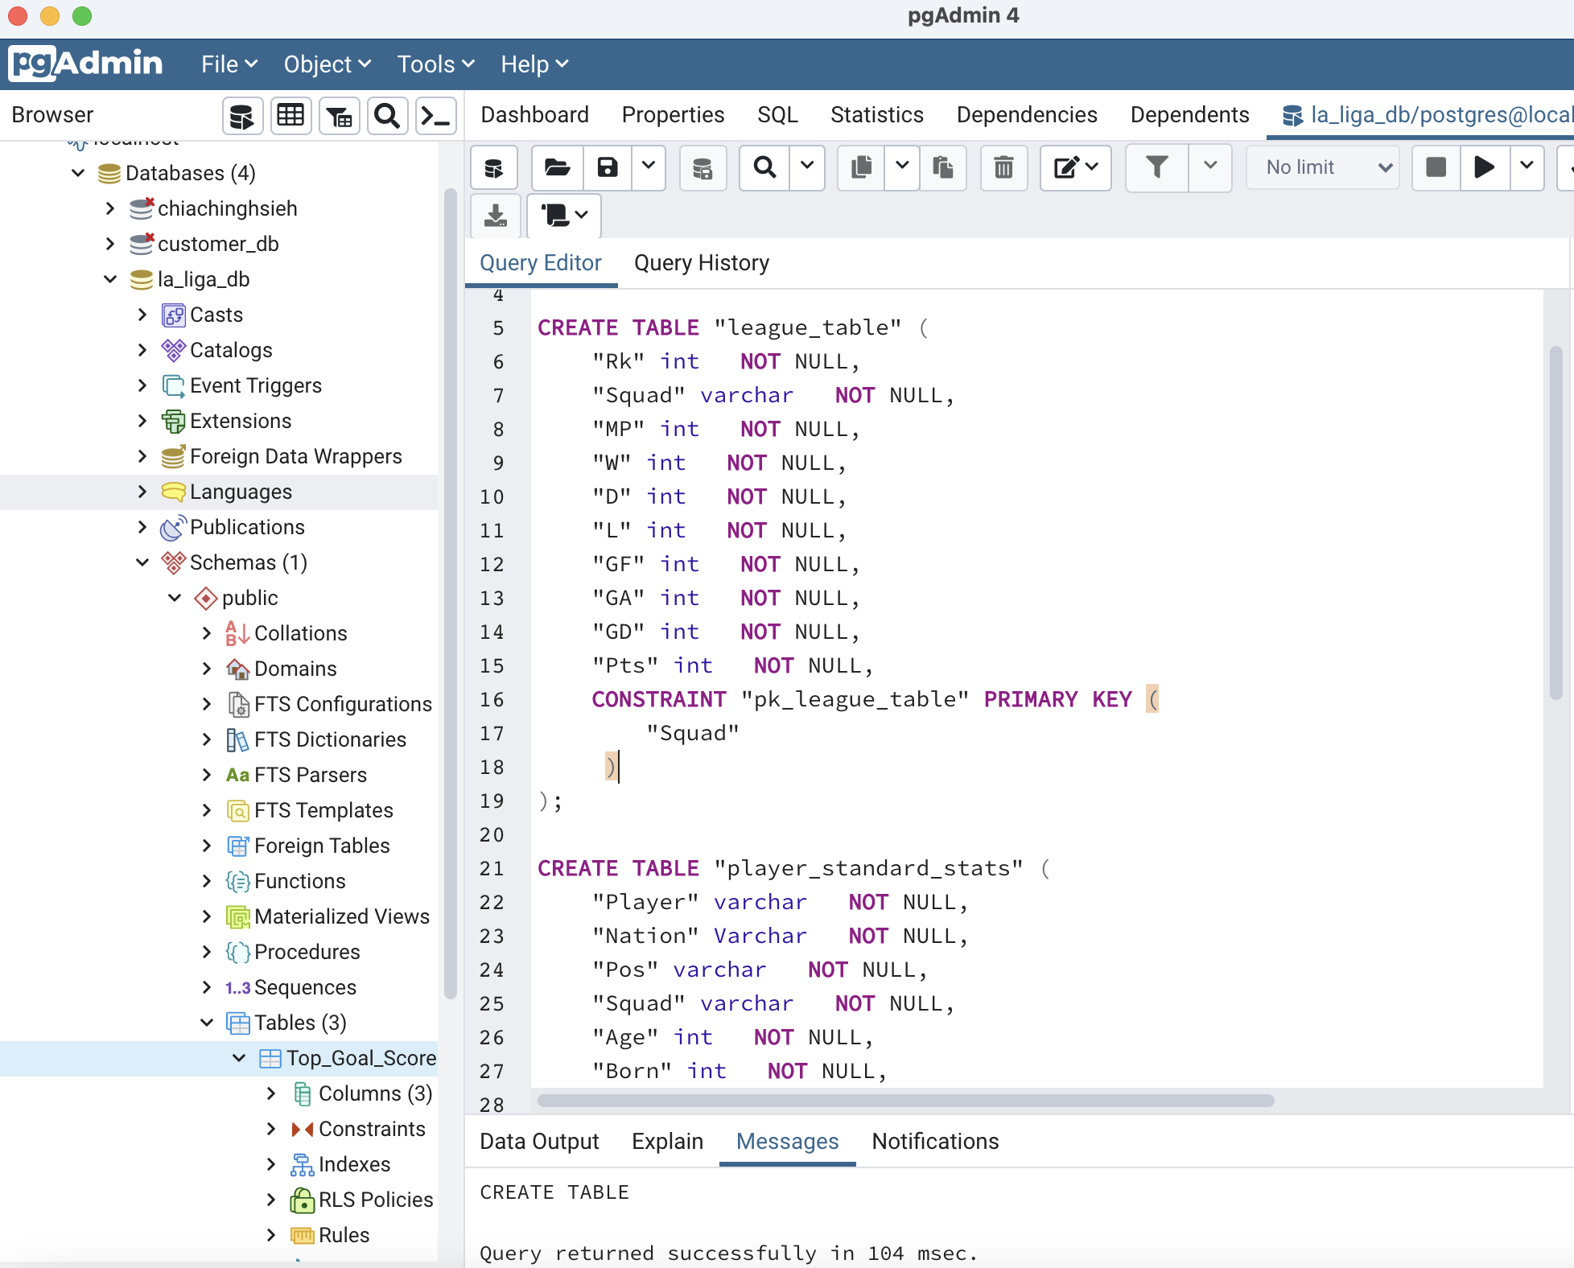
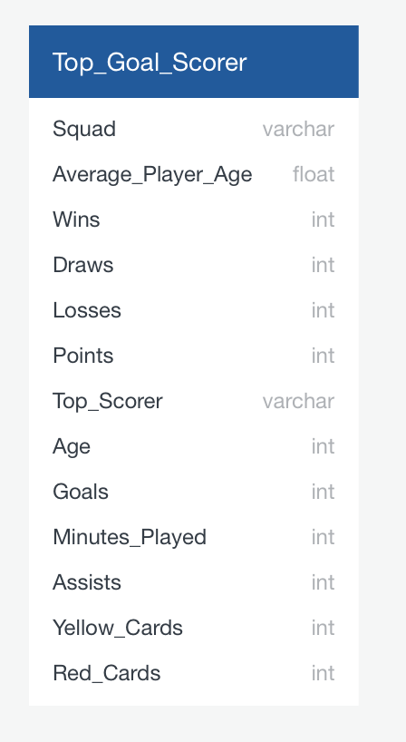
ERD & DataBase

Slide 7
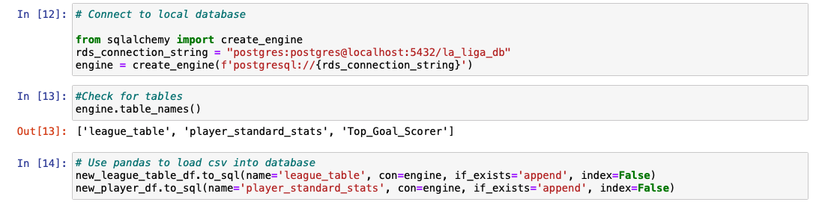
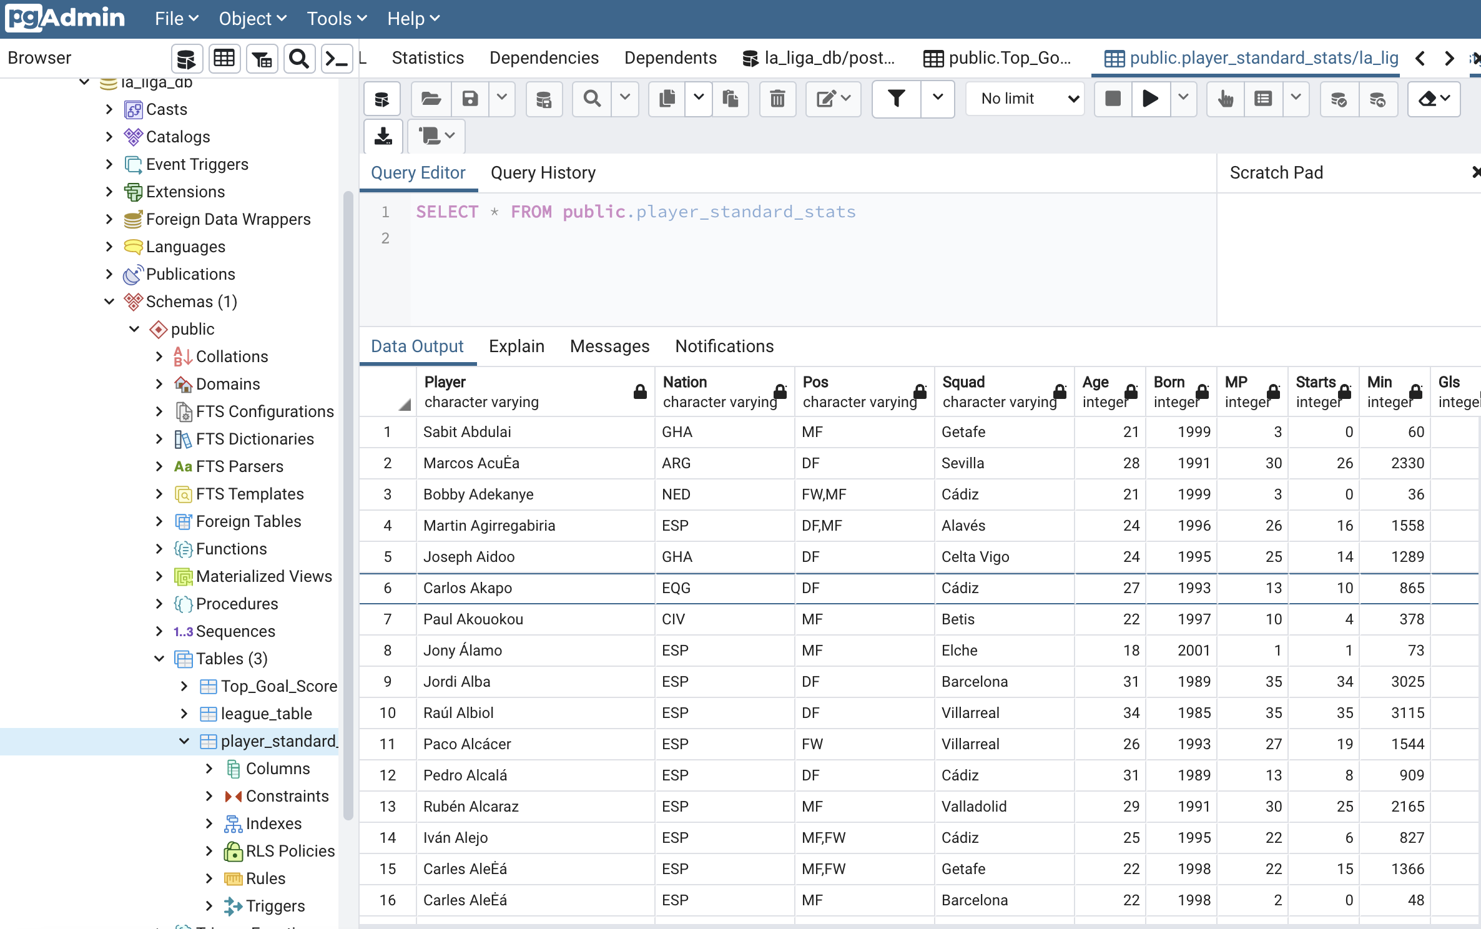
ETL process
Load (Write the data into database for storage)

Slide 8
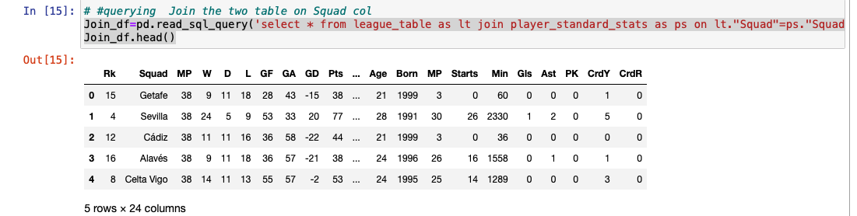
Join Two Table
Join_df=pd.read_sql_query('select * from league_table as lt join player_standard_stats as ps on lt."Squad"=ps."Squad"', con=engine)

Slide 9
Target Table
Source DB | Source Table | Target DB | Target Table | Business/Target Rule
La_liga_db | player_standard_stats &League_table | La_liga_db | Top_Goal_Scorer | Write to DataBase Groupby: ”Squad” and find max goals scored then sort by max
df4 = Top_player.groupby('Squad')['Age'].agg(['mean’])
df4 = df4.rename(columns={"mean": "Average_Player_Age",})
df4 = df4.reset_index()
df3 = Top_player.sort_values(['Gls'],ascending=False).groupby(['Squad']).head(1)
df3 = df3.set_index('Squad').join(df4.set_index('Squad’))
df3 = df3.round({'Average_Player_Age': 1})
#insert new datafrmae into database new table
df3.to_sql(name='Top_Goal_Scorer', con=engine, if_exists='append', index=True)

Slide 10
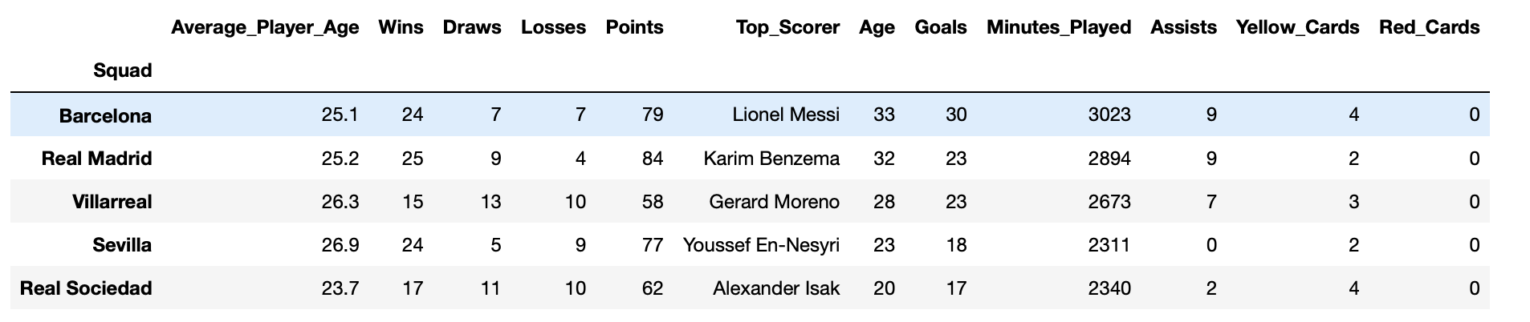
Table Sample

Slide 11


Thank you

