Slide 1
The Battle of Neighborhoods
Philadelphia, Pennsylvania

Slide 2
Objective:
Gather top venues for Philadelphia neighborhoods using Foursquare API
Form clusters of neighborhoods based on similarities/differences of venue categories gathered from Foursquare API
Compare features of two neighborhoods from different clusters to gather enough insight to determine which neighborhood makes for the better business decision

Slide 3
Python Dependencies:
BeautifulSoup - Library for web scraping postal codes for Philadelphia neighborhoods
Pandas - Library for data analysis
NumPy - Library to handle data manipulation
Sklearn - Library to handle k-mean clustering
Requests - Library to handle http requests
JSON - Library to handle JSON files
Geopy - Library to pull location data
Matplotlib - Library for data visualization
Folium - Map rendering library

Slide 4
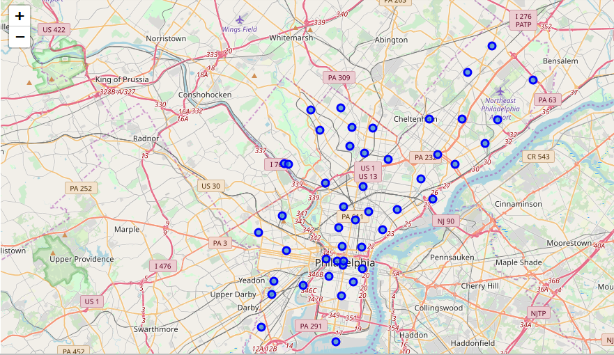
Folium map of neighborhoods

Slide 5
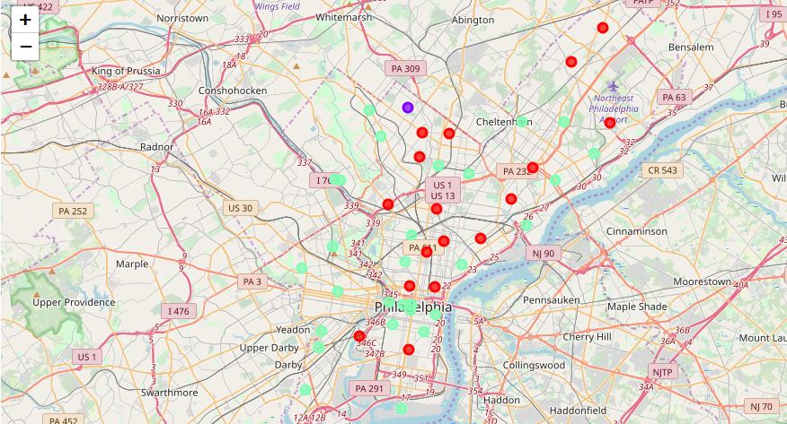
Folium map of neighborhood clusters

Slide 6
Neighborhood comparisons: Manayunk and Germantown
Most common venues
School Ratings
Median home prices

Slide 7
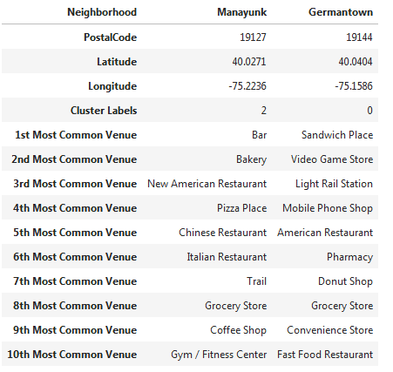
Venue Comparison

Slide 8
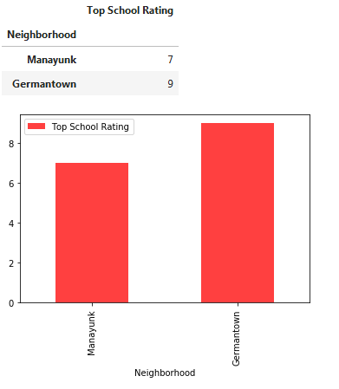
School Rating Comparison

Slide 9
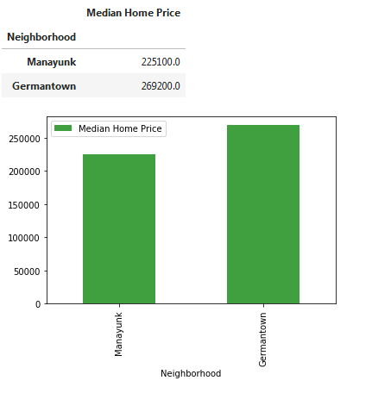
Median Home Price Comparison

Slide 10
Conclusion:
This analysis concludes that Germantown...
Has more desirable venues such as a pharmacy and access to the city via light rail
Boasts a higher school rating
Has a higher median home price
Therefore, it can be concluded that Germantown is the better business location

