Slide 1

Cognitive Analytics
April 4, 2017

Slide 2
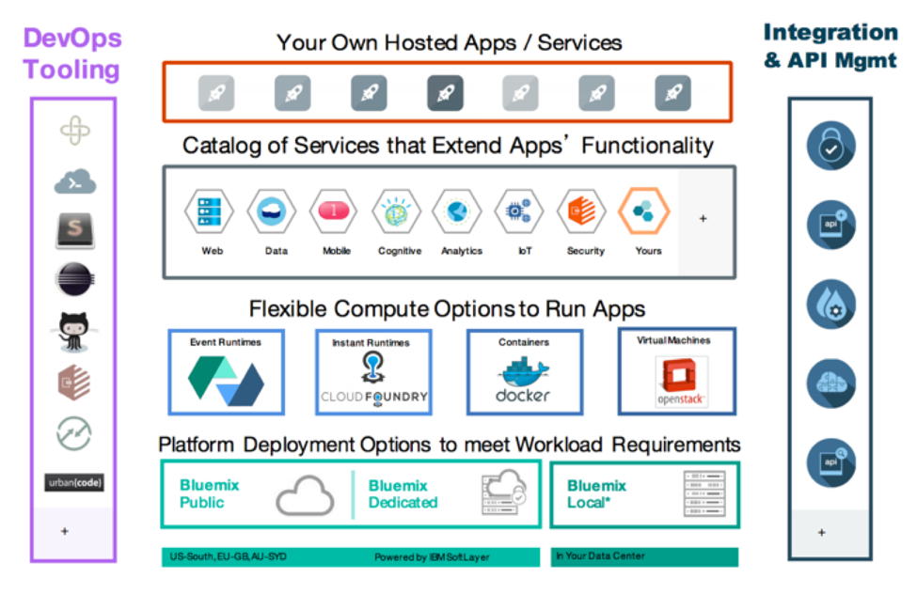

Slide 3
