Slide 1
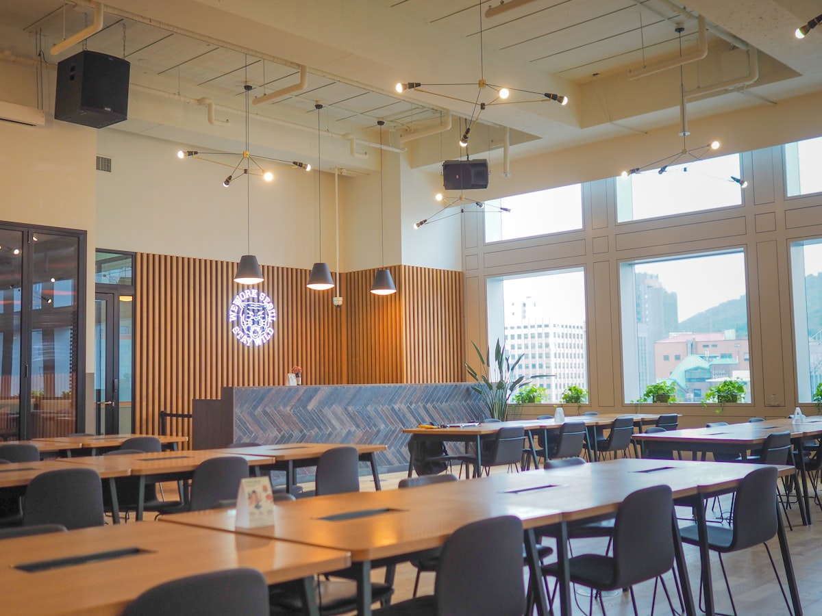
STARTUP PITCH CONCEPT • CAMPUS DINING 2026–2027
FoodLine
Skip the Line, Not the Meal.
Next-Generation Campus Pre-Ordering, Smart Slot Throttling & 30-Second Express Counter Collection Ecosystem for Indian Universities.
📍 Target Pilot Campus
Sanjivani University (Cafe @7)
⚡ Express Handover
30-Sec Counter QR Pass
💰 0% UPI PG Fees
Direct Merchant UTR Engine
📡 Real-Time SSE
Zero-Refresh Live Tracking

Slide 2
PROBLEM STATEMENT
The Collegiate Break Bottleneck
Why 4.65 million college students across Maharashtra lose valuable break time daily.
⏳ 40% Break Time Lost
Short 30-minute campus breaks are crushed by 10–15 minute billing queues before food preparation even begins. Students spend more time waiting than eating.
📌 14.5 min avg wait | 20 min meal window
🍳 Kitchen Rush Chaos
Canteen operators face uncoordinated demand spikes, leading to kitchen bottlenecks, food wastage, or stockouts — with no visibility into upcoming demand.
📌 Unpredictable spikes | 35% revenue loss
💰 Payment & Cash Friction
Cash change delays, offline token slips, and high 2% payment gateway fees eat into fragile canteen operating margins on ₹20–50 items.
📌 2% PG fees | Cash bottleneck
📊 KEY METRIC
Average student spends 14.5 minutes in line for a 20-minute meal window. Result: Students skip meals, arrive late to lectures, and campus food vendors lose over 35% of potential daily turnover.

Slide 3
PRODUCT SOLUTION
The FoodLine Campus Dining Ecosystem
Four interconnected pillars designed for sub-second collegiate dining efficiency.
📱
1. Browse & Order Ahead
Students browse real-time canteen menus and customize meals directly from classrooms before break bells ring.
✔ Cloud Sync ✔ Frictionless
🎯
2. Smart Slot Throttling
10-minute dynamic break slots balance kitchen load and eliminate rush-hour batching delays.
✔ Load Balance ✔ Auto-Slots
🔐
3. 0% Fee UPI QR (Option C)
Direct vendor UPI scanning + 12-digit UTR validation eliminates payment gateway fees completely.
✔ Zero Fees ✔ Direct UTR
🚀
4. 30-Sec Express Handover
High-contrast dynamic optical QR pass and 4-digit token verification at the dedicated FoodLine counter.
✔ QR Pass ✔ 30-Sec Pickup

Slide 4
FLAGSHIP PILOT PLAN
Target Launch: Sanjivani University, Kopargaon
Proposed deployment model at Cafe @7 designed around actual campus schedule and seed menu.
🏫 Planned Pilot Campus & Outlet
University: Sanjivani University, Kopargaon (MH)
Anchor Outlet: Cafe @7 (Main Campus Cafeteria)
Merchant UPI: Direct Merchant Standee QR (Option C)
Break 1 (Lunch): 11:50 AM – 12:30 PM (40 mins)
• Slot A: 11:50 AM – 12:10 PM
• Slot B: 12:10 PM – 12:30 PM
Break 2 (Evening): 2:30 PM – 2:50 PM (20 mins)
🍽️ Cafe @7 Verified Menu Highlights
• Vada Pav / Dabeli / Samosa [Fast Grab] — ₹20
• Special Campus Tea [Hot Fuel] — ₹10
• Crispy Masala Dosa [Bestseller] — ₹50
• Thick Iced Cold Coffee [Student Fav] — ₹50
• Veg. Cheese Grill Sandwich [Hot Grill] — ₹100
• Peri Peri French Fries [Snack Fav] — ₹80
• Veg Fried Momo [Hot Momo] — ₹70
• KitKat / Oreo Thick Shake [Shake] — ₹90

Slide 5
PAYMENT INNOVATION
Option C: Zero-Fee UPI & UTR Verification
Solving the micro-transaction dilemma: 0% payment gateway fees on ₹20 campus items.
Step 1 • 📱
Scan Standee QR
Student views Cafe @7 UPI QR Standee image and UPI ID displayed in the FoodLine app.
Step 2 • ⚡
Pay via Any UPI App
Pays exact total directly via GPay, PhonePe, Paytm, or CRED with zero platform fees.
Step 3 • 🔑
Submit 12-Digit UTR
Inputs bank UTR reference number into FoodLine verification modal for real-time validation.
Step 4 • 🎟️
Generate Token & Pass
Backend validates uniqueness, prevents replay, and issues verified digital token #FL-XXXX.
🏆 WHY OPTION C WINS ON CAMPUS
Traditional Razorpay/Paytm PG charges 2.0% + GST per transaction — unfeasible for low ticket ₹20–50 canteen items. Option C ensures 100% merchant payout directly to the canteen's bank account with zero intermediary commissions.

Slide 6
KITCHEN INTELLIGENCE
Kitchen Display System (KDS) & Real-Time Sync
Empowering cafeteria cooks with automated batch forecasting and real-time handovers.
📈 Smart Slot Batching
Groups incoming orders by upcoming 10-minute break slots so kitchen staff can batch-cook (e.g., 15 Dosas for 11:50 AM). Reduces waste and prep chaos.
📡 Server-Sent Events (SSE)
Real-time bi-directional pipeline updates order status from PREPARING → READY with zero screen refreshes. Students see live progress.
📷 Optical QR Handover
Express counter staff scan student digital QR code or enter 4-digit PIN for sub-30-second meal handovers. No paper tokens needed.
📦 Instant Inventory Toggle
1-tap out-of-stock switcher prevents students from ordering sold-out dishes during sudden surges. Real-time menu sync across all devices.

Slide 7
MARKET OPPORTUNITY
Collegiate Foodservice Market in India
Massive unorganized campus dining market ready for digital transformation.
₹18,000+ Cr
TAM — Total Addressable Market
45,000+ colleges across India with on-campus cafeterias and dining halls serving over 40 million students annually.
🚀 $2.2 Billion Market | 45K+ Colleges
₹2,400 Cr
SAM — Serviceable Addressable
5,380 colleges & universities in Maharashtra with 46.5 Lakh (4.65M) enrolled collegiate students.
🚀 $290 Million Market | 5,380 Colleges
₹35 Cr
SOM — Target Launch Reach
Targeting 50 university campuses across Pune, Kopargaon, Ahmednagar, Nashik, and Mumbai university hubs in Year 1-2.
🚀 $4.2M GMV Target | 50 Campuses

Slide 8
BUSINESS MODEL
Multi-Stream Sustainable Revenue Model
Zero barrier to vendor entry paired with scalable transaction and SaaS revenue.
🆓
1. Free Canteen Onboarding
Zero setup fees and zero hardware requirement guarantees 100% canteen vendor adoption across campuses.
₹0 Setup • No Hardware Barrier
📊
2. Pickup Commission (3-5%)
Small platform fee per successful order covering hosting, SSE infrastructure, and continuous support.
3-5% Per Order • Volume Scaled
🏃
3. Campus Delivery Fee
Optional in-campus delivery (₹10–20) to library and hostel drop zones, powered by student runners.
₹10-20 Fee • Peer Logistics
💎
4. Merchant Analytics SaaS
Predictive demand forecasting, wastage reduction, and menu engineering dashboards for vendors.
Premium SaaS • AI Reports

Slide 9
COMPETITIVE MATRIX
Why Existing Delivery Apps Fail on Campus
FoodLine is architected specifically for collegiate micro-breaks and low-AOV dynamics.
Feature / Attribute | Traditional Canteen | Swiggy / Zomato | FoodLine Campus ✓
Break Window Alignment | ❌ 15-min queue chaos | ❌ 35-45 min delivery | ✅ 10-min smart slot pickup
Average Order Value | ₹20 – ₹60 | ❌ ₹200+ (High minimums) | ✅ No minimum (₹15 Chai)
Delivery / Platform Fees | Zero (offline only) | ❌ ₹30-60 + 25% take | ✅ 0% Fee UPI QR
Kitchen Load Throttling | ❌ Overload & delays | ❌ Uncoordinated spikes | ✅ Algorithmic slot throttle
Campus Integration | ❌ No digital layer | ❌ External delivery only | ✅ Native campus system
Real-Time Order Tracking | ❌ No visibility | ✅ Delivery GPS | ✅ SSE live status
Vendor Onboarding Cost | N/A | ❌ Commission + listing | ✅ ₹0 Free onboarding

Slide 10
IMPACT & PROJECTED BENCHMARKS
Target Operational Breakthroughs
Quantifiable performance benchmarks engineered for campus cafeterias.
≥ 12 Min
Target Time Saved
Students gain back 40%+ of their break time to socialize, study, or relax instead of standing in queues.
2.5×
Peak Capacity Boost
Canteens fulfill 2.5× more orders in the same 30-minute rush window without expanding space or staff.
≤ 30 Sec
Express Pickup Goal
Instant QR scan & 4-digit PIN verification ensures rapid pickup with zero billing delays at the counter.
≥ 65%
Projected Retention
Daily campus dining habits create industry-leading organic retention rates — no marketing spend needed.

Slide 11
ENGINEERING ARCHITECTURE
Modern Enterprise Technology Stack
Engineered for high concurrency, sub-second latency, and responsive mobile experiences.
⚙️ Frontend Engine
Production-grade frontend with server-side rendering, strict type safety, and spring-physics animations for a native-app feel.
⚡ Next.js 15+ • React 19 • TypeScript • Tailwind v4
🧩 Component System
Accessible, themeable component library with high-contrast OKLCH color tokens and custom UI primitives.
⚡ shadcn/ui • Radix UI • OKLCH Tokens • Nova
🔌 Backend & Real-Time
Serverless API handlers with persistent SSE connections for zero-latency bi-directional order updates.
⚡ API Routes • SSE Pipeline • Supabase • PostgreSQL
🧠 Knowledge Graph
Graphify AST mapping for automated code intelligence, clean architecture enforcement, and dev velocity.
⚡ Graphify • AST Analysis • Code Intelligence

Slide 12
ROADMAP & TIMELINE
From Concept to Pan-India Scale
A 3-phase execution strategy designed for rapid, capital-efficient campus expansion.
PHASE 1
Pilot Launch & Validation
Target: Sanjivani University (Cafe @7)
• Launch flagship pilot at Sanjivani University
• Target 500+ daily active student orders
• Validate Option C UPI flow with campus vendors
• Refine KDS and SSE infrastructure in real conditions
• Onboard additional campus canteens
PHASE 2
City-Cluster Expansion
Pune, Nashik & Mumbai Clusters
• Expand across regional university hubs
• Target 50 campus deployments
• Launch campus delivery with student runners
• Introduce Merchant Analytics SaaS
• Target ₹35 Cr annualized GMV
PHASE 3
National Standardization
5,000+ Colleges Across India
• Scale across major universities nationwide
• Partner with university administrations
• Launch FoodLine API for canteen POS systems
• AI-powered demand prediction engine
• Target ₹500 Cr+ annual GMV

Slide 13
FINANCIAL PROJECTIONS
Revenue & Growth Trajectory
Projections based on target unit economics and Maharashtra campus density.
Year 1 (Pilot Phase)
₹1.2 Cr
Gross Target Revenue [Pilot Target]
Year 2 (Expansion)
₹8.5 Cr
Gross Target Revenue [↑ 608% YoY Growth]
Year 3 (Scale)
₹35 Cr
Gross Target Revenue [↑ 312% YoY Growth]
Avg Order Value
₹45
Per Transaction
Target Daily Orders
12,000+
Across 50 Campuses (Y2)
Target Gross Margin
72%
Asset-Light Model
💡 UNIT ECONOMICS ADVANTAGE
CAC: ₹0 (organic campus adoption via QR standees) • LTV: ₹2,400+/year (avg student places 200+ orders/year) • LTV:CAC Ratio: ∞. Break-even expected within 8 months of campus deployment.

Slide 14
THE TEAM
Built by Students, for Students
A founding team with deep campus insight and full-stack engineering capabilities.
SN
TC
OL
Shivam Nirmal
Founder & CEO
Full-stack engineer and campus operations strategist. Architect of FoodLine's Option C payment engine and SSE infrastructure.
Technical Co-Founder
Chief Technology Officer (CTO)
Systems architect specializing in real-time event-driven architectures, database optimization, and mobile-first experiences.
Operations Lead
Chief Operating Officer (COO)
Campus engagement expert managing vendor relationships, student ambassador programs, and ground-level pilot execution.

Slide 15
THE FUTURE OF CAMPUS DINING
The Future of Campus Dining Starts Here
A Startup Concept Ready to Scale: From Sanjivani University to 5,000+ Campuses Across India.
PHASE 1
Flagship Pilot
Sanjivani University (Cafe @7)
PHASE 2
City Expansion
50 Campuses across MH
PHASE 3
National Scale
5,000+ Colleges Pan-India
🚀 FoodLine — Skip the Line, Not the Meal.
Prototype Architecture Ready • Next.js 15 + React 19 + Supabase
Let's Talk →

