Slide 1

Department of Computer Science and Engineering
EMBEDDED PROGRAMMING
CHIRALNET: Distributed Wi‑Fi Coverage Analysis & Optimization System
Presentation by Batch 15
Dakshan Kumar S – 24CS0165
D Prince Piriyan – 24CS0163
Supervisor
Mr. Muthupandi
EMBEDDED PROGRAMMING PROJECT-ZEROTH REVIEW

Slide 2
Introduction
ChiralNet is an IoT-based wireless network diagnostics system using multiple ESP32 nodes placed in different locations. The nodes collect Wi‑Fi metrics such as RSSI, latency, and channel information. Data is sent to a central dashboard for analysis, visualization, and optimization recommendations. The system helps identify dead zones and improve wireless coverage.

Slide 3
Project Description
The project uses distributed ESP32 nodes connected through MQTT to monitor wireless network performance. A backend server processes the collected data and displays it on a dashboard. Features include dead-zone detection, heatmap generation, congestion analysis, and router placement recommendations.

Slide 4
Aim and Scope of the Proposed work
Aim: To develop a low-cost IoT-based platform for analyzing Wi‑Fi coverage and optimizing wireless performance.
Scope:
Real-time Wi‑Fi monitoring
Dead-zone detection
Heatmap visualization
Congestion analysis
Router placement recommendations

Slide 5
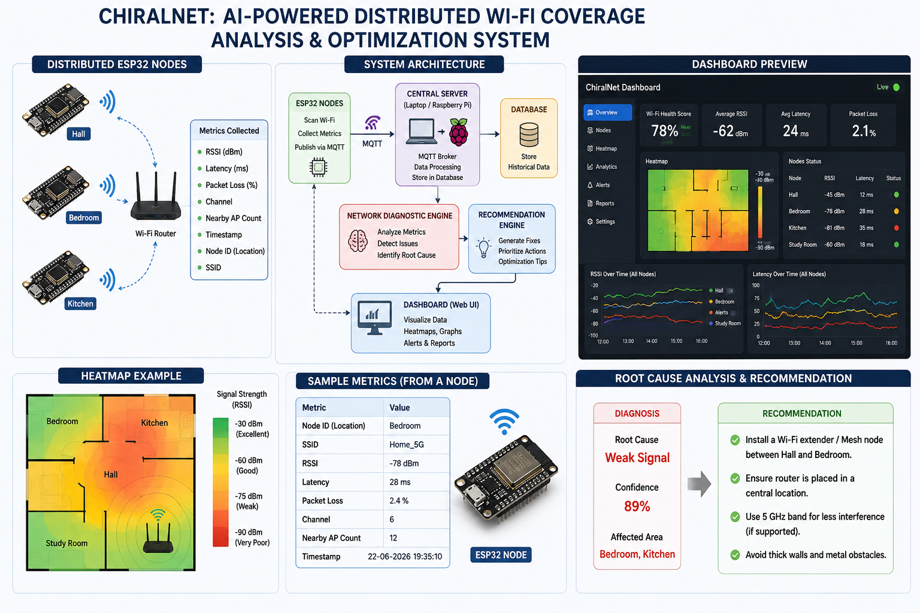
System Architecture

Slide 6
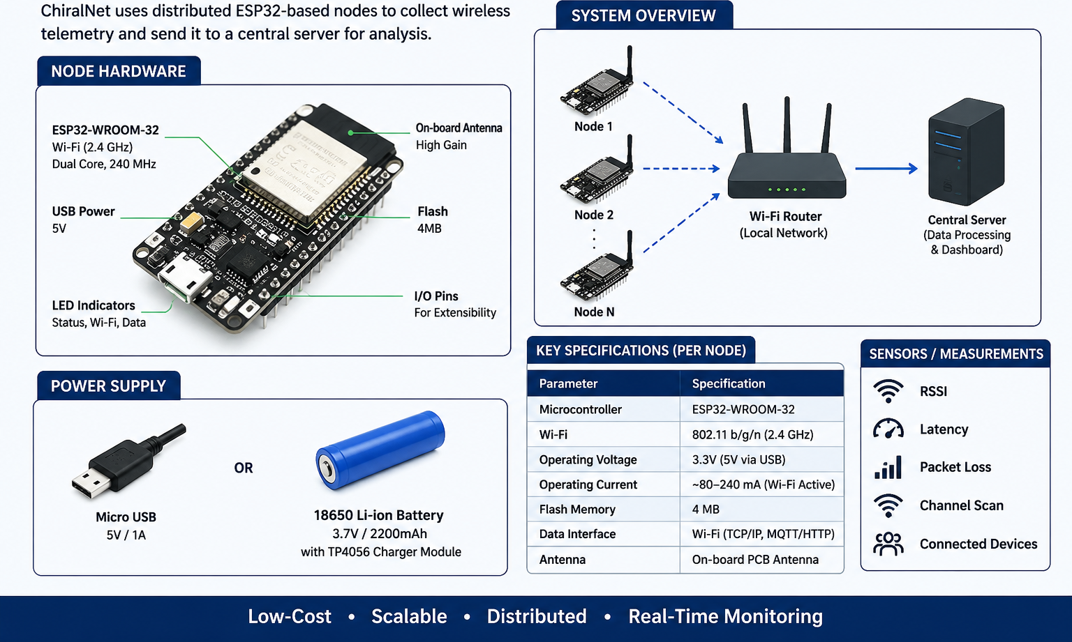
Hardware Component

Slide 7
Project Planning
Week 1: ESP32 Setup and Wi‑Fi Monitoring
Week 2: MQTT Communication and Data Collection
Week 3: Dashboard Development
Week 4: Heatmap and Analytics

Slide 8
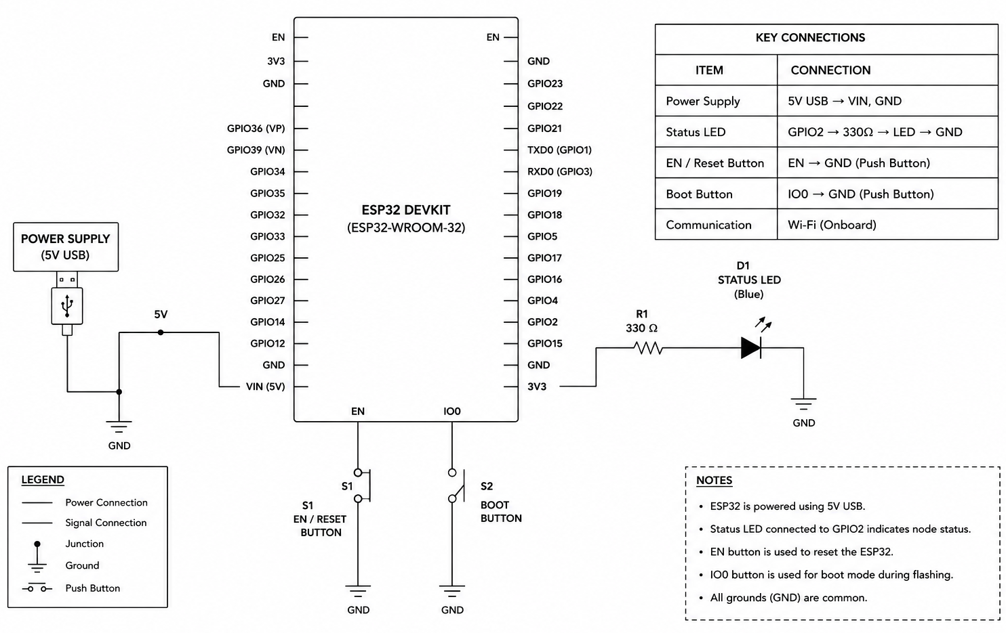
Circuit Design

Slide 9
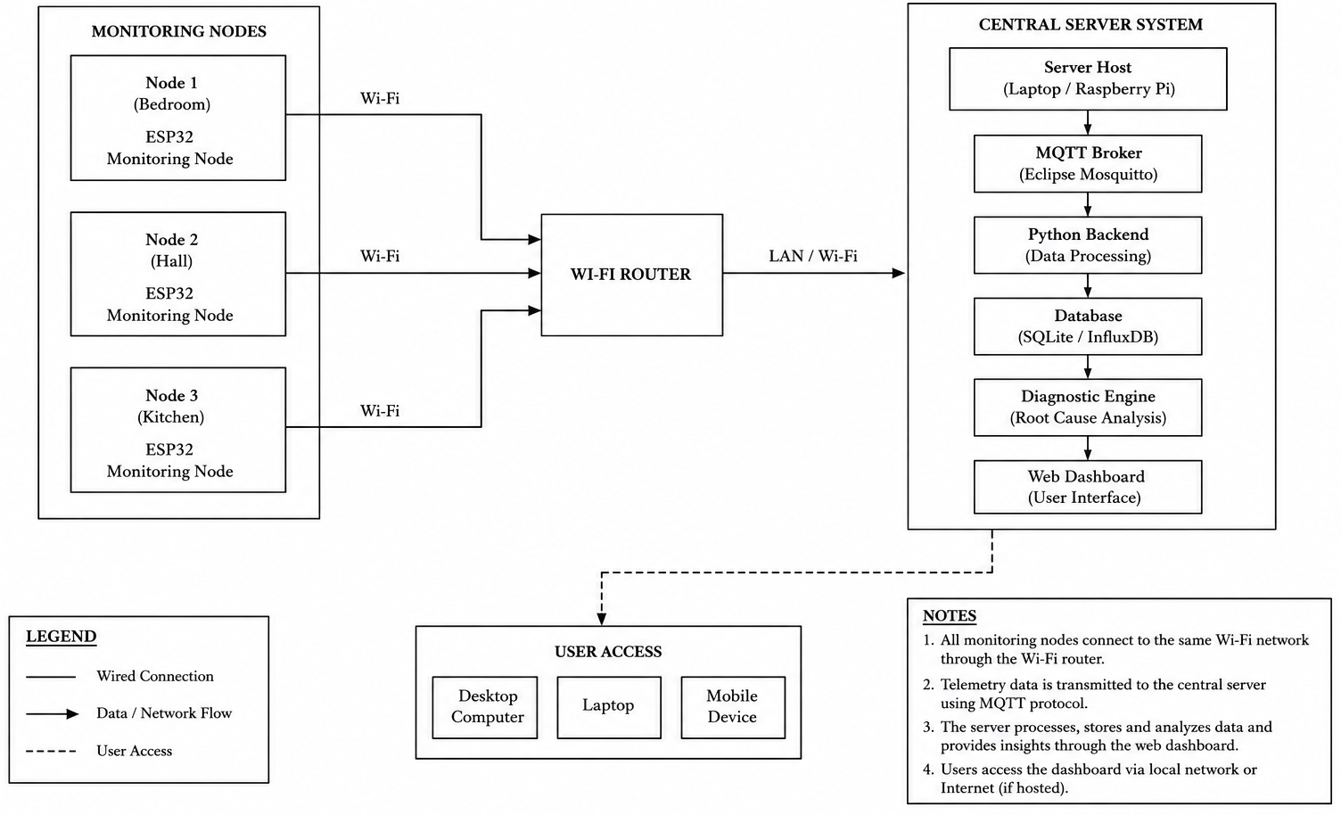
Physical Design

Slide 10
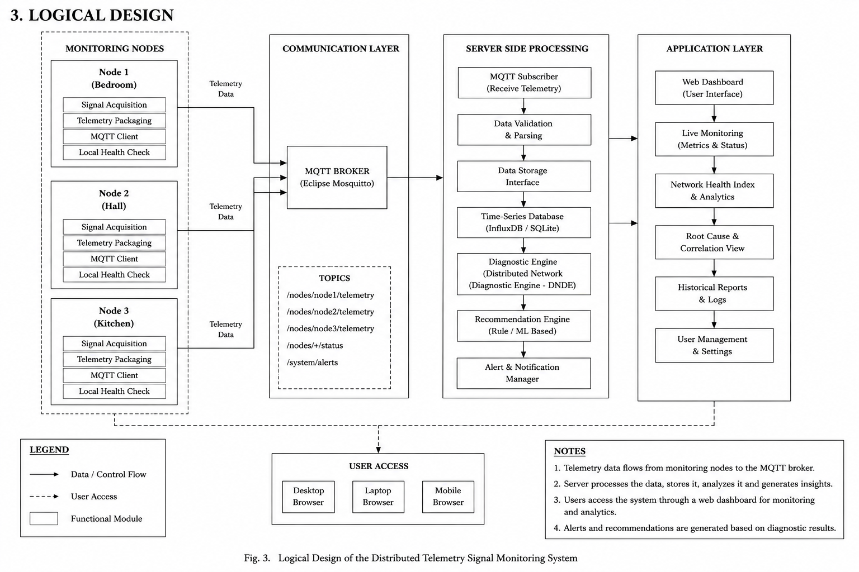
Logical Design

Slide 11
FUTURE SCOPE
Adaptive Node Operation
Dynamic switching between Monitoring Mode and Repeater Mode based on network conditions.
Automatic Router Optimization
Integration with router APIs for automatic Wi-Fi channel selection and optimization.
AI-Based Root Cause Analysis
Replace rule-based diagnosis with machine learning models for higher diagnostic accuracy.

