Slide 1

Department of Computer Science and Engineering
EMBEDDED PROGRAMMING
CHIRALNET: Distributed Wi‑Fi Coverage Analysis & Optimization System
Presentation by
Dakshan Kumar S – 24CS0165
D Prince Piriyan – 24CS0163
Supervisor
Mr. Muthupandi
EMBEDDED PROGRAMMING PROJECT-ZEROTH REVIEW

Slide 2
CONTENTS
Introduction
Problem Statement
Project Description
Aim and Scope of the Proposed work
Literature Survey
Hardware Component
Block Diagram Design
Project Planning

Slide 3
Introduction
ChiralNet is an IoT-based wireless network diagnostics system using multiple ESP32 nodes placed in different locations. The nodes collect Wi‑Fi metrics such as RSSI, latency, and channel information. Data is sent to a central dashboard for analysis, visualization, and optimization recommendations. The system helps identify dead zones and improve wireless coverage.

Slide 4
Problem Statement
Many homes, hostels, and offices suffer from poor Wi‑Fi coverage due to walls, interference, and poor router placement. Users often cannot determine the root cause of connectivity issues. Existing enterprise survey tools are expensive. ChiralNet provides a low-cost solution for monitoring and diagnosing wireless network problems.

Slide 5
Project Description
The project uses distributed ESP32 nodes connected through MQTT to monitor wireless network performance. A backend server processes the collected data and displays it on a dashboard. Features include dead-zone detection, heatmap generation, congestion analysis, and router placement recommendations.

Slide 6
Aim and Scope of the Proposed work
Aim: To develop a low-cost IoT-based platform for analyzing Wi‑Fi coverage and optimizing wireless performance.
Scope:
Real-time Wi‑Fi monitoring
Dead-zone detection
Heatmap visualization
Congestion analysis
Router placement recommendations

Slide 7
Literature Survey(1/2)
A Survey on Ubiquitous WiFi-Based Indoor Localization System
Authors: P. Roy et al., 2022
Findings:
Reviews Wi-Fi RSSI-based indoor localization techniques.
Discusses Wi-Fi fingerprinting and signal propagation.
Focuses mainly on determining user location rather than diagnosing network performance.
Comprehensive Analysis of Applied Machine Learning in Wi-Fi Indoor Positioning
Authors: V. Bellavista-Parent et al., 2022
Findings:
Explores machine learning techniques for Wi-Fi signal analysis.
Uses RSSI and wireless features for indoor positioning.
Primarily targets localization accuracy rather than network troubleshooting.

Slide 8
Literature Survey(2/2)
Existing Commercial Tools
NetSpot
Generates Wi-Fi heatmaps.
Performs manual wireless site surveys.
Mainly provides signal visualization and measurement.
Ekahau
Enterprise-grade Wi-Fi planning and survey platform.
Used by large organizations for professional wireless deployments.

Slide 9
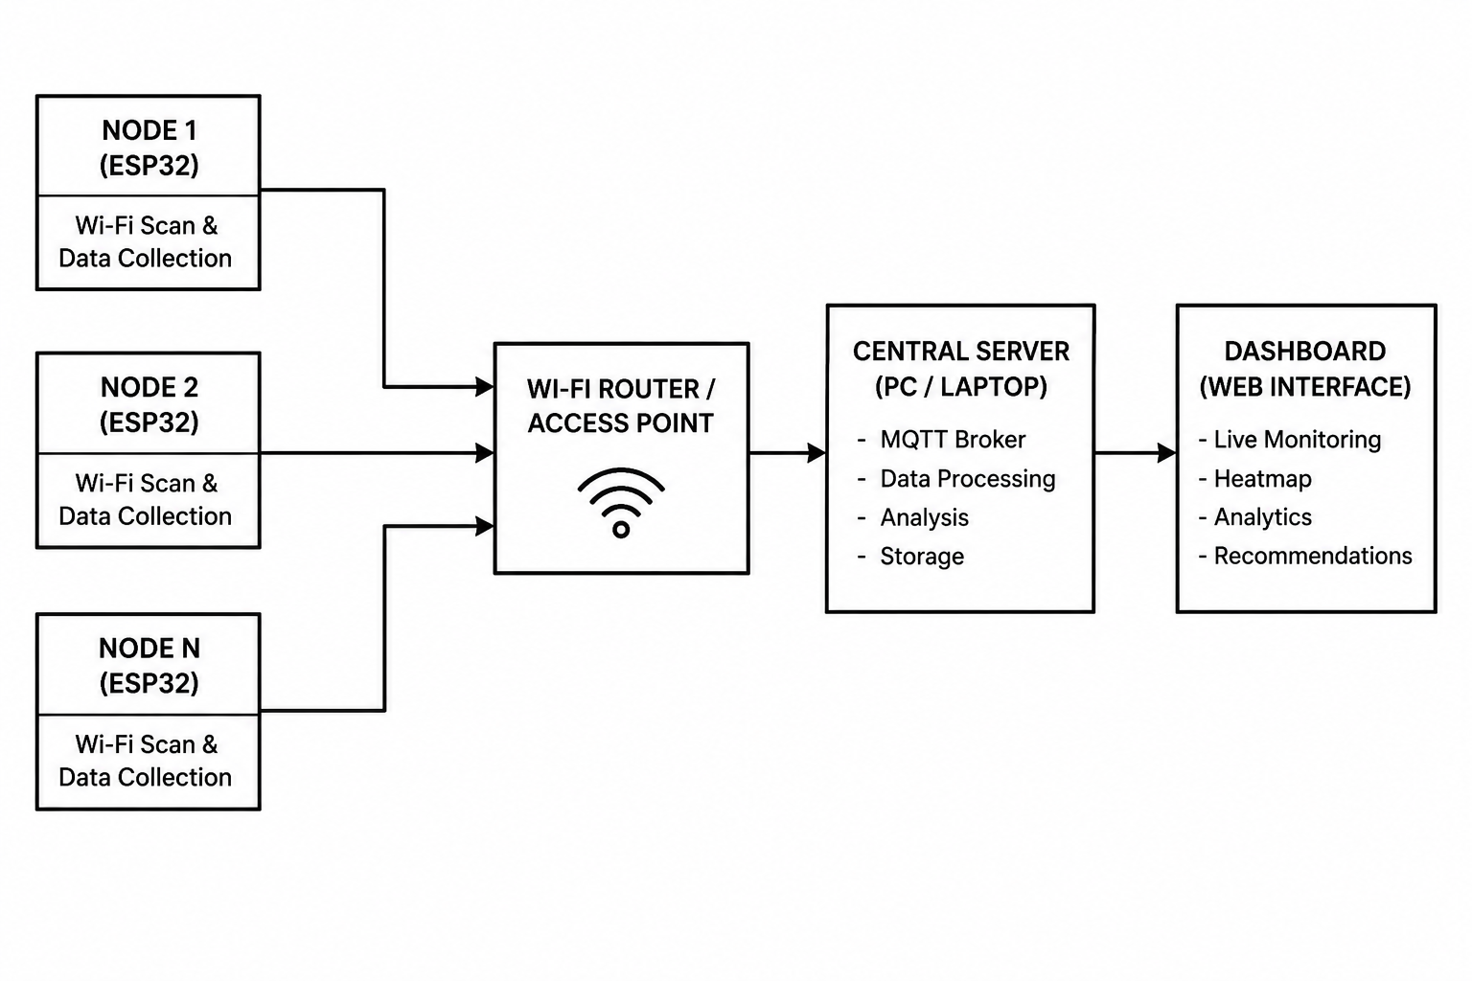
Block Diagram Design

Slide 10
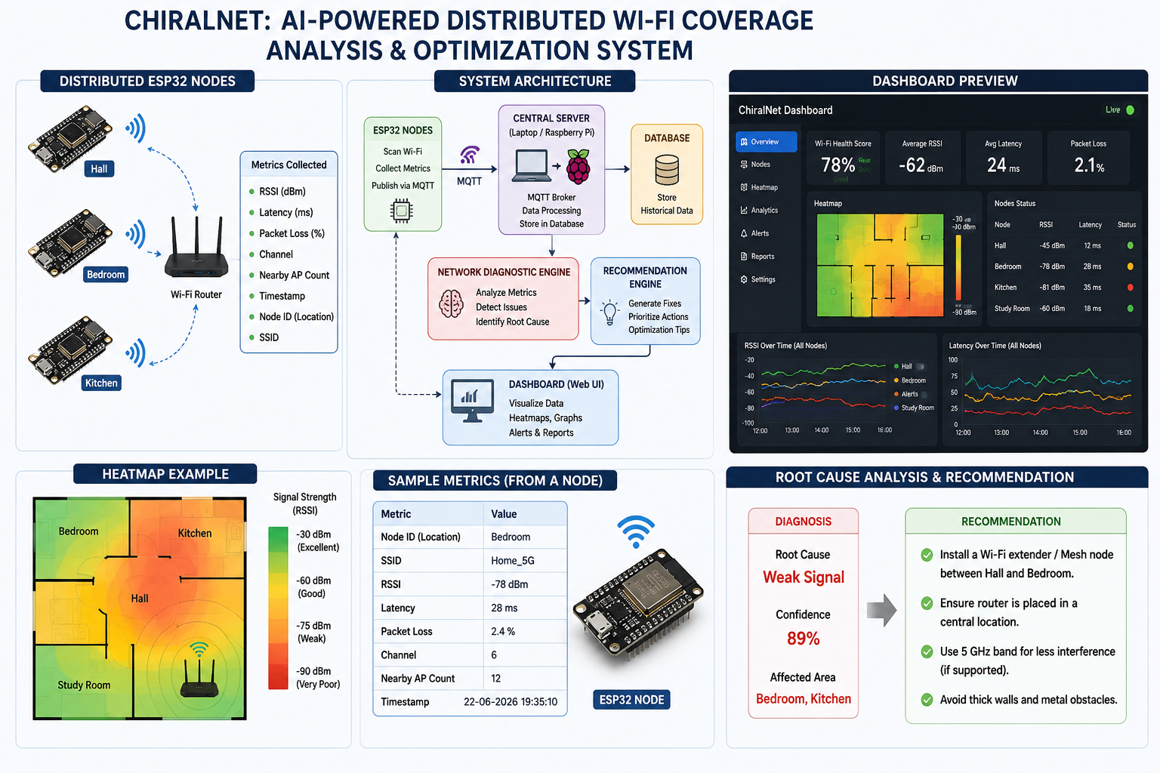
System Architecture

Slide 11
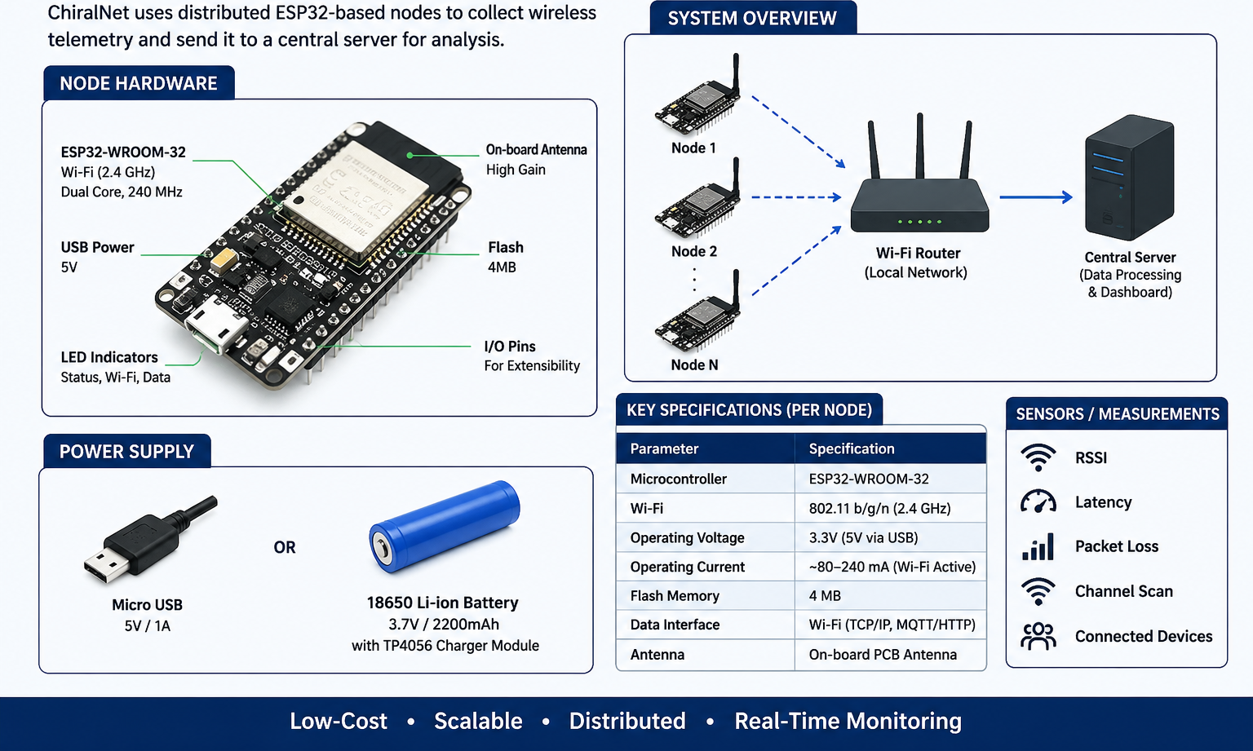
Hardware Component

Slide 12
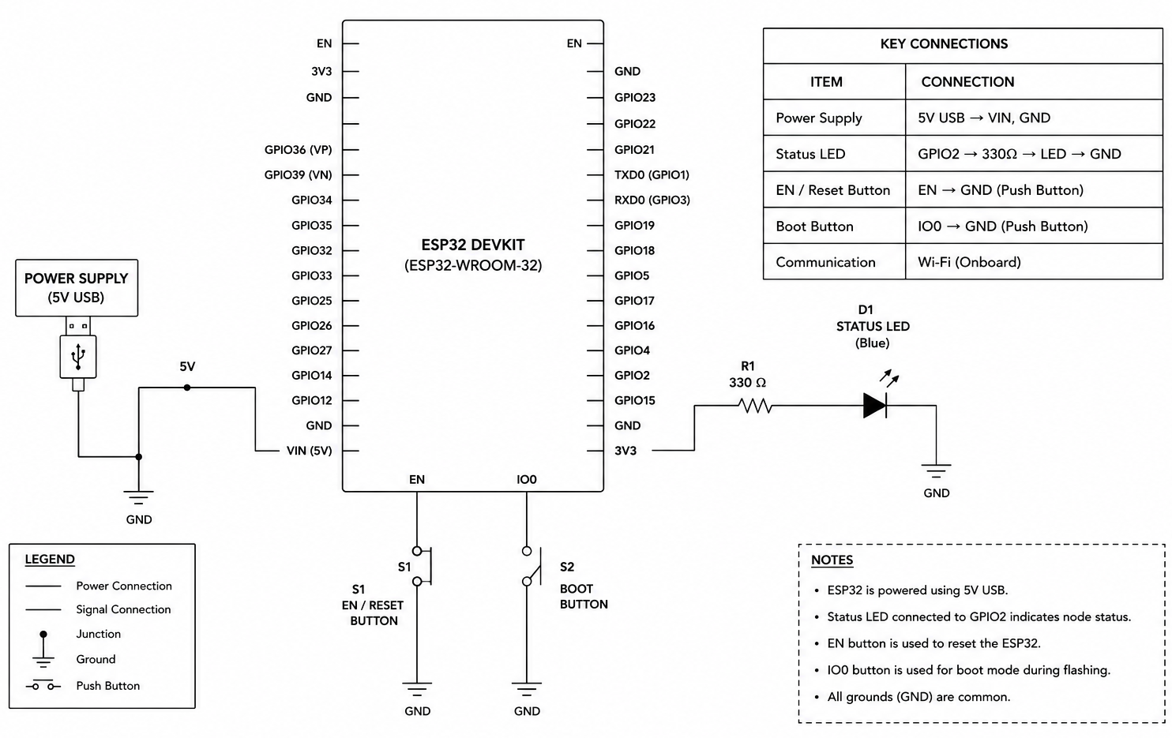
Circuit Design

Slide 13
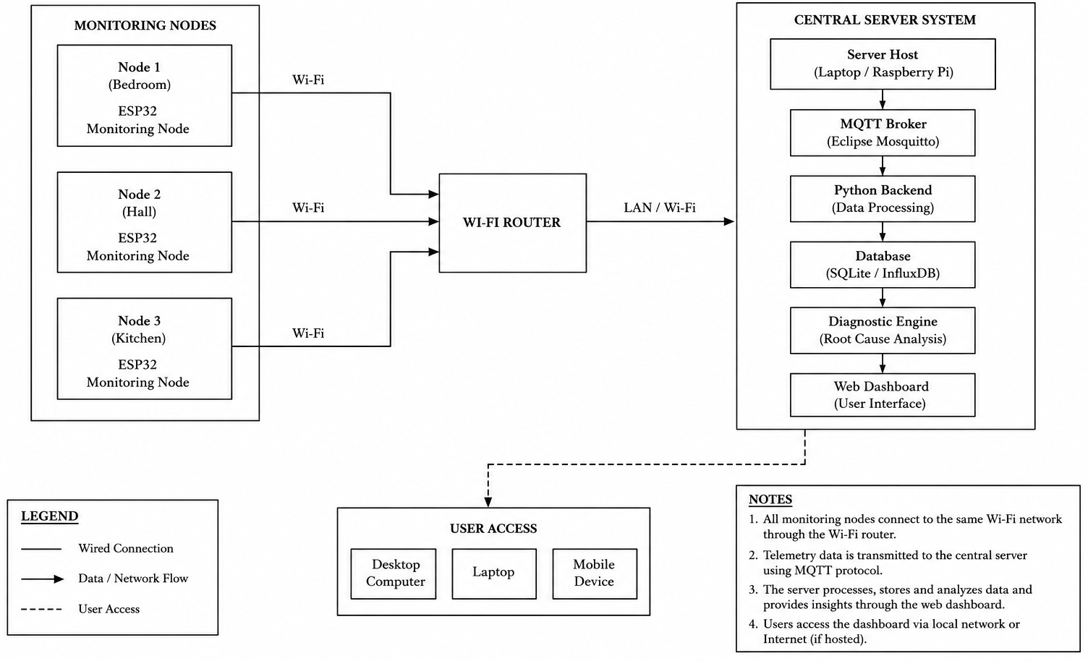
Physical Design

Slide 14
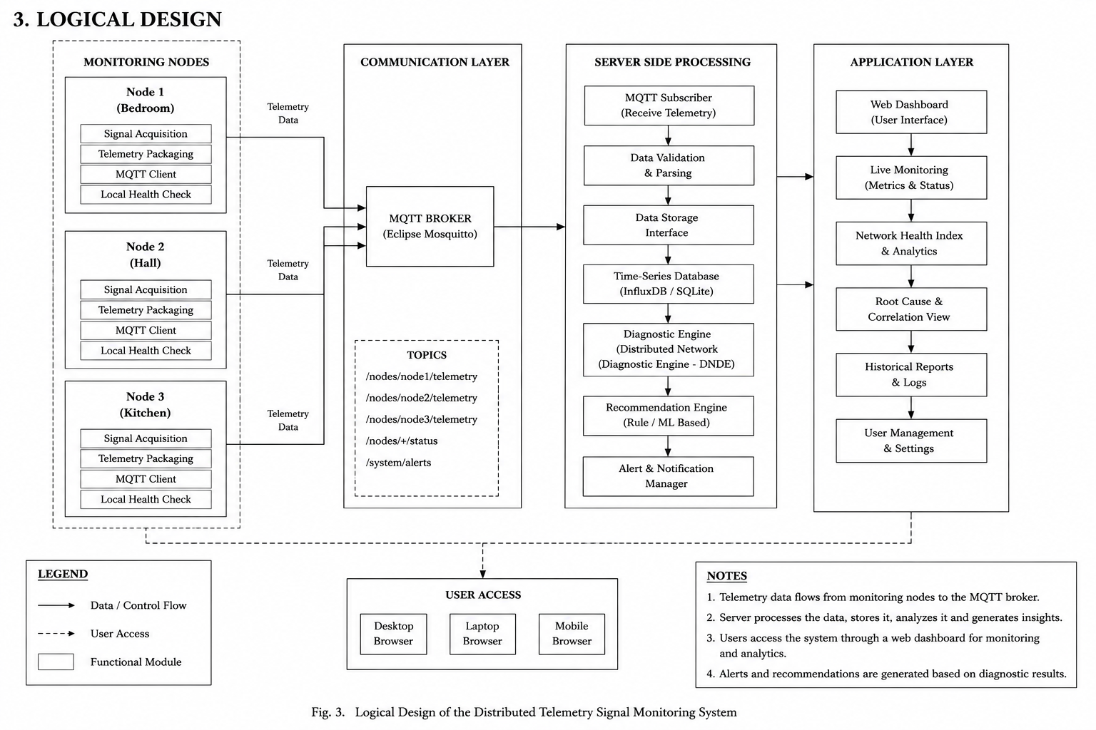
Logical Design

Slide 15
Project Planning
Week 1: ESP32 Setup and Wi‑Fi Monitoring
Week 2: MQTT Communication and Data Collection
Week 3: Dashboard Development
Week 4: Heatmap and Analytics
Week 5: Testing and Optimization
Week 6: Documentation and Final Presentation

Slide 16
FUTURE SCOPE
Adaptive Node Operation
Dynamic switching between Monitoring Mode and Repeater Mode based on network conditions.
Automatic Router Optimization
Integration with router APIs for automatic Wi-Fi channel selection and optimization.
AI-Based Root Cause Analysis
Replace rule-based diagnosis with machine learning models for higher diagnostic accuracy.

