Slide 1
LL(1) Parser
Compiler Design (3170701)
C. K. Pithawala College of Engineering and Technology
Computer Engineering
Team: [Name 1], [Name 2], [Name 3], [Name 4], [Name 5]

Slide 2
Where Parsing Fits
Pipeline:
Source → Lexer → **Parser** → Semantic → ICG → Optimizer → Codegen
The parser takes tokens and builds a derivation (parse tree).
Notes:
The parser is the core of syntax analysis. We are focusing on the top-down parser today.

Slide 3
What is LL(1)?
L = Left-to-right scan of input
L = Leftmost derivation
1 = one lookahead symbol
Top-down predictive parsing
No backtracking needed
Notes:
LL(1) is highly efficient because it predicts the rule to use by looking at just one symbol ahead.

Slide 4
Objectives
Parse without backtracking
Use a table-driven predictive approach
Detect syntax errors early
Run in linear time (O(n))
Notes:
Our goal with this LL(1) parser is speed and clear error detection.

Slide 5
Architecture
Input buffer: contains string to parse followed by $
Stack: holds grammar symbols, bottom is $
Parsing table M[A,a]: 2D array predicting rules
Driver program: executes actions
Output: the sequence of derivations
Notes:
These are the main data structures. The driver loops and checks the table.

Slide 6
Parsing Algorithm
Driver rules:
(1) X = a = $ → accept
(2) X = a ≠ $ → pop and advance
(3) X terminal ≠ a → error
(4) X non-terminal → look up M[X,a], pop X, push RHS in reverse
If M[X,a] is blank → error
Notes:
The algorithm simply matches terminals, or expands non-terminals using the predictive table.

Slide 7
Grammar Preparation
Original: E → E+T | T; T → T*F | F; F → (E) | id
After left recursion removal: E → TE'; E' → +TE' | ε ...
FIRST: terminals that begin the strings derivable from a symbol
FOLLOW: terminals that can appear immediately to the right of a non-terminal
Left factoring: required if two rules share a prefix.
Notes:
We must eliminate left recursion and perform left factoring to make a grammar LL(1).

Slide 8
FIRST, FOLLOW and Parsing Table
 | id | + | * | ( | ) | $
E | E→TE' |  |  | E→TE'
E' |  | E'→+TE' |  |  | E'→ε | E'→ε
T | T→FT' |  |  | T→FT'
T' |  |  | T'→*FT' |  | T'→ε | T'→ε
F | F→id |  |  | F→(E)
Notes:
The table has no overlapping entries, so the grammar is LL(1).

Slide 9
Step-by-Step Parsing: id + id * id (1-8)
# | Stack | Input | Action
1 | E $ | id + id * id $ | E → T E'
2 | T E' $ | id + id * id $ | T → F T'
3 | F T' E' $ | id + id * id $ | F → id
4 | id T' E' $ | id + id * id $ | match id
5 | T' E' $ | + id * id $ | T' → ε
6 | E' $ | + id * id $ | E' → + T E'
7 | + T E' $ | + id * id $ | match +
8 | T E' $ | id * id $ | T → F T'
Notes:
This shows the stack expanding and matching tokens.

Slide 10
Step-by-Step Parsing: id + id * id (9-17)
# | Stack | Input | Action
9 | F T' E' $ | id * id $ | F → id
10 | id T' E' $ | id * id $ | match id
11 | T' E' $ | * id $ | T' → * F T'
12 | * F T' E' $ | * id $ | match *
13 | F T' E' $ | id $ | F → id
14 | id T' E' $ | id $ | match id
15 | T' E' $ | $ | T' → ε
16 | E' $ | $ | E' → ε
17 | $ | $ | ACCEPT
Notes:
The parsing concludes when the stack and input both contain only $.

Slide 11
Error Case (id + * id) & Attributes
Stack | Input | Action
E $ | id + * id $ | E → T E'
T E' $ | id + * id $ | T → F T'
F T' E' $ | id + * id $ | F → id
id T' E' $ | id + * id $ | match id
T' E' $ | + * id $ | T' → ε
E' $ | + * id $ | E' → + T E'
+ T E' $ | + * id $ | match +
T E' $ | * id $ | ERROR: M[T,*] empty
Advantages: Simple, no backtracking, O(n) time, easy to debug.
Limitations: No left recursion, needs left factoring, less powerful than LR, hard to recover from errors.
Applications: Recursive descent, data formats (JSON), teaching compilers.
Notes:
Here we see an error caught correctly. Also summarizing advantages and limitations.

Slide 12
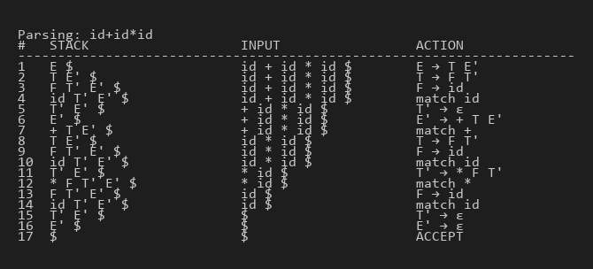
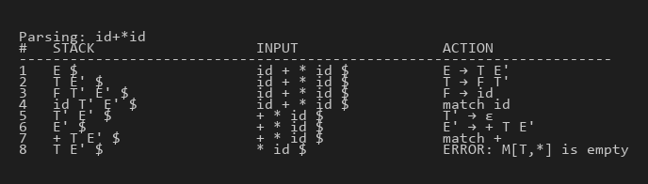
Demo and Conclusion
- Successfully implemented LL(1) parsing in Python.
- Handled First/Follow generation and trace simulation.
- Thank you! Questions?
Notes:
Thank you.

