Slide 1
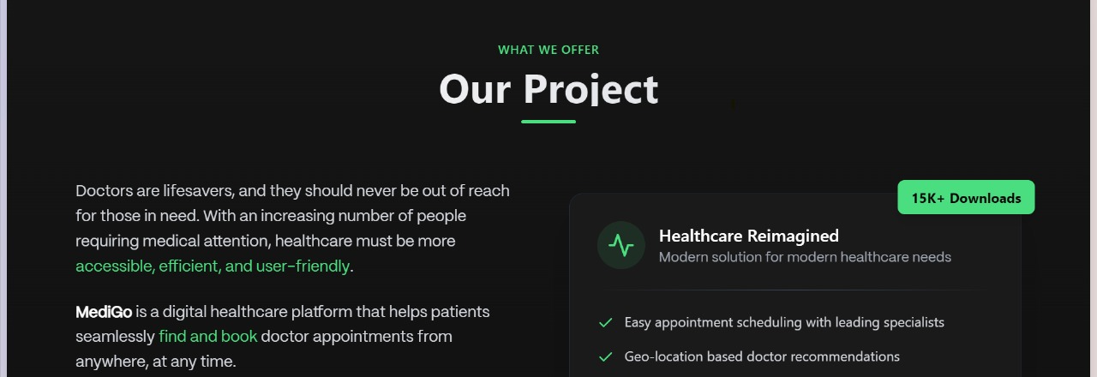
Revolutionizing Healthcare Scheduling: A Seamless Appointment Booking Solution
An innovative solution for seamless appointment booking in the healthcare industry

Slide 2



Problem Statement
Long Waiting Times
Appointment Mismanagement
Lack of Communication
Patients often experience lengthy delays in getting appointments with doctors, leading to frustration and potential health concerns.
Inefficient scheduling systems and lack of coordination between doctors and staff can result in missed appointments, double-bookings, and overall poor appointment management.
Patients and doctors often face challenges in communicating effectively about appointment details, rescheduling, and follow-up, leading to confusion and dissatisfaction.
Addressing these issues can lead to a more streamlined and efficient appointment scheduling process, improving patient satisfaction and the overall healthcare experience.

Slide 3

Why We Chose This Problem Statement
The healthcare industry faces a significant challenge in the area of patient-doctor communication and coordination. Inefficient processes and outdated systems often lead to frustration for both patients and healthcare providers, resulting in suboptimal outcomes and a strain on the entire healthcare ecosystem.

Slide 4
Our Solution
Appointment Scheduling Website
Doctor Availability
Intuitive User Interface
The website will display real-time availability of doctors, allowing patients to choose a suitable appointment time that fits their schedule.
The website's interface will be designed to be intuitive and easy to navigate, ensuring a seamless booking experience for patients.
A user-friendly website that allows patients to easily book appointments with doctors. Patients can view available appointment slots, select a convenient time, and complete the booking process.
Mobile App Integration
Doctor search by Specialty and location
Patients will have the option to download a mobile app that provides the same functionality as the website, allowing them to book appointments on-the-go.
Easily find the right doctor based on specialty and location, ensuring quick access to the best healthcare professionals near you.

Slide 5
Features
User-friendly UI/UX for Smooth Appointment Booking
A clean and intuitive interface that guides users through the appointment booking process seamlessly, with clear visual cues and intuitive navigation.
Real-time Availability of Doctors
Patients can view the real-time availability of doctors, allowing them to select appointment slots that fit their schedules conveniently.
Secure and Fast Backend for Managing Appointments
A robust and secure backend system that efficiently handles appointment scheduling, storage, and management, ensuring a fast and reliable user experience.
Notification System for Reminders and Confirmations
Automated notifications and reminders sent to users about their upcoming appointments, as well as confirmation messages to ensure a seamless booking process.
Downloadable App for Additional Flexibility
A mobile application that allows users to access the service on the go, providing additional convenience and flexibility for scheduling and managing appointments.

Slide 6


Tech Stack
For App
For Website
Flutter, Backend: Firebase , Database: Firebase, Maps API: Google Maps API
Backend: Node.js , Express.js , Architecture: MVC
JavaScript , Notifications : Flutter local notifications plugin
Frontend : EJS Templating,Tailwind CSS
*The technology stack information was provided by the client for the presentation.

Slide 7





Clever Approach to Hosting Our App - THE WEBSITE
Render for website Development
Netlify Uptime Reliability
GitHub repository for Open-Source

Slide 8



Limitations of the Application
Server Downtime
Internet Connectivity
Scalability Concerns
The application's availability may be affected by potential server outages or maintenance periods, leading to temporary service disruptions.
The application's functionality is dependent on stable internet connectivity, and users may experience performance issues or limited access in areas with poor or intermittent network coverage.
As the user base grows, the application may face challenges in terms of scaling to accommodate increased traffic and data demands, potentially impacting performance and responsiveness.
While the application aims to provide a reliable and efficient service, it's important to acknowledge these potential limitations and work towards mitigating their impact on the user experience.

Slide 9
Future Work
AI-based doctor recommendations
Integrate an AI system to provide personalized doctor recommendations based on the patient's medical history, symptoms, and preferences.
Multi-language support for accessibility
Implement a multi-language interface to ensure the platform is accessible to users from diverse linguistic backgrounds.
Payment gateway integration for paid consultations
Integrate a secure payment gateway to enable patients to seamlessly pay for online medical consultations.
Blockchain for secure medical records
Implement a blockchain-based system to store and manage patient medical records, ensuring their security and integrity.

