Slide 1
NetworkLogger
Android Telecom & Device Health Monitoring
Real-time signal, cell-tower, throughput and device-health logging for network research

Slide 2
Introduction & Purpose
A field-data collection tool for real-world cellular network research.
Lab equipment and drive tests capture network conditions in controlled settings. NetworkLogger instead runs as an ordinary Android app on ordinary phones, capturing authentic signal, mobility, and throughput data during everyday use — the actual conditions a network operates under.
What. Cellular RF conditions, GPS-based mobility, realized throughput, and device-health context (battery/RAM/storage) that can confound signal readings.
How. Two independent logging pipelines on-device — a user-triggered 5-second foreground session, and an always-on 15-minute background trace — both writing structured CSV logs that sync to the cloud.
Why it matters. Enables comparing signal quality, radio-technology behavior (4G/5G), and throughput across real devices, carriers, and locations — not synthetic benchmarks.
2

Slide 3
What It Monitors
Cellular signal & cell identity — RSRP, RSRQ, PCI, TAC, NCI; distinguishes 4G, 5G Standalone, and 5G NSA
Location & throughput — GPS lat/lon, downlink/uplink kbps
Device health — battery %, RAM, storage
Two logging cadences — a 5-second foreground service for fine-grained sessions, and a 15-minute background worker for always-on monitoring
QUICK GLOSSARY
RSRP — how strong the signal is
RSRQ — how clean/usable the signal is (accounts for interference)
PCI — which physical cell/sector you're connected to
TAC — identifies a group of nearby cells
NCI — the exact cell's unique ID
3

Slide 4
System Architecture
Android App
(Service + WorkManager)
→
Firebase
Cloud Storage
→
Local Ingestion
Script (Python)
→
InfluxDB
→
Grafana
1. Tapping Start Logging launches a foreground Service that samples GPS, signal, and throughput every 5 seconds and writes to a local CSV.
2. Independently, a WorkManager job runs every 15 minutes in the background — capturing device health and coarse signal data whether or not a session is active.
3. On Stop, both CSVs are tagged with device/session/tester metadata, uploaded to Firebase Cloud Storage, and cleared locally for the next session.
4

Slide 5
Engineering Challenges Solved
Background execution limits (Doze). The 5-second sampling loop was silently throttled once the screen turned off — gaps grew to several minutes. Fixed with a dedicated foreground Service plus a WorkManager-based watchdog that detects and alerts on silent failures.
Correct radio-technology detection. TelephonyManager.networkType misreports 5G NSA (LTE anchor + NR data) as plain 4G. Switched to TelephonyDisplayInfo.overrideNetworkType, the modern API built to distinguish NSA / SA / carrier-aggregation states.
Correct Cell ID extraction. CellIdentityLte.ci returns the ECI, not the local Cell ID. Decomposed per 3GPP: ECI = 256 × eNodeB ID + Cell ID.
5

Slide 6
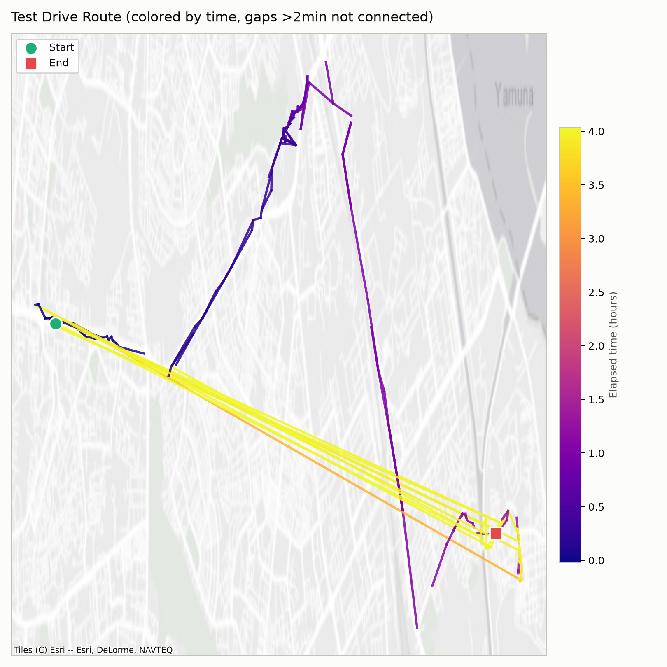
Data & Findings — Route
Route colored by elapsed time — reveals repeated test passes over ~4 hours, not just a single trip
6

Slide 7
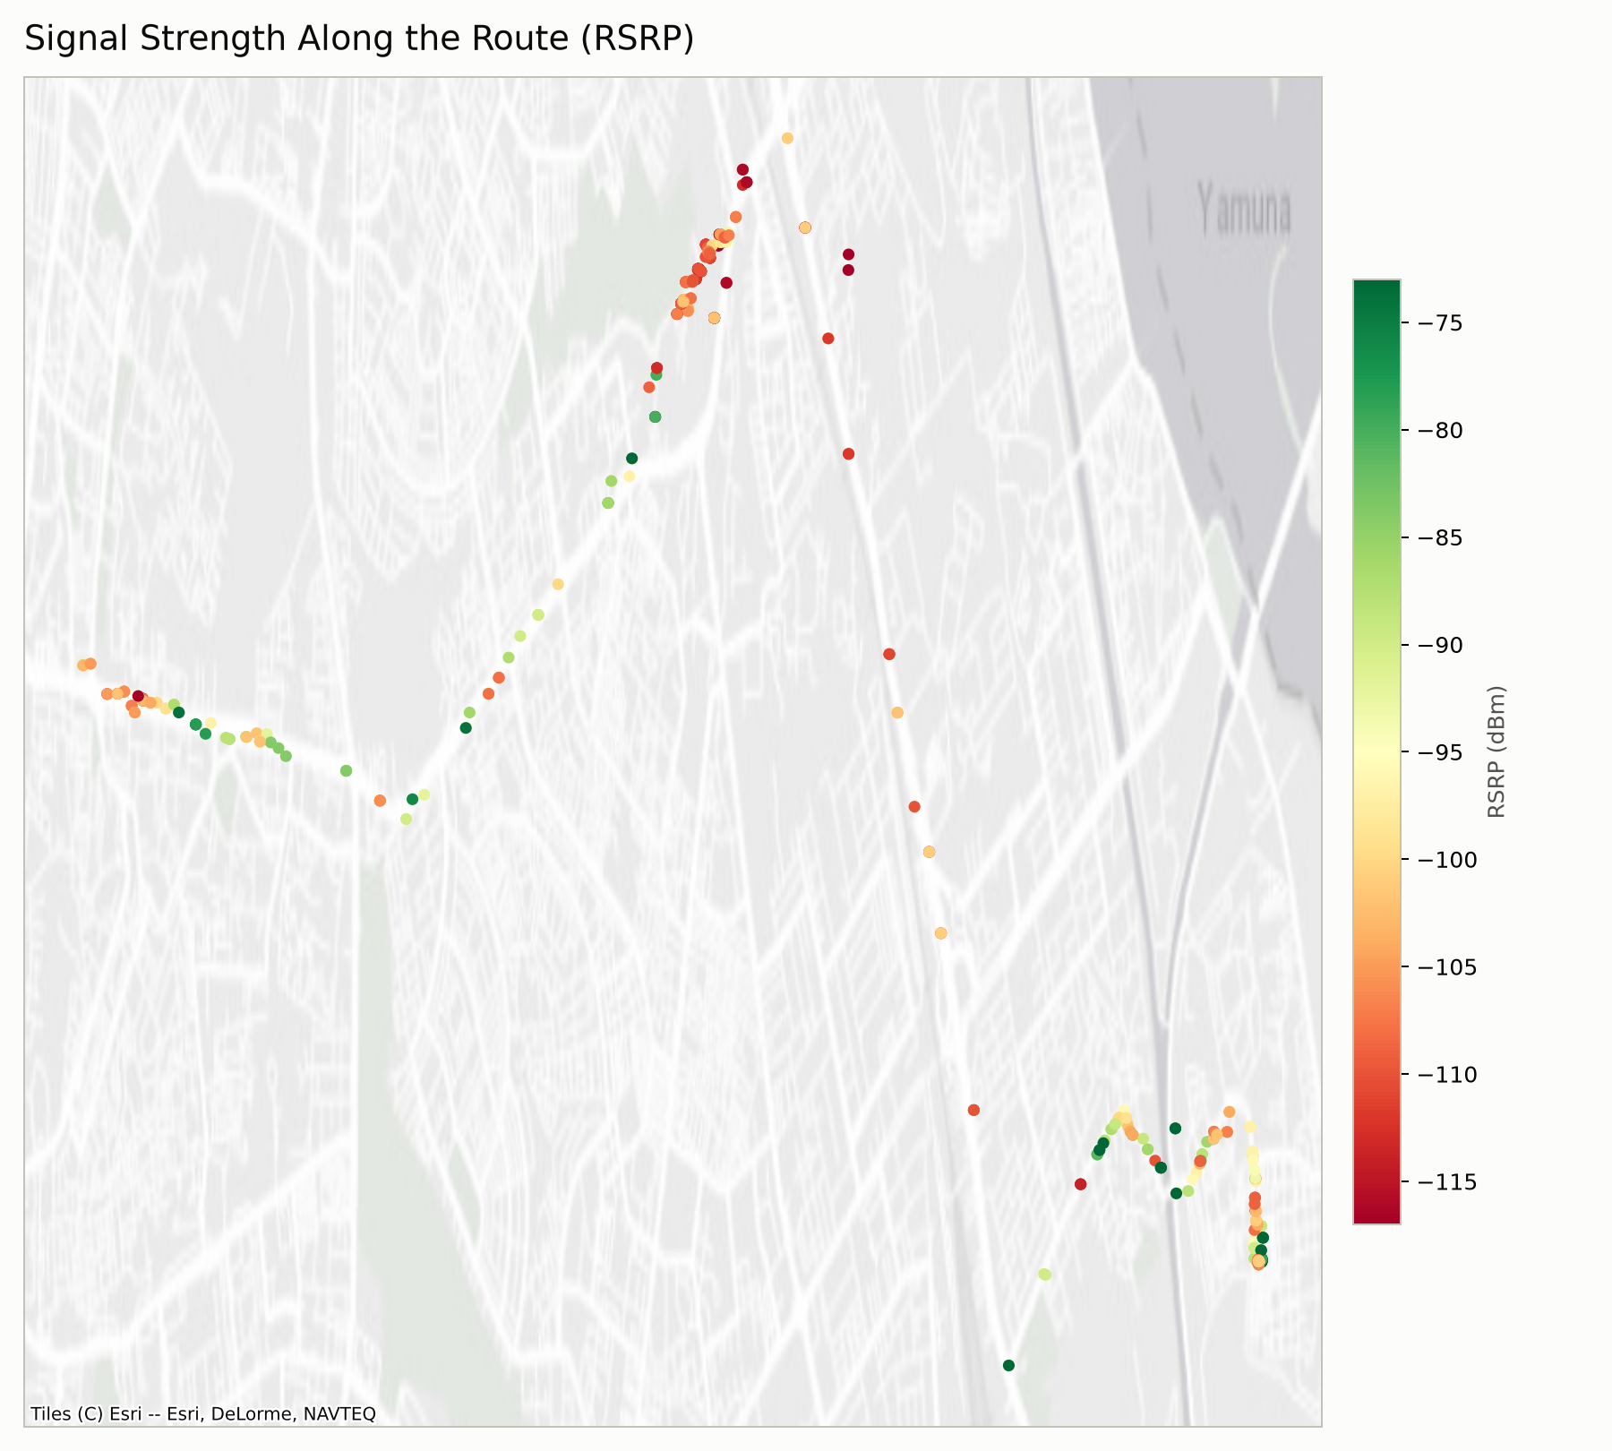
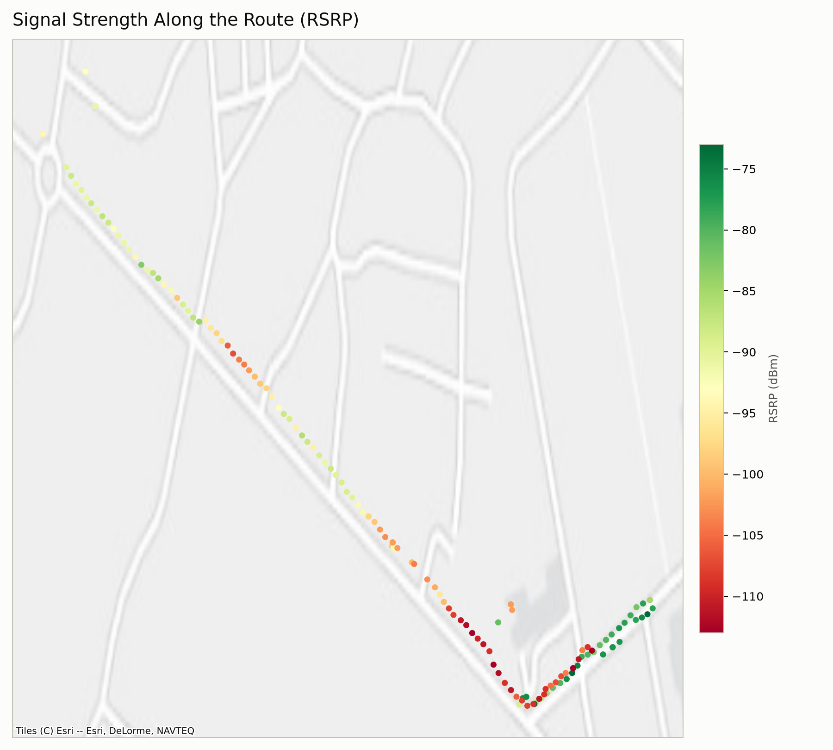
Data & Findings — Signal Strength (RSRP)
Session 1: ~10km journey, mixed coverage quality
Session 2: short drive, sharp dead zone at low point
7

Slide 8
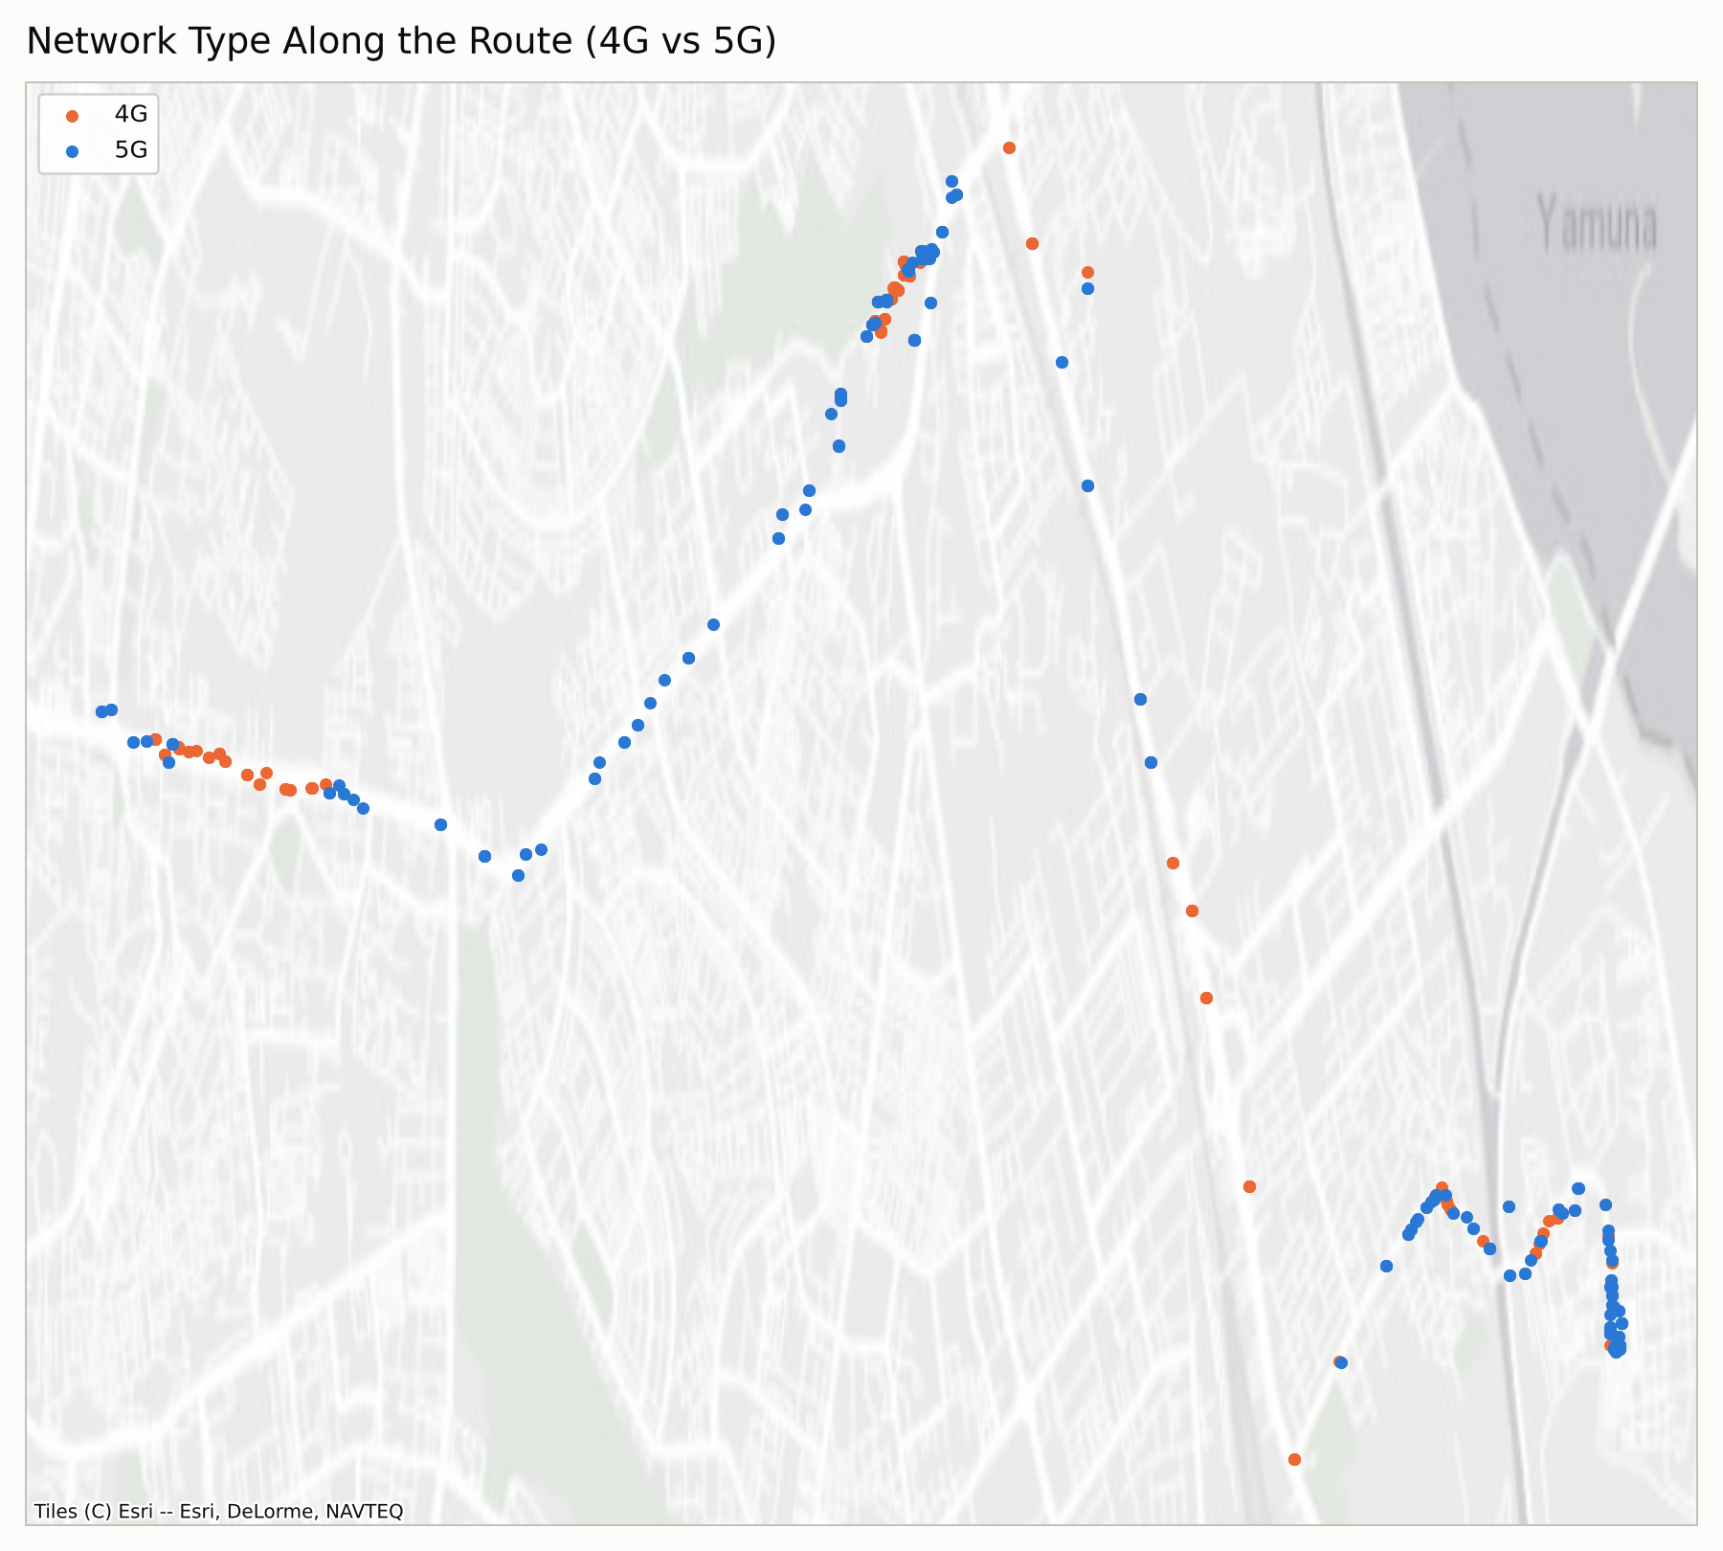
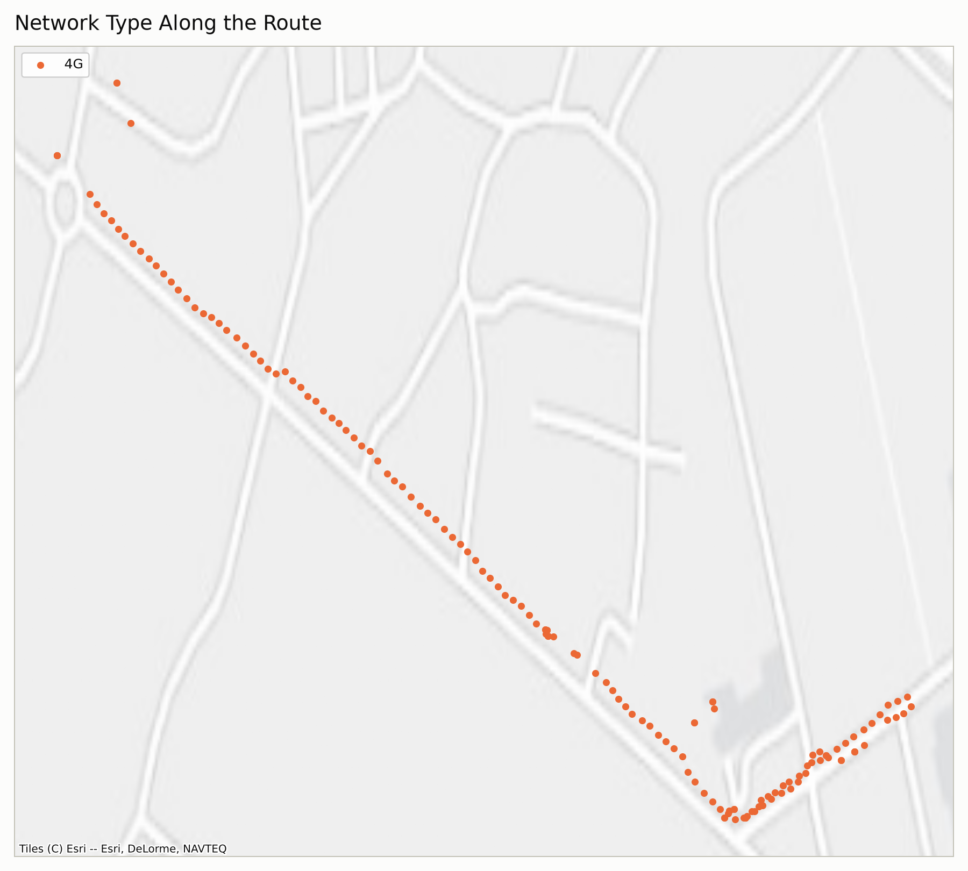
Data & Findings — Network Type (4G / 5G)
Session 1: mixed 4G/5G along the route
Session 2: consistently 4G throughout
8

Slide 9
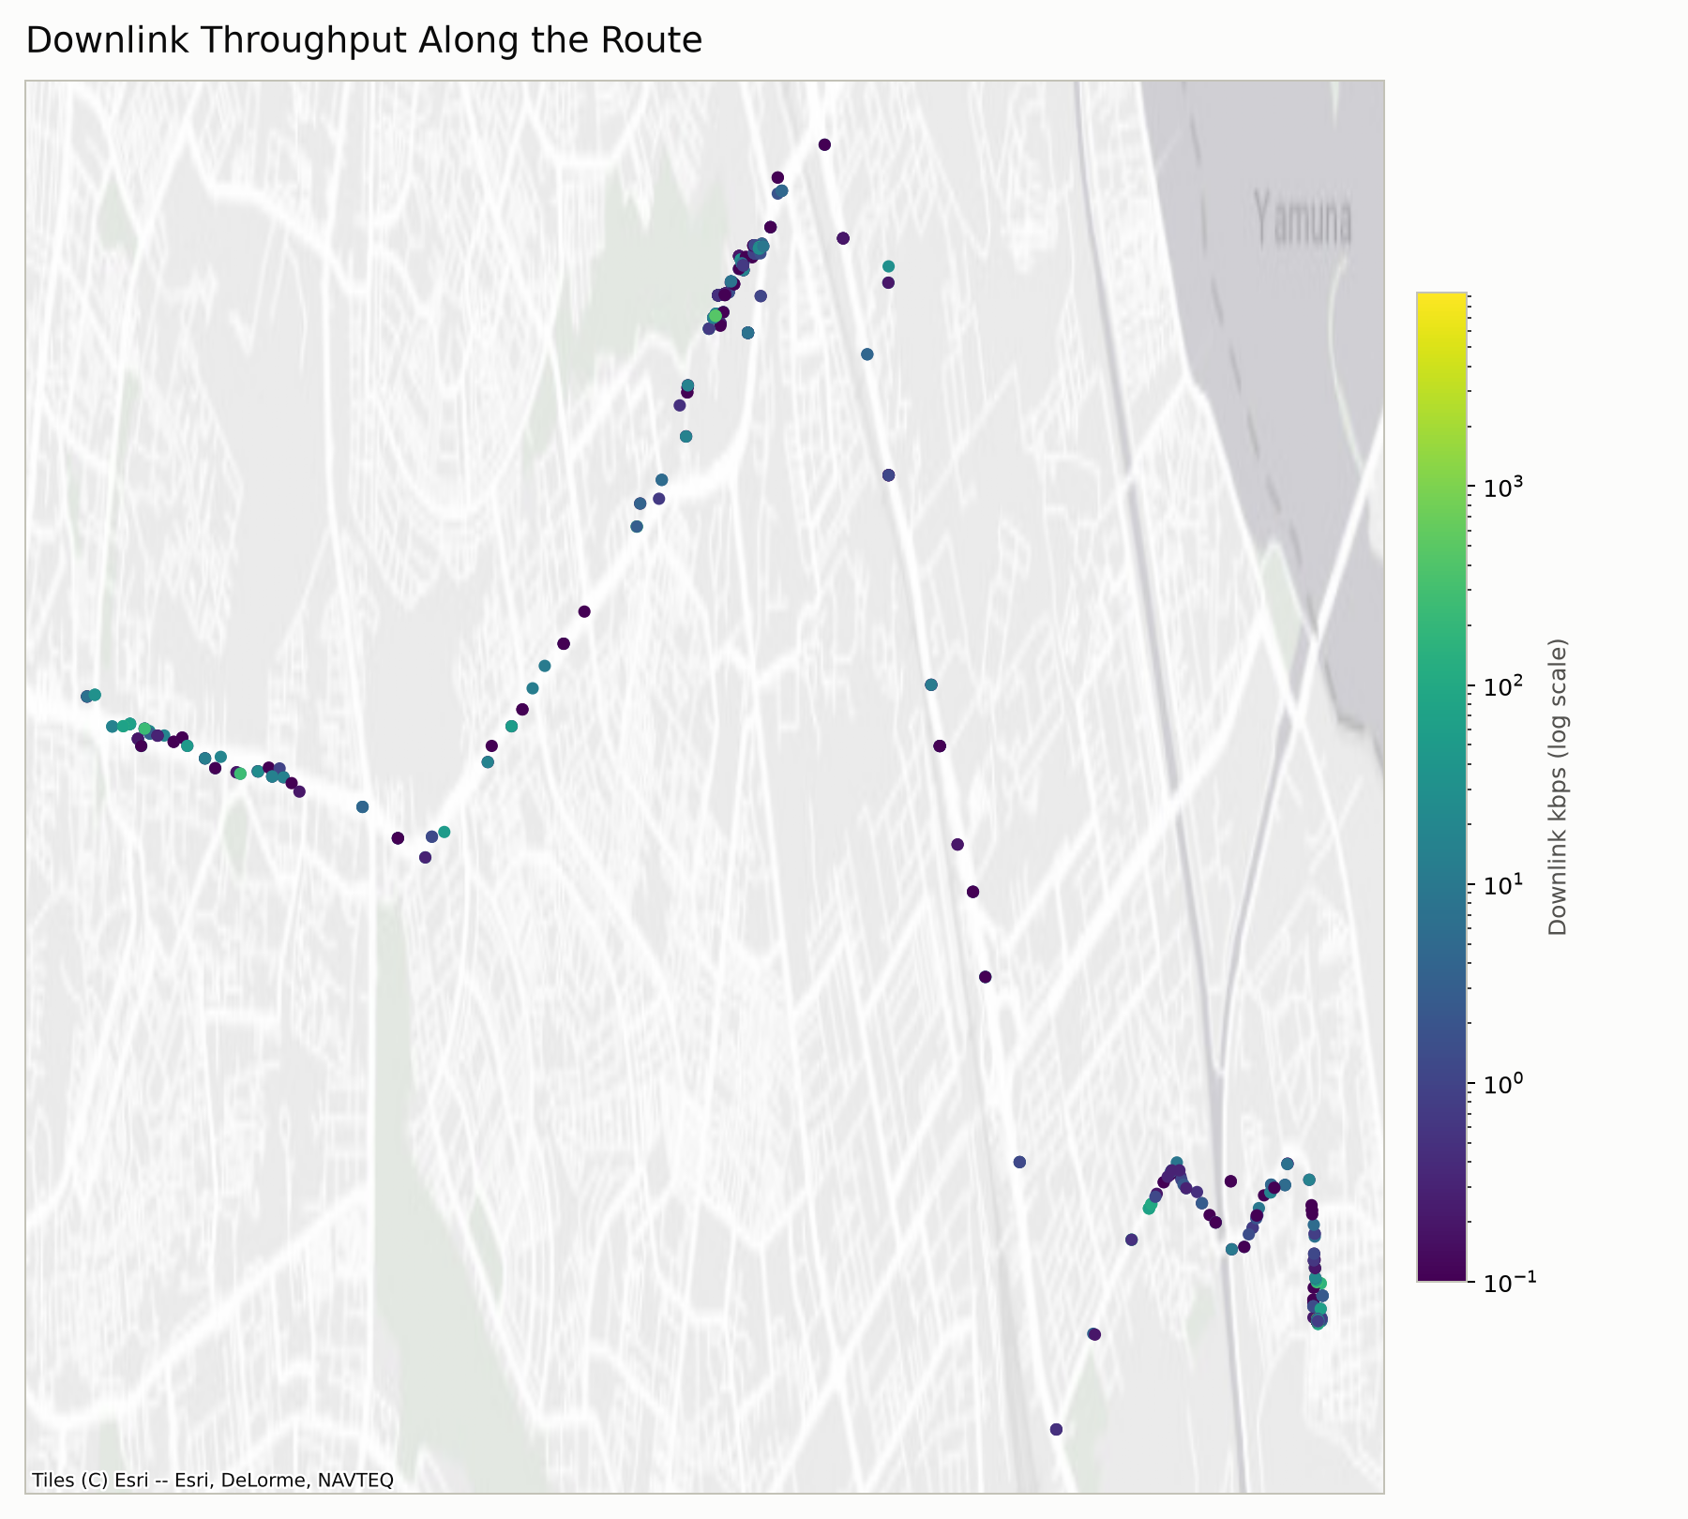
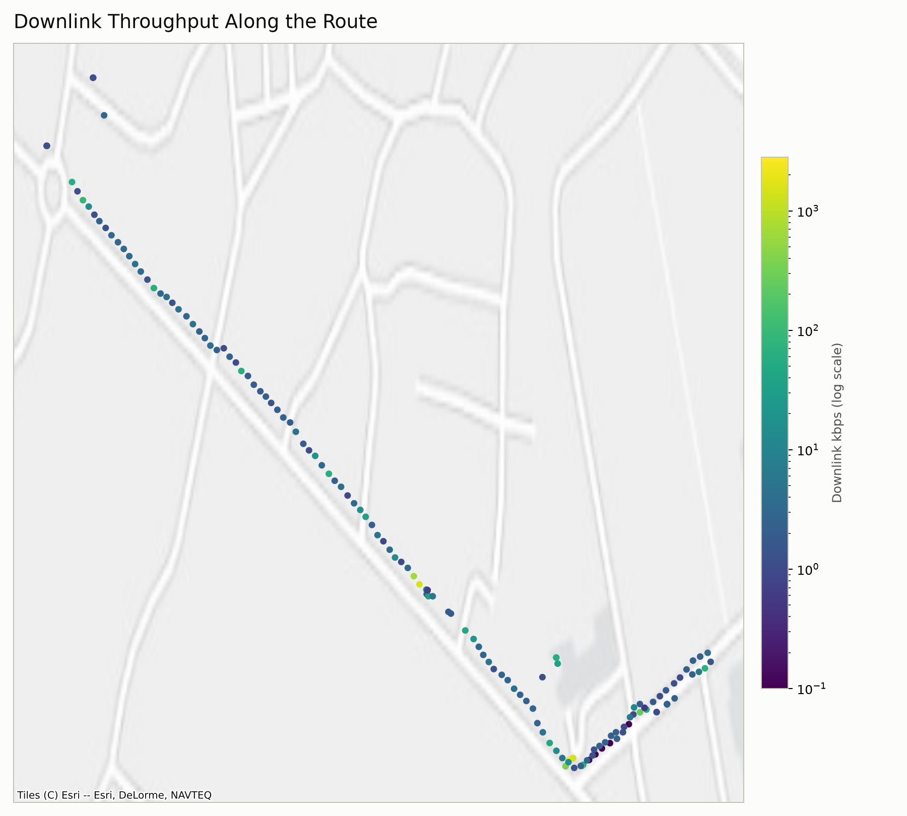
Data & Findings — Downlink Throughput
Session 1: bursty throughput, log scale
Session 2: mostly low-rate background traffic
9

Slide 10
Live Demo
Grafana + InfluxDB dashboard
Real-time signal, throughput, and battery data across every device and session

