Slide 1
HACKATHON / RETAIL INTELLIGENCE
SmartCart AI
PHYSICAL PICKUP
01
Shelf event observed
Scan. Verify. Go.
MOBILE SCAN
02
Checkout-anywhere, with a separate layer checking
what left the shelf against what was scanned.
Barcode recorded
EXIT DECISION
03
Match or review
SINGLE SHOPPER
3 DEMO PRODUCTS
MOCK BILLING
The prototype validates the workflow, not real-store security accuracy.

Slide 2
THE PROBLEM
Scan & go has a trust gap
A phone records what people scan — not necessarily what physically leaves the shelf.
01
02
03
Missed scans
Wrong quantities
Ambiguous events
An item is picked up, but never added to the mobile cart.
A scanned count does not match physical shelf activity.
Shadows, returns and sensor noise can create false alarms.
Opportunity
Verify physical actions without adding another checkout queue.
SMARTCART AI / HACKATHON PROTOTYPE
02 / 10

Slide 3
OUR IDEA
Two carts. One exit decision.
A mismatch becomes a chance to correct the cart, not an accusation.
PHYSICAL CART
DIGITAL CART
Shampoo × 1
≠
Shampoo × 0
From shelf pickup / return evidence
From scanned mobile barcodes
REVIEW REQUIRED
Do not issue a receipt until counts and pending evidence are resolved.
SMARTCART AI / HACKATHON PROTOTYPE
03 / 10

Slide 4
LIVE DEMO
A five-step proof in two minutes
Use the deterministic simulator for the main judging flow; then show camera monitoring as a separate experiment.
01
02
03
04
05
›
›
›
›
RESET
PICK UP
TRY EXIT
SCAN
EXIT
Fresh shopping session
Shampoo simulated
Blocked: not scanned
Shampoo × 1 matched
₹199 mock receipt
Expected result
The unscanned item blocks checkout; the matched cart receives one simulated receipt.
SMARTCART AI / HACKATHON PROTOTYPE
04 / 10

Slide 5
ARCHITECTURE
From observation to reconciliation
One backend resolves accepted shelf events against mobile barcode scans.
MOBILE SCAN
CAMERA OBSERVER
SIMULATED WEIGHT
Barcode / digital cart
OpenCV fixed shelf zones
Second signal in fusion mode
FASTAPI RECONCILIATION
Accepted physical events + per-product scan counts + unresolved evidence
MISMATCH / UNCERTAINTY → REVIEW
MATCH + CLEAR EVIDENCE → MOCK RECEIPT
YOLO tracking and reference-image SKU checks are optional overlays, not authoritative billing inputs.
SMARTCART AI / HACKATHON PROTOTYPE
05 / 10

Slide 6
COMPUTER VISION
A simple, honest camera MVP
For live camera mode: fixed viewpoint, stable lighting, one product per shelf zone.
CALIBRATED SHELF VIEW
IMPORTANT LIMIT
ZONE A
ZONE B
ZONE C
Detect a likely shelf change —
not a person’s intent.
SHAMPOO
BISCUITS
COLA
YOLO tracking and visual SKU similarity are optional advisory experiments; neither authorizes checkout.
OpenCV compares “empty” and “stocked” reference views after movement settles.
SMARTCART AI / HACKATHON PROTOTYPE
06 / 10

Slide 7
SENSOR FUSION
One observation can wait for confirmation
Two-signal mode uses simulated weight readings — physical load cells are a future milestone.
Camera reports Shampoo pickup
1
PENDING
No corresponding weight event
Camera pickup + simulated 250g reduction
2
CONFIRMED
Same product and action
Camera Shampoo + weight Biscuits
3
REVIEW
Conflicting evidence
Safety behavior: pending and uncertain evidence prevent automatic simulated exit.
SMARTCART AI / HACKATHON PROTOTYPE
07 / 10

Slide 8
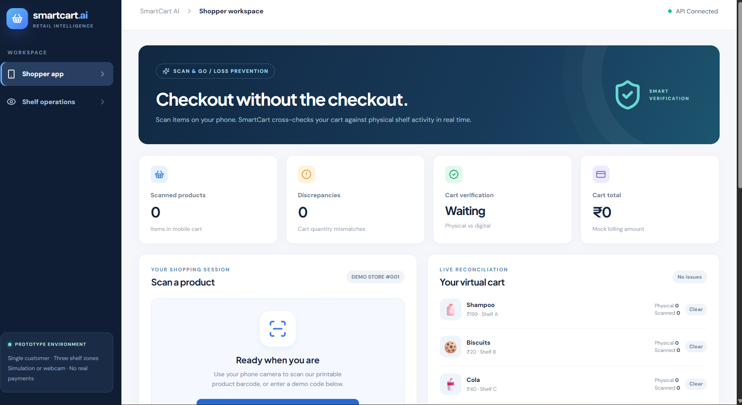
WHAT WE BUILT
A working connected interface
This development screenshot shows the shopper workspace successfully connected to the local API.
REACT / VITE
Responsive shopper & operator screens
FASTAPI / SQLITE
Scan events, event history, checkout rules
OPENCV / ZXING
Shelf zone analysis, barcode scan support
Screenshot: earlier local UI capture. Advanced features require local acceptance verification.
SMARTCART AI / HACKATHON PROTOTYPE
08 / 10

Slide 9
EVIDENCE & BOUNDARIES
Tested logic. Clearly stated limits.
Backend acceptance tests use synthetic JPEG frames and simulated shelf events, not real retail conditions.
VERIFIED BY AUTOMATED TESTS
22 / 22
Backend behavior and synthetic-frame scenarios.
BACKEND TESTS PASSED
PENDING LOCAL CHECKS
Frontend build, webcam, and phone scanning.
Reconciliation, uncertain evidence, safe exit refusal, mock receipt deduplication.
NOT PART OF THIS PROTOTYPE
Physical shelf sensors, real billing, multiple shoppers.
SMARTCART AI / HACKATHON PROTOTYPE
09 / 10

Slide 10
ROADMAP
Prototype now. Retail-grade validation next.
A path from a controlled three-product demo toward trustworthy checkout-anywhere retail.
01
02
03
04
Validate
Instrument
Scale safely
Pilot
Measure false pickup/return alerts with real shelf setups and mobile devices.
Integrate ESP32, HX711 and load cells; calibrate physical shelf signals.
Add authenticated sessions, privacy controls and multi-shopper association.
Integrate consent-based payments and test with retailer oversight.
SMARTCART AI — SCAN. VERIFY. GO.
SMARTCART AI / HACKATHON PROTOTYPE
10 / 10

