Slide 1
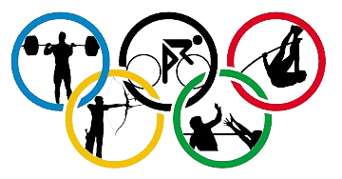
120 Year’s of Olympics

Slide 2
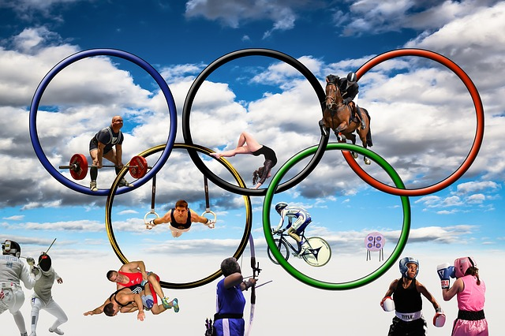
OLYMPIC: The Dream of Athlete
The modern Olympic Games or Olympics are the leading international sporting events featuring summer and winter sports competitions in which thousands of athletes from around the world participate in a variety of competitions.
The Olympic Games are normally held every four years, and since 1994, have alternated between the Summer and Winter Olympics every two years during the four-year period.
The Olympic Movement consists of international sports federations (IFs), National Olympic Committees (NOCs), and organising committees for each specific Olympic Games. As the decision-making body, the IOC is responsible for choosing the host city for each Games, and organises and funds the Games according to the Olympic Charter.

Slide 3
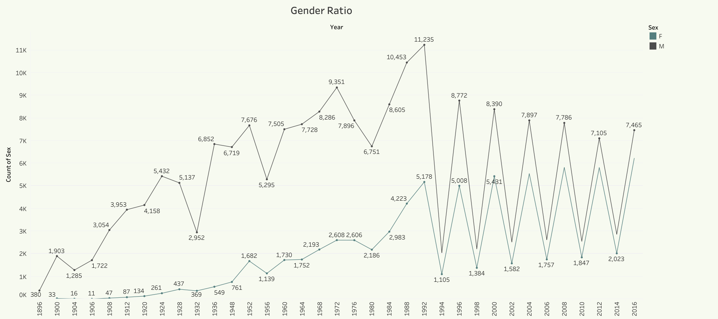
Women Participation Growth In Olympics Since from 1900
The Olympic Games have grown to be the largest, gender equal sporting event in the world.
The rate of participation of women in the Olympic Games has been increasing since their first participation in 1900. Some sports are uniquely for women, others are contested by both sexes, while some older sports remain for men only.
The first modern Olympic Games to feature female athletes was the 1900 Games in Paris. Hélène de Pourtalès of Switzerland became the first woman to compete at the Olympic Games and became the first female Olympic champion, as a member of the winning team in the first 1 to 2 ton sailing event on May 22, 1900.

Slide 4
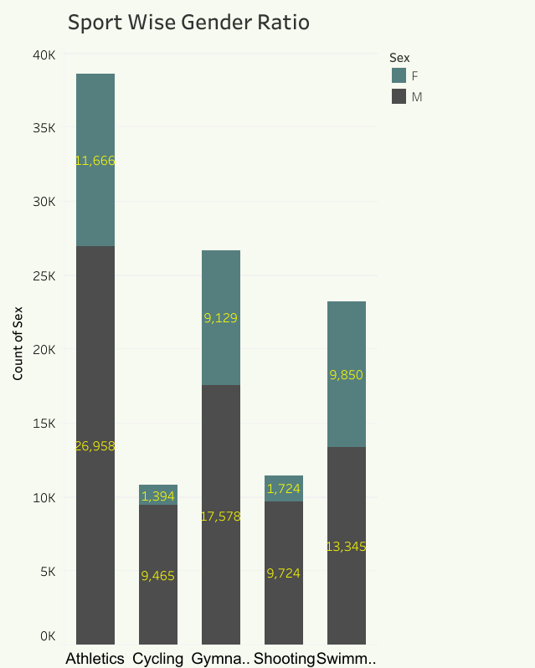
Comparison of Male and Female Participation in different sports
Gender in youth sports refers to the role and influence that both young male and females have in sports.
The participation of youth in sports is a matter that is always trying to be improved and appeal to all genders.
There are organizations across the world that are trying to improve the disparity of participation rates between boys and girls. Every sport can be played by both girls and boys.

Slide 5
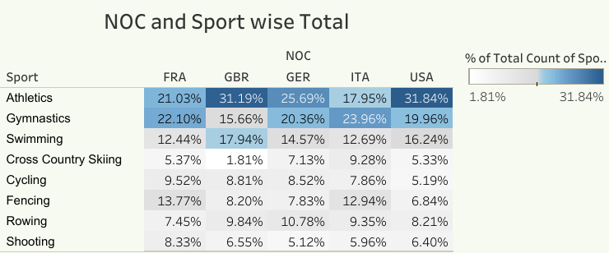
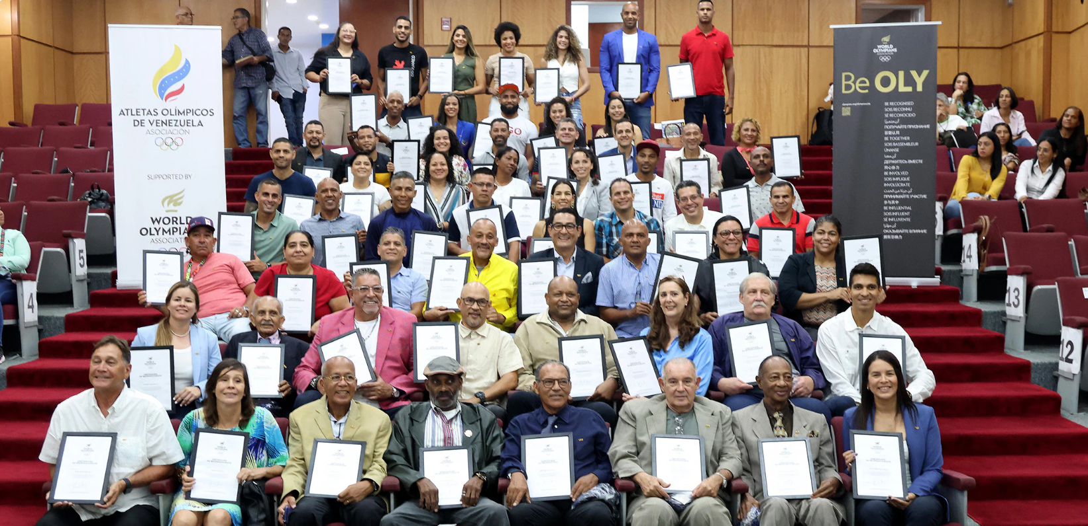
NOC Involvment For better Solympic Event
There are 206 NOCs.
The IOC is the sole authority to recognise a NOC. Together with the International Sport Federations, the NOCs are a constituent of the Olympic Movement under the leadership of the IOC.
The mission of the NOCs is to develop, promote and protect the Olympic Movement in their respective countries, in accordance with the Olympic Charter.

Slide 6
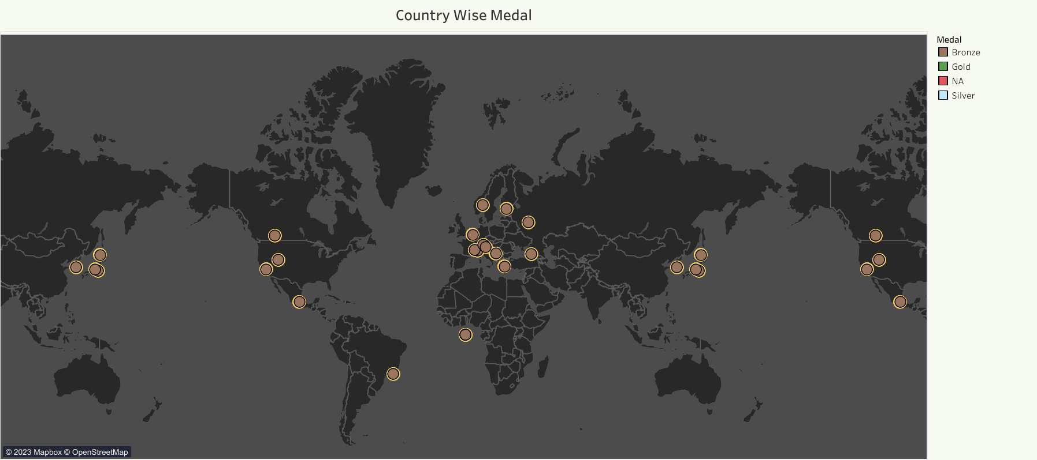
Country and Region with the Highest Medals in Olympics

Slide 7
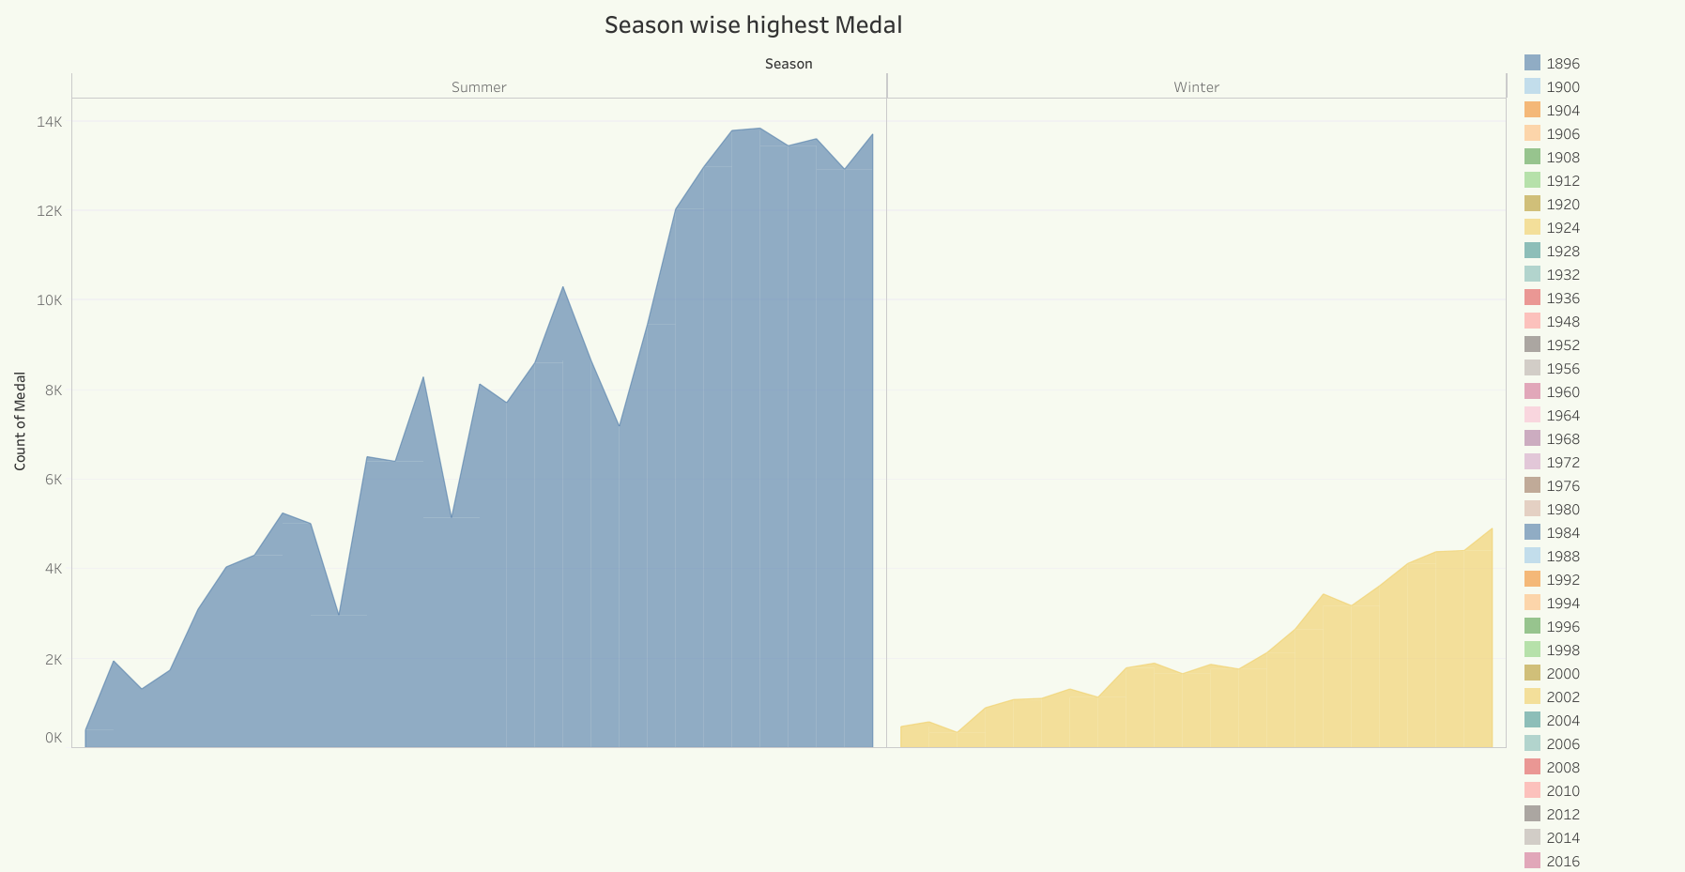
Summer Olympic and Winter Olympic
The Summer and Winter Olympic Games organized by the International Olympic Committee occur every four years.
The Summer Olympics, more popularly known as just The Olympics is a much bigger event with 206 countries participating in the 2020 Olympics held in Tokyo in 2021.
The Winter Olympics is an event on a relatively smaller scale, with 91 countries participating in the 2022 Winter Olympics in China.
Even though these events occur every four years, the summer and winter events are staggered so that there's an Olympic event every two years — the Summer Olympics are held every leap year (2016, 2020, 2024), and the Winter Olympics are held 2 years after the leap year (2014, 2018)

Slide 8
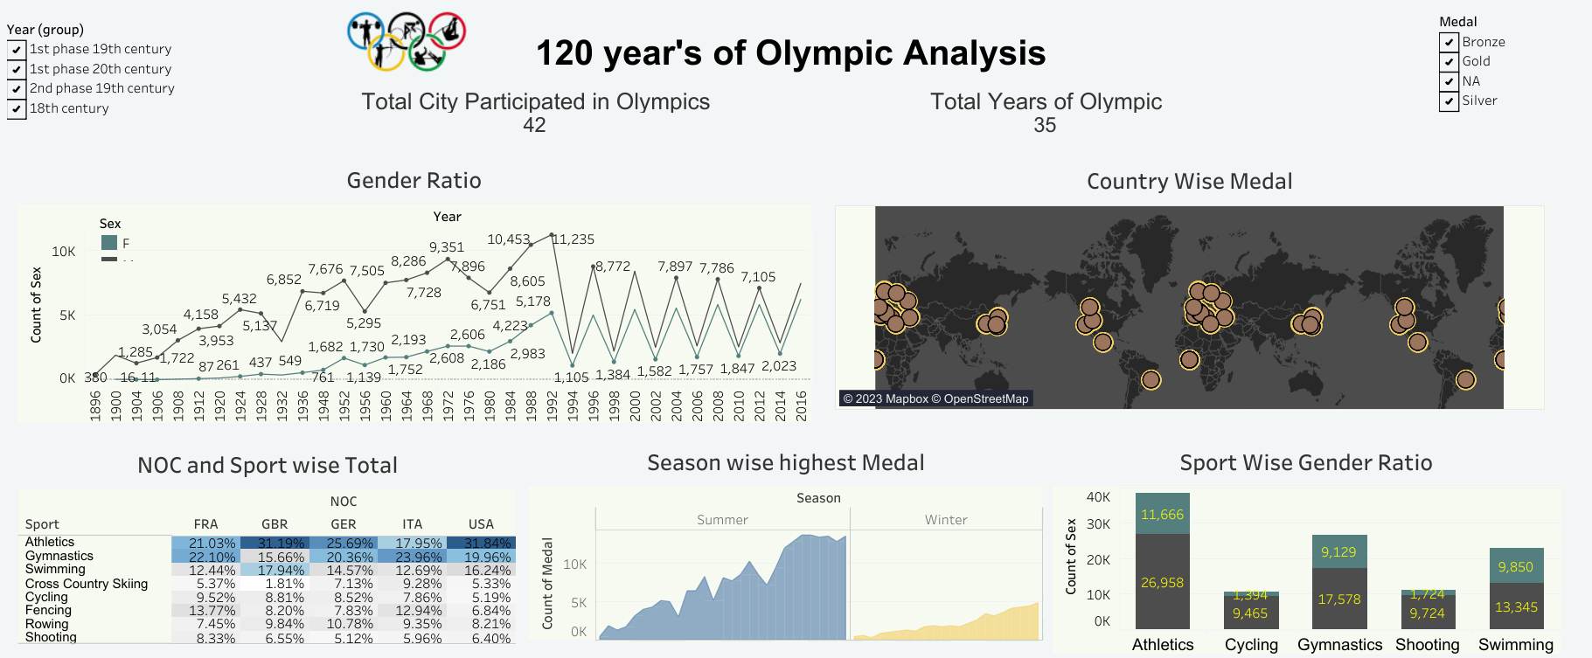
Dashboard For 120 Year’s of Olympic Analysis
https://public.tableau.com/app/profile/daksh.mandal/viz/Project_Tabaleau_presentation/CountryWiseMedal?publish=yes

