Slide 1













Image to ASCII ART
Presented By Apoorav Sharma (24bsc014) and Vishavjeet Singh (24bcs088)

Slide 2

Origin of the creative idea
The idea began with a curiosity: how can images be represented purely using characters? ASCII art has been a unique blend of computer science and creativity, and this project aimed to explore that intersection using low-level programming in C.

Slide 3
To deepen understanding of image processing, file handling, and ASCII encoding using pure C — encouraging learning through creative implementation.
01.
Project vision and mission
Promote the power of doing more with less—no heavy dependencies or GUIs, just clean, efficient code that runs fast and works across platforms.
02.
Vision: To create a minimalist yet powerful tool that converts images into character-based art using pure C.
Mission: Build an efficient, platform-independent CLI tool that demonstrates how image data can be interpreted creatively in resource-constrained environments.
03.
Encourage viewing programming as a medium for artistic expression, bridging the gap between logic and creativity through a visual output.

Slide 4
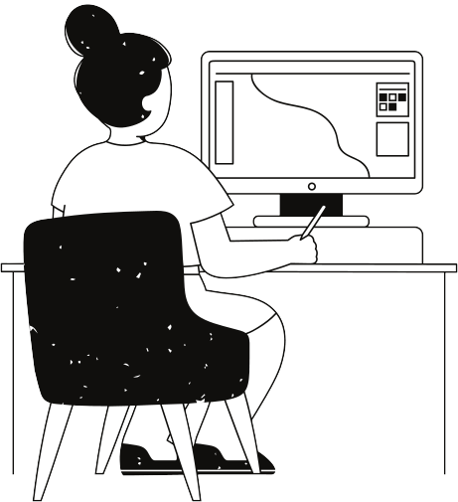
Inspiration and creativity
Inspired by old-school terminals and the early days of computing when graphical displays were limited, the project draws from retro aesthetics and the challenge of doing more with less—turning pixels into expressive characters.

Slide 5
Ideation process
01
02
03
04
Thought of converting images into text using ASCII characters—a blend of programming and visual art.
Researched how to handle image files and pixel data in C using lightweight libraries.
Designed a mapping system where brightness levels are assigned to ASCII characters based on their visual density.
Decided on command-line usage, output format (plain text), and adjustable resolution to balance performance and quality.

Slide 6

Creation process
Researched image formats and C libraries (like stb_image or lodepng).
Implemented grayscale conversion and brightness mapping.
Developed ASCII character scaling based on luminance.
Built CLI support and tested with real images.
Optimized output and handled edge cases (e.g., resizing).

Slide 7
WHY PPM?
1: No Compression or Metadata
Unlike JPEG or PNG, PPM does not use compression or complex encoding.
That makes it ideal for directly accessing pixel data without needing to decode the image using libraries.
2:Structured Pixel Data
The format directly maps each pixel’s RGB value to its position in a grid, which makes it easy to process using 2D arrays or matrices.
P3
# Example PPM file
4 2
255
#Raw RGB values:-
255 0 0 0 255 0 0 0 255 255 255 0
255 255 255 0 0 0 127 127 127 255 0 255

Slide 8
Success cases
Successfully converted multiple image formats to ppm which are then converted to ASCII.
Produced visually appealing outputs in various resolutions.
Ran efficiently even on low-end systems.
Received positive feedback from peers

Slide 9
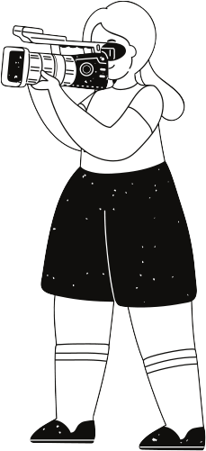
Weaknesses
Threats
Limited color support, no GUI.
Add color ASCII, animated GIF support, web integration.
Strengths
Opportunities
Lightweight, fast, pure C implementation.
Modern tools overshadowing CLI-based tools.

Slide 10
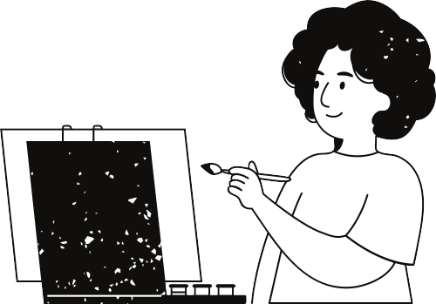
Final reflections and future steps
This project combined low-level programming with artistic expression. It deepened my understanding of file I/O, image processing, and CLI design in C.
Next Steps:
Add colored ASCII output
Build a simple GUI version
Possibly port it to WebAssembly for online use

Slide 11
Thank you very much!
Presented By Apoorav Sharma (24bsc014) and Vishavjeet Singh (24bcs088)

