Slide 1


Slide 2
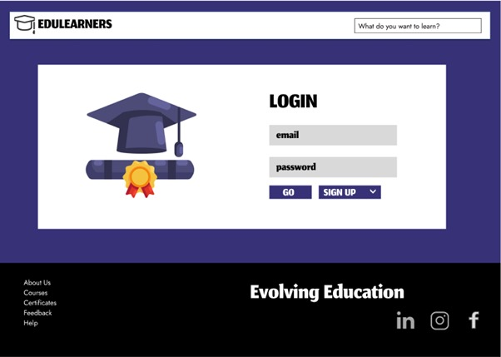

Slide 3
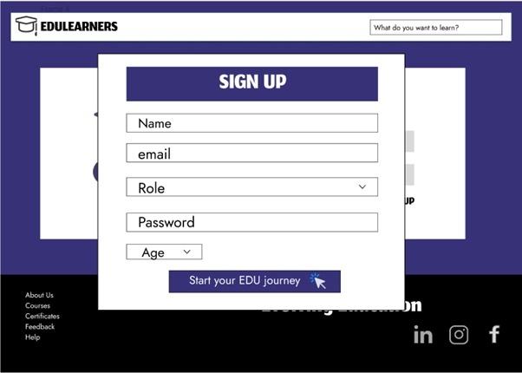

Slide 4
Kirtpreet Kaur

Slide 5
Kirtpreet Kaur
kirtpreetk@gmail.com

Slide 6
Kirtpreet Kaur
kirtpreetk@gmail.com
Teacher
Student
Working professional

Slide 7

Kirtpreet Kaur
kirtpreetk@gmail.com
Student

Slide 8

Kirtpreet Kaur
kirtpreetk@gmail.com
Student

Slide 9
Kirtpreet Kaur
kirtpreetk@gmail.com
Student
17
18
19
20
21
22
23
24

Slide 10
Kirtpreet Kaur
kirtpreetk@gmail.com
Student
21

Slide 11
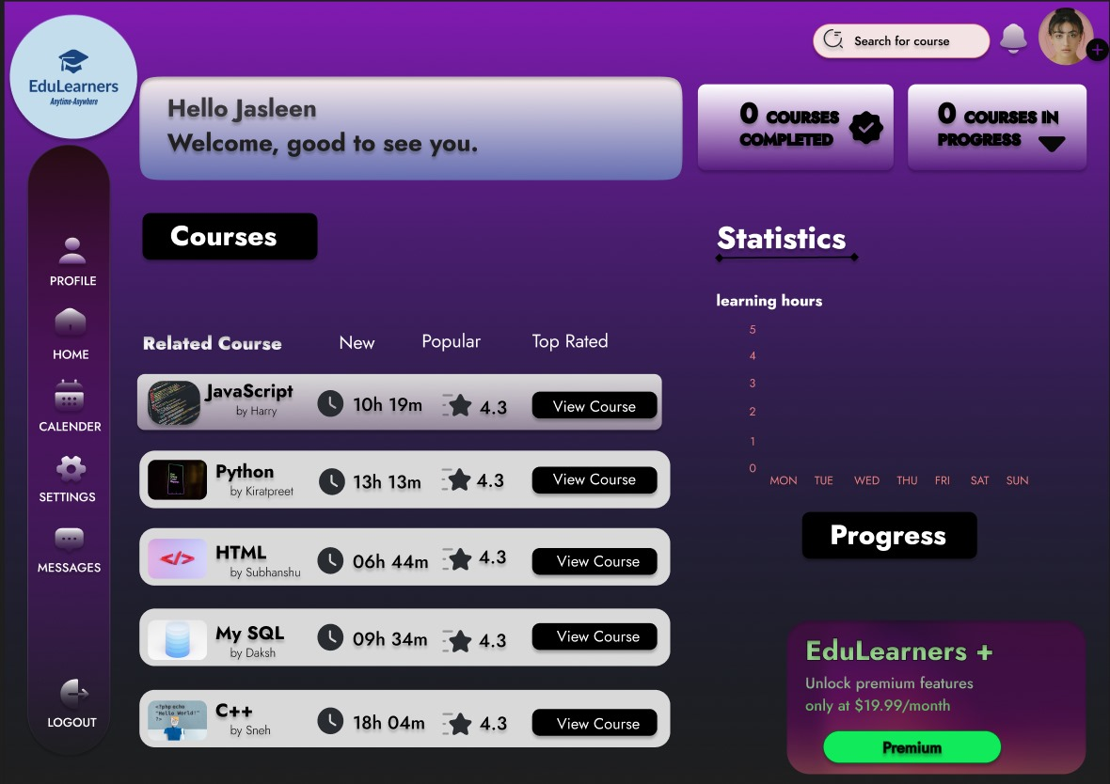

Slide 12
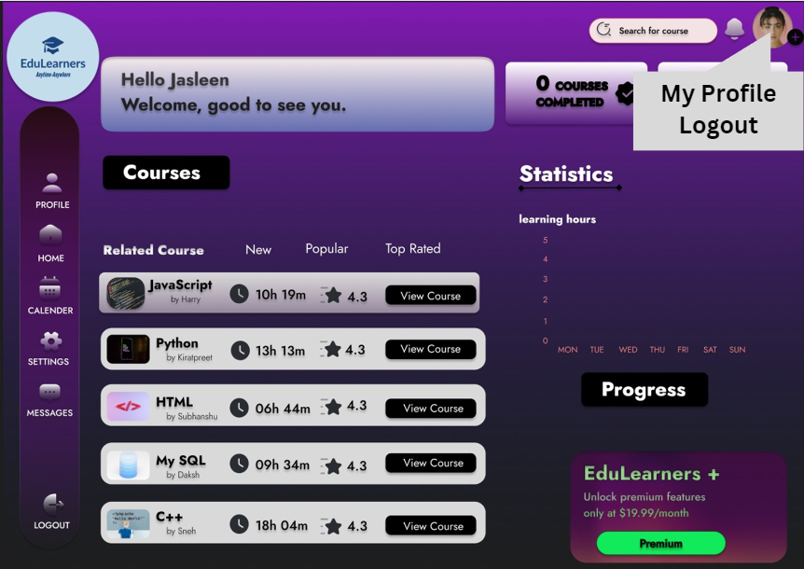

Slide 14





kirtpreetk@gmail.com

Slide 15








kirtpreetk@gmail.com

Slide 16
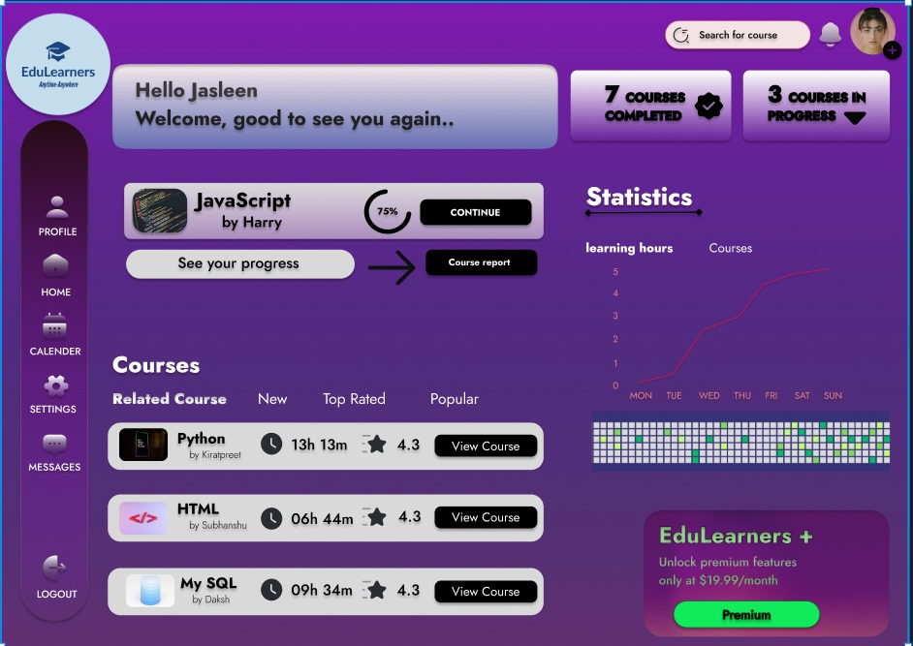

Slide 17
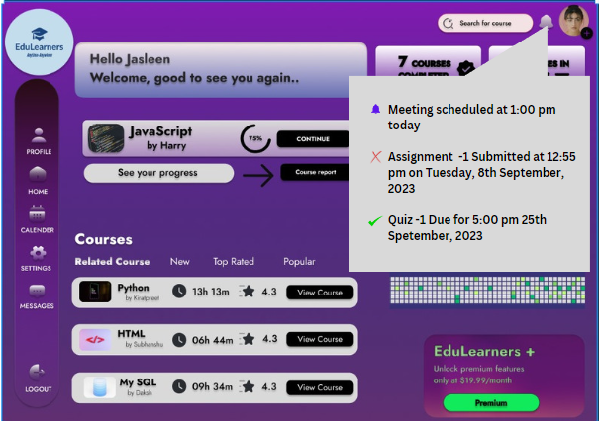

Slide 18
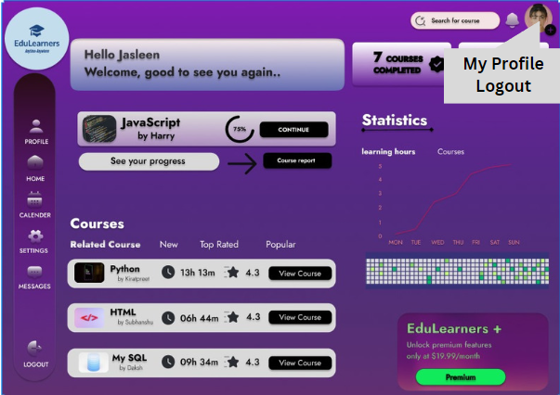

Slide 19


Slide 20
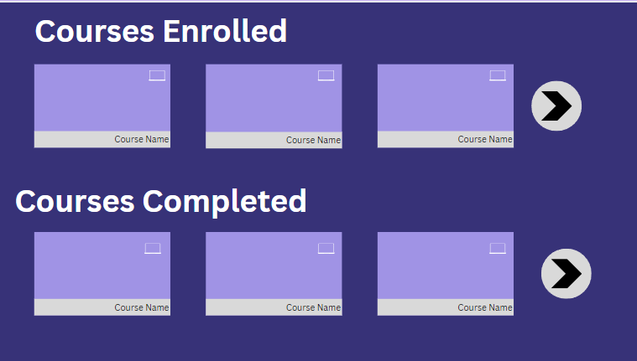
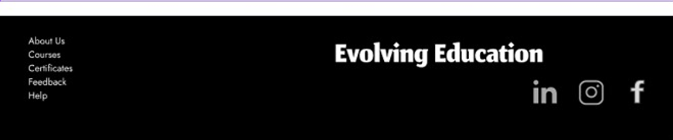

Slide 21


Slide 22
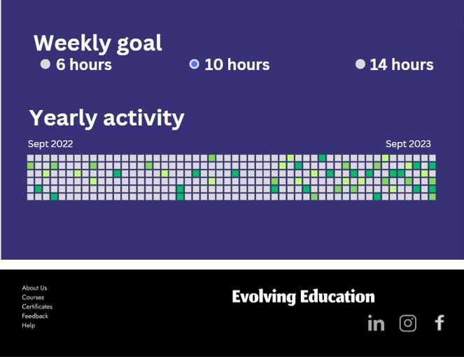

Slide 24
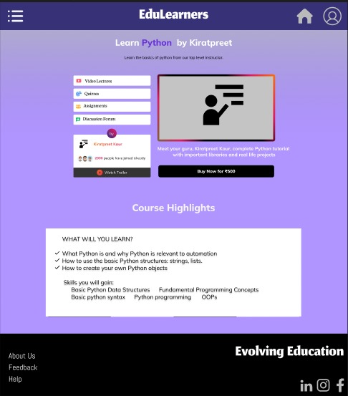

Slide 26



Slide 27
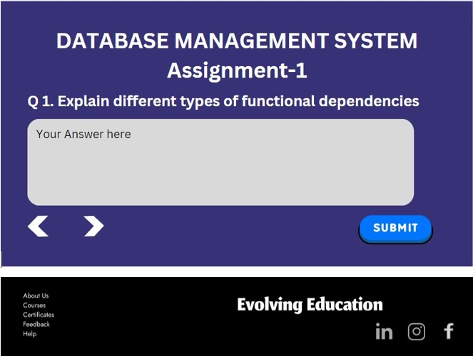

Slide 28
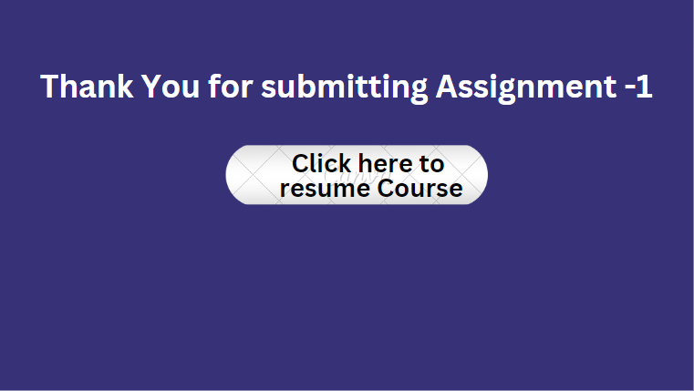

Slide 30
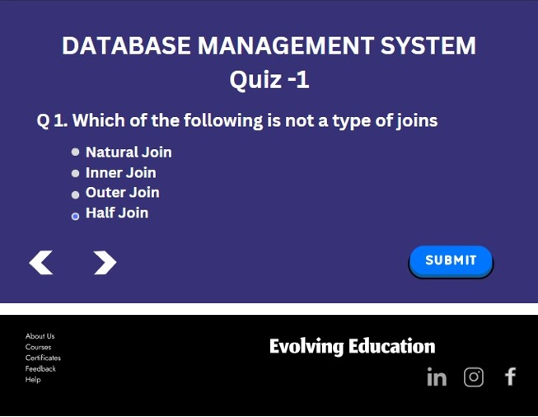

Slide 31
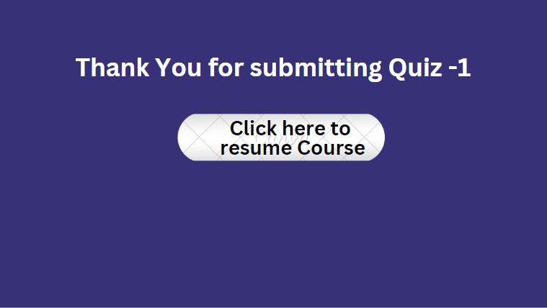

Slide 34
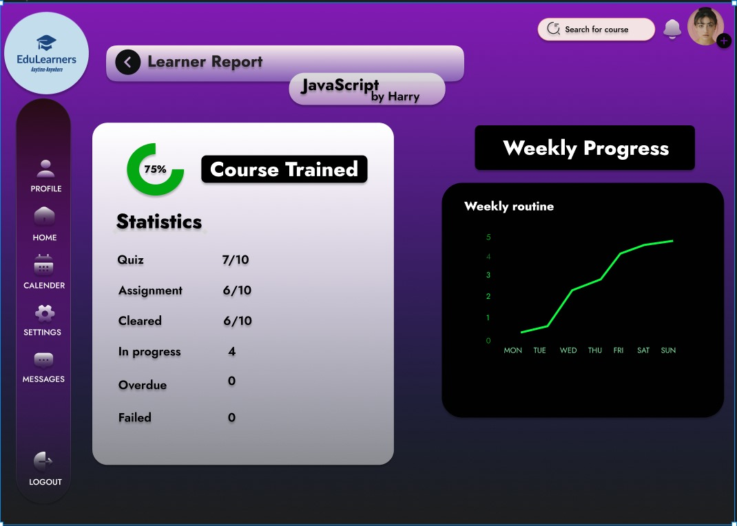

Slide 38
kirtpreetk@gmail.com

Slide 39
kirtpreetk@gmail.com

Slide 40
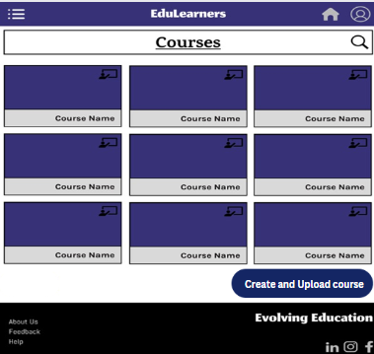










Slide 41
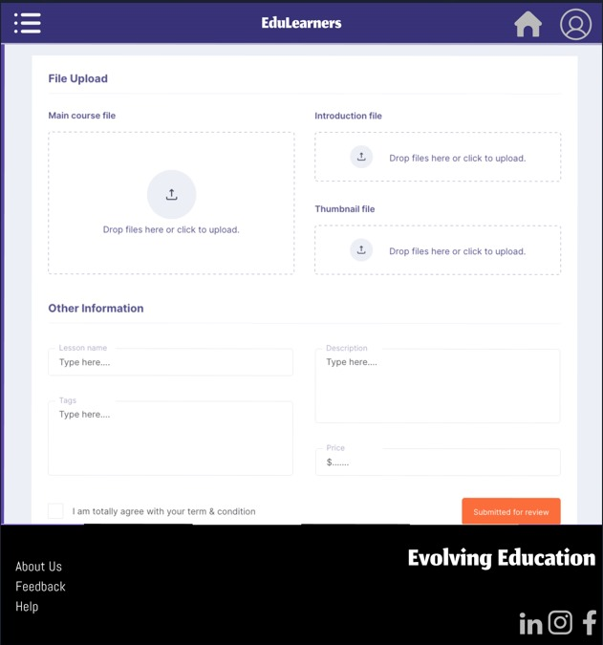

Slide 44
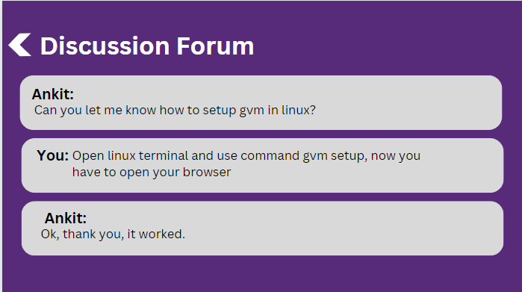
kirtpreetk@gmail.com

Slide 46
Logout

Slide 48


