Slide 1
Multifamily Risk Score
Daksha Gummadi

Slide 2
Agenda
Problem Statement
Data Sources
Key EDA Findings
Modeling Approach
Results
Recommendations

Slide 3
Problem statement
Where are rents heading next?
The pain – Investors rely on lagging reports that arrive months after the market has already changed
The gap – No tool exists that uses real econocmice sugnals to forecast rent growth before it happens
The goal – build a regression model that predicts year over year rent growth using leading economic indicatiors

Slide 4
Data Sources
Zillow ZORI - Observed Rent Index for 544 US metros
2015 to 2025 | Monthly rent in dollars
FRED Vacancy Rate - National rental vacancy rate quarterly
RRVRUSQ156N from US Census Bureau
FRED Building Permits - New housing permits issued monthly
PERMIT series in thousands of units
FRED Timber PPI - Producer Price Index for lumber
WPU081 | Construction cost signal
FRED CPI Inflation - Consumer Price Index year over year
CPIAUCSL | Purchasing power signal
FRED Unemployment - National unemployment rate monthly
UNRATE | Labor market demand signal

Slide 5
Key EDA Findings
The rental market went through a dramatic boom and bust cycle from 2020 to 2025.
Low vacancy in 2021 to 2022 gave landlords pricing power causing the rent spike.
Building permits surged to 1,900K in 2021. Those units hit the market in 2024 to 2025 causing oversupply.
Class A peaked highest at 14.5% growth. Class C was the most stable with smaller swings.
All three property classes moved together with correlations above 0.95 for rent levels.
Building permits and vacancy rate were the strongest predictors of rent growth.

Slide 6
Modeling Approach
Stationarity Test
Used Augmented Dickey Fuller test on all features. Vacancy rate, permits, and inflation failed. Applied first differencing to make them stationary before modeling.
Sliding Window
12 month window slides one month at a time. Each window predicts the 13th month. Features are mean, std, min, max over the window. Produced 43 rows with 32 features.
Train and Test Split
Chronological 80/20 split. No shuffling because this is time series data. TimeSeriesSplit with 5 folds for cross validation inside the training set.
Three Models Built
Linear Regression as baseline. Ridge Regression with alpha tuning. Random Forest with GridSearchCV tuning across n_estimators, max_depth, and min_samples_leaf.

Slide 7
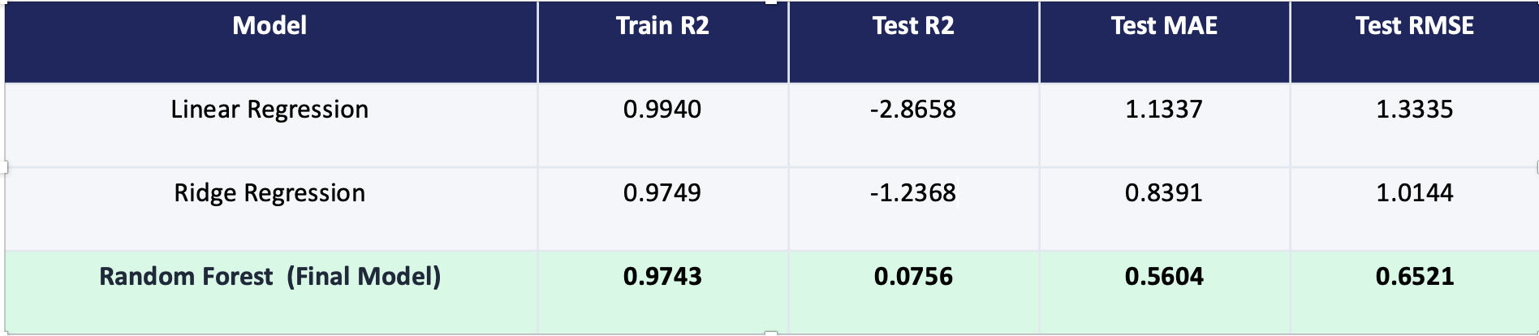
Model Results
Why random forest won?
Only model with a positive Test R2 meaning it actually learned useful patterns from the data.
Linear Regression and Ridge both scored negative Test R2 meaning they were worse than just guessing the average.
Random Forest builds many trees and averages predictions which reduces overfitting on small datasets.
Lowest prediction errors with MAE of 0.56 and RMSE of 0.65 percentage points.

Slide 8
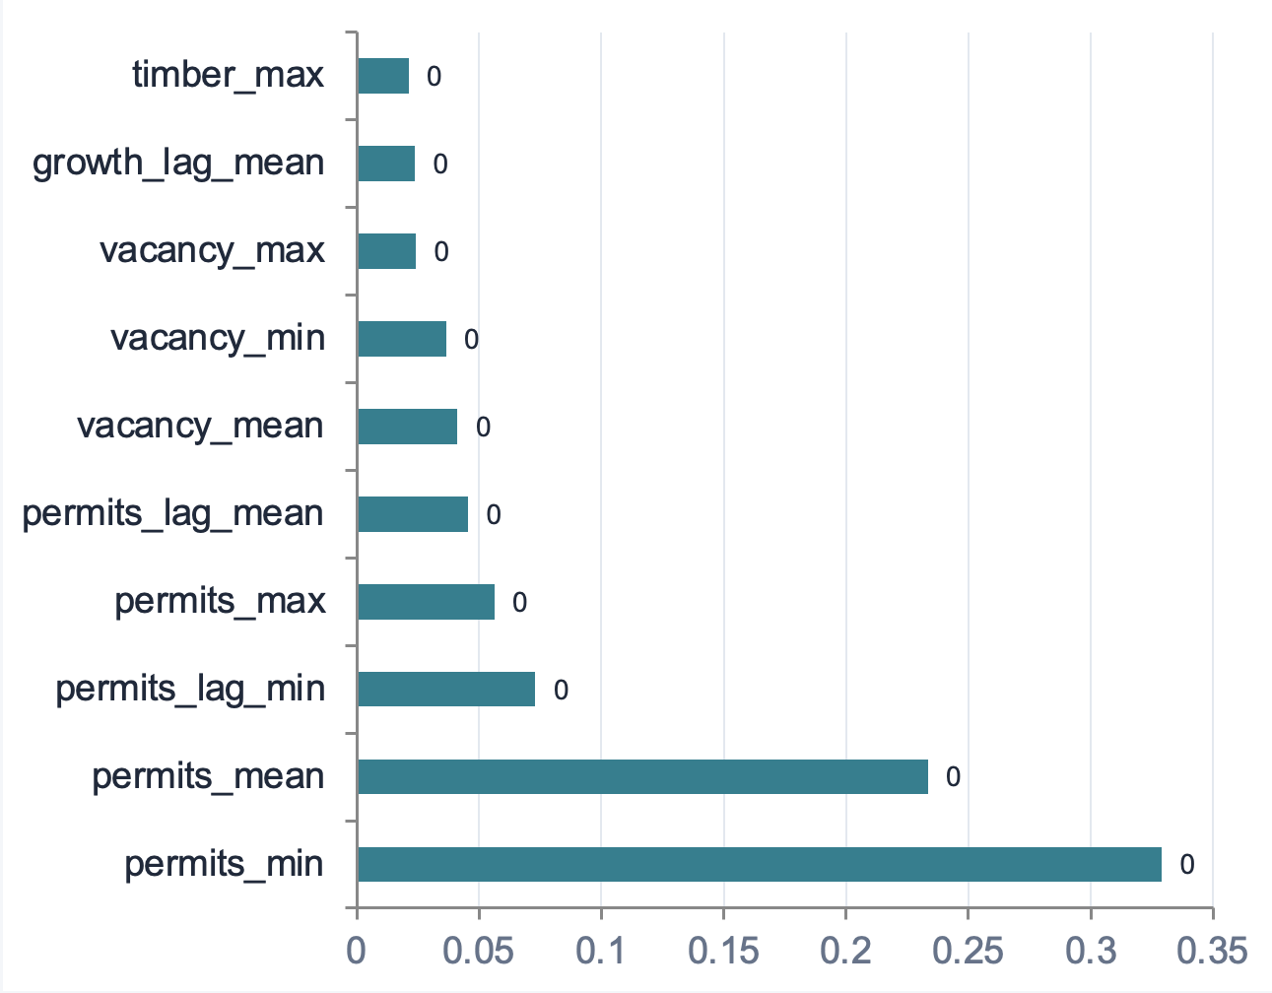
What Drove the Model
Building Permits - Dominated the model at 0.33 and 0.23. Permits predict future supply. The model learned that high permits mean future softness in rents.
Vacancy Rate - Mean, min, and max all appeared in the top features. Low vacancy gives landlords pricing power. High vacancy puts downward pressure on rents.
Economic Features - Lumber prices, inflation, and unemployment all contributed but ranked lower. They provided supporting context rather than primary signals.

Slide 9
Recommendations
Watch Buidling permits because permits were the most important predictor by a wide margin. When permits start declining from elevated levels it signals future supply pressure will ease and rents may stabilize or recover. Monitor FRED PERMIT data monthly.
Use Vacancy as a Risk Gauge because when vacancy climbs above 6.5 to 7 percent it is a strong signal that rent growth will slow or turn negative. Operators should consider locking in longer lease terms before vacancy rises to protect revenue.
Consider Class C for Stability because Class A had the biggest swings peaking at 14.5 percent then dropping to negative. Class C was more stable throughout the cycle. Investors seeking consistent returns should consider affordable housing.

Slide 10
Limitations & Future Work
Future Work
Add mortgage rate and interest rate data from FRED.
Expand to metro level modeling using the full Zillow dataset.
Test XGBoost and gradient boosting once more data is available.
Gather more historical years to grow the training set.
Limitations
Data only covers 2020 to 2025 including the unusual COVID period.
Predictions are at national average level not metro level.
Test set is only 9 months which limits score confidence.
Test R2 of 0.08 is low. Model is directionally useful but not yet production ready.

Slide 11
Thank you!
github.com/daksha-g/Multifamily-Risk-Score-Capstone

