Slide 1
ChatOps
Stackstorm - StackStorm is a platform for integration and automation across services and tools.

Slide 2
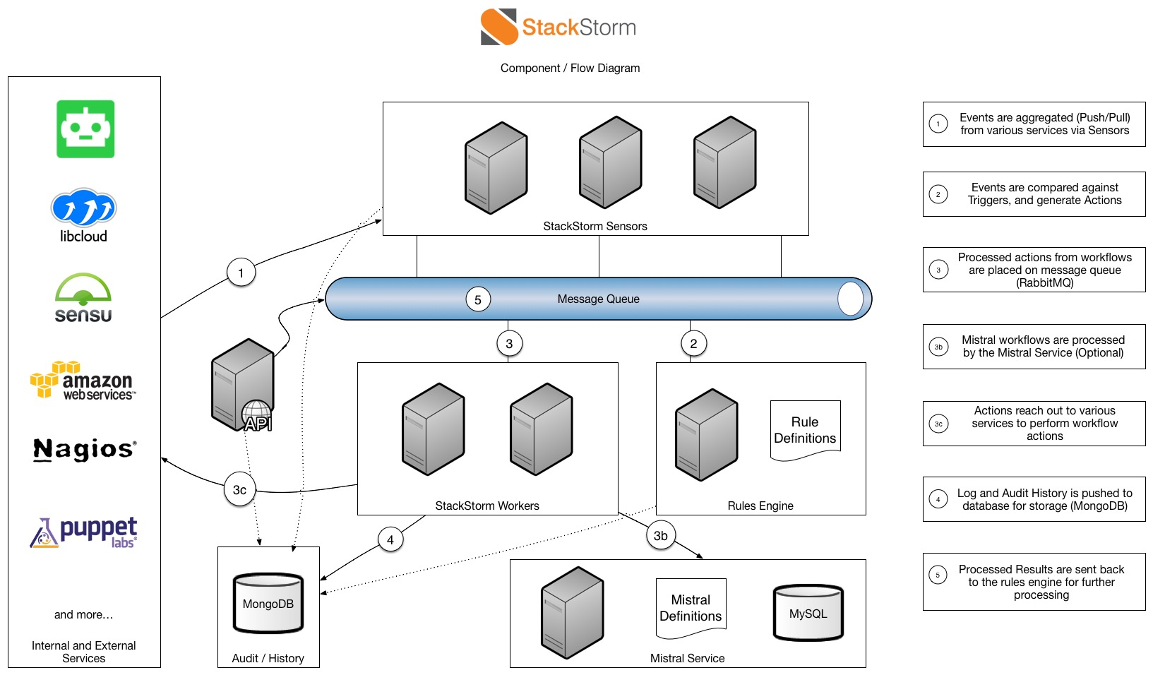
Architecture:

Slide 3
Stackstorm
Sensors - Webhooks
Actions - Commands (create, edit, delete, trigger)
Triggers - (parameters)
Rules - if this then that
Workflow - Workflows string together multiple actions: define the order, transitions, conditions, and data transformation.
Packs – tools (Agile, CI, CD tools)
IFTTT - IF THIS THEN THAT

Slide 4
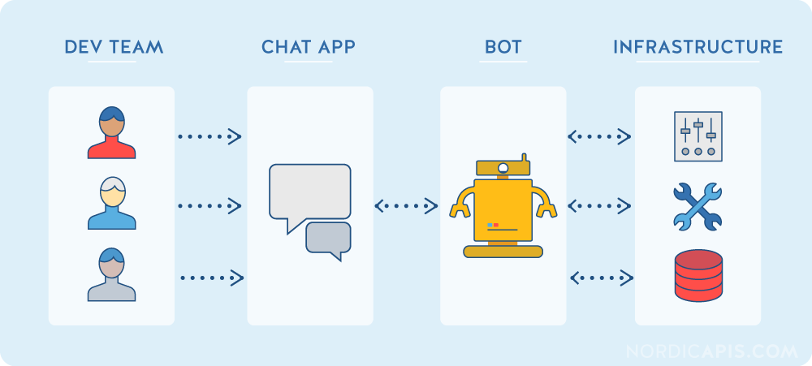
ChatOps Approach

