Slide 1
Image Classifier
by
Daksh Gupta

Slide 2
Task
Given a set of images I want to classify them as ‘spam’ or ‘notspam’. I want ‘spam’ images to be memes, images with large text content, cartoons etc., and ‘notspam’ images to be photographs of people, landscapes, etc.
After training a model, I will classify test images as ‘spam’ or ‘notspam’.

Slide 3
Dataset
I collected 3,426 images and labelled them as ‘spam’ and ‘notspam’ manually
I processed the images using OpenCV. I defined the features myself, by detecting faces, number of unique colors, detecting the area of text and detecting the area of the image covered by the top ten colors. That gave me 13 features each image.
So, my dataset has 3,426 rows and 13 columns

Slide 4
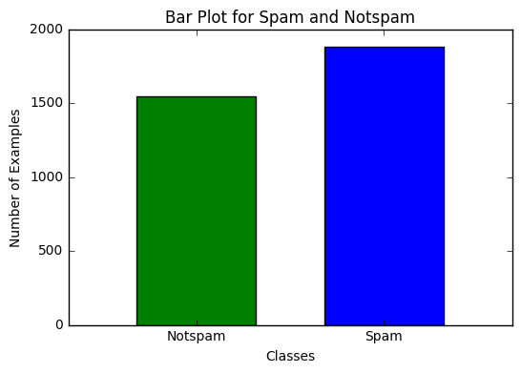
Visualization of the Class
I have 1,548 ‘notspam’ images and 1,878 ‘spam’ images.

Slide 5
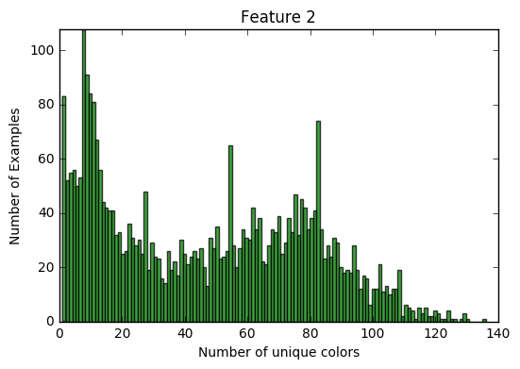
Visualization of one feature
Here I am visualizing the feature ‘Number of unique colors’. I have set a threshold of percentage of image area shared to discard noise colors from an image.

Slide 6
Model Selection Results
I used F1 Score because if F1 is high that means both precision and recall are high, which in turn means that there are very less mismatches between predicted classes and true classes.
I performed 10-fold cross validation on 100 train test splits to perform a coarse model selection between 5 classifiers. Then I performed a fine model selection on the model that performed best in coarse selection to further tweak its parameters to improve performance.
I tried 30,200 combinations for coarse model selection and 2,400 combinations for fine model selection.
Results are one the next slide

Slide 7
Model Selection Results (Coarse)
Model | Parameters | train_test_split random state | Performance
Baseline | Majority class | - | 0.7081
 | Random class | - | 0.5300
Logistic regression | C=0.03 | 97 | 0.8505
 | C=0.05 | 97 | 0.8502
MLP | alpha=0.51 | 81 | 0.8518
 | alpha=0.64 | 81 | 0.8515
SVC | C=0.03 | 42 | 0.8461
 | C=0.03 | 97 | 0.8449
MultinomialNB | default | 79 | 0.4606
 | default | 56 | 0.4589
DecisionTree | default | 0 | 0.8442
 | default | 18 | 0.8379

Slide 8
Model Selection Results (Fine)
random_state | activation | hidden_layer_sizes | solver | Performance
29 | relu | (33,33,33) | lbfgs | 0.8712
9 | relu | (100) | lbfgs | 0.8693
26 | tanh | (50,50) | lbfgs | 0.8689
45 | tanh | (100) | lbfgs | 0.8689
30 | relu | (25,25,25,25) | lbfgs | 0.8656
40 | logistic | (33,33,33) | lbfgs | 0.8571
25 | tanh | (25,25,25,25) | adam | 0.8546
48 | relu | (50,50) | adam | 0.8542
39 | identity | (33,33,33) | lbfgs | 0.8533
41 | identity | (100) | adam | 0.8533
7 | tanh | (25,25,25,25) | sgd | 0.8523

Slide 9
Best Parameters
The best model was MLPClassifier at the train_test_split random state 81, with parameters:
alpha=0.51
shuffle = False
learning_rate = adaptive
max_iter = 500
random_state = 29
activation = relu
solver = lbfgs
hidden_layer_sizes = (33, 33, 33)

Slide 10
Top Features
My model is a Neural Network, so I don’t know what the best features for my model are.
The selected MLP Classifier has 3 hidden layers with 33 neurons in each layer.
The activation function for these neurons is rectified linear unit (relu).

Slide 11
Interesting/unexpected cases
The classifier didn’t misclassify any spam images as ‘notspam’, but it did classify ‘notspam’ images as ‘spam’
The next few slides have some ‘notspam’ labelled images that have been labeled as ‘spam’
The training data has instances very similar to those that have been misclassified.

Slide 12

Interesting/unexpected cases
This image should have been classified as ‘notspam’ because the training data contains a very similar image as this one. I can’t determine the exact reason for this being classified as ‘spam’

Slide 13
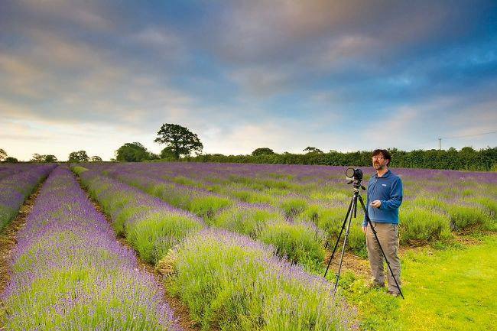
Interesting/unexpected cases

Slide 14
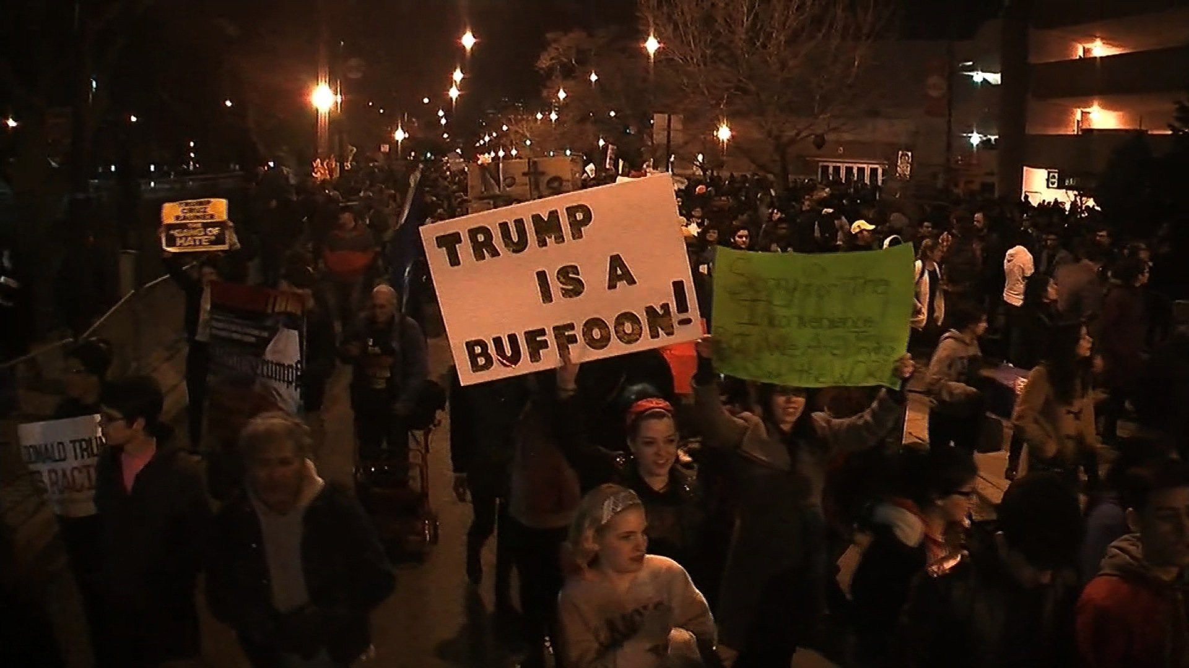
Interesting/unexpected cases
This image and the image on the next slide may have been classified as ‘spam’ because of large percentage of image is covered by the same shade of color.

Slide 15
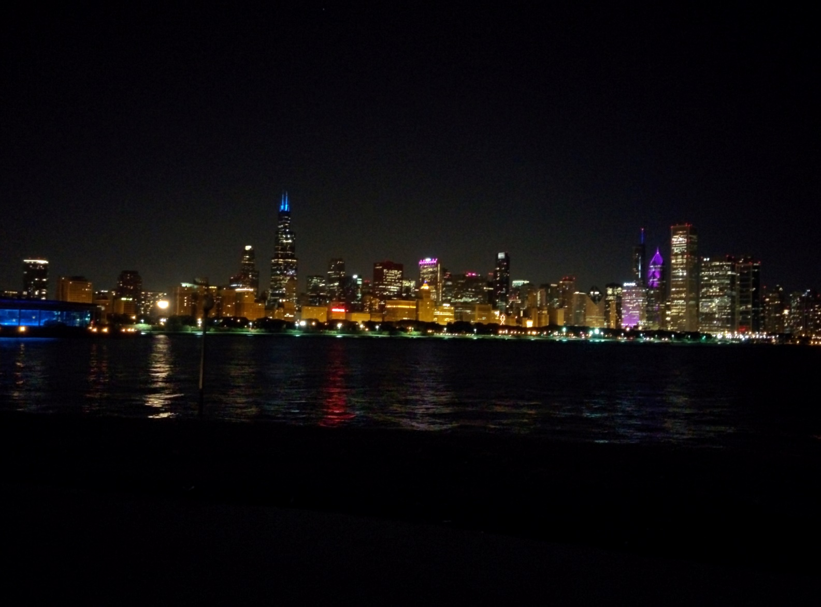
Interesting/unexpected cases

Slide 16
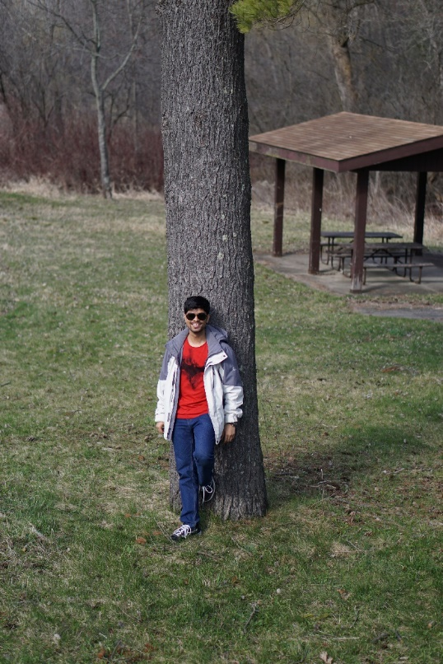
Interesting/unexpected cases
This image contains a face, lots of colors but many distinct edges. Maybe that’s what confused the classifier to tag it as ‘spam’

