Slide 1

BIRLA INSTITUTE OF TECHNOLOGY, MESRA
EE400M MINOR PROJECT
“Adaptive Control-Driven AI for Prostate Cancer”
under
Department of Electrical and Electronics Engineering
Team Members
Daksh Abrol (BTECH/10022/21)
Chaitanya Khare (BTECH/10448/21)
Project Supervisor
Dr. Surendra Kumar
Dr. Sanjeev Kumar

Slide 2
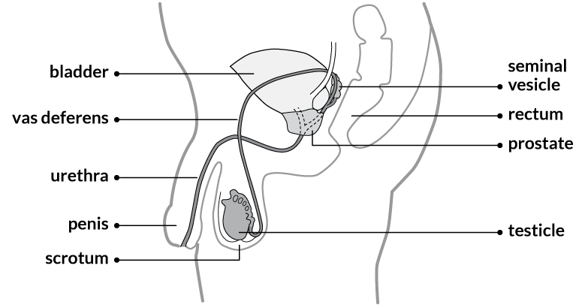
PROSTATE CANCER
A malignant tumor that develops in the prostate gland, a small gland in the male reproductive system.
It is the second most common cancer in men worldwide.
Early detection and treatment are crucial for better outcomes.
WHY STUDY THIS?
Epidemiology and statistics
Risk factors
Importance of early detection
Fig. 1 — location of the prostate

Slide 3
continued…
Epidemiology and Statistics
In 2020, an estimated 1.4 million men were diagnosed with prostate cancer globally.
It is the fifth leading cause of cancer death in men.
The incidence of prostate cancer varies widely across regions and populations.
Risk Factors
Age: The risk increases with age, most cases diagnosed in men over 65.
Family history: Having a father or brother with prostate cancer increases risk.
Race/ethnicity: More common in African American men.
Lifestyle factors: Diet and obesity may play a role.
Importance of Early Detection
Early-stage prostate cancer often has no symptoms.
Prostate cancer can be slow-growing or aggressive.
Early detection allows for more treatment options and better chances of survival.

Slide 4
CHALLENGES IN PROSTATE CANCER DIAGNOSIS
LIMITATIONS OF DIAGNOSTIC METHODS
PSA TESTS — Often elevated due to benign issues like prostatitis or benign prostatic hyperplasia (BPH), leading to low specificity and unnecessary biopsies.
BIOPSIES — Invasive with risks of complications; they can miss significant cancers due to sampling errors.
OVERDIAGNOSIS AND OVERTREATMENT
Detection of indolent cancers that may not require intervention, resulting in unnecessary treatments that can adversely affect quality of life.
NEED FOR PERSONALIZED APPROACH
Emphasis on accurately identifying aggressive cancers and customizing treatment based on individual risk factors to improve outcomes and minimize overtreatment.

Slide 5
LITERATURE REVIEW
S.NO. | AUTHORS | TITLE OF PAPER | MERITS | DEMERITS
1 | Iqbal et al. | Prostate cancer detection using deep learning and traditional techniques. | Deep learning methods achieved 100% accuracy and AUC, outperforming non-deep methods​. | LSTM models face gradient issues and are feed-forward only.
2 | Mehralivand et al. | Deep learning-based artificial intelligence for prostate cancer detection at biparametric MRI. | Higher sensitivity (up to 95.3%) aids accurate lesion detection​. | Higher false positives per patient (up to 1.90 lesions) complicates results.
3 | Abbasi et al. | Detecting prostate cancer using deep learning convolution neural network with transfer learning approach. | High prostate cancer detection accuracy of 100% using GoogleNet CNN model. | Requires large datasets and high computational power for CNN training.
4 | Tătaru et al. | Artificial Intelligence and Machine Learning in Prostate Cancer Patient Management—Current Trends and Future Perspectives. | AI models improve prostate cancer detection accuracy to over 90%​ | AI integration requires large datasets, increasing computational costs significantly​

Slide 6
LITERATURE REVIEW
S.NO. | AUTHORS | TITLE OF PAPER | MERITS | DEMERITS
5 | Michaely et al. | Current Value of Biparametric Prostate MRI with Machine-Learning or Deep-Learning in the Detection, Grading, and Characterization of Prostate Cancer: A Systematic Review. | High accuracy (up to 98.4%) in detecting clinically significant prostate cancer. | Limited standardization in imaging sequences causing inconsistent results across studies.
6 | De Vente et al. | Deep Learning Regression for Prostate Cancer Detection and Grading in Bi-Parametric MRI. | The method achieved a moderate weighted kappa score of 0.446, indicating fair agreement. | Low Dice similarity coefficient of 0.370, indicating suboptimal segmentation accuracy​
7 | Tolkach et al. | High-accuracy prostate cancer pathology using deep learning. | High accuracy for tumor detection (97.3%) with efficient Gleason grading. | Dependency on extensive annotations and validation limits scalability
8 | Chiu et al. | Enhancement of prostate cancer diagnosis by machine learning techniques: an algorithm development and validation study. | Machine learning models, especially RF, achieved 52% fewer unnecessary biopsies. | Limited external validation with the same hospital cohort only.

Slide 7
MOTIVATION
Health Importance: Early detection of prostate cancer is vital for improving treatment outcomes and survival rates.
Limitations of Current Diagnostics: Existing methods, such as PSA tests and biopsies, often lack specificity and can be invasive, leading to unnecessary procedures.
AI Integration: Utilizing Artificial Intelligence (AI) can enhance diagnostic accuracy by analyzing complex medical data, including imaging and genetic information.
Adaptive Control Systems: Implementing adaptive control allows for continuous monitoring and real-time adjustments to treatment plans, optimizing personalized care.
Improving Patient Outcomes: The goal is to provide healthcare professionals with advanced tools for tailored interventions, ultimately enhancing patient care and reducing mortality rates.

Slide 8
RESEARCH GAP
Addressing Identified Gaps
Lack of large-scale, multi-institutional datasets and comprehensive models for accurate prostate cancer detection, grading, and reducing false positives in diagnostic algorithms.
Integrating Merits of Reviewed Papers
Deep learning optimizes prostate cancer detection and grading using MRI, enhancing biopsy decisions, reducing false positives, improving predictive accuracy, and facilitating automated diagnostic efficiency.
Focus Areas
Prioritize feature extraction, AI-driven diagnostics, and adaptive control systems to create a dynamic framework for personalized treatment strategies, addressing limitations in existing literature.

Slide 9
OBJECTIVES OF RESEARCH
Conduct correlation analysis on National Cancer Institute dataset to derive preliminary AI insights.
Develop AI models by integrating imaging and genetic data for precise feature extraction.
Evaluate Model Predictive Control (MPC) for personalized prostate cancer treatments.

Slide 10
RESEARCH HYPOTHESES
HYPOTHESES AND CORRELATION RESULTS
SMOKING AND BMI — Smoking may influence BMI, with a weak positive correlation of 0.077, suggesting lifestyle factors that could impact prostate cancer risk.
PSA SCREENING AND PROSTATE CANCER — PSA results can evaluate screening effectiveness, showing a weak positive correlation of 0.167 for further investigation patterns.
SMOKING AND DIABETES — Long-term smoking may link to diabetes, indicated by a very weak positive correlation of 0.042, highlighting broader health implications.
FAMILY HISTORY AND AGE OF ONSET— A family history of prostate cancer might correlate with earlier onset, but data limitations yield a correlation of NaN.
TREATMENT AND CANCER STAGE — Initial treatment relationship with prostate cancer stage at diagnosis shows a weak negative correlation of -0.236, offering insights into treatment effectiveness.

Slide 11
PROBLEM DEFINITION
Research Problem
Investigate the impact of adaptive control-driven AI on early detection and personalized treatment of prostate cancer.
Research Questions
Which AI models enhance detection?
What features guarantee accuracy?
Can Model Predictive Control (MPC) elevate treatment efficacy and patient outcomes?

Slide 12
METHODOLOGY
Data Acquisition
Utilize the National Cancer Institute (NCI) dataset with patient data, medical imaging, and genetic markers.
Preprocessing
Apply standardization and normalization to ensure data quality.
AI Model Development
Develop and validate AI models for early detection of prostate cancer.
Model Predictive Control (MPC)
Evaluate MPC for optimizing treatment strategies based on disease progression predictions.
Performance Evaluation
Assess model effectiveness using metrics such as accuracy, sensitivity, and specificity.

Slide 13
TOOLS AND TECHNIQUES USED
AI Algorithms
Random Forest Method
CNN
KNN
Software & Hardware Infrastructure
Languages: Python,
Libraries: TensorFlow, PyTorch
Application: Jupyter Notebook, Google Colab Notebook

Slide 14
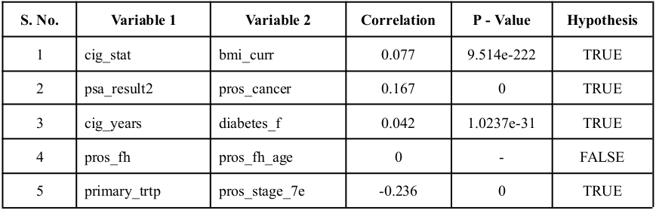
HYPOTHESIS VALIDITY
Five hypotheses were tested for correlation and validated using P-values. Results are summarized in the table and graphs below. Out of the five, only one hypothesis was found to be false, determined by a P-value greater than 0.05, indicating that the others are true.

Slide 15
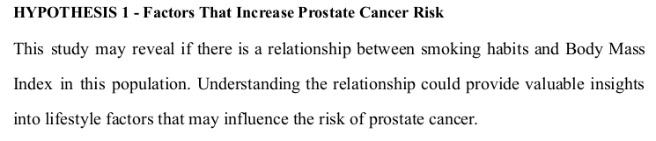
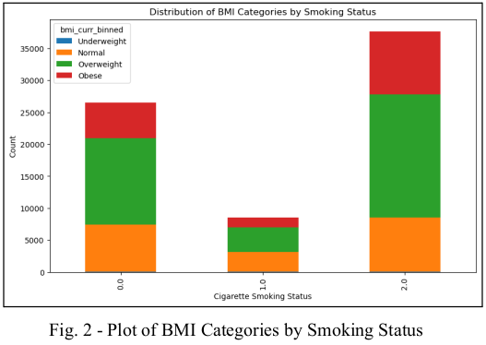

Slide 16
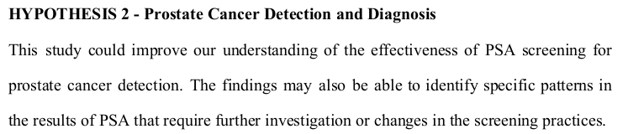
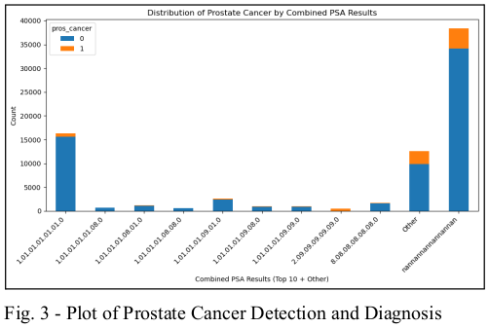

Slide 17
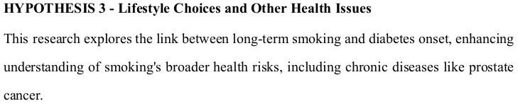
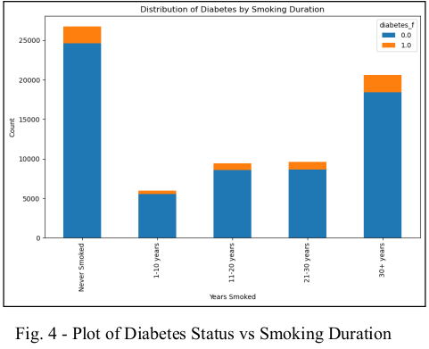

Slide 18
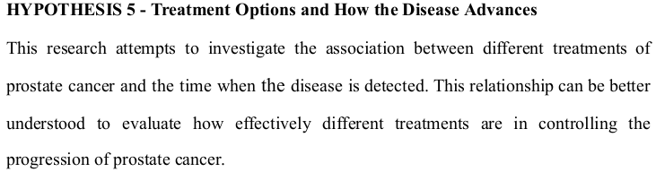
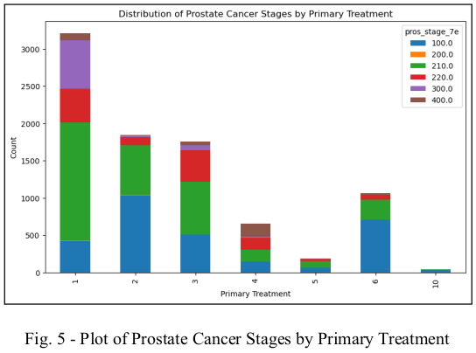

Slide 19
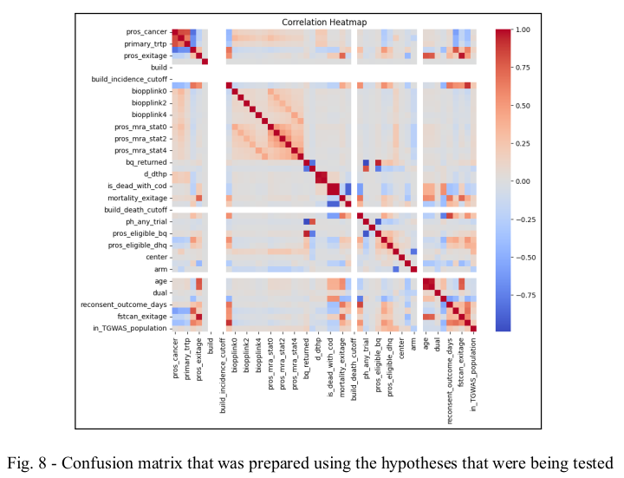
CORRELATION MATRIX
Expected Outcomes
Early Detection: Improved accuracy through analysis of medical imaging, genetic markers, and patient histories.
Personalized Treatment: Continuous health monitoring using control systems for tailored treatment plans.
Reduced Mortality Rates: Early detection and personalized strategies aim to lower mortality.

Slide 20
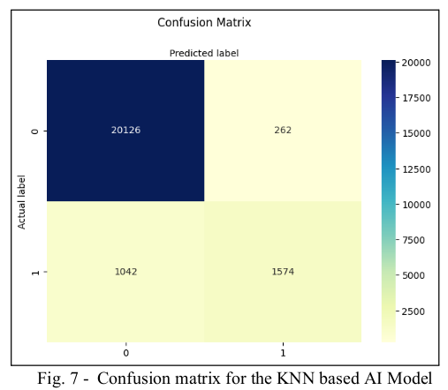
RESULTS
Key Findings
The KNN algorithm excelled in predicting outcomes from large datasets, achieving 80% accuracy with an 80/20 training/testing split.
A correlation heatmap validated hypotheses and informed AI model training.

Slide 21
RESULTS
 | Precision | Recall | f1-score | Support
0 | 0.95 | 0.99 | 0.97 | 20388
1 | 0.86 | 0.6 | 0.71 | 2616
Accuracy |  |  | 0.94 | 23004
Macro avg. | 0.9 | 0.79 | 0.84 | 23004
Weighted avg. | 0.94 | 0.94 | 0.94 | 23004
TABLE 2: Results showing accuracy of the Model
Optimal KNN Accuracy: 94.33%
Logistic Regression Accuracy: 68.00%
Neural Network Accuracy: 70.00%

Slide 22
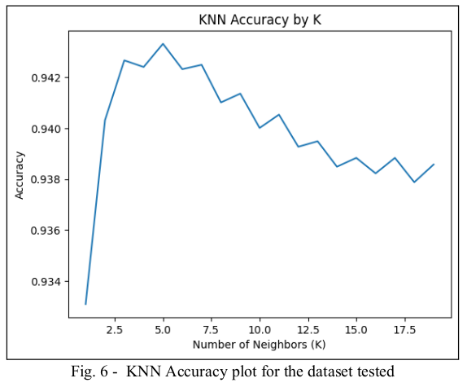
RESULTS
This framework aims to transform prostate cancer management by enhancing diagnostic accuracy, personalizing treatments, and reducing mortality rates. This version maintains the essential information while being more concise.

Slide 23
CONCLUSION
Impact on Management
Enhanced diagnostics and patient outcomes.
Lower healthcare costs through early detection.
AI Enhancements
Improved detection accuracy; fewer unnecessary biopsies.
Personalized treatment via adaptive strategies.
Future Research
Validate AI frameworks across diverse datasets.
Explore new AI models and user-friendly interfaces.
Transformative Potential
Significant advancements in early detection and treatment.
Goal: Reduce prostate cancer mortality rates.

Slide 24
REFERENCES
S. Iqbal et al., “Prostate cancer detection using deep learning and traditional techniques,” IEEE Access, vol. 9, pp. 27085–27100, Jan. 2021, doi: 10.1109/access.2021.3057654.
S. Mehralivand et al., “Deep learning-based artificial intelligence for prostate cancer detection at biparametric MRI,” Abdominal Radiology, vol. 47, no. 4, pp. 1425–1434, Jan. 2022, doi: 10.1007/s00261-022-03419-2.
A. A. Abbasi et al., “Detecting prostate cancer using deep learning convolution neural network with transfer learning approach,” Cognitive Neurodynamics, vol. 14, no. 4, pp. 523–533, Apr. 2020, doi: 10.1007/s11571-020-09587-5.
O. S. Tătaru et al., “Artificial Intelligence and Machine Learning in Prostate Cancer Patient Management—Current Trends and Future Perspectives,” Diagnostics, vol. 11, no. 2, p. 354, Feb. 2021, doi: 10.3390/diagnostics11020354.
H. J. Michaely, G. Aringhieri, D. Cioni, and E. Neri, “Current Value of Biparametric Prostate MRI with Machine-Learning or Deep-Learning in the Detection, Grading, and Characterization of Prostate Cancer: A Systematic Review,” Diagnostics, vol. 12, no. 4, p. 799, Mar. 2022, doi: 10.3390/diagnostics12040799.
C. De Vente, P. Vos, M. Hosseinzadeh, J. Pluim, and M. Veta, “Deep learning regression for prostate cancer detection and grading in Bi-Parametric MRI,” IEEE Transactions on Biomedical Engineering, vol. 68, no. 2, pp. 374–383, May 2020, doi: 10.1109/tbme.2020.2993528.
Y. Tolkach, T. Dohmgörgen, M. Toma, and G. Kristiansen, “High-accuracy prostate cancer pathology using deep learning,” Nature Machine Intelligence, vol. 2, no. 7, pp. 411–418, Jul. 2020, doi: 10.1038/s42256-020-0200-7.
P. K.-F. Chiu et al., “Enhancement of prostate cancer diagnosis by machine learning techniques: an algorithm development and validation study,” Prostate Cancer and Prostatic Diseases, vol. 25, no. 4, pp. 672–676, Jul. 2021, doi: 10.1038/s41391-021-00429-x.

