Slide 1

Faculty of Engineering and Technology
Department of Computer Science and Engineering
Interim-Project Presentation
A Lightweight Self-Supervised Framework for Text Representation Learning Using Masked Latent Prediction
Batch PB93
Team Details
R Daksha Subramanya: ____
Sudeep S S Suvarna: ____
Akash U S: ____
Mentor
Dr. Prabadevi B
Associate Professor
Dept. of CSE, MSRUAS, Bengaluru

Slide 2
Outline
Introduction and approved problem statement
Literature survey and identified research gap
Approved objectives and objective-wise progress
Methodology and system architecture
Dataset and computing requirements
HPC / GPU resource usage
Implementation evidence and preliminary results
Live demonstration
Remaining work, timeline and risks
SDG alignment and conclusion
References

Slide 3
Introduction and approved problem statement
A small encoder on one free GPU cannot imitate BERT-scale pretraining; what it is trained to predict decides what its representation is worth.
MLM predicts token identity, so the target is lexical — and our own measurement shows 30% of masked positions have five or more plausible fillers.
Approved problem: predict a masked latent from a frozen EMA teacher instead, and measure whether representation quality improves without collapse.
Scope: one shared 4-layer encoder, identical data and token budget across conditions, free GPU only.

Slide 4
Literature survey and identified research gap
BERT (Devlin et al., 2019) — masked-token prediction: strong transfer, but the target is defined over the vocabulary, never over meaning.
MAE (He et al., 2022), BEiT — latent targets beat raw-input targets in vision, because the prediction happens in representation space.
BYOL, SimSiam, VICReg, DINO — self-distillation from an EMA teacher, plus an explicit guard against collapse.
Gap: latent-target self-supervision is well characterised for vision, thinly characterised for small text encoders at student-scale budgets.
This work measures the trade-off directly: one encoder, conditions A/B/C, collapse by effective rank, transfer by a frozen linear probe.

Slide 5
Approved Objectives and Objective-wise Progress:
Status against the approved proposal; every row is backed by a file in the repository.
Approved objective | Work completed | Evidence | Status
Objective 1: Survey representation-learning methods | Compared MLM with latent-target self-supervision; fixed the comparison protocol | docs/EXPERIMENT_PROTOCOL.md; literature table | Completed
Objective 2: Dataset and masking pipeline | WikiText-2/103 loaders, independent + span masking, corpus statistics | src/data.py; tests/test_data.py | Completed
Objective 3: Shared encoder and latent objectives | 4-layer encoder, MLM control, latent recipes A/B, EMA teacher, checkpoints | src/model.py, objectives.py, train.py; 55 tests | Completed
Objective 4: Collapse vs transfer characterisation | Geometry, frozen probe and ambiguity analysis run; full-budget sweep in progress | results/person1/*.json; PERSON1_LONG_PILOT.md | Partial

Slide 6
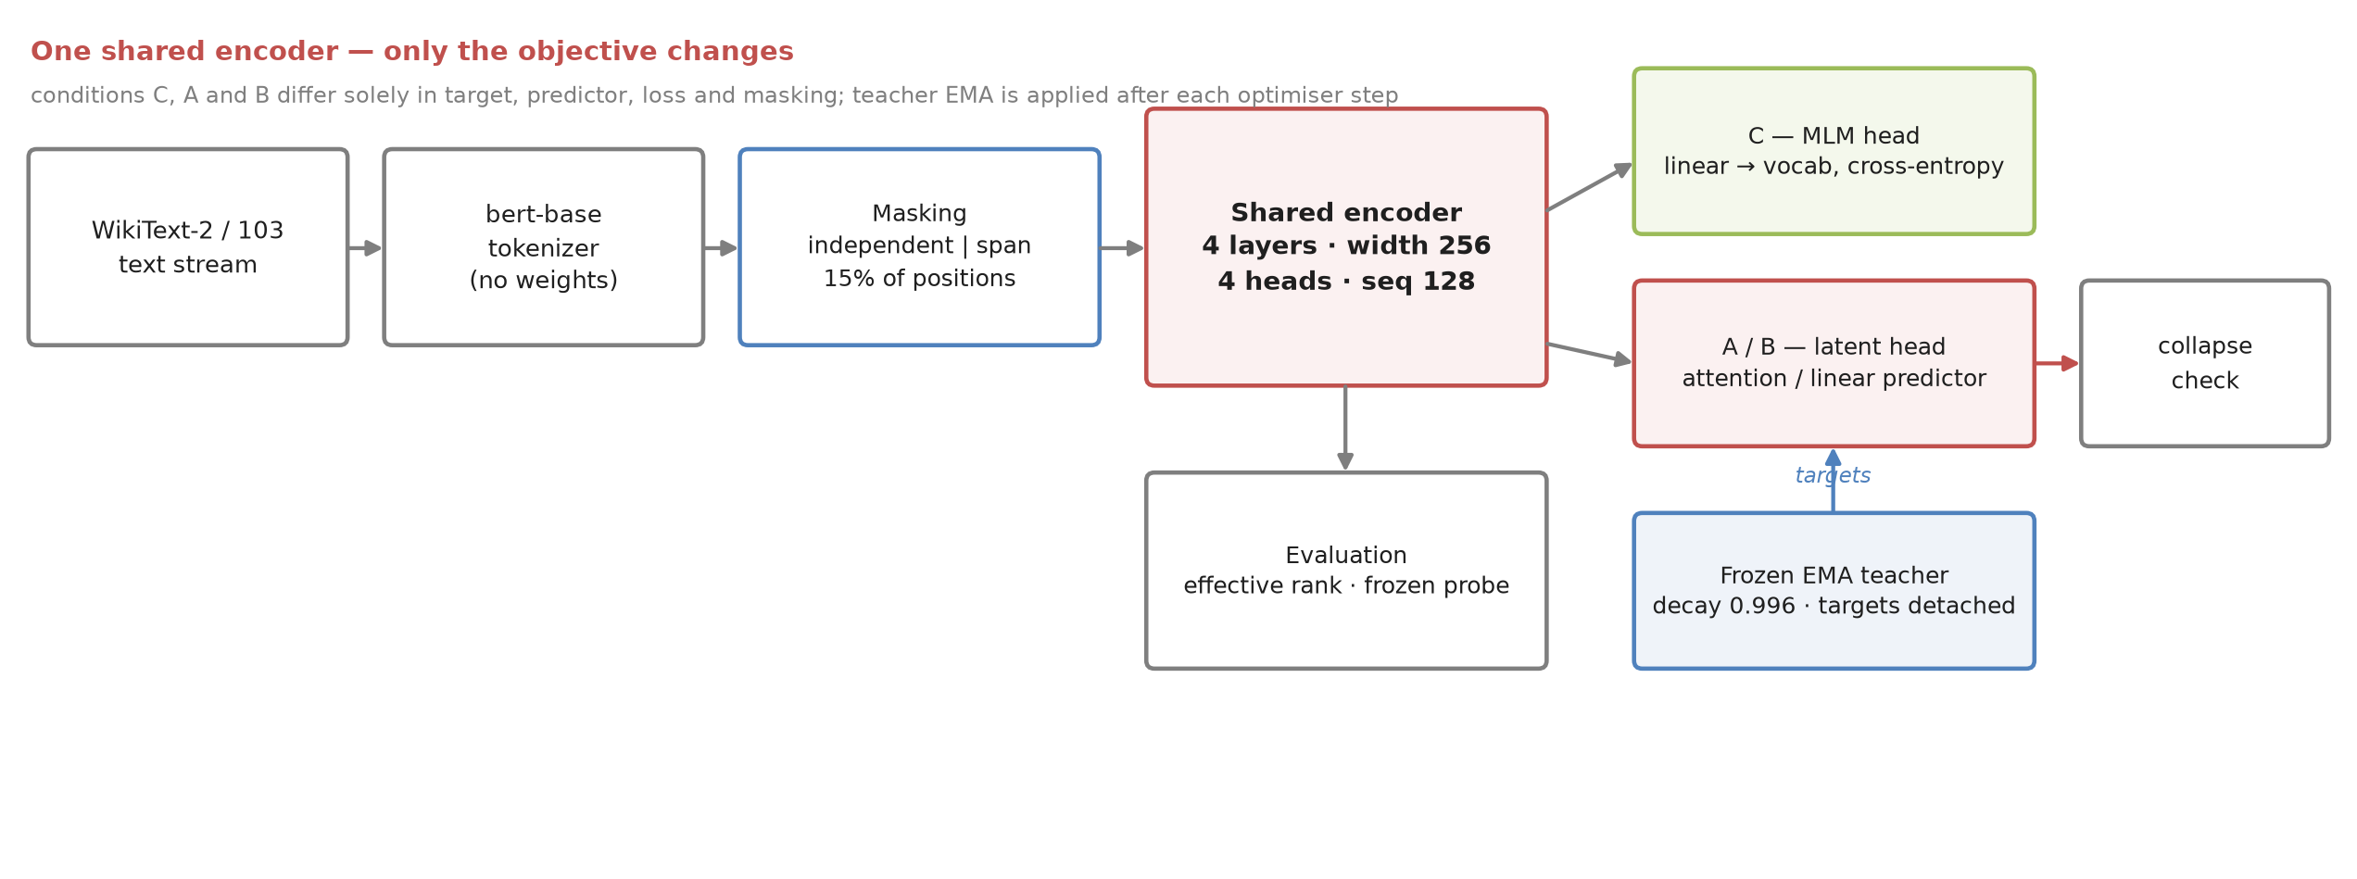
Methodology and system architecture
C — MLM: cross-entropy over the vocabulary.
A — final-layer target, attention predictor, MSE, span masks.
B — mean of top-2 normalised layers, linear predictor, Smooth L1, independent masks.
Teacher — frozen EMA copy (decay 0.996), targets detached.

Slide 7
Dataset and computing requirements
Data: WikiText-2 and WikiText-103 raw (Salesforce); AG News for the frozen probe.
Tokenisation: bert-base-uncased as a tokenizer only — no pretrained weights in the model.
Preprocessing: length 128, 15% of positions masked, independent and span policies, special tokens excluded from prediction.
Scale reached: 700,482 non-padding tokens per run — 14% of the proposed 5M-token budget.
Compute: free Kaggle T4 (15 GB, torch 2.11 + cu128); ~7 min per six-run batch; local machine CPU-only. Colab's free tier refused a backend from our location.

Slide 8
HPC lab requirement details
No HPC cluster used: all GPU work ran on a free Kaggle T4 inside a 30 GPU-hour weekly quota.
Measured need: a 700k-token run takes ~45 s, so the full 5M-token sweep (3 conditions x 2 seeds + 4 ablations + probes) is about 6 GPU-hours.
Minimum viable hardware: one CUDA GPU with ≥ 8 GB, PyTorch 2.x; no interconnects or special storage — the pipeline is single-GPU and fully checkpointed.
Lab access would remove the two real constraints: the weekly quota and session resets.

Slide 9
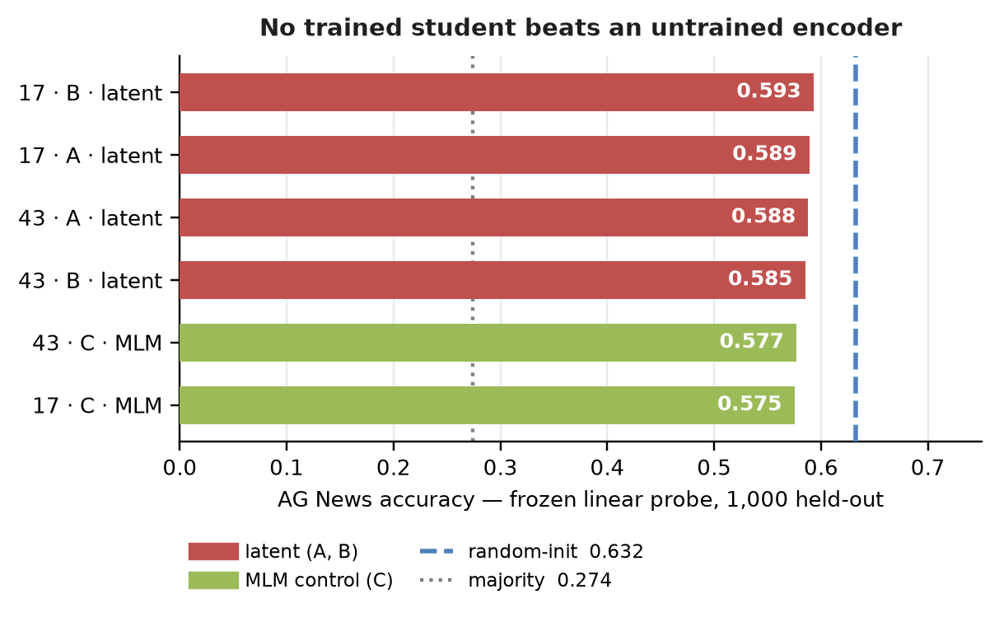
Implementation evidence and preliminary results
55 tests pass (2 skipped: CUDA-only resume, integration-only); ruff clean; resume reproduces state exactly.
Training is stable: seed-to-seed spread under 3% (A 0.505 vs 0.519; B 0.150 vs 0.154).
No collapse: effective rank 76.4 / 80.8 for latent A versus 10.2 / 17.0 for MLM.
Transfer did not improve: every trained student is below a random-initialised encoder (0.575–0.593 vs 0.632).
At 0.7M tokens the constraint is budget, not recipe — which the running 5M-token sweep tests.

Slide 10
Demonstration
Build batches from WikiText-103 and train one run end-to-end, printing live loss.
Show metrics.jsonl, checkpoint.pt and metadata.json — commit hash and token count included.
Interrupt and resume the same run: counters and loss continue exactly.
Run the frozen AG News probe and the geometry report on the new student.
Rebuild this deck's figures from results/*.json — no number is typed by hand.
Repository: github.com/dakshadev/7th-sem (main); all commands in README.md.

Slide 11
Remaining work, timeline and risks
This week: finish the 5M-token sweep (0.7M → 5M, C/A/B, two seeds) and report whether transfer overtakes the random-initialised reference.
Next: rerun ablations D–G at full budget with probes and a second seed — currently loss-only, single-seed.
Then: SIGReg-style collapse regulariser (recipe H) and a second probe task (SST-2), so one easy task cannot carry the conclusion.
Risks: free-tier quota and session resets (mitigated by committed kernels and hashed artifacts); and the chance that no condition beats the random baseline — reported as the finding if so.
Before final evaluation: full report, final deck, viva preparation.

Slide 12
Sustainable Development Goals(SDG) Aligned to your project
SDG 4 — Quality Education: lowers the compute cost of usable text representations, so small institutions can train their own models.
SDG 9 — Industry, Innovation and Infrastructure: a tested, reproducible NLP pipeline that runs on free or consumer hardware.
SDG 10 — Reduced Inequalities: language technology should not be gated behind budgets only well-funded labs can meet.
Secondary — SDG 12: smaller models mean less energy per experiment.

Slide 13
Conclusion
A complete, tested system exists: one shared encoder, three matched conditions, one evaluation harness, 55 passing tests.
Preliminary (0.7M-token) evidence: optimisation is stable, nothing collapses, and transfer does not yet beat an untrained encoder — a budget effect, reported as such.
The 5M-token sweep decides whether masked-latent targets help at the scale the proposal promised. Either outcome is informative.

Slide 14
References
[1] Devlin, J., Chang, M.-W., Lee, K., & Toutanova, K. (2019). BERT: Pre-training of Deep Bidirectional Transformers for Language Understanding. NAACL-HLT, 4171–4186.
[2] He, K., Chen, X., Xie, S., Li, Y., Dollár, P., & Girshick, R. (2022). Masked Autoencoders Are Scalable Vision Learners. CVPR, 16000–16009.
[3] Grill, J.-B., et al. (2020). Bootstrap Your Own Latent. NeurIPS, 21271–21284.
[4] Bardes, A., Ponce, J., & LeCun, Y. (2022). VICReg: Variance-Invariance-Covariance Regularization for Self-Supervised Learning. ICLR.
[5] Merity, S., Xiong, C., Bradbury, J., & Socher, R. (2017). Pointer Sentinel Mixture Models (WikiText). ICLR.
[6] Zhang, X., Zhao, J., & LeCun, Y. (2015). Character-level Convolutional Networks for Text Classification (AG News). NeurIPS, 649–657.

Slide 15
Thank You

