Slide 1
IBM University Engagement
Project Submission
“Exploring the Power of Agentic AI with IBM Granite and LangFlow”

Slide 2

Project Tile – Managing Content Overload for Blog Writers
Domain of Project – Education
Student Name | Recent Passport Photo | Email ID | Mobile Number [Whatsapp]
Dakshayini G.R |  | dakshayini@kssem.edu.in | 7989137176

Slide 3
Problem Statement : Managing Content Overload for Blog Writers
The Challenge:
Bloggers today face an overwhelming flood of scattered information—news updates, research articles, social media trends, and audience feedback. This content is fragmented, quickly outdated, and difficult to organize, making it hard for writers to focus on creating impactful blogs. The challenge is not just to collect ideas but to synthesize, prioritize, and guide writers toward high-quality content creation.
The Objective:
Build an agentic AI application that acts as an intelligent writing assistant. The solution should:
Fuse Disparate Sources: Collect real-time data from multiple channels (news sites, research papers, social media, comments) and synthesize into clear summaries with actionable blog topic suggestions.
Enable Multimodal Content Curation: Accept user inputs (text, images, or voice notes), refine ideas, and recommend blog structure, tone, or supporting visuals.
Create a Predictive & Agentic Layer: Analyze engagement patterns to predict trending topics and suggest optimal publishing time, hashtags, or angles for maximum reach.
Visualize the Writing Pulse: Provide a clean, real-time dashboard showing curated topics, sentiment analysis, and engagement forecasts to help writers align with audience interests.

Slide 4
Proposed Solution
Proposed Solution :SmartBlog AI Assistant
Our solution is an Agentic AI assistant that automates research and blog planning.
Features
Collects data from multiple online sources.
Summarizes key insights using AI.
Suggests trending blog topics.
Recommends blog structure and tone.
Predicts engagement and publishing time.
Displays insights through an interactive dashboard.

Slide 5
Technology Used
IBM BOB (Build on IBM) Platform : Provides an integrated environment to develop, deploy, and manage AI applications.
IBM Granite Large Language Models (LLMs) : Power the intelligence behind the AI writing assistant.
IBM Cloud Platform : Hosts and runs the complete AI application.

Slide 6
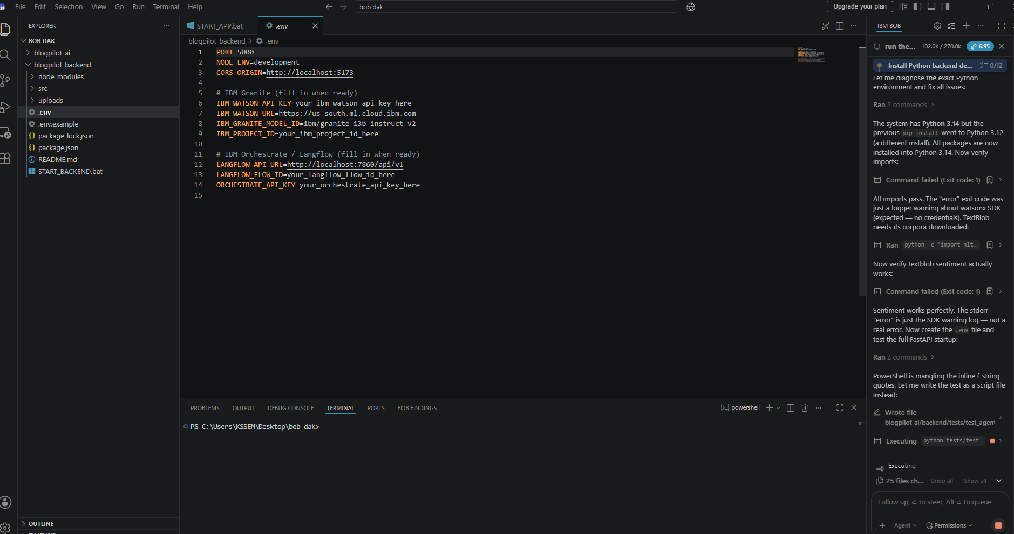
Required Files created using IBM Bob

Slide 7
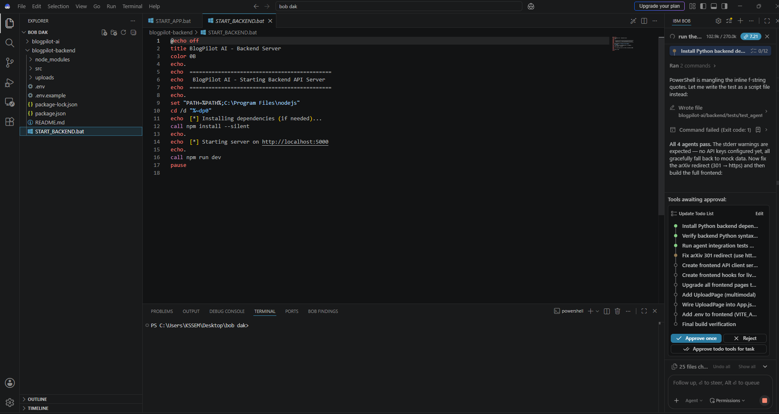

Slide 8
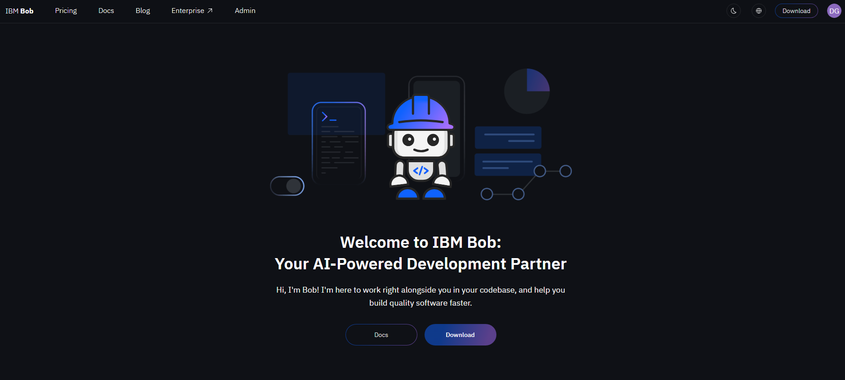

Slide 9
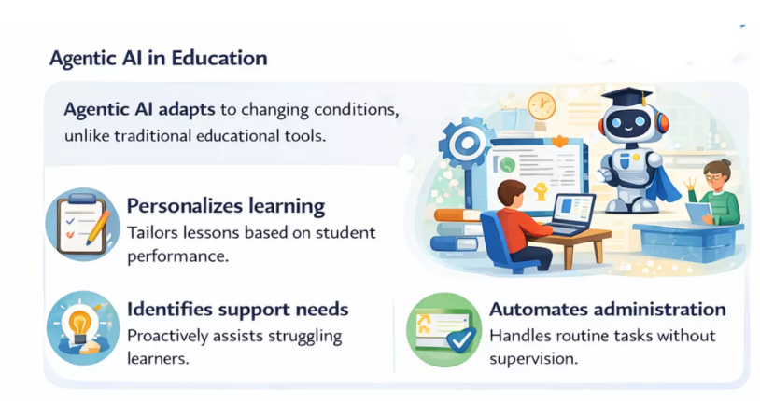
Role of Agentic AI in the Solution
Agentic AI acts as an intelligent writing assistant that autonomously collects information from multiple sources, summarizes key insights, identifies trending topics, and recommends personalized blog ideas. It also suggests content structure, tone, hashtags, and the best publishing time based on audience engagement, reducing information overload and enabling bloggers to create high-quality content more efficiently.

Slide 10
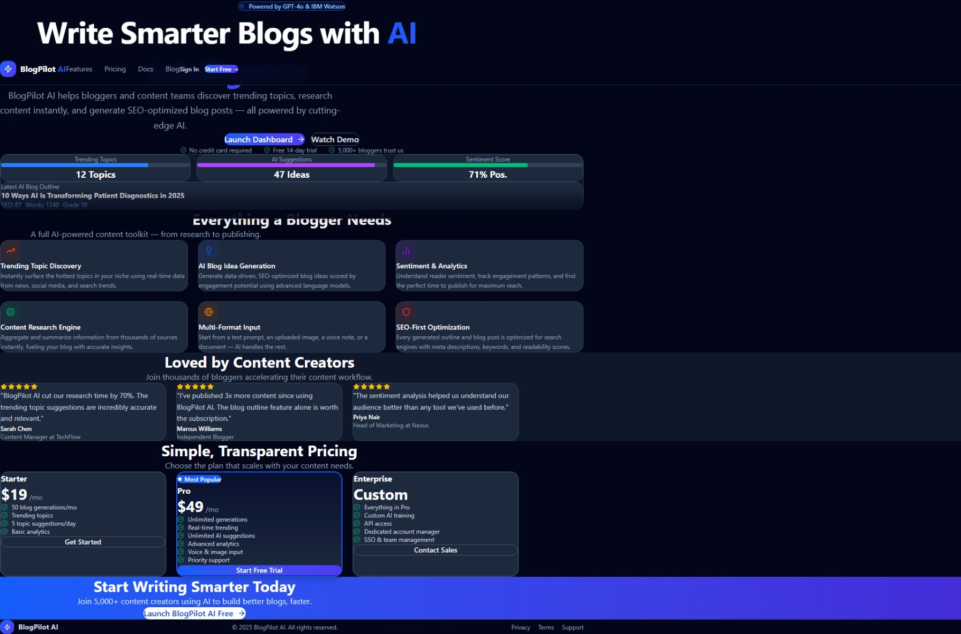

Slide 11
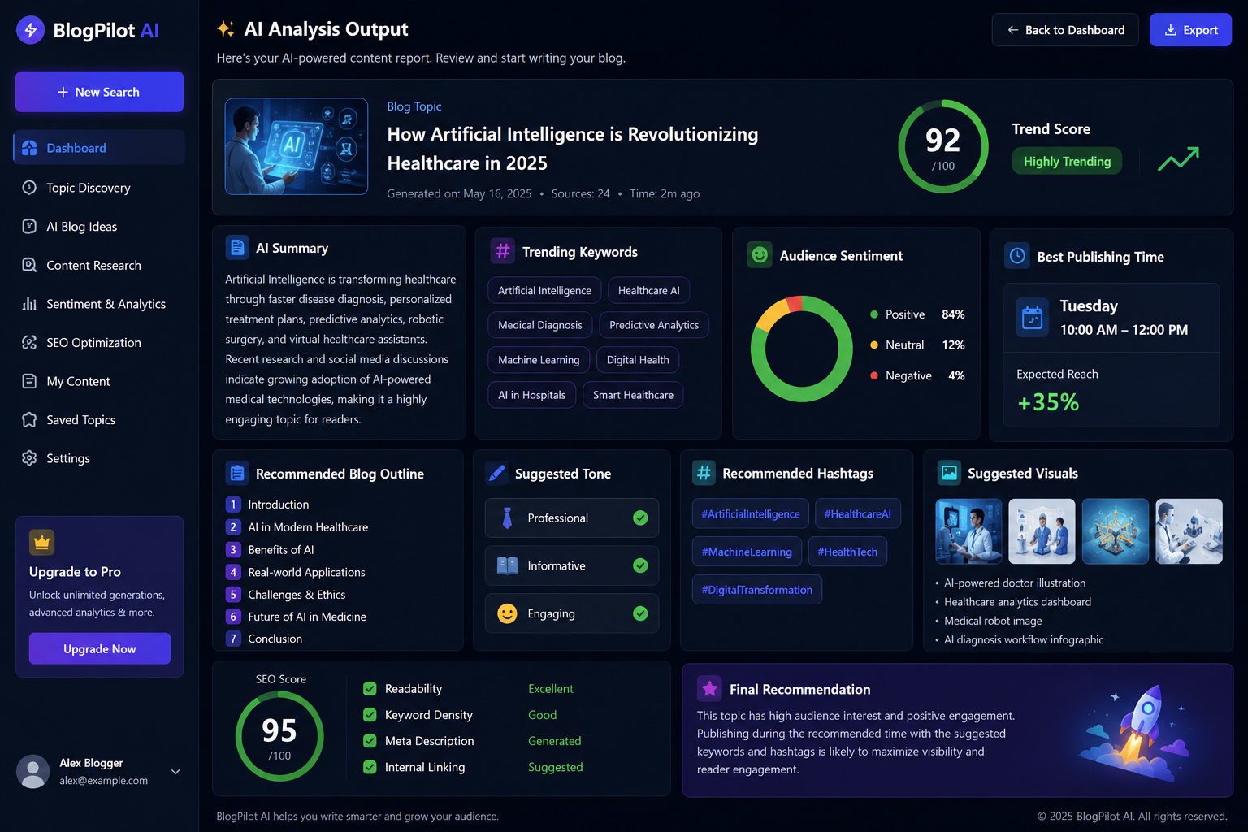
Project Output Screenshort

Slide 12
Git Hub Link https://github.com/dakshayinid2-prog/Managing-Content-Overload-for-Blog-Writers

Slide 13
Future Scope
One-click blog generation
SEO optimization suggestions
AI-generated images
Multi-language blogging
WordPress & Medium publishing integration
Team collaboration workspace
Personalized writing style learning
AI fact-checking before publishing

Slide 14
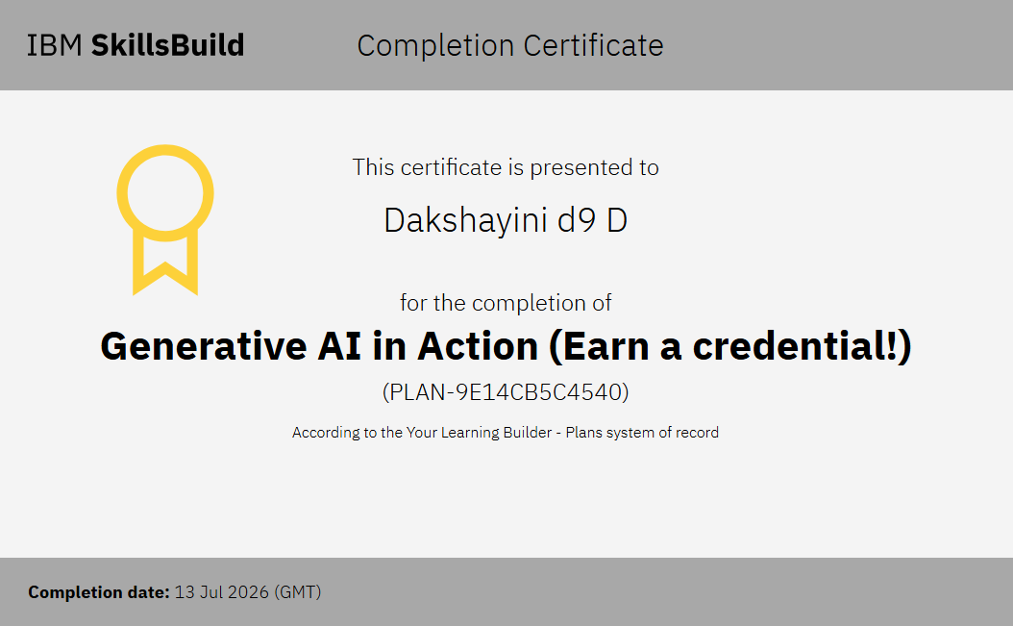
Certificates Earned:

Slide 15
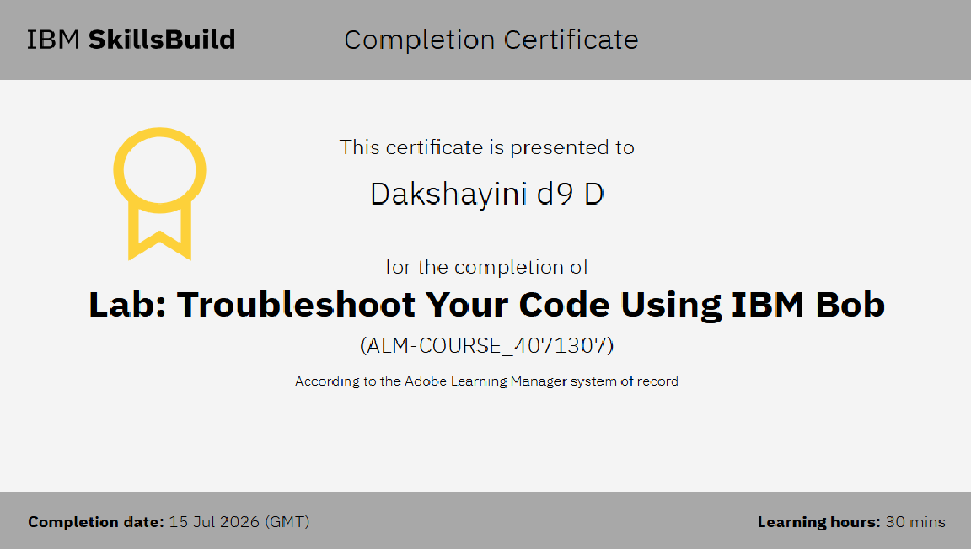

Slide 16
Thank you

