Slide 1

INNOV8 4.0 · EIGHTFOLD.AI × ARIES, IIT DELHI
THE BATTLE
ARENA.
An autonomous hiring agent that learned the market, caught the fakes, and signed first.
Team confused_devs
Daksh Chugh · Adityam Vashist · Himanshu Rawat
#1 score 1,827.3 on the live board
Notes:
Hi, we are team confused_devs. In the Battle Arena, 51 teams each sent an autonomous agent into one live candidate market. Nobody could touch the agent once the arena opened. Our agent finished at the top of the live leaderboard with a score of 1,827.3. In the next few minutes we will show how it worked: the architecture, the flow, the numbers, and the mistakes we fixed.

Slide 2
THE PROBLEM
One market. 51 agents. Every name signed only once.
1,000,000
51
50,000
116
candidate profiles, shared by all teams
autonomous agents competing live
credits per team; every call costs
slots across 10 requisitions
SCORE = points of people you hold − credits used × 0.05
Information costs money: search 1 · profile 2 (batch 1.2) · verified assessment 25 · offer 10 (20 in closing).
Fabricated profiles exist, and signing one earns zero while blocking the slot.
Recon hour: offers locked. Then the market opens and the best names go in seconds.
Notes:
The problem: a pool of one million candidates, shared by 51 teams. Each person can be signed by only one team. Every API call costs credits, and the final score is points minus credits times 0.05. So every decision is a trade-off: pay for information, or save credits. There are also fake profiles in the pool, and a fake signing earns nothing. The first hour is recon, when nobody can sign anyone.

Slide 3
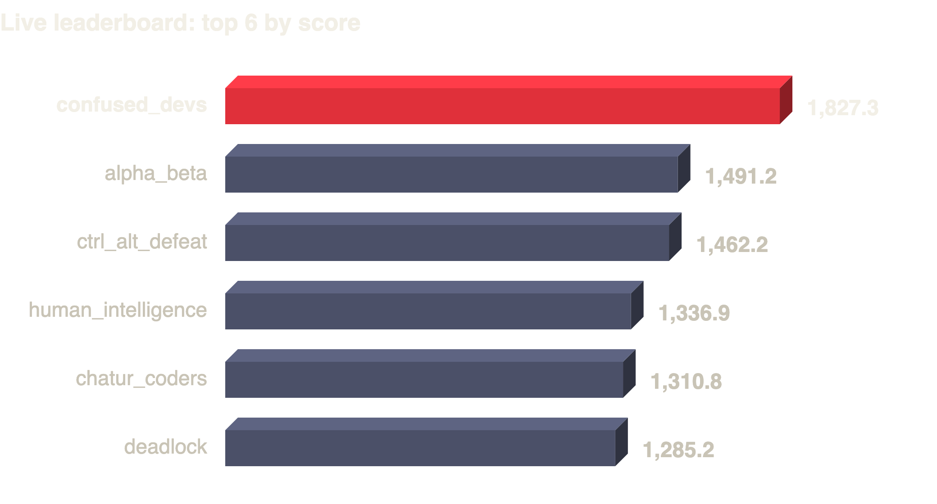
THE RESULT
116 of 116 signed. Zero rejections. Rank #1.
2,494
points earned (most of any team)
13,334
credits used · 666.7 penalty
1,827.3
final arena score
Snapshot of the live board at 15:45. Our final ledger at close (17:01) was unchanged. Official results pending.
Notes:
The result. We filled all 116 slots in the first seconds of the market with zero rejected offers. We earned 2,494 points, the most of any team. We used 13,334 credits, a penalty of 666.7, so the score is 1,827.3. On the live board we were first, about 336 points ahead of number two. Some teams spent fewer credits, but they got far fewer points, because our signings were all verified and high quality.

Slide 4
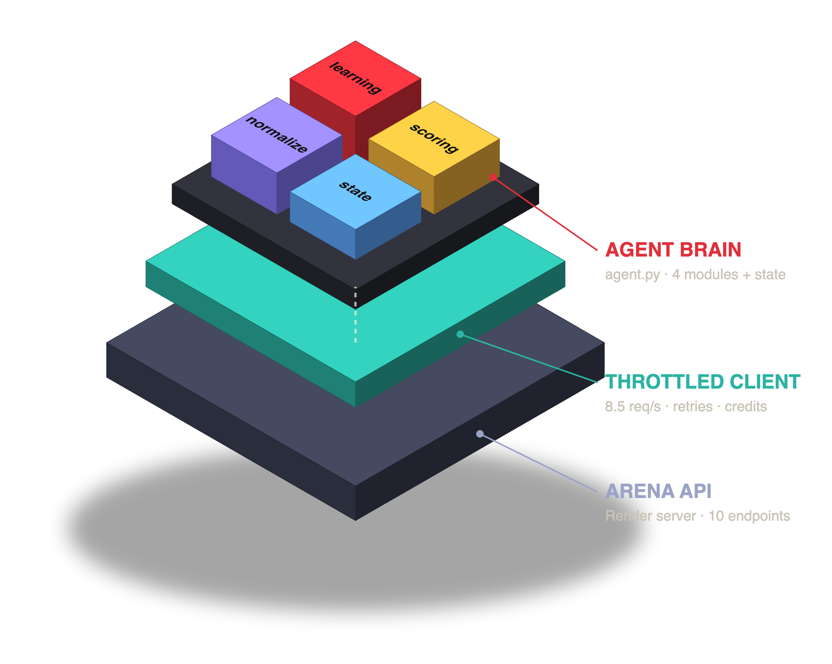





ARCHITECTURE
Three layers, one brain.
agent.py
Orchestrator: phase loop, spend rule, signing waves, crash-safe main loop.
normalize.py
Parses messy fields: skills, CTC, notice, assessment, experience.
scoring.py
Requisition model, bar checks, quality score, risk flags, identity keys.
learning.py
Assessment model + note scorer: learns from what we paid for.
state.json
Everything bought, saved atomically: restarts never pay twice.
ThrottledArena
Organiser client + our 8.5 req/s gate and response sampling.
Notes:
The architecture has three layers. At the bottom is the Arena API on the organisers' server. In the middle is the HTTP client: the organisers' arena_client, wrapped by our ThrottledArena, which spaces calls to 8.5 per second so we never hit the rate limit. On top is the agent brain: agent.py runs the phase loop and decides what to buy and sign; normalize.py cleans messy fields; scoring.py checks the bar and computes quality; learning.py learns from our paid verifications; and state.json saves everything so a restart never pays twice.

Slide 5

THE FLOW
What the agent does in each phase.
1
2
3
4
5
6
WAIT
RECON
PLAN
BURST
HOLD
CLOSE
Poll free /ledger until the arena opens.
Sweep search · batch-buy profiles · score notes · verify top picks.
Rank every eligible person per requisition, with backups.
Market opens → all 116 offers fire best-first in seconds.
Top up empty slots every 5 min, only if it's worth the credits.
Closing hour: offers cost 20, rule gets stricter. Exit on real close.
One spend rule everywhere: buy only if expected points > credits × PENALTY_FACTOR + 25k hard cap
Notes:
This is the flow. First the agent waits for the arena to open, using the free ledger call. In recon it sweeps searches, batch-buys profiles, scores the recruiter notes, and verifies its top picks. Then it builds a ranked plan for every requisition, with backups. The moment the market opens, it fires all 116 offers best-first in parallel. After that it holds, and fills a slot only if one opens and it is worth the credits. In the closing hour offers cost double, so the same rule becomes stricter. Everything follows one rule: buy only if the expected points are more than the credit cost times the penalty.

Slide 6
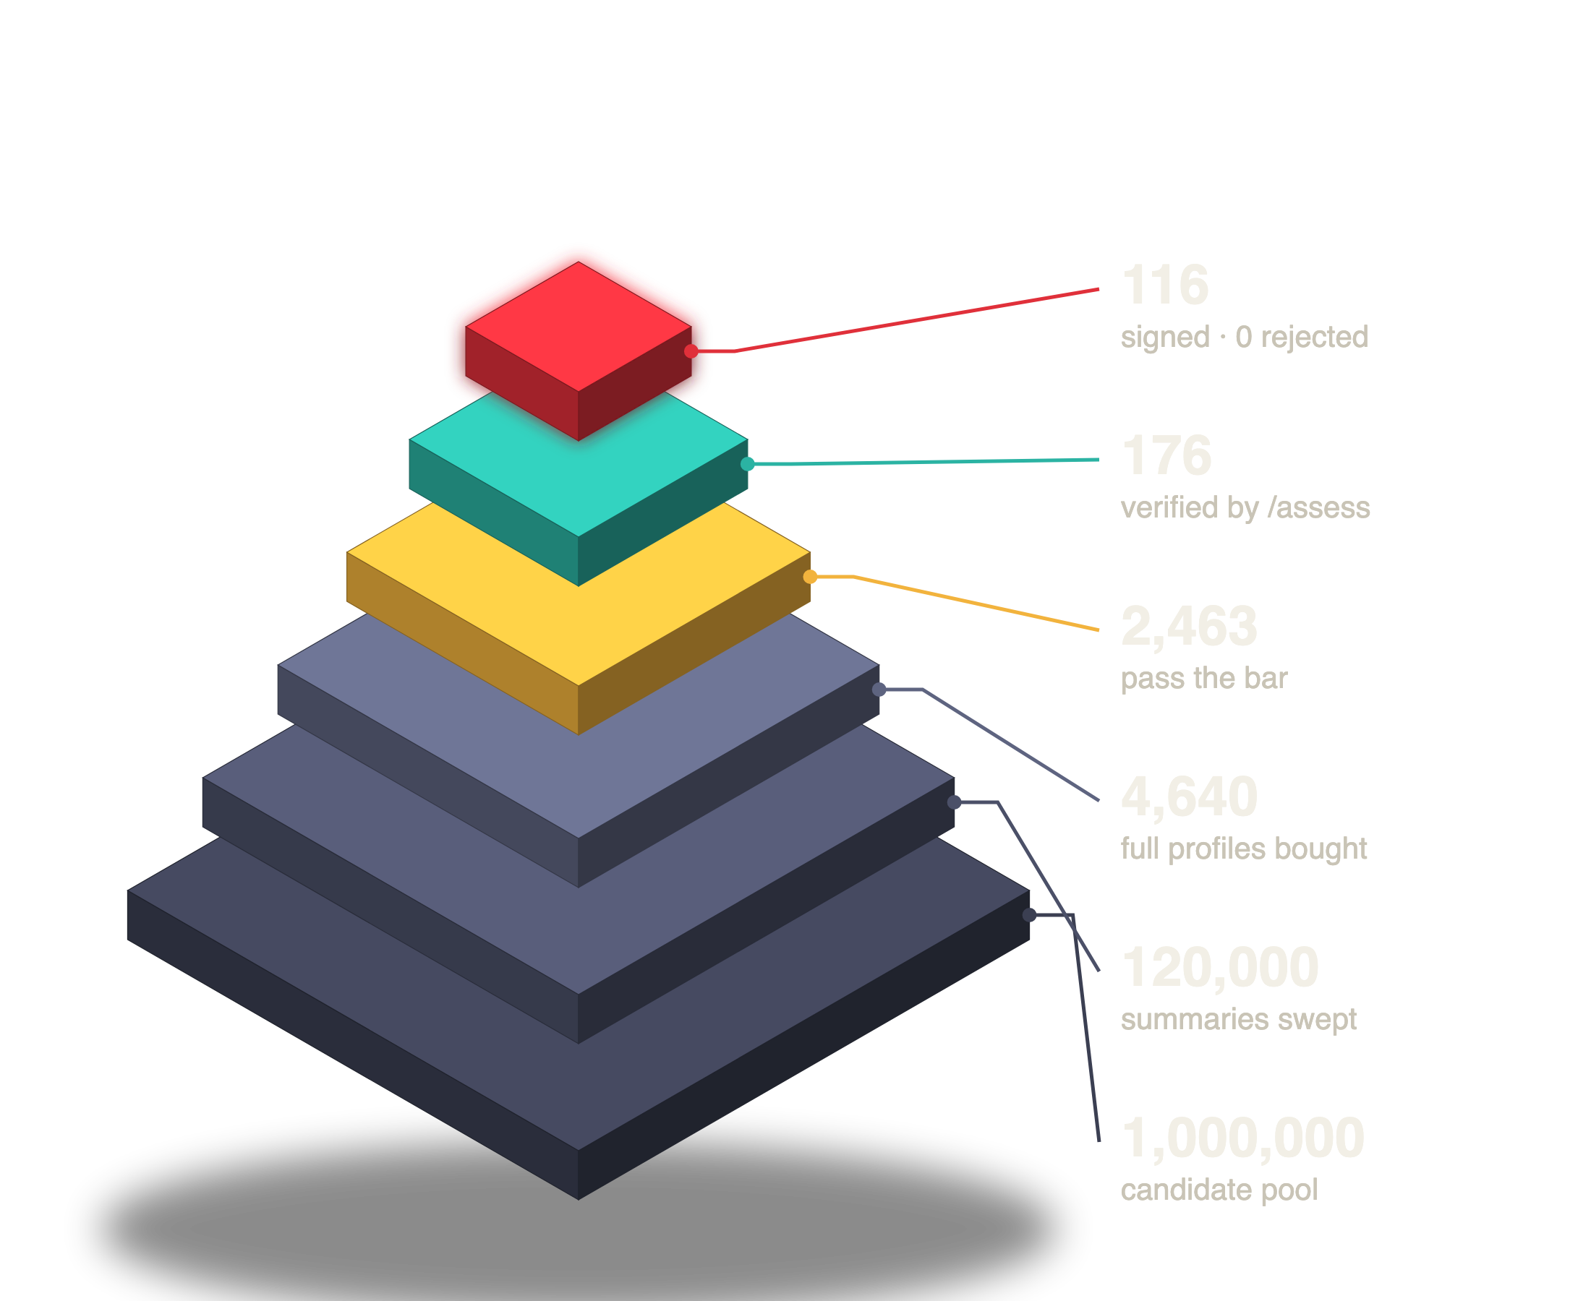
THE FUNNEL
From one million names to 116 signings.
Why each step
Search is nearly free: 100 summaries per credit, so sweep wide (120 pages per role).
Rank summaries locally by skill match, then buy only the best profiles, in batches of 50 at 1.2 credits each.
Check the real bar on the full profile: assessment, notice ≤ 60 days, expected CTC ≤ budget.
Verify top picks with /assess, the only proof against fakes.
Sign the best verified person per slot. Backups wait in line.
Notes:
This funnel is the whole story in numbers. From one million candidates we looked at 120,000 cheap summaries, bought 4,640 full profiles, and 2,463 of those passed the requisition bar. We verified 176 with the paid assessment and signed 116. Each step is more expensive than the one before, so we only go deeper where it matters.

Slide 7
TIMELINE
How the day actually went.
10:55
11:19
11:24
11:42
11:49
12:01
17:01
Format check
Agent live
Recon done
Market burst
Pause glitch
Fix + resume
Arena closed
7 manual calls, 31 credits, to learn real field names
SSL fix on macOS Python, then start
120k summaries · 4,640 profiles · 176 verified
116 signed in seconds, 0 rejected
Server said 'closed'; agent exited, signings safe
Exit only after closing phase; no re-buying
Final ledger 2,494 pts · score 1,827.3
The market opened ~12 minutes late (planned 11:30). The agent simply kept polling and fired the moment it opened.
Notes:
Here is how the day went. We checked the real data format with a few manual calls, then started the agent at 11:19 after fixing an SSL certificate problem on the Mac. Recon finished at 11:24. The market opened late, at 11:42, and the agent signed all 116 in seconds. At 11:49 the server briefly reported closed during a pause, and our agent treated that as the end and exited. Our signings were safe on the server. We fixed the rule so the agent exits only after the real closing phase, and restarted it at 12:01 from saved state without buying anything again. The arena closed at 17:01 with our score unchanged.

Slide 8
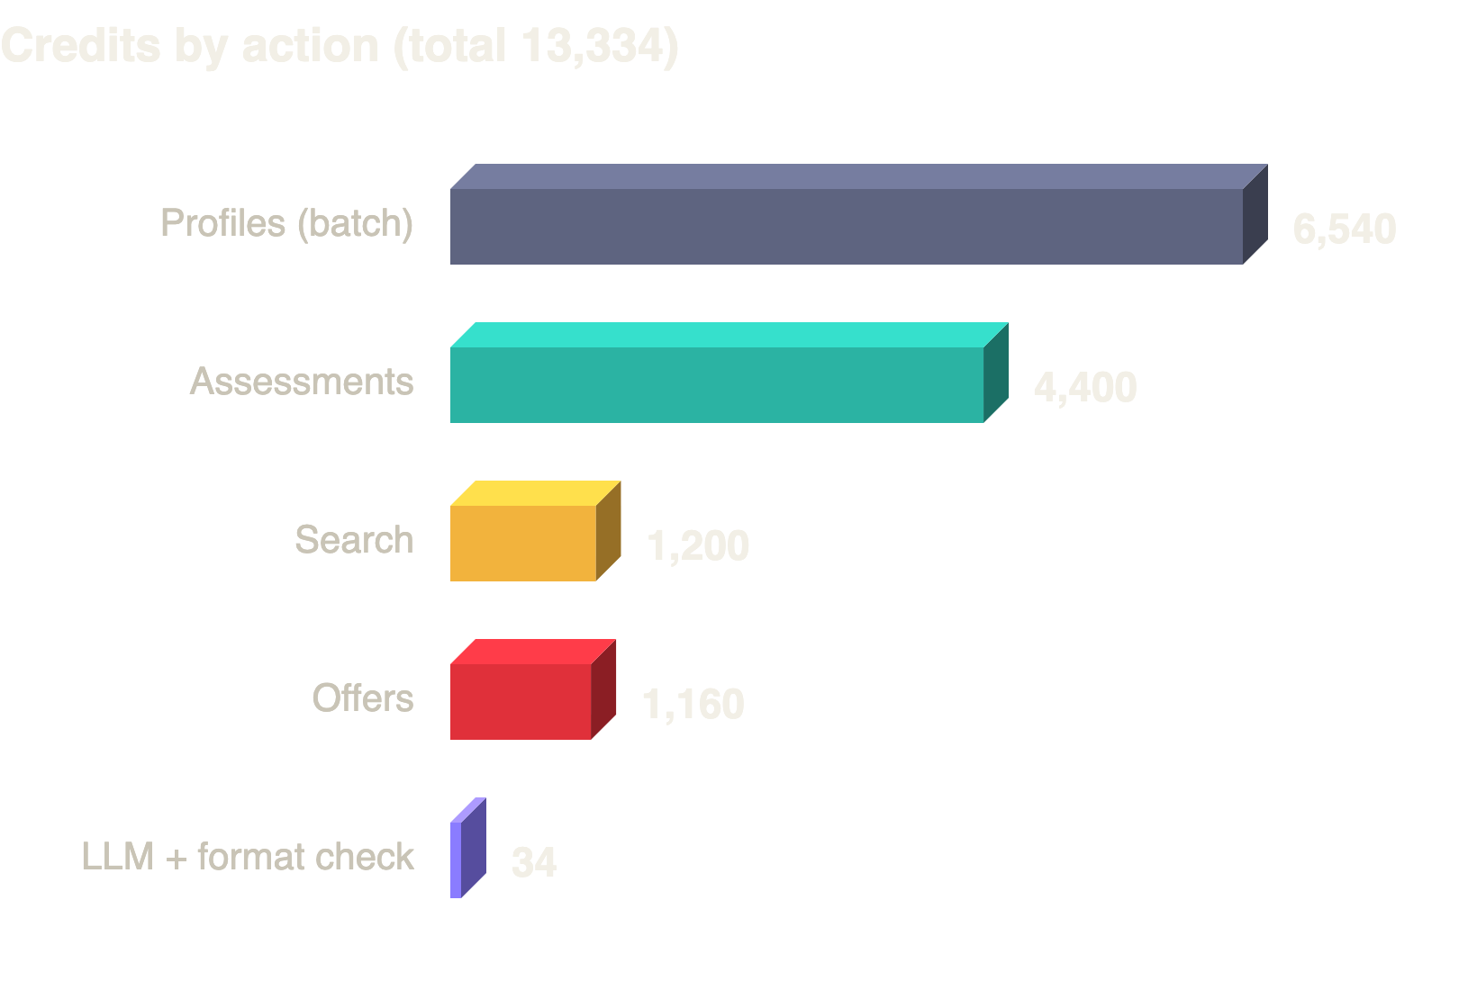
CREDIT ECONOMICS
Where 13,334 credits went, and why it paid.
Cost in points, at penalty 0.05
1 profile (batch)
0.06 pts
1 verified assessment
1.25 pts
1 offer
0.5 pts
1 signing earned
≈ 21.5 pts
Information was cheap and a wrong signing was expensive, so we invested in recon and verification, then spent nothing after 11:42.
Notes:
Where did the credits go? About half on full profiles, a third on verified assessments, and the rest on searches and offers. With a penalty of 0.05, a profile costs us only 0.06 points and an assessment 1.25 points, but one signing earned about 21.5 points. So information was cheap compared to a signing, and a wrong signing was expensive. That is why we invested in recon and verification. After 11:42, when all slots were full, we spent nothing more.

Slide 9
DATA CLEANING
Messy in, clean out.
Field | Real messy values | What the agent does
skills | "Mongodb; Docker; REST; Node" "Redis | Postgres" | Split on , ; | → map synonyms (REST→rest apis, Postgres→postgresql, k8s→kubernetes)
experience | "67 months" "4+ years" "8.4" | First number; months → years
expected_ctc | "1370000" "25.9 LPA" | Everything to rupees; bar is max_expected_ctc_lpa × 1,00,000
notice_period | "Immediate" "30 days" "90 days" | Days; Immediate = 0; must be ≤ 60
assessment | "55" "0.56" "91/100" "" | 0–100 scale; empty = unknown, never zero
note | "reference check was lukewarm exploring other offers" | Each distinct note scored once by the LLM (−2..+2)
Before finalising the parsers we checked the live format. That caught a field our first draft missed (max_expected_ctc_lpa).
Notes:
The data was deliberately messy. Skills came with different separators and spellings, experience in months or years, salary in rupees or lakhs, and assessments as percentages, fractions or blanks. normalize.py turns all of these into clean numbers and sets. An important detail: an empty assessment is treated as unknown, never as zero, so we don't wrongly reject or accept anyone. We also checked the real field names first, which caught the salary field our first draft had missed.

Slide 10
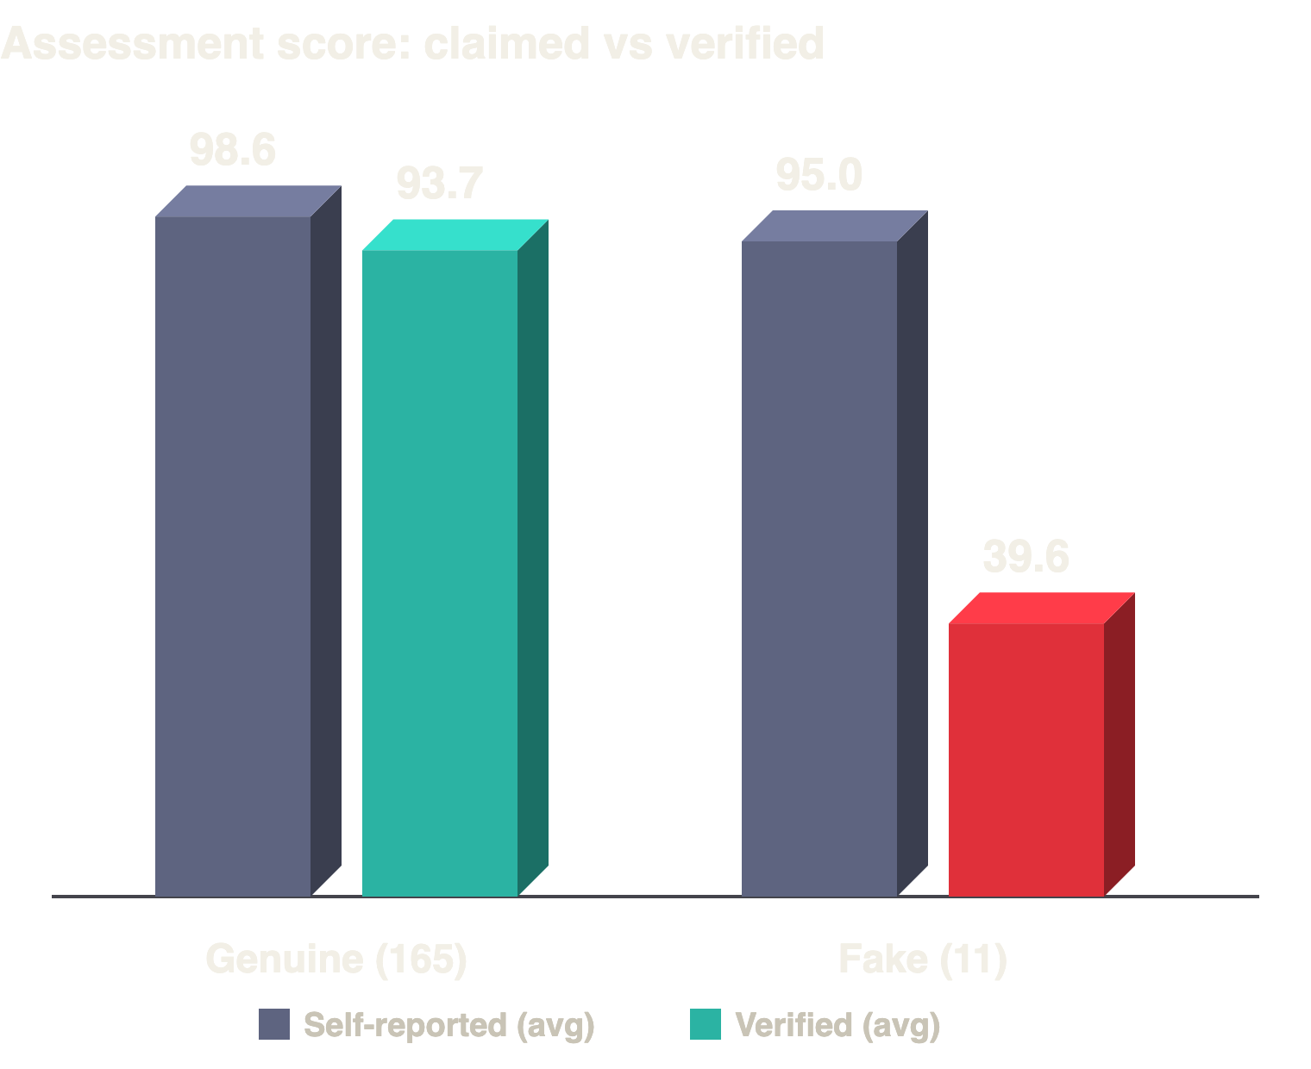
CATCHING THE FAKES
Self-reported scores lie. Verification doesn't.
11 of 176
failed verification (6.3%): identity not verified, “could not verify employment”
85–99 → 25–54
fakes claim high but not perfect; all 103 perfect-100s were genuine
+5 points
average inflation among genuine candidates
116 / 116
of our signings verified: min margin +11 over the bar, 100% skill match
Notes:
This is our biggest edge. Look at the chart: genuine candidates claim about 98.6 and verify at 93.7, so they inflate by about 5 points. The 11 fakes claim 95 on average but verify at only about 40. So a high self-score alone means nothing. Interestingly, the fakes claimed 85 to 99, never exactly 100, and all 103 perfect scores were genuine. Because of this we verified every single one of our 116 signings, and none of them was fake.

Slide 11
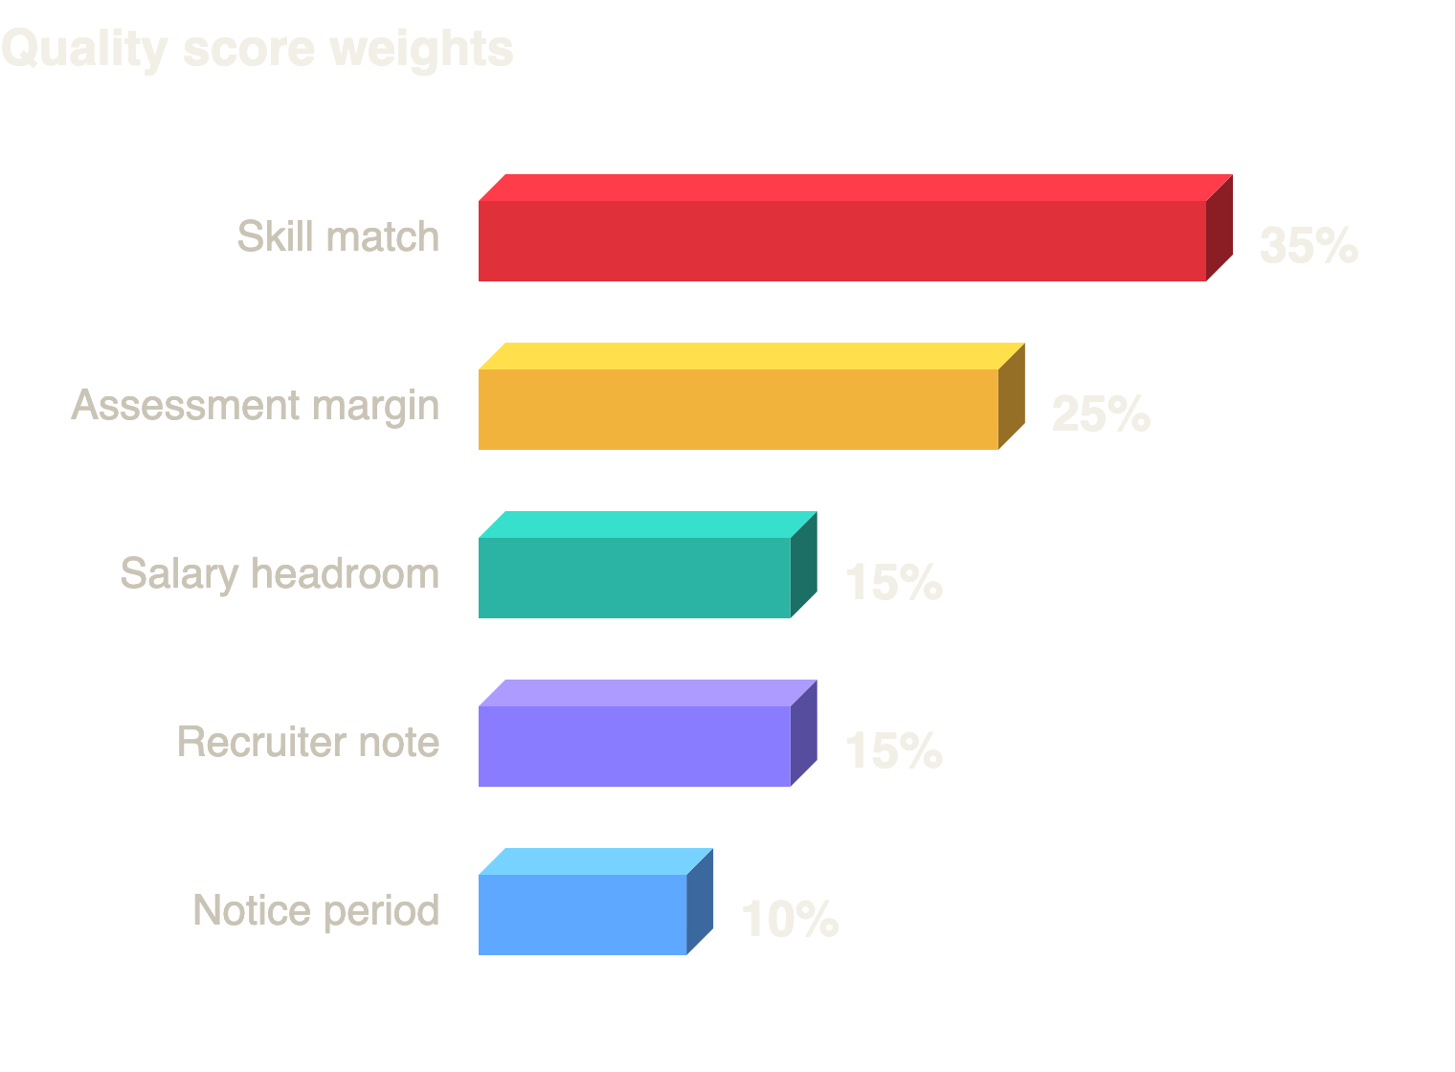
HOW WE CHOOSE
Scored exactly how points are earned.
Two gates, then a score
Hard bar first: verified assessment ≥ minimum, notice ≤ 60 days, CTC ≤ budget, right role, not claimed.
Trust second: failed verification = dead forever. Doubtful + unverified = never signed.
Then value = points × quality, and each requisition takes its top-headcount people.
Assessment model: least-squares fit of verified on self-reported score, from our own paid checks.
Note scorer: 100 distinct notes scored once in 2 LLM calls (≈3 credits), cached, keyword fallback.
Notes:
How do we choose? First, hard gates: the candidate must clear the requisition bar, and must not have failed verification. Then we compute a quality score, and its weights follow the organisers' own note on what points depend on: skill match, assessment margin, salary headroom, the recruiter note, and notice period. Two small learning components help: a regression that learns how much self-reported scores are inflated, and a note scorer that uses the LLM just twice to score all 100 distinct notes.

Slide 12
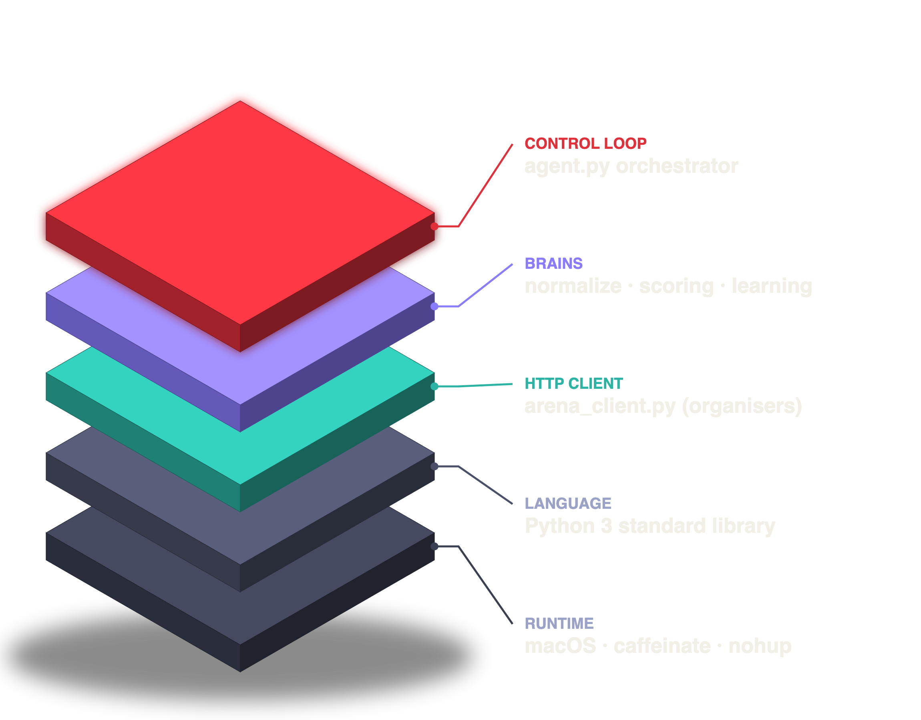
TECH STACK
Small, dependency-free, and explainable.
LANGUAGE
Python 3, standard library only: http.client, threading, concurrent.futures, statistics, json, re
CLIENT
Organisers' arena_client.py, unmodified, wrapped by our ThrottledArena
LLM
Arena's hosted /reason endpoint, used only to score recruiter notes
RUNTIME
Team laptop · nohup + caffeinate so it survives and never sleeps
TESTING
Our own mock arena with the real formats: phases, rejections, restarts
AI ASSISTANT
Claude Code (Anthropic), declared as required
Notes:
Our tech stack is deliberately small. Only the Python standard library, no third-party packages, so there is nothing to install or break. We used the organisers' client unmodified and wrapped it with our own throttle. The only AI inside the agent is the arena's own LLM endpoint, used twice for notes. The agent ran on our laptop with nohup and caffeinate. We tested everything first on our own mock arena. We used Claude Code as a coding assistant and declared it.

Slide 13

EDGE CASES
Built so nothing breaks, and nothing is paid twice.
1
Rate limits
2
Crash / restart
3
API errors
Our own 8.5 req/s gate below the 10 req/s limit. We never needed a 429 retry.
Atomic state.json after every step. Two restarts, zero re-buying.
Client retries network and 5xx errors; one bad batch never stops the rest.
4
Phase glitches
5
Rejected offers
6
Out of credits
409 → re-read the phase. A 'closed' pause no longer ends the run.
Fall through to backups; the candidate is marked so we never pay twice.
Final: stop metered calls and hold, logging free ledger calls.
Notes:
Edge cases were ten percent of the judging, so we designed for them. We throttle ourselves below the rate limit. State is saved after every step, so the two restarts we had cost nothing. Network and server errors are retried, and one failed batch never stops the others. Wrong-phase errors make the agent re-read the phase, and after our fix, a temporary closed status no longer ends the run. Rejected offers fall through to backups. If credits ever ran out, the agent would stop spending and just hold.

Slide 14
HONEST LESSONS
What didn't work, and what we'd do next.
What didn't work
With two more hours
Template idea of ranking by skill count and trusting self-scores.
Linear model fitted on all pairs was skewed by fakes (2.47·self − 152). On genuine only: 1.26·self − 30.7. No harm, since every signing was verified directly.
Splitting skills on “/” broke a/b testing and ci/cd. Fixed before going live.
Treating any 'closed' as the end: the 11:49 exit, fixed at 12:01.
Fit the assessment model only on verified-genuine candidates.
Upgrade swaps: release a weak signing when the gain beats 15 credits × penalty.
Use /market price pressure to prioritise contested requisitions.
Record /reason spend in the local ledger (3-credit gap vs server).
Notes:
We want to be honest about what didn't work. Our regression was fitted on all verified pairs, including the fakes, which distorted the slope. On genuine candidates only, the fit is much more sensible. It didn't hurt us, because every signing was verified directly. We also had the closed-phase glitch, which we fixed. With two more hours we would fit the model only on genuine data, add upgrade swaps, and use the market feed to focus on contested roles.

Slide 15
Learn cheap.
Verify what matters.
Sign first.
116/116
2,494
1,827.3
signed
points
score
Thank you · team confused_devs · questions welcome
Notes:
To sum up: learn the market cheaply, verify only what matters, and sign first. That gave us 116 of 116 signings, 2,494 points and a score of 1,827.3. Thank you, and we're happy to take questions.

