Slide 1
COMPILER DESIGN LABORATORY · PHASE 3 REVIEW
CodeFlow
Phase 3 — Optimization, Execution & Integration
Constant Folding · Unreachable & Dead-Code Elimination · TAC Execution Engine · Compiler Explorer
Daksh Arora · B.Tech Computer Science and Engineering (Information Security) · VIT Vellore
Register Number: 24BCI0259 · Course Code: BCSE307P · Individual Project
GitHub: https://github.com/dakshcodez/CodeFlow_DSL

Slide 2
OVERVIEW
Phase 3 at a Glance
Phases 1 and 2 built the front and middle end. Phase 3 closes the loop: TAC is now optimized and then actually executed, so a CodeFlow program runs from source to an alert / log / action trace.
3
131
4
6/6
optimization passes
automated tests passing
runtime error kinds
pipeline stages complete
Folding · unreachable · dead code
10 Vitest suites, 50 new since Phase 2
Missing input · type · divide-by-0 · operand
Source through execution trace
Phase 3 target Source → Tokens → AST → Semantic → TAC → Optimized TAC → Execution → Trace
CodeFlow — Phase 3 · Compiler Design Laboratory · github.com/dakshcodez/CodeFlow_DSL
2

Slide 3
ARCHITECTURE
COMPLETE · PHASE 3
Complete Pipeline After Phase 3
Every stage is implemented, consumes the previous stage's artifact, and is inspectable.
ERROR HANDLER — Lexical · Syntax · Semantic · Runtime diagnostics, one shared CompilerError
1
2
3
4
5
6
Lexical
Syntax
Semantic
IR Gen
Optimizer
Execution
Tokens with line/col
Recursive descent → AST
Scope + types, symbol table
Structured TAC
Fold · unreachable · dead
Interpret TAC → trace
COMPLETE
COMPLETE
COMPLETE
COMPLETE
NEW · PHASE 3
NEW · PHASE 3
COMPILER EXPLORER — Tokens · AST · Symbol Table · Errors · TAC · Optimized TAC · Execution Trace
Phase 3 adds stages 5 and 6 and turns the Phase 2 "Phase 3" placeholders (optimized TAC, trace, runtime diagnostics) into live features.
CodeFlow — Phase 3 · Compiler Design Laboratory · github.com/dakshcodez/CodeFlow_DSL
3

Slide 4
STAGE 5
NEW · PHASE 3
Optimizer: Three Passes, One Order
Design
Pass ordering on a program
Operates on IRInstruction[] only — never sees source text or the AST.
Each pass is an exported, independently testable function.
optimizeWorkflow composes them: fold → unreachable → dead.
Order matters: folding exposes constant conditions, unreachable removal uses them, dead-code removal sweeps what is left unread.
Out of scope by design: register allocation, scheduling, inter-procedural work.
foldConstants
1
10 + 20 → 30 ; 5 > 3 → true
eliminateUnreachableCode
2
drop bodies behind a known-false jump
eliminateDeadCode
3
drop temporaries nobody reads
CodeFlow — Phase 3 · Compiler Design Laboratory · github.com/dakshcodez/CodeFlow_DSL
4

Slide 5
OPTIMIZATION 1
NEW · PHASE 3
Constant Folding
Before
After folding
t2 = 10
t3 = 20
t4 = t2 + t3
t5 = t1 > t4
t2 = 10
t3 = 20
t4 = 30
t5 = t1 > t4
The now-unused t2 and t3 are removed later by dead-code elimination.
→
How it works
Safety rules
Tracks the known constant value of each temporary.
Binary / Unary with constant operands become one Assign.
Knowledge resets at every Label — a control-flow merge point.
Sensor / input values are never constants.
x / 0 is left unfolded so the runtime reports it.
Mixed-type operands are left alone.
CodeFlow — Phase 3 · Compiler Design Laboratory · github.com/dakshcodez/CodeFlow_DSL
5

Slide 6
OPTIMIZATION 2
NEW · PHASE 3
Unreachable-Code Elimination
Algorithm
Example: when 2 > 9 { action never_called() }
Build a small control-flow graph over instruction indices: fall-through edge plus a jump edge for Goto / IfFalse.
Breadth-first search from instruction 0; keep only reachable instructions.
If an IfFalse condition is a known boolean, follow only the edge it can take.
This is why a statically false when loses its body.
t11 = false
IF_FALSE t11 GOTO L3
CALL never_called()
LABEL L3
↓
t11 = false
IF_FALSE t11 GOTO L3
LABEL L3
The CALL is unreachable and is removed.
CodeFlow — Phase 3 · Compiler Design Laboratory · github.com/dakshcodez/CodeFlow_DSL
6

Slide 7
OPTIMIZATION 3
NEW · PHASE 3
Dead-Code Elimination
Rule
Real output after folding
Remove an Assign / Binary / Unary whose result temporary is never read by a later instruction.
Calls, alerts, logs and jumps are never removed — they are the program's observable effects.
One backward pass is enough: CodeFlow has no loops, so every jump target lies after its jump and each temporary has one static definition.
t1 = temperature
t2 = 10 ; never read
t3 = 20 ; never read
t4 = 30
t5 = t1 > t4
↓
t1 = temperature
t4 = 30
t5 = t1 > t4
CodeFlow — Phase 3 · Compiler Design Laboratory · github.com/dakshcodez/CodeFlow_DSL
7

Slide 8
DEMO
NEW · PHASE 3
Before / After IR: dead-code.cflow
Generated TAC — 20 instructions
Optimized TAC — 12 instructions
t1 = temperature
t2 = 10
t3 = 20
t4 = t2 + t3
t5 = t1 > t4
IF_FALSE t5 GOTO L1
ALERT "High temperature"
LABEL L1
t6 = 5
t7 = 3
t8 = t6 > t7
IF_FALSE t8 GOTO L2
LOG "Always runs"
LABEL L2
t9 = 2
t10 = 9
t11 = t9 > t10
IF_FALSE t11 GOTO L3
CALL never_called()
LABEL L3
t1 = temperature
t4 = 30
t5 = t1 > t4
IF_FALSE t5 GOTO L1
ALERT "High temperature"
LABEL L1
t8 = true
IF_FALSE t8 GOTO L2
LOG "Always runs"
LABEL L2
t11 = false
IF_FALSE t11 GOTO L3
LABEL L3
temperature = 40 → ALERT: High temperature, LOG: Always runs — identical to the unoptimized program.
Known limit: a jump on a known constant is kept, not collapsed.
CodeFlow — Phase 3 · Compiler Design Laboratory · github.com/dakshcodez/CodeFlow_DSL
8

Slide 9
STAGE 6
NEW · PHASE 3
Execution Engine
Design
Instruction semantics
Interprets optimized TAC — never reparses source.
State: program counter, map of temporaries, label index.
Sensor / input values come from a JSON record supplied at run time.
Actions are observable effects, not real side effects.
Result: { workflowName, trace, errors } per workflow.
Instruction | Runtime behaviour
Assign / Binary / Unary | evaluate, store in temporary
IfFalse / Goto | set the program counter from the label index
Label | no-op target
Call | emit Action effect with arguments
Alert / Log | emit Alert / Log effect
CodeFlow — Phase 3 · Compiler Design Laboratory · github.com/dakshcodez/CodeFlow_DSL
9

Slide 10
DEMO
NEW · PHASE 3
Execution in Action
CoolingSystem
OrderProcessing
Inputs | Execution trace
{"temperature": 38} | ALERT: High temperature ACTION: start_fan()
{"temperature": 20} | LOG: Temperature normal
Inputs | Execution trace
{"orderAmount": 12000} | ACTION: fraud_check() ACTION: manager_approval() ACTION: process_payment()
Both canonical programs from the Phase 1 proposal now run end to end and are kept as regression tests. The branch taken depends only on the supplied runtime values.
CodeFlow — Phase 3 · Compiler Design Laboratory · github.com/dakshcodez/CodeFlow_DSL
10

Slide 11
ERROR HANDLING
NEW · PHASE 3
Runtime Diagnostics
Behaviour
Real diagnostics
First runtime error halts the workflow.
Reported as a "runtime"-stage CompilerError with line and column.
The trace produced before the error is kept.
Detected: missing input, declared-vs-supplied type mismatch, division by zero, operand type mismatch.
a / b > 2 with {"a":4,"b":0}
Runtime error at line 4, column 10:
Division by zero
temperature = "hot"
Runtime error at line 4, column 10:
Type mismatch for 'temperature': expected number but received string ("hot")
CodeFlow — Phase 3 · Compiler Design Laboratory · github.com/dakshcodez/CodeFlow_DSL
11

Slide 12
INTEGRATION
NEW · PHASE 3
Pipeline API and CLI
compiler/pipeline.ts
Why two functions
compile(source)
lex → parse → analyze
→ generateIR → optimize
→ { tokens, program, symbolTables,
ir, optimizedIR, errors }
run(source, inputs)
compile(), then execute(
optimizedIR, inputs, symbolTables)
Compiling never needs runtime values; running does.
Every stage runs even if an earlier one reported errors, so all artifacts stay inspectable.
The CLI prints every artifact; a JSON argument also executes the program.
npm run compile -- examples/cooling.cflow
'{"temperature": 38}'
CodeFlow — Phase 3 · Compiler Design Laboratory · github.com/dakshcodez/CodeFlow_DSL
12

Slide 13
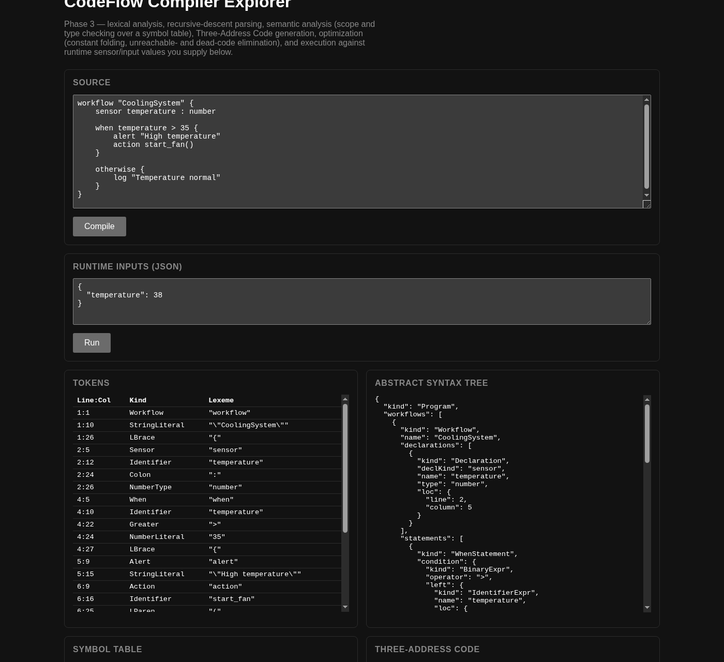
VISUALIZATION
NEW · PHASE 3
Compiler Explorer — Final
Panels (all live)
Source and Runtime Inputs (JSON) editors.
Tokens, AST, Symbol Table.
Three-Address Code and Optimized TAC side by side for before/after comparison.
Errors from every stage, with line and column.
Execution Trace after pressing Run.
Lightweight HTML/CSS/TypeScript bundled with esbuild — no framework, no backend.
CodeFlow — Phase 3 · Compiler Design Laboratory · github.com/dakshcodez/CodeFlow_DSL
13

Slide 14
VERIFICATION
COMPLETE · PHASE 3
Testing by Compiler Stage
131 / 131
tests passing · 10 Vitest suites
Optimizer: each pass as input IR → output IR, plus unchanged execution semantics.
Runtime: both branches, dispatch, alerts, logs, runtime errors.
E2E: source → trace for valid and malformed programs.
CodeFlow — Phase 3 · Compiler Design Laboratory · github.com/dakshcodez/CodeFlow_DSL
14

Slide 15
PROGRESS
From Phase 2 to Phase 3
Component | After Phase 2 | After Phase 3
Lexer / Parser / AST | Complete | Unchanged — regression-tested
Symbol table / Semantic | Complete | Unchanged — feeds the runtime type check
TAC generation | Complete — 9 instruction kinds | Unchanged — now the optimizer's input
Optimizer | Planned | Complete — fold, unreachable, dead code
Execution engine | Planned | Complete — TAC interpreter, runtime errors
Error handling | Lexical · syntax · semantic | + runtime, same CompilerError shape
Visualization | Tokens · AST · Symbols · TAC · Errors | + Optimized TAC · inputs · execution trace
Tests | 81 | 131
CodeFlow — Phase 3 · Compiler Design Laboratory · github.com/dakshcodez/CodeFlow_DSL
15

Slide 16
HONEST NOTES
Limitations and Future Work
Current limitations
Possible next steps
A conditional jump on a known constant (t8 = true; IF_FALSE t8 GOTO L2) is kept, not collapsed.
Constant knowledge resets at labels; no propagation across merge points.
Actions are simulated effects only, by design.
Each workflow runs independently against one shared input record.
Rewrite constant-condition IfFalse into Goto or nothing.
Link each IR line and trace entry back to its source line in the UI.
Step-through view showing temporaries after each instruction.
CodeFlow — Phase 3 · Compiler Design Laboratory · github.com/dakshcodez/CodeFlow_DSL
16

Slide 17
ROADMAP
Phase-wise Roadmap
PHASE 1
PHASE 2
PHASE 3
Problem Definition & System Design
Core Compiler Construction
Optimization, Execution & Integration
Language specification, formal grammar, architecture, technology stack, lexer and basic parser prototype.
Complete lexer and parser, full AST, symbol table, semantic analysis, TAC generation, layered errors.
Constant folding, unreachable and dead-code elimination, execution engine, before/after IR, full Explorer, E2E tests.
COMPLETE
COMPLETE
COMPLETE
CodeFlow — Phase 3 · Compiler Design Laboratory · github.com/dakshcodez/CodeFlow_DSL
17

Slide 18
IN SUMMARY
CodeFlow now compiles, optimizes and runs real programs from source to an execution trace, with every stage inspectable.
Constant folding, unreachable- and dead-code elimination, shown as before/after IR.
Execution engine runs the optimized TAC against supplied sensor / input values.
Runtime errors share the one CompilerError channel with line and column.
Compiler Explorer shows every artifact; 131 tests pass across all stages.
Thank You
GitHub: https://github.com/dakshcodez/CodeFlow_DSL Daksh Arora · 24BCI0259 · VIT Vellore

