Slide 1
Innovative Evaluation Practices · BCSE308P Computer Networks Lab · Fall 2026-27
NetLab: Network Performance Analyzer and Simulator
Theory vs simulation vs real networks, and an RTT-aware Selective Repeat window
Team 15
Ishita Anant · 24BCE0555
Aniket Bhayana · 24BCE2989
Daksh Arora · 24BCI0259
Slot F1 · VIT, School of Computer Science and Engineering
Notes:
Introduce the team. NetLab studies protocols at three levels: theory, our own simulation, and real networking. Our proposed mechanism is a window-sizing rule for Selective Repeat.

Slide 2
Problem and motivation
Course formulas (1/(1+2a), 1-p, Mathis, OSPF cost) are rarely checked against a running implementation
We built NetLab: each protocol is run as theory, simulation and reality and plotted on the same axes
Scope: VLSM, RIP/OSPF, CRC/checksum, ARQ, DNS, TCP Reno/CUBIC/BBR, pcap analyzer, Streamlit dashboard
Comparing Selective Repeat with its formula revealed a systematic gap, which is the focus of this project
Theory
textbook formula
Simulation
our Python, seeded
Reality
UDP sockets, netns + veth + netem
Team 15 · NetLab · 2/10
Notes:
Textbook formulas are true under assumptions. We wanted to see where they stop being true, with measurements instead of trust.

Slide 3
Existing approach (baseline) and its gap
Baseline: Selective Repeat, window N = 1 + 2a (one round trip of frames), per-frame timers
Textbook efficiency: 1 - p once N ≥ 1 + 2a
Assumes a lost frame costs only its own retransmission
The gap (a = 5, 5% loss)
Formula 0.95 · simulation 0.717 · real UDP 0.702
Team 15 · NetLab · 3/10
Notes:
Baseline is textbook Selective Repeat with window N = 1+2a. The formula predicts 1-p. Both simulation and real UDP fall well below it at 5% loss.

Slide 4
Proposed novelty
N = ceil( 2 × (1 + 2a) )
instead of the textbook N = 1 + 2a
Why: a lost frame blocks the window for a timeout plus a round trip, about two round trips of frames, not one
Timers, ACKs and receiver logic unchanged; only the window (and receive buffer) doubles
Rule derived from a measured gap, then checked with 10 seeds per scenario and over real sockets
Also novel: one tool overlaying theory, simulation and reality for every protocol
Team 15 · NetLab · 4/10
Notes:
The change is a single line. Everything else in the protocol is identical, so the comparison isolates the window.

Slide 5
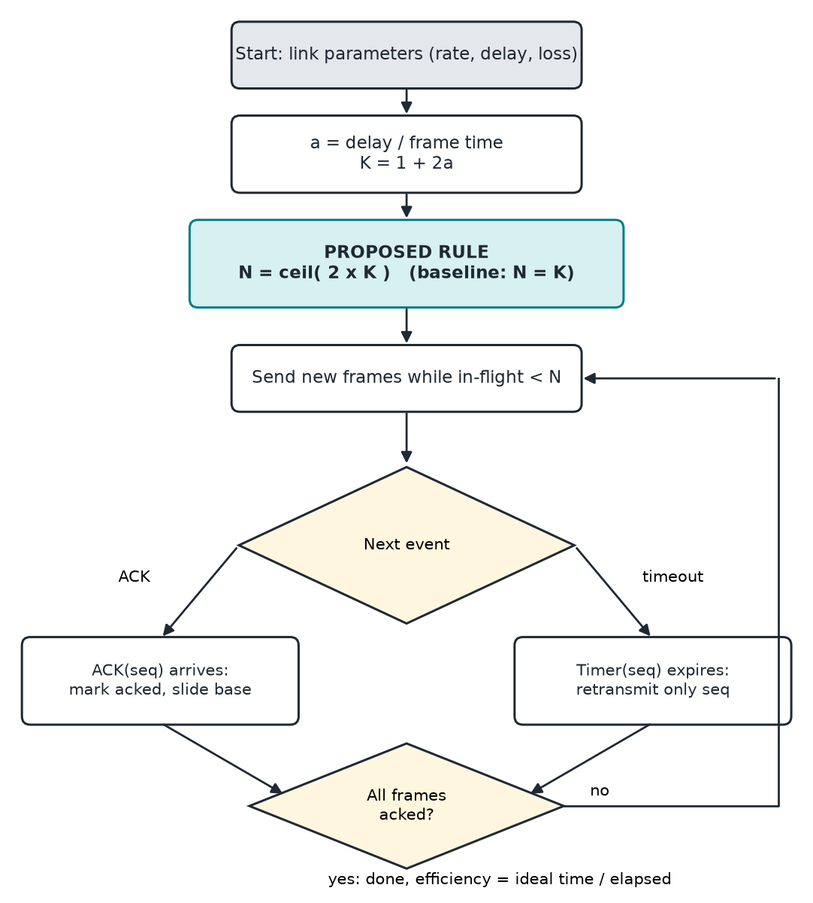
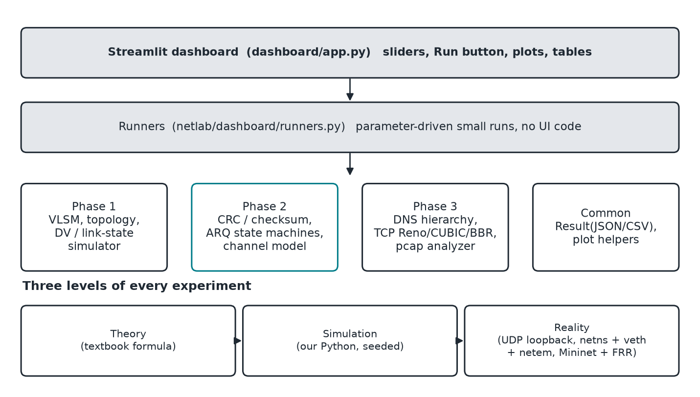
Architecture and algorithm
The same arq.py state machines run in the discrete-event simulator and over UDP sockets, so the two levels differ only in the transport.
Team 15 · NetLab · 5/10
Notes:
Left: the flowchart of the sender with the proposed rule. Right: the architecture; state machines are shared between the simulator and the UDP runner.

Slide 6
Implementation setup
Item | Setting
Language / tools | Python 3.14, uv, matplotlib, Streamlit, pytest
Simulation | Discrete-event, seeded channel: 1 Mbit/s, 109-byte frames, 3000 frames/run
Real level | UDP sockets + delay/loss relay (loopback, 2 ms frames, 150 frames); netns + veth + tc netem
Link | a = 5 (K = 11 frames per round trip), timeout = ACK round trip
Baseline / proposed N | 11 / 22
Repeats | 10 seeds per scenario, mean ± SD
Dashboard | Live baseline vs proposed page with sliders
Not run: Mininet + FRR (RIP vs OSPF), Linux TCP with iperf3. Those results are simulation only.
Team 15 · NetLab · 6/10
Notes:
About 6,500 lines of Python, 94 unit tests. The Mininet and FRR experiments are written but were not run for this report.

Slide 7
Scenarios and metrics
Scenario | Loss | Meaning
S1 (low load) | 1% | clean link
S2 (medium load) | 5% | typical wireless / congested
S3 (high load) | 20% | stress test
Link efficiency = ideal time / elapsed time (1.0 = link always sending first copies)
Retransmissions and discards per frame explain why efficiency changed
Mean ± standard deviation over 10 seeds
Improvement % = proposed / baseline − 1
Extra studies: sweep of a (1 to 20), window sweep, timeout and reordering
Same channel seeds for baseline and proposed
ACKs are not lost; timeout = round trip (textbook assumptions)
Team 15 · NetLab · 7/10
Notes:
Three load scenarios as required. Efficiency is the quantity the formulas predict.

Slide 8
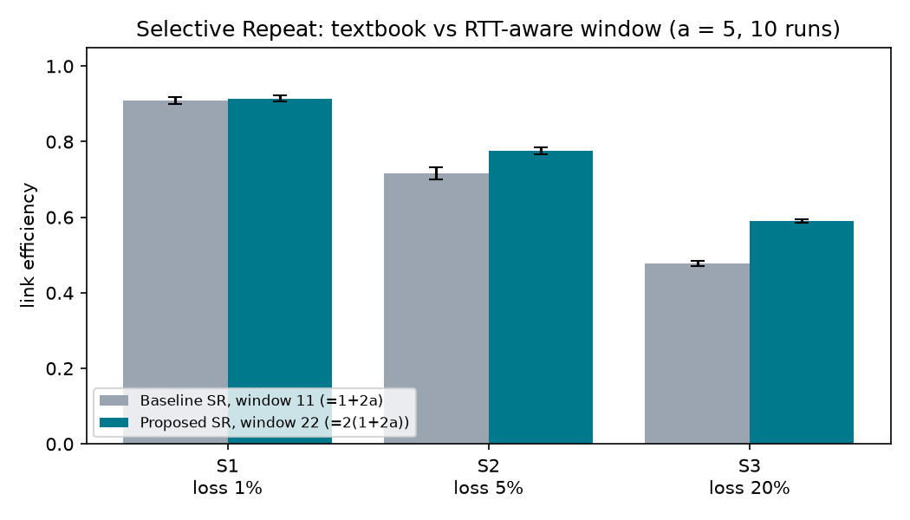
Results: baseline vs proposed
 | Sim base | Sim prop | Gain | Real base | Real prop | Gain
S1 1% | 0.909 ± 0.010 | 0.914 ± 0.008 | +0.6% | 0.871 ± 0.049 | 0.872 ± 0.049 | +0.1%
S2 5% | 0.717 ± 0.016 | 0.776 ± 0.009 | +8.2% | 0.702 ± 0.062 | 0.754 ± 0.061 | +7.4%
S3 20% | 0.478 ± 0.008 | 0.590 ± 0.005 | +23.5% | 0.443 ± 0.039 | 0.552 ± 0.048 | +24.6%
a | Baseline N → proposed | Gain
1 | 3 → 6 | +1.6%
5 | 11 → 22 | +8.2%
10 | 21 → 42 | +12.5%
20 | 41 → 82 | +18.9%
Sensitivity at 5% loss (simulation, 10 runs)
Team 15 · NetLab · 8/10
Notes:
Efficiency, mean ± SD over 10 runs. Real UDP agrees with simulation; its SD is about five times larger because each run has only 150 frames.

Slide 9
Analysis and limitations
Analysis
Limitations
A lost frame stalls an N = K window for about two round trips; N = 2K keeps the link busy meanwhile
Gain grows with loss and with a (longer stalls)
Simulation and real UDP agree; only S3 is a clear win at the real level (SD ~5× larger)
Also: GBN collapses under reordering (0.39 vs SR 0.91 at 10%); CRC-32 caught every error, checksum missed 100% of reordered words
Does not reach 1 − p: 0.776 vs 0.95 at 5% loss; N = 48 reaches 0.835
No gain on clean links; doubles buffer, timers and sequence space
Assumes no ACK loss and timeout = round trip
Real level is loopback with 150-frame runs
Mininet/FRR and iperf3 runs not done; BBR model simplified
Team 15 · NetLab · 9/10
Notes:
Be upfront: the proposal does not reach the textbook ideal, and the Mininet testbed was not run.

Slide 10
Conclusion, future work and references
RTT-aware window 2(1+2a): +0.6% / +8.2% / +23.5% efficiency at 1 / 5 / 20% loss (simulation), +0.1% / +7.4% / +24.6% over real UDP
NetLab: 6,500 lines, 94 tests, dashboard, reproducible via make
Future: run Mininet + FRR and iperf3, ACK loss and adaptive timeouts, derive the window analytically, complete BBR model
References
[1] W. Stallings, Data and Computer Communications, 10th ed., Pearson, 2013.
[2] J. Kurose and K. Ross, Computer Networking: A Top-Down Approach, 8th ed., Pearson, 2021.
[3] B. Lantz, B. Heller, N. McKeown, "A network in a laptop," HotNets-IX, 2010.
[4] M. Mathis et al., "The macroscopic behavior of the TCP congestion avoidance algorithm," ACM CCR 27(3), 1997.
[5] S. Ha, I. Rhee, L. Xu, "CUBIC," ACM SIGOPS OSR 42(5), 2008. [6] N. Cardwell et al., "BBR," ACM Queue 14(5), 2016.
Full list in the report. Code: github.com/dakshcodez/netlab
Team 15 · NetLab · 10/10
Notes:
Close with the quantified result, then future work. References are in IEEE style in the report.

