Slide 1

ANALYSING API DATA
MENU
ANALYSIS
CONTACT
Data ANALYSIS
Made BY:-
SANYAM JAIN[N229]
DAKSH GEHLOT[N230]
GAUTAM KUNDALIA[243]

Slide 2
Table of Content
MENU
ANALYSIS
CONTACT
API,TYPES OF API.
Problem Statement
Expected Solution
Methodology
Tools Used
Working
Source Code
Application and Conclusion

Slide 3
API
MENU
ANALYSIS
CONTACT
Data ANALYSIS
APIs are mechanisms that enable two software components to communicate with each other using a set of definitions and protocols. For example, the weather bureau’s software system contains daily weather data. The weather app on your phone “talks” to this system via APIs and shows you daily weather updates on your phone.

Slide 4
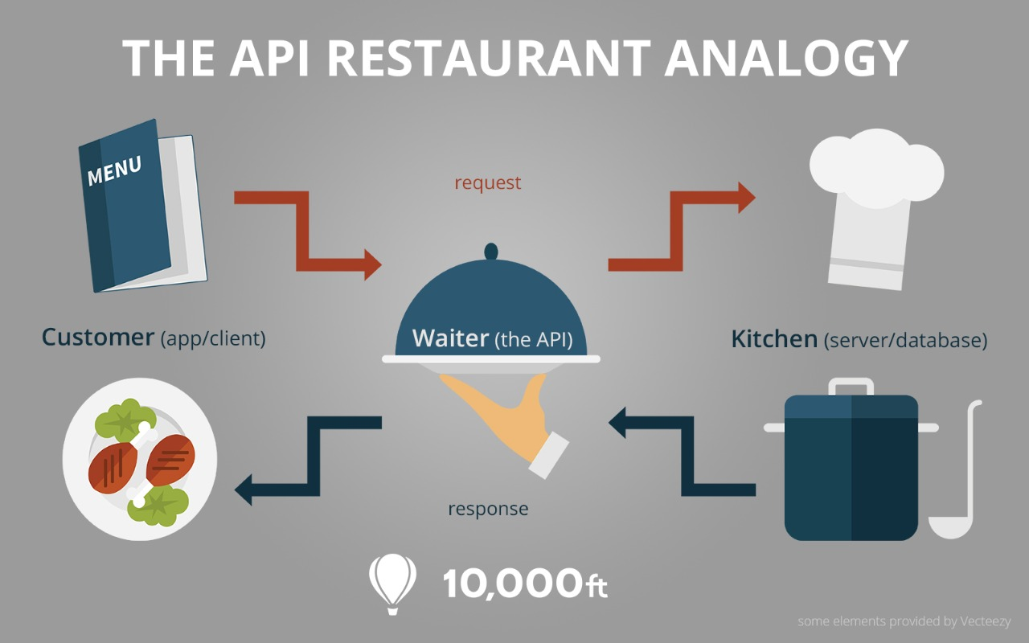
Example

Slide 5
Types of API
MENU
ANALYSIS
CONTACT
Data ANALYSIS
PUBLIC APIs
PRIVATE APIs
PARTNER APIs
COMPOSITE APIs

Slide 6
Problem Statement
Predicting the climatical analysis of a particular place.
Expected Solution
Knowing the weather conditions of a particular place

Slide 7
Tools Used
RStudio; an integrated development environment for R, a programming language for statistical computing and graphics.
Visual Studio Code, also commonly referred to as VS Code, is a source-code editor made by Microsoft with the Electron Framework, for Windows, Linux and macOS.

Slide 8
Methodology
Using the platform R Studio to get datasets, create our own, do data extraction, data cleaning, and data visualisation tasks.
Using API to retrieve data on various climatic constraints and filtering that data using python

Slide 9
Working
In our program, we used two APIs, one is called the Open Weather Map API and the other is the Geocoder API. The first is used to identify the geo coordinates of a specific location that the user has specified, and the other to receive details about the local weather. The data is received as nested lists and dictionaries.
The incoming data is saved as a CSV file, from which it is later possible to execute data analysis using R programming language.

Slide 10
Source CODE

Slide 11
APPLICATION
Google Maps API and Twitter API may be among the most widely used API examples, but most software-as-a-service (SaaS) providers offer APIs that let developers write code that posts data to and retrieves data from the provider's site as well.

Slide 12
CONCLUSION
APIs are essential to good software design, and they assume a range of incarnations in the different layers of our software. When you are writing software, it is valuable to think of the code you are writing as a component, potentially reusable in other systems.
Using well-designed APIs lets us compose our software of logically distinct components. These components can be maintained in relative isolation, and the functionality behind them can be reused between different applications.

Slide 13
References
Other Useful free websites that helped us overcome the errors 1:
https://www.mulesoft.com
https://www.infoworld.com
https://pypi.org
Weather API via: https://openweathermap.org/api/
API used for coordinates via: https://opencagedata.com/

