Slide 1




IBM SkillsBuild
AI
TEAM AETHERMINDS
AI STARTUP LAUNCHPAD
Turning a raw startup idea into a structured, investor-ready analysis — in seconds.
Project Presentation — IBM SkillsBuild Gen AI & Cloud Computing Internship
Dakshita Biwal
24EACCS077 / CSE
Raunak Mishra
24EACCS657 / CSE
Aman Singh
24EACAD005 / AIDS
Chanda Kumari
24EACCS072 / CSE
Team Lead · Backend & Deployment
Frontend Development & UI/UX
Testing & Documentation
Research, Content & Presentation
September 2026

Slide 2
AGENDA
What We'll Cover Today
01
02
03
04
Our Internship
The Problem
Our Solution
Live Product
BharatCares × IBM SkillsBuild journey
Why founders struggle to structure an idea
How AI Startup Launchpad solves it
Features, architecture & screenshots
05
06
07
Engineering
Our Team
What's Next
Key technical decisions we made
Roles, contributions & what we learned
Limitations & future roadmap
AI Startup Launchpad · Team AetherMinds

Slide 3
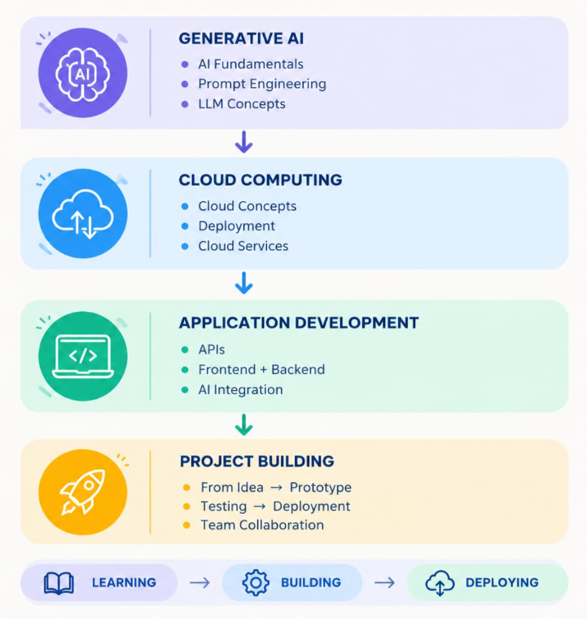
BEFORE THE PROJECT
Our Internship Journey
All four of us completed the BharatCares 6-week ‘IBM SkillsBuild Gen AI & Cloud Computing Internship’, conducted from 22nd June 2026 to 31st July 2026, in association with the All India Council for Technical Education (AICTE) and IBM SkillsBuild.
6 weeks of structured, hands-on Generative AI & Cloud training
Hands-on exposure to AI fundamentals, prompt engineering & cloud basics
This project is our practical submission for the internship
IN ASSOCIATION WITH
AI Startup Launchpad · Team AetherMinds

Slide 4
THE PROBLEM
A Good Idea Isn't the Same as a Structured Pitch
Early-stage founders — especially first-time founders, students, and hackathon participants — usually have a strong intuition for a problem worth solving. What they lack is the structured language investors, mentors, and reviewers expect.
BLANK TEMPLATE
Structure ✓ Content ✗
You're still stuck — just inside labeled boxes instead of a blank page.
Founders lose time formatting instead of validating substance
Blank templates give structure — but zero content
GENERIC AI CHATBOT
Content ✓ Structure ✗
General chatbots give content — but no consistent structure
Only useful if you already know the right 8-9 questions to ask, in order.
Reviewers spend more time decoding notes than judging ideas
AI Startup Launchpad · Team AetherMinds

Slide 5
OUR SOLUTION
One Idea In. Eight Structured Sections Out.
AI Startup Launchpad sits between a blank template and an open-ended chatbot: it supplies both the structure AND a first-pass of the content, in a single submission.
Raw Startup Idea
Google Gemini
8 Structured Sections
→
→
"A mobile app that helps college students find affordable tiffin services..."
One structured request → predictable, validated 8-section JSON response
Streamed progressively to the browser via Server-Sent Events
Business Summary
Problem Statement
Target Audience
UVP
SWOT Analysis
MVP Features
Revenue Model
Elevator Pitch
AI Startup Launchpad · Team AetherMinds

Slide 6
WHO IT'S FOR
Built for People Racing a Deadline
1
2
3
Student / Hackathon Participant
Internship / Accelerator Applicant
First-Time Founder
Has a strong idea, no formal business background — needs a credible structured draft to build on.
Faces a tight, judged deadline — needs fast, professional-looking output without prior pitch experience.
Must fill a fixed submission template — needs section-by-section coverage of every required field.
AI Startup Launchpad · Team AetherMinds

Slide 7
PRODUCT OUTPUT
The Eight-Part Business Framework
1
2
3
4
Business Summary
Problem Statement
Target Audience
Unique Value Proposition
5
6
7
8
SWOT Analysis
MVP Features
Revenue Model
Elevator Pitch
AI Startup Launchpad · Team AetherMinds

Slide 8
KEY FEATURES
What Makes the Product Feel Complete
✓
AI-Powered Analysis
✓
Progressive Streaming
Enter almost any startup concept and get a structured business analysis via Gemini.
Sections render live via SSE — no blank-screen wait for a single big response.
✓
Structured & Validated Output
✓
Quick Examples
Gemini's response is validated against a Pydantic schema before reaching the UI.
Built-in example ideas so any user can try the tool immediately.
✓
Dark / Light Theme
✓
PDF Export
A theme toggle for a more flexible, comfortable viewing experience.
Users can export their generated analysis as a shareable PDF report.
✓
Fully Responsive
✓
Interactive API Docs
Consistent experience across desktop and smaller screen sizes.
FastAPI auto-generates Swagger documentation at /docs.
AI Startup Launchpad · Team AetherMinds

Slide 9
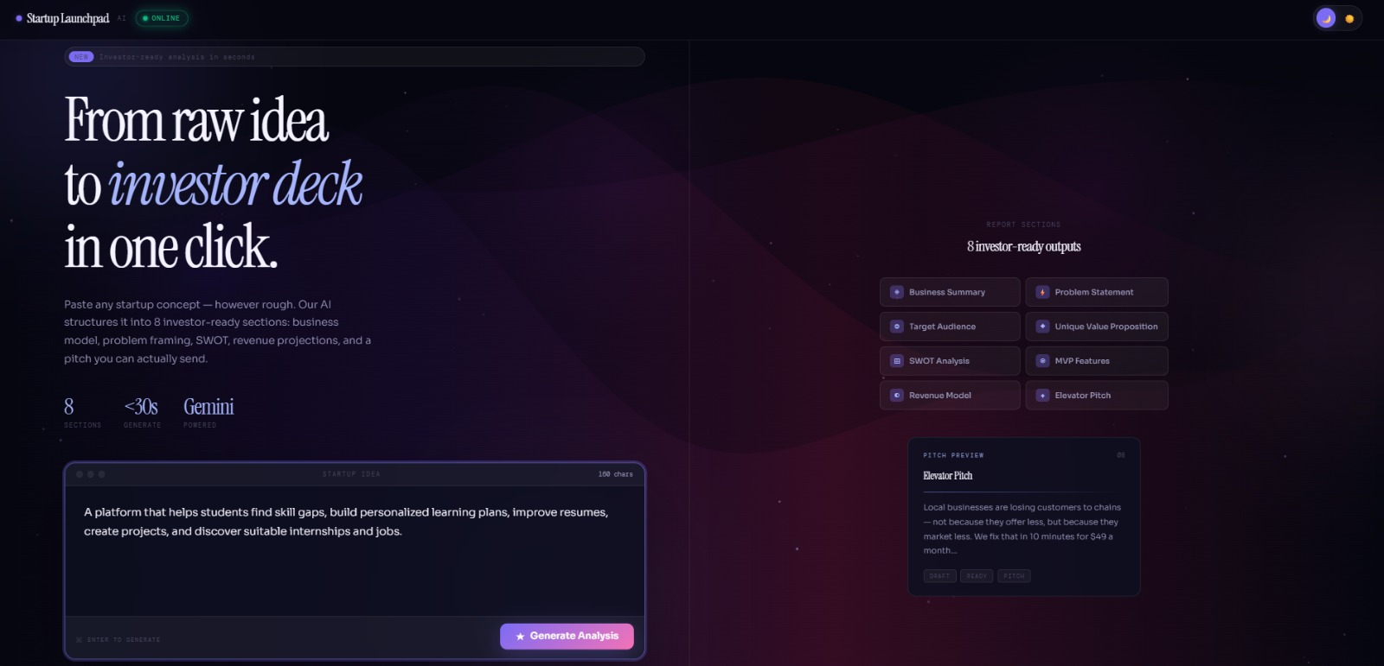
LIVE PRODUCT
See It In Action
AI Startup Launchpad · Team AetherMinds

Slide 10
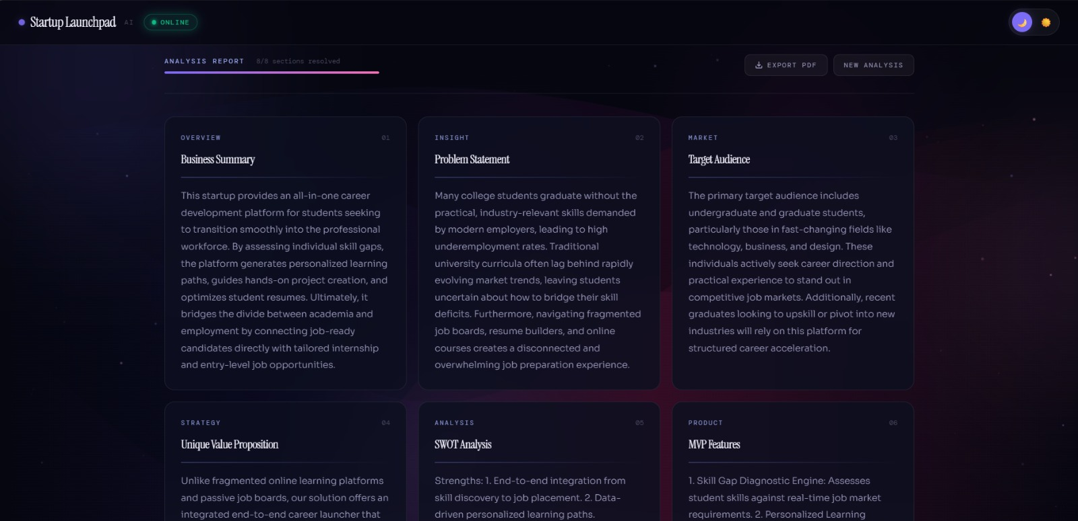
LIVE PRODUCT
See It In Action
AI Startup Launchpad · Team AetherMinds

Slide 11
PROCESS FLOW
How It Works — Step by Step
1
2
3
4
User enters a startup idea
→
Frontend sends a POST request
→
FastAPI backend receives the idea
→
Backend sends ONE structured request to Gemini
5
6
7
8
Gemini generates all 8 sections
→
Backend validates the response (Pydantic)
→
Backend streams sections via SSE
→
Frontend renders each section progressively
AI Startup Launchpad · Team AetherMinds

Slide 12
SYSTEM ARCHITECTURE
The Technology Layers Behind It
USER
NETLIFY
RENDER
GEMINI
PYDANTIC
SSE
→
→
→
→
→
Enters idea
Frontend UI
FastAPI backend
One structured request
Schema validation
Progressive events
Frontend renders the report progressively, then offers PDF export.
Frontend
Backend
AI Layer
HTML · CSS · JavaScript · Netlify
Python · FastAPI · Uvicorn · Render
Google Gemini API · google-genai SDK
AI Startup Launchpad · Team AetherMinds

Slide 13
ENGINEERING DECISION
From 8 API Calls to 1 — Why It Matters
BEFORE
AFTER
8 independent Gemini requests
1 structured Gemini request
Created unnecessary API pressure and risked hitting Gemini's free-tier rate limits.
Returns all 8 sections as one validated JSON object, then streamed via SSE.
Fewer API calls, lower rate-limit risk
Simpler, easier-to-maintain backend
Predictable, schema-validated response
Frontend still renders progressively via SSE
Note: SSE delivers the 8 completed sections progressively — this is not token-by-token Gemini streaming.
AI Startup Launchpad · Team AetherMinds

Slide 14








TECHNOLOGY STACK
What We Built It With
Frontend
Backend
Artificial Intelligence
Deployment
HTML5
Python
Google Gemini API
Netlify — Frontend
JavaScript
FastAPI
google-genai SDK
Render — Backend
Fetch API / SSE
Uvicorn
Structured JSON
GitHub — Source Control
Responsive UI
Pydantic
AI Startup Launchpad · Team AetherMinds

Slide 15
TEAM COLLABORATION
Our Git & GitHub Workflow
main branch
feature branch
changes
commit
push
pull request
review
merge to main
→
→
→
→
→
→
→
Every team member worked on their own feature branch before merging
Pull requests were reviewed before merging into main
GitHub kept a clear history of who contributed what, and when
After a merge: git checkout main → git pull origin main
AI Startup Launchpad · Team AetherMinds

Slide 16
OUR TEAM
Roles & Individual Contributions
D
Dakshita Biwal
R
Raunak Mishra
A
Aman Singh
C
Chanda Kumari
Team Lead
Frontend Development & UI/UX
Testing & Documentation
Research, Content & Presentation
Backend development & FastAPI architecture
Frontend implementation
Application testing
Startup / business research
Gemini API integration
UI/UX improvements
Test case design
Content preparation
Structured AI response design
Responsive design
Documentation
Presentation support
Server-Sent Events implementation
Startup analysis interface
Research support
Project explanation
API testing & deployment
Frontend interaction logic
Presentation preparation
Documentation assistance
GitHub repo management
Visual presentation
AI Startup Launchpad · Team AetherMinds

Slide 17
SKILLS GAINED
What We Learned Through This Project
FastAPI & REST APIs
Pydantic schema validation
Gemini API & Google GenAI SDK
Structured AI responses
Server-Sent Events (SSE)
Asynchronous Python
JavaScript Fetch API
Responsive frontend development
Git & GitHub workflows
Pull requests & code review
Netlify & Render deployment
Environment variables & API security
AI Startup Launchpad · Team AetherMinds

Slide 18
TRY IT YOURSELF
The Project Is Live — Here's Where
Live Website
Backend API
ai-startup-launchpad.netlify.app
ai-startup-launchpad.onrender.com
API Documentation
GitHub Repository
ai-startup-launchpad.onrender.com/docs
github.com/dakshita01/ai-startup-launchpad
AI Startup Launchpad · Team AetherMinds

Slide 19
WHAT'S NEXT
Future Scope
User authentication
Saved analyses & history
Startup comparison tool
Competitor research module
Market-size estimation
AI-generated business model canvas
AI-generated pitch deck
Financial projections
Team collaboration features
These can be added incrementally without changing the current frontend/backend architecture.
AI Startup Launchpad · Team AetherMinds

Slide 20
AI
Thank You
Questions & Discussion Welcome
Team AetherMinds · Dakshita Biwal · Raunak Mishra · Aman Singh · Chanda Kumari
github.com/dakshita01/ai-startup-launchpad

