Slide 1

ARYA'S DOMAIN VERSE 1.0
Data Science Domain | Internal Hackathon | 24-30 September 2026
Employee Attrition
Risk Predictor
PS-05 — Employee Attrition Analysis & Prediction
Name
Dakshita Biwal
Roll No.
24EACCS077
Department
Computer Science & Engineering
Institution
Arya College of Engineering, Kukas, Jaipur
Section
Alpha
Arya's Domain Verse 1.0 | PS-05: Employee Attrition Prediction
1

Slide 2
Problem Statement
!
The Real-World Problem
→
Expected Outcome
Organizations invest heavily in recruiting and training employees. When employees leave unexpectedly, it disrupts productivity and increases hiring costs. Rich employee data — salary, role, satisfaction, overtime, tenure — already exists but is rarely used proactively to anticipate attrition before it happens.
A working classification system that:
Predicts whether an employee is at risk of leaving
Identifies the key factors driving attrition
Presents a simple Low / Medium / High risk score
Why it matters: Losing employees unexpectedly costs organizations both time and money, and disrupts ongoing work.
Is usable through a live, interactive interface
Users: HR teams, organizations, business analysts.
Arya's Domain Verse 1.0 | PS-05: Employee Attrition Prediction
2

Slide 3
Objective & Key Features
What this project sets out to do, and what was actually built
Objective
Key Features Built
Build a classification model that predicts employee attrition risk
Trained Logistic Regression model on the full employee dataset
1
Low / Medium / High attrition risk classification
2
Identify the factors most strongly associated with attrition
Feature-importance analysis of key attrition drivers
3
Convert model output into an easy-to-read risk indicator
Two-model comparison (Logistic Regression vs Random Forest)
4
Compare two different classification approaches fairly
Interactive Streamlit app with live prediction + dashboard
Arya's Domain Verse 1.0 | PS-05: Employee Attrition Prediction
3

Slide 4
Dataset Overview
IBM HR Analytics Employee Attrition & Performance Dataset (Kaggle)
1,470
35
7
~44
Employee Records
Original Attributes
Categorical Fields
Model-Ready Features
Attribute Categories Used
Demographic
Job & Role
Age, Gender, Marital Status, Distance From Home, Education
Department, Job Role, Job Level, Business Travel, Job Involvement
Compensation
Satisfaction & Tenure
Monthly Income, Monthly Rate, Daily Rate, Hourly Rate, Salary Hike
Job/Environment Satisfaction, Work-Life Balance, Overtime, Years at Company
Removed during cleaning: EmployeeCount, StandardHours, Over18 (constant values) and EmployeeNumber (unique ID) — none carry predictive information.
Arya's Domain Verse 1.0 | PS-05: Employee Attrition Prediction
4

Slide 5
Approach & Methodology
A structured, end-to-end data science pipeline
1
2
3
4
5
6
Clean
›
Explore
›
Encode
›
Train
›
Evaluate
›
Deploy
Remove constant/ID columns; encode target
EDA on department, overtime, income, satisfaction
One-hot encode 7 categorical fields (~44 features)
Logistic Regression vs Random Forest
Accuracy, Precision, Recall, F1, ROC-AUC
Streamlit app for live prediction + insights
Arya's Domain Verse 1.0 | PS-05: Employee Attrition Prediction
5

Slide 6
Model Training & Comparison
Selected Model:
Logistic Regression
Random Forest scores higher on accuracy, but the dataset is imbalanced (~84% stay, ~16% leave). Accuracy alone rewards predicting "stays" by default.
Logistic Regression achieves 0.617 Recall vs 0.277 — catching over 2x more employees who actually leave — plus higher F1 and ROC-AUC.
Missing an at-risk employee costs more than a false alarm.
Arya's Domain Verse 1.0 | PS-05: Employee Attrition Prediction
6

Slide 7
Key Insights from the Data
1
2
3
Overtime
Satisfaction
Income & Tenure
Employees working overtime leave at a noticeably higher rate than those who don't.
Lower job satisfaction and work-life balance scores correlate with higher attrition.
Employees with fewer working years and lower stock options show elevated risk.
Arya's Domain Verse 1.0 | PS-05: Employee Attrition Prediction
7

Slide 8
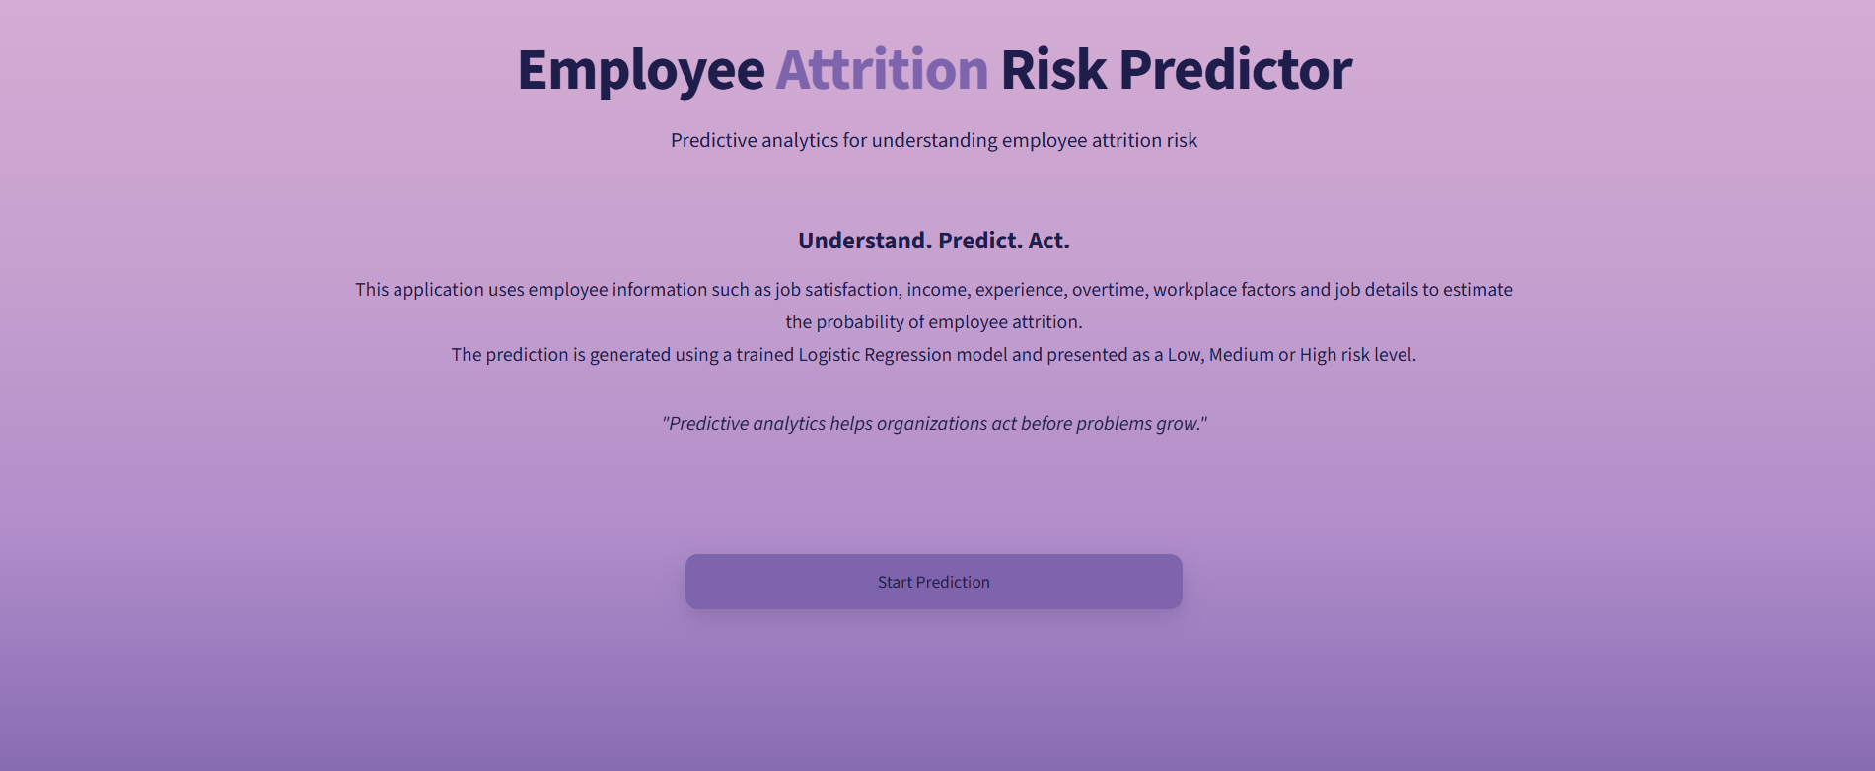
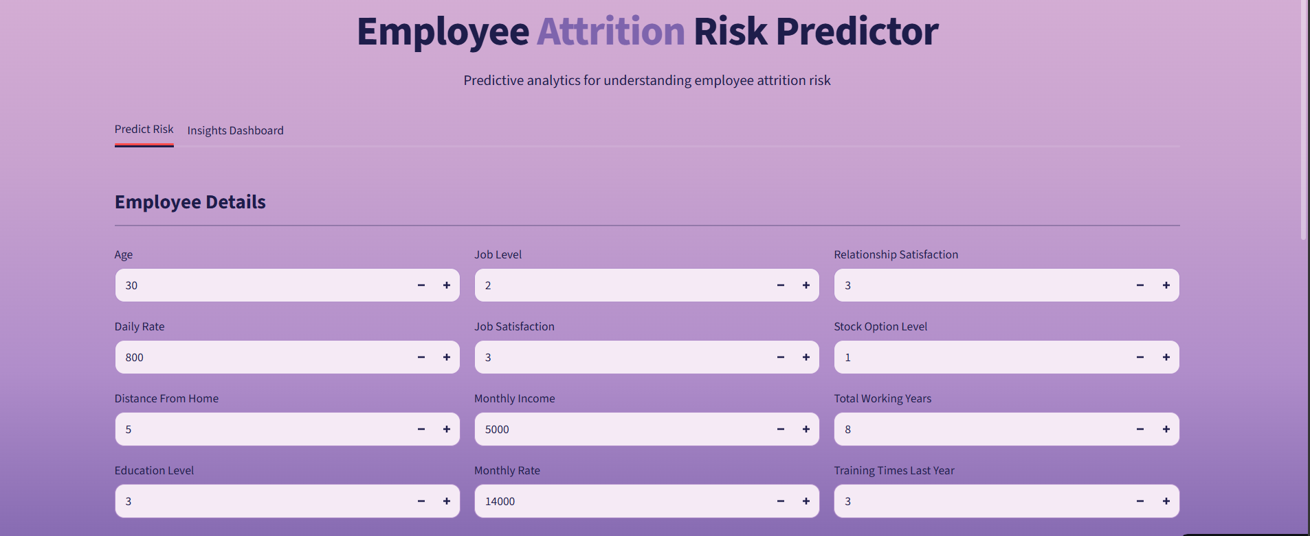
Live Demo — Overview & Dashboard
Screenshots of the deployed Streamlit application
Landing Page
Employee Details Input
The dashboard summarizes dataset-wide attrition patterns — total employees, attrition rate, and breakdowns by department and overtime status.
Arya's Domain Verse 1.0 | PS-05: Employee Attrition Prediction
8

Slide 9
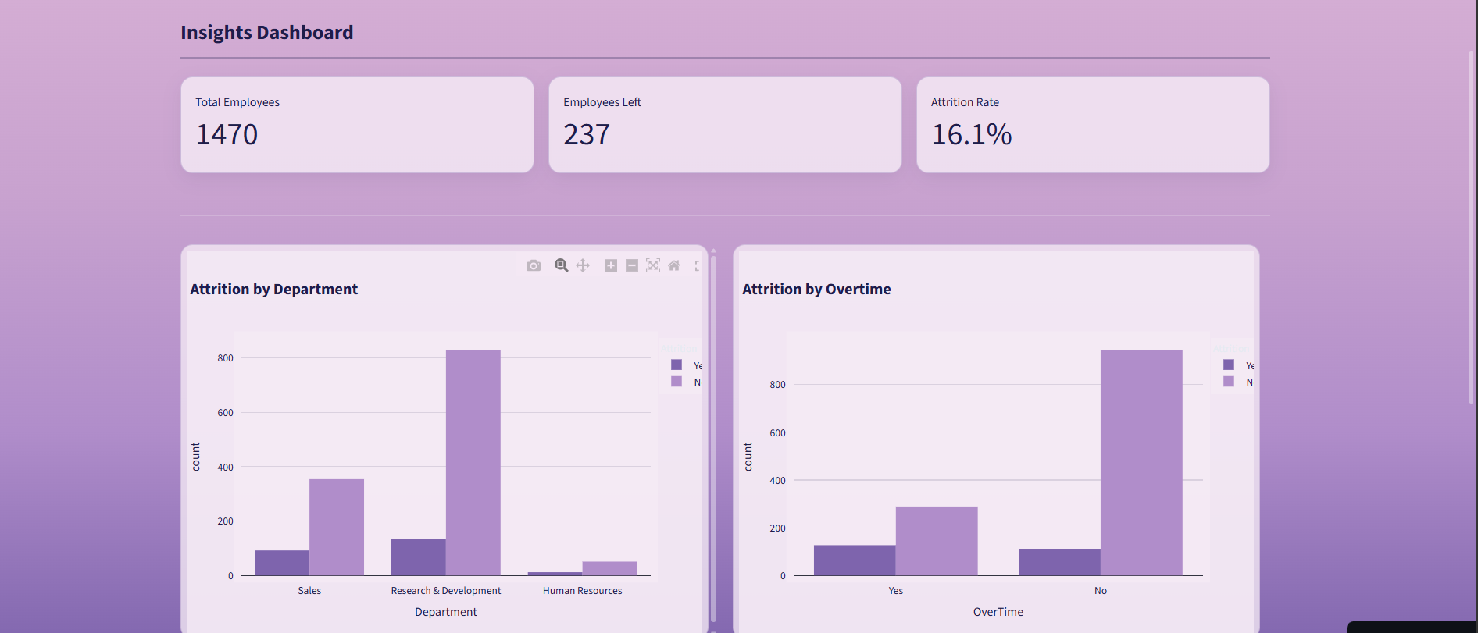
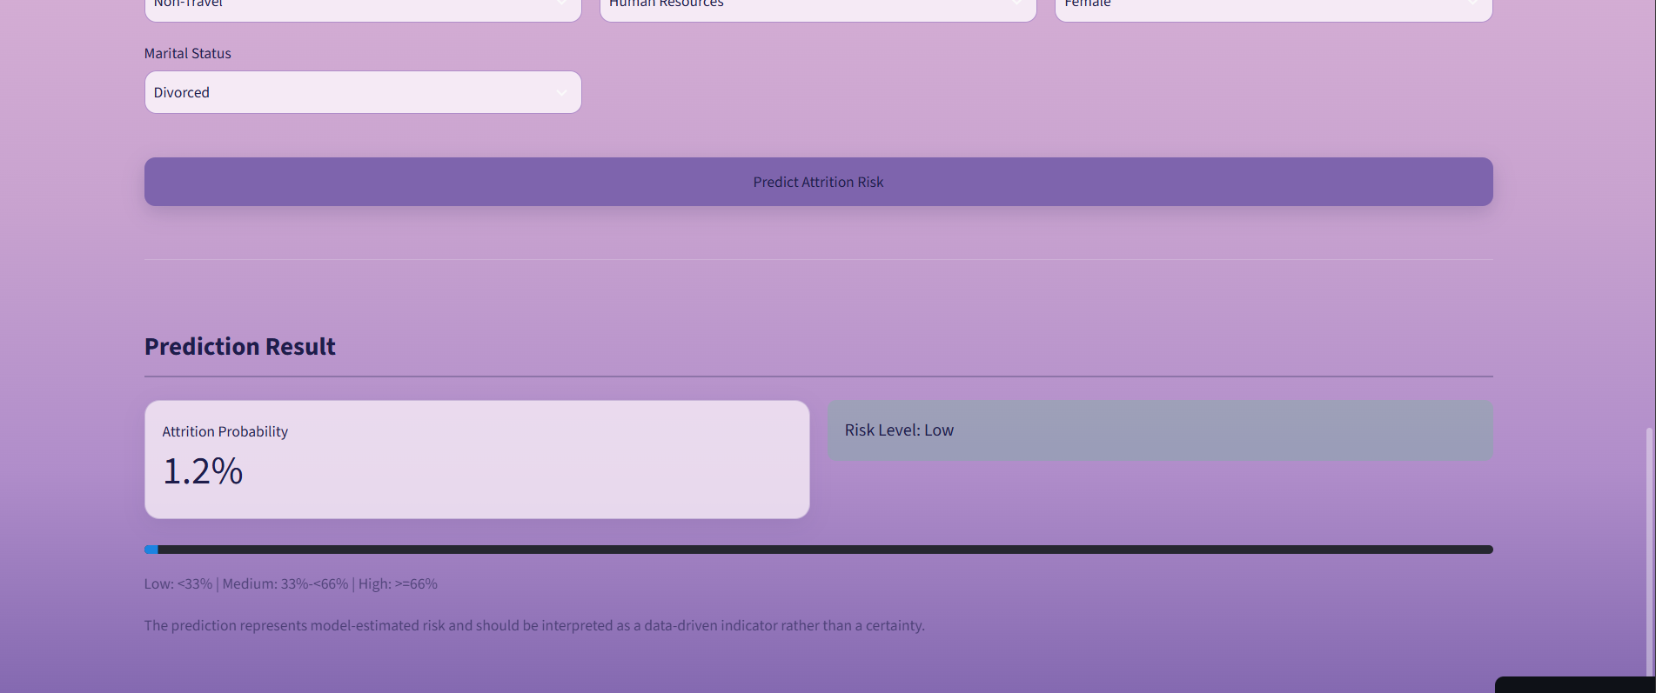
Live Demo — Risk Prediction
From employee input to a live, explainable prediction
Insights Dashboard
Prediction Result
A user fills in an employee's profile, clicks Predict, and instantly receives an attrition probability and a color-coded Low / Medium / High risk level.
Arya's Domain Verse 1.0 | PS-05: Employee Attrition Prediction
9

Slide 10
Technology Stack
Python
pandas
NumPy
scikit-learn
Matplotlib
Seaborn
Plotly
Streamlit
joblib
Jupyter Notebook
VS Code
Git & GitHub
Arya's Domain Verse 1.0 | PS-05: Employee Attrition Prediction
10

Slide 11

Thank You
Employee Attrition Risk Predictor | PS-05
GitHub Repository
https://github.com/dakshita01/attrition-predictor-domainverse
Live Demo
https://attrition-predictor-domainverse.streamlit.app/
Roll No.
24EACCS077 | CSE, Section Alpha
Arya College of Engineering, Kukas, Jaipur

