Slide 1



COMPUTER ORGANIZATION &
ARCHITECTURE
(21CS34)
PRESENTATION
TOPIC:- A GENERAL 8-BIT PARALLEL INTERFACE
DAKSHITH S
ISE 1SV21IS004

Slide 2
*Data-lines P7 through Po can be used for either input or output purposes.
*The DATAOUT register is connected to data-lines via 3-state drivers that are controlled by a DDR.
*The processor can write any 8-bit pattern into DDR. (DDR→ Data Direction Register).
* If DDR=1,
Then, data-line acts as an output-line;
Otherwise, data-line acts as an input-line.

Slide 3

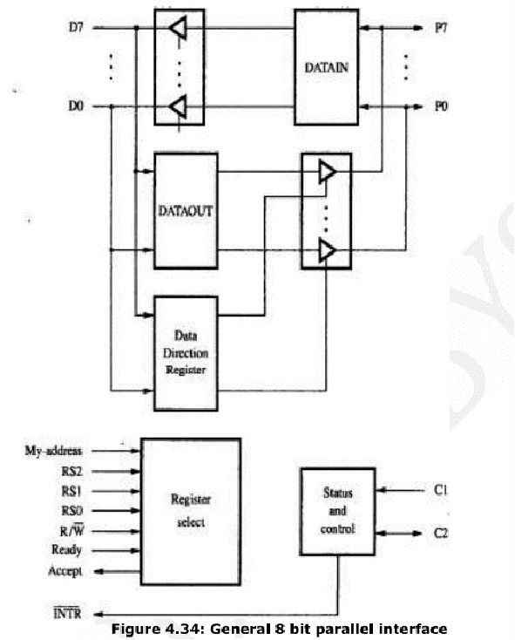

*Two lines, C1 and C2 are used to control the interaction between interface-circuit and I/O device.
*Two lines, C1 and C2 are also programmable.
*The Ready and Accept lines are the handshake control lines on the processor-bus side.
*Hence, the Ready and Accept lines can be connected to Master-ready and Slave-ready.
3

Slide 4
* The input signal My-address should be connected to the output of an address-decoder.
The address-decoder recognizes the address assigned to the interface.
* There are 3 register select lines: RS0-RS2. Three register select lines allows up to eight registers in the interface.
* An interrupt-request INTR is also provided. INTR should be connected to the interrupt-request line on the computer-bus.
4

Slide 5
THANK YOU

