Slide 1
FIRSTGEAR-ONE STOP PLACE FOR CAR SPARES
Mentor: Dr. Suneet Kumar Gupta
Presented by
Daksh Mehta
E18CSE043
Submitted
to
DEPARTMENT OF COMPUTER SCIENCE ENGINEERING
BENNETT UNIVERSITY, GREATER NOIDA, 201310, UTTAR PRADESH, INDIA

Slide 2
OUTLINE
Introduction & Background
What Problem does it solve?
Relevance of the problem
Methodology
Technologies Used
Results
Conclusion and Future Work
YouTube Video and GitHub Link

Slide 3

Introduction
FirstGear is an online marketplace for car spare parts.
It is a one stop destination for all kinds of car spare parts such as brakes, tyres, engine oil, etc.
Our service is available via a web app which the user can access and place their order online through it by browsing through the parts listed on the website.

Slide 4
What Problem Does It Solve?
Traditionally, general vehicle service has been done at dealerships. This process costs a lot since labour charges pile up.
FirstGear sells these parts to the consumers and ships them directly to their home. They can then install them themselves by simply looking at YouTube videos or via a local mechanic.
This process would lead to considerable savings.

Slide 5
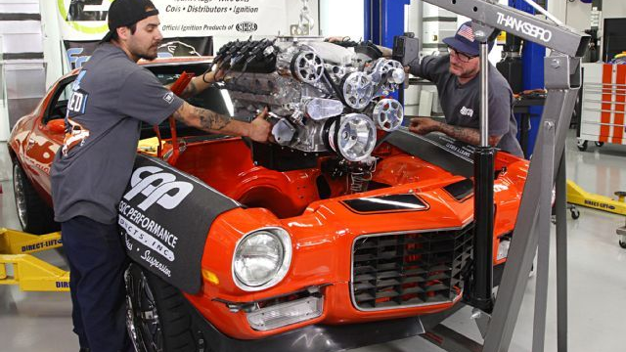
Relevance of the Problem
Our service targets car enthusiasts, people who love to pamper their vehicles and like to perform some of the regular maintenance tasks on their own such as changing the oil, air filter etc.
In case of a minor accident, it may turn out to be costly to send the car to the showroom. In such cases, procuring the part from FirstGear and getting it fit via a local mechanic would be cheaper.
Currently Not many such services exist in the Indian market.
A few companies such as boodmo and GoMechanic are the only main players in this field. FirstGear aims to compete with them.
Compared to others, FirstGear offers a simple and intuitive UI design so that it is extremely easy to use it.

Slide 6
Methodology
Firstly, created a rough design of the frontend and made a note of the features that should be included in the website. (Such as search, contact us, checkout page, payment gateway)
Researched which programming language would suit this use-case and set up the environment accordingly by installing the relevant dependencies.
Created the front-end of the application.
Created a database and linked the backend with the frontend.
Created a super-user to list more items and add them to the database.
Added search functionality to list the items the user is looking for.
Integrated payment gateway to make the process easier.
Hosted the complete application online.

Slide 7




Technologies used
Python
Django
HTML
CSS
JavaScript
Heroku

Slide 8
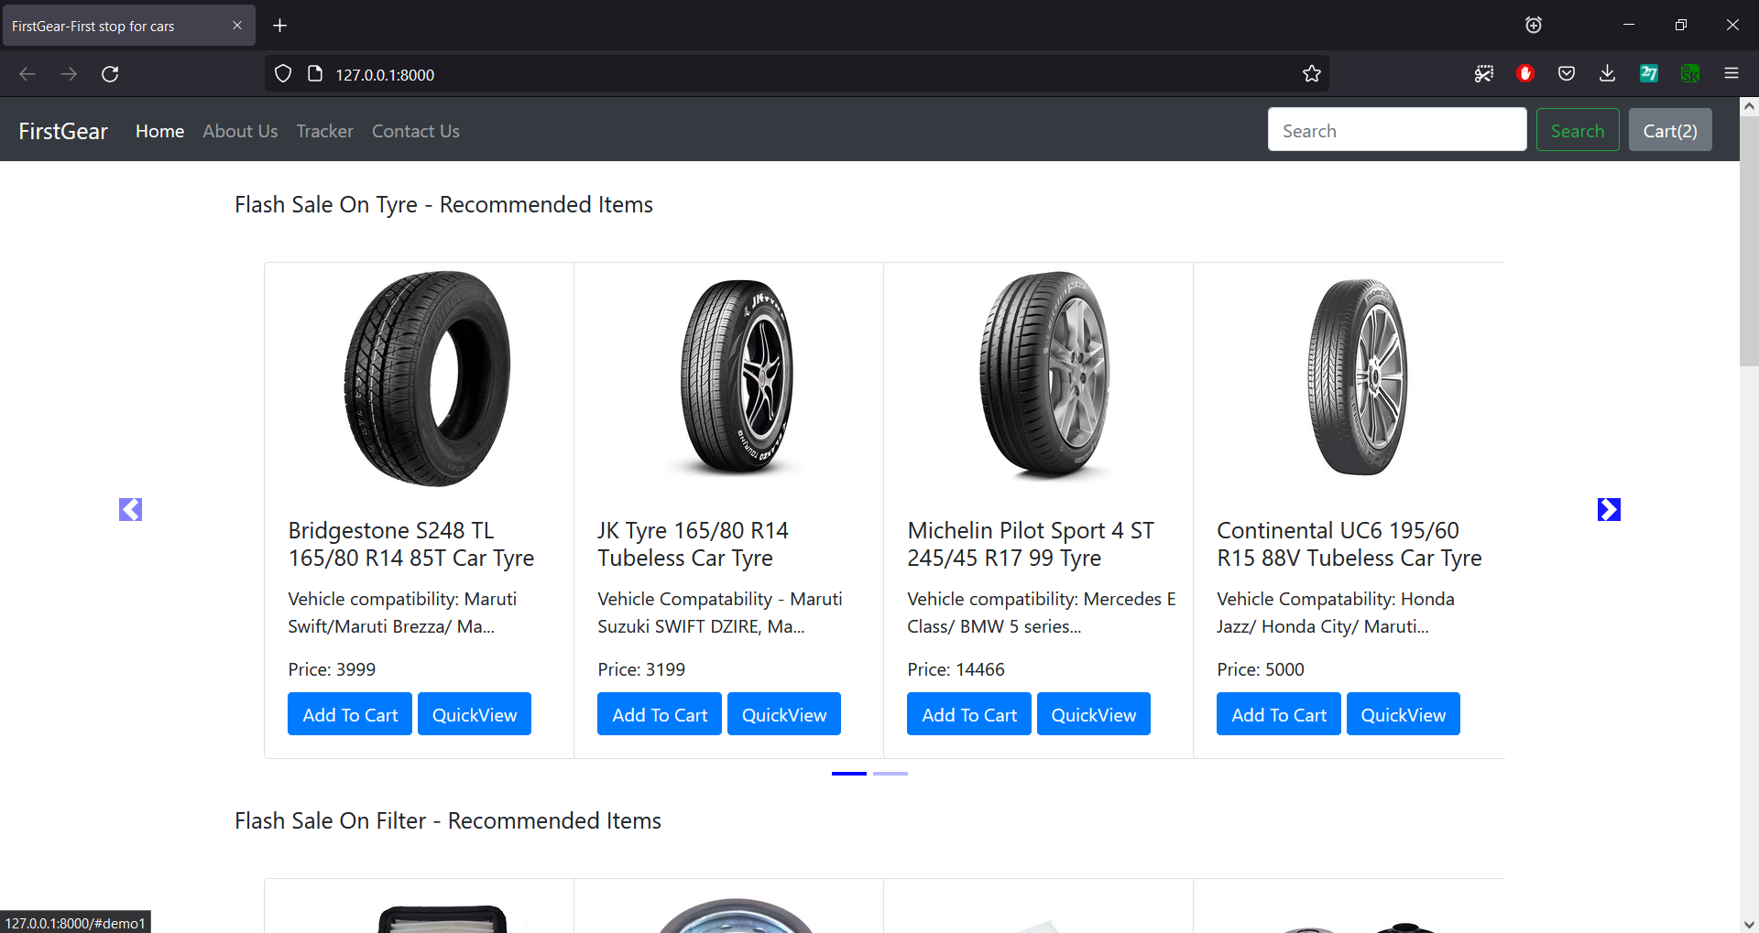
Results

Slide 9
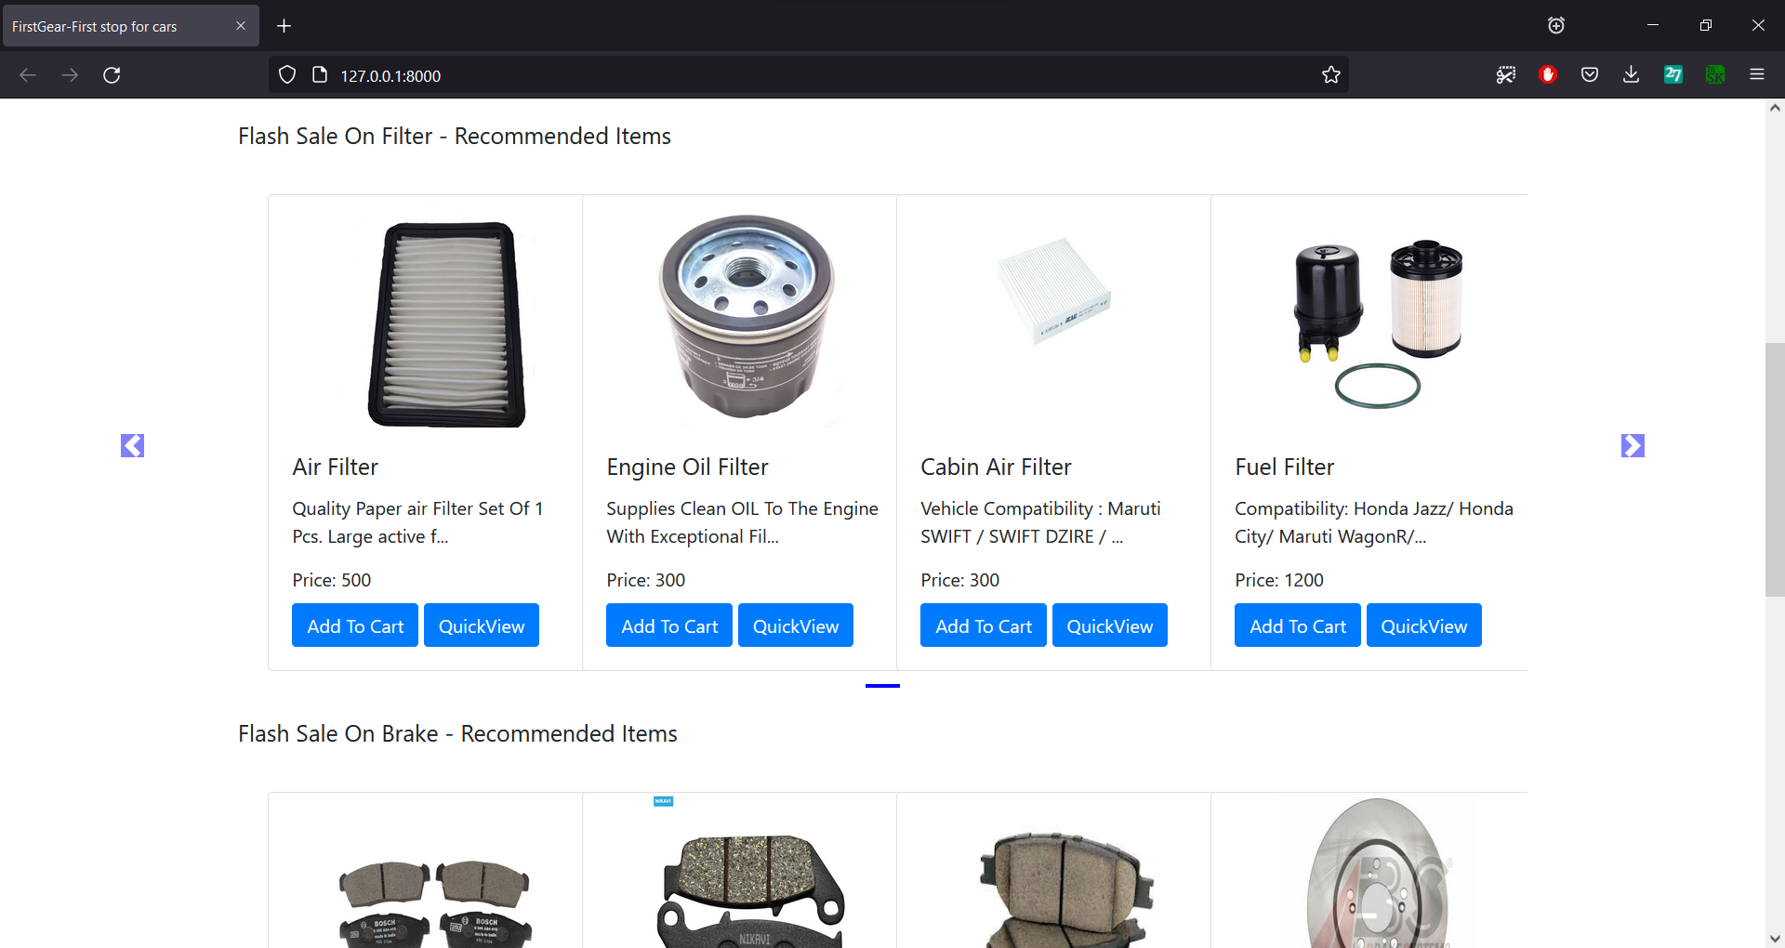
Scrolling Down…

Slide 10
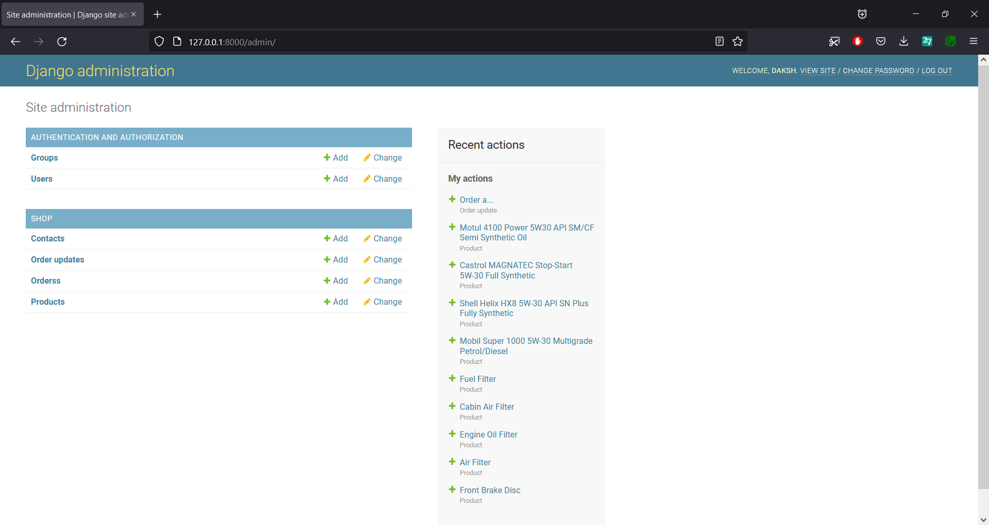
Admin View

Slide 11
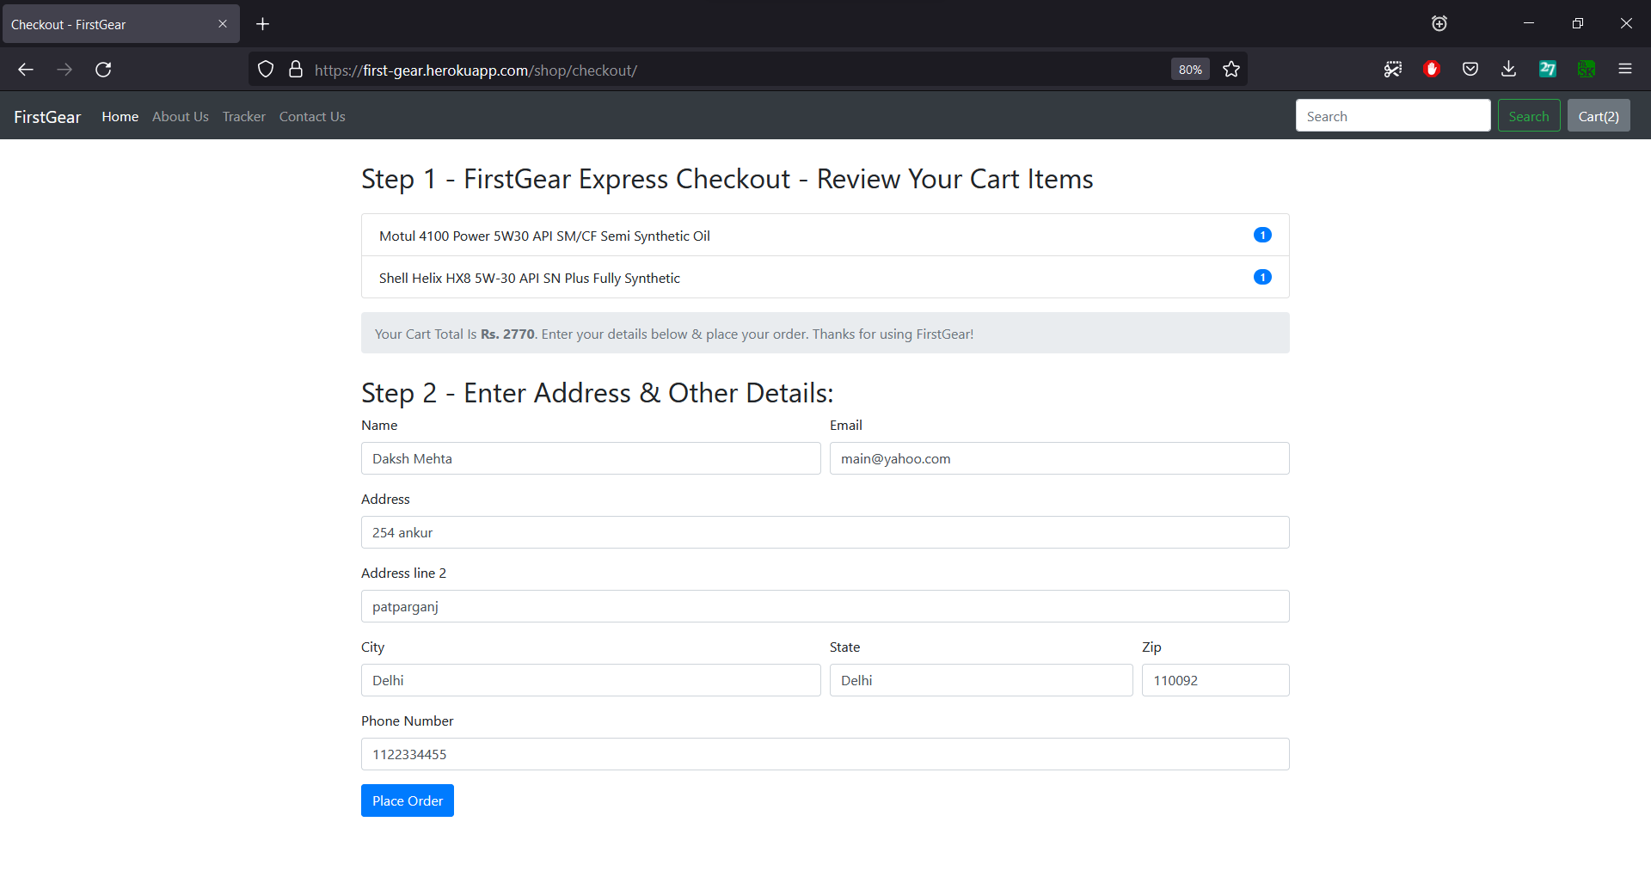
Checkout Page
After clicking here you will be redirected to the payment gateway

Slide 12
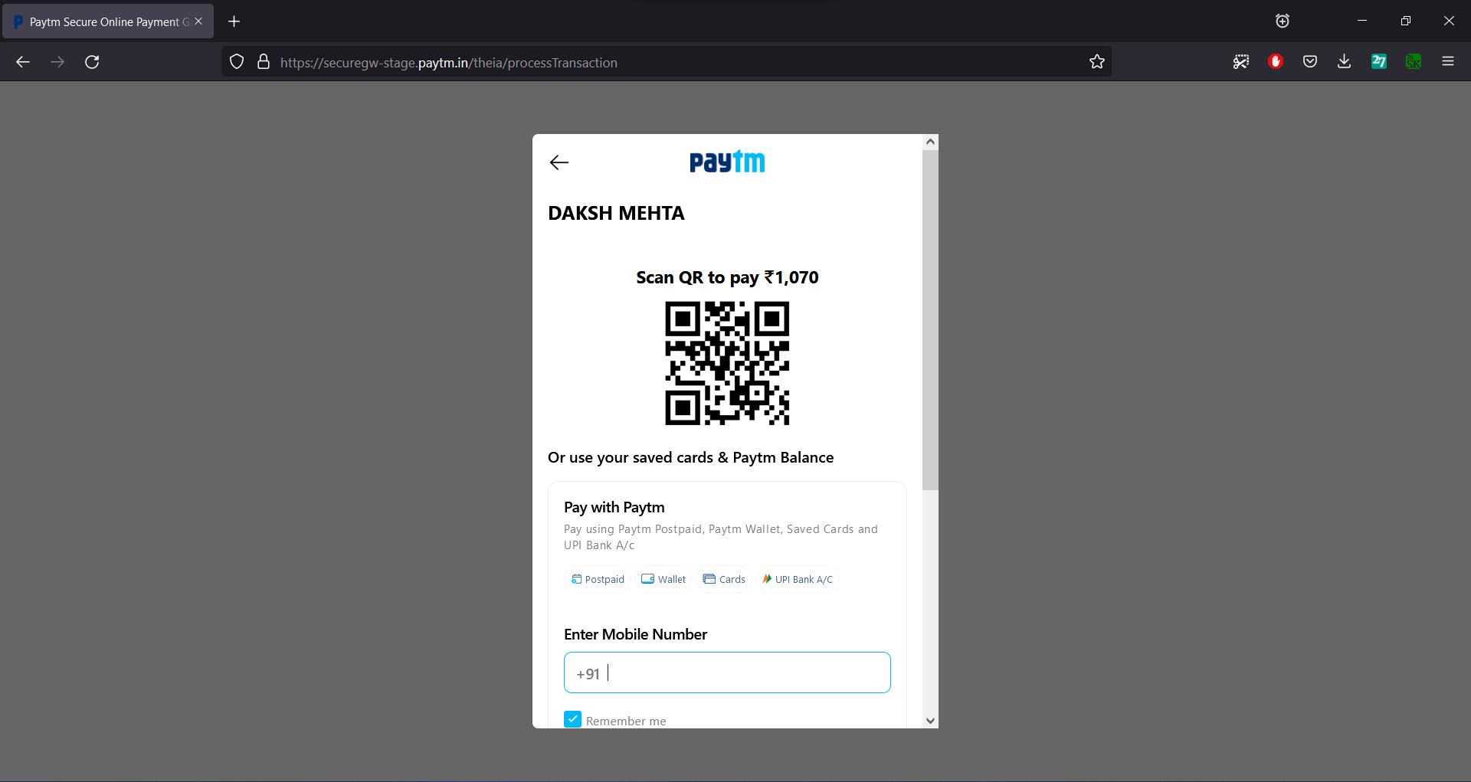
PayTm Gateway Integration

Slide 13
Conclusion and Future Work
The objective was achieved, i.e., to create an online marketplace which was done using Django framework.
PayTm payment gateway was integrated to make transactions secure and seamless.
In future, the user interface can be made more attractive by using ReactJS.
Additional functionality such as sorting the items by their price can be added.
5. A functionality for users being able to review their purchases can also be added.

Slide 14
YouTube Video & GitHub Repo Link
YouTube video Web Link : https://youtu.be/5fv1mGzE0ZA
Github: https://github.com/dakshmehta23/FirstGear

Slide 15
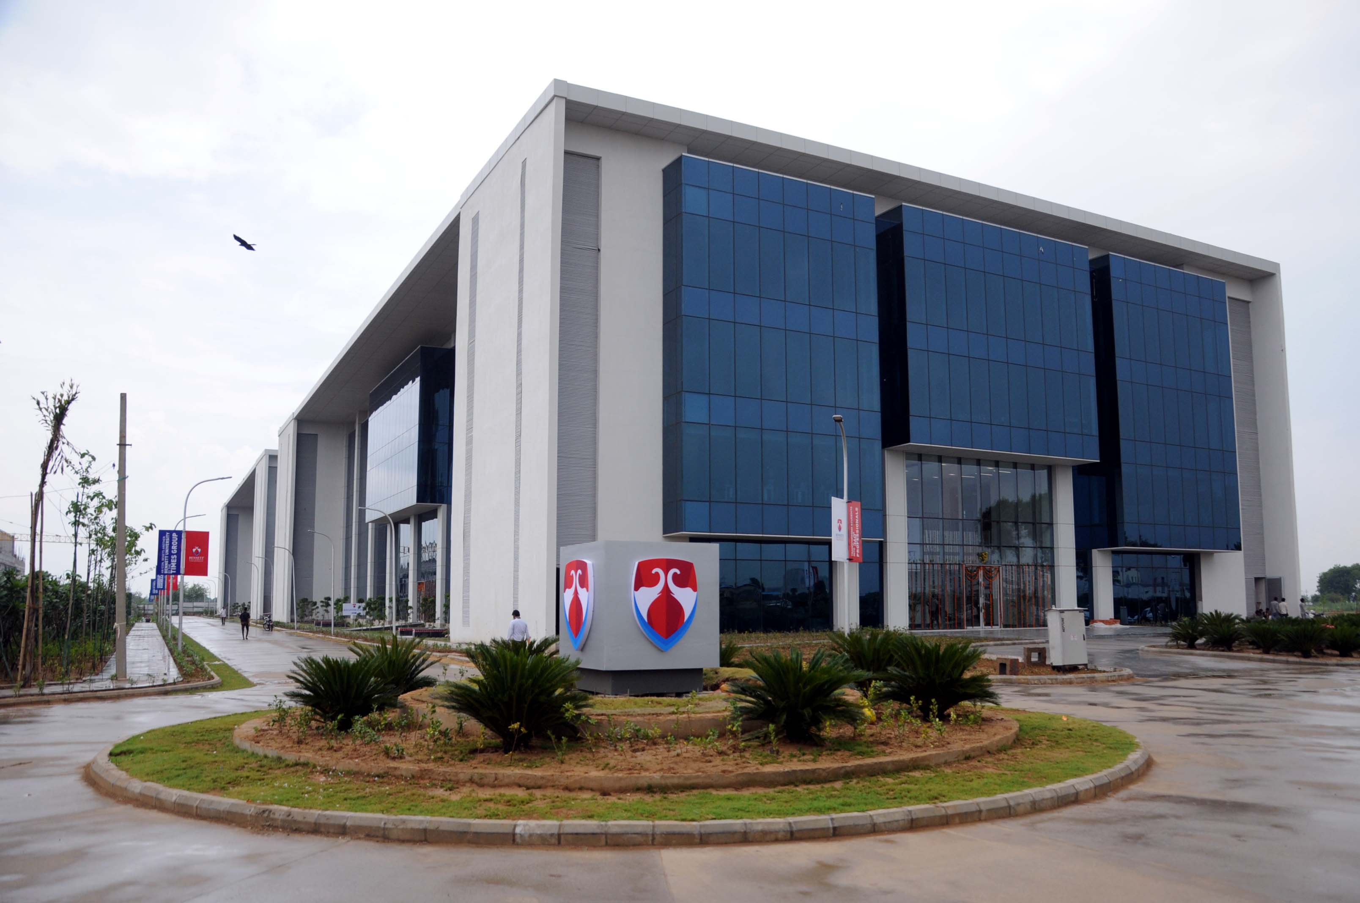
THANK YOU!

