Slide 1
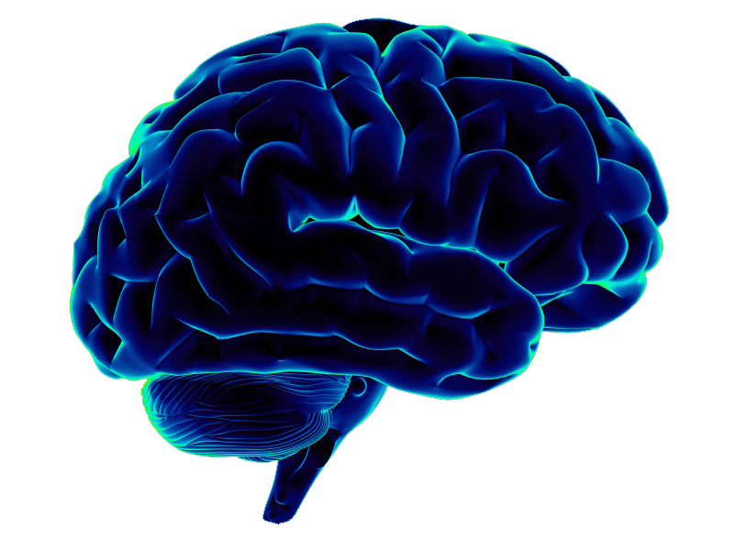
CEREBRUNO:
Brain Tumor Detection
TEAM MEMBERS
Chandni Gupta (E22CSEU0955)
Jaswanthi Vemuri (E22CSEU0958)
Dakshpreet Singh (E22CSEU0953)
MENTOR NAME
Dr. Pratyush Pranav

Slide 2
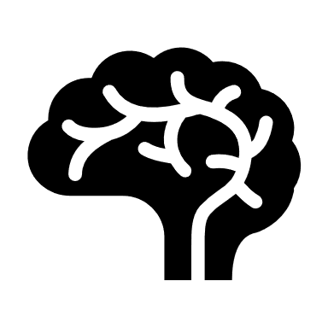
INTRODUCTION
An algorithm to analyze medical imaging data such as MRI or CT scans.
Locates Tumors in the brain.
Made to help radiologists and clinicians.
Trained to distinguish between different types of Brain Tumors.
Can be integrated with MRI machines.

Slide 3
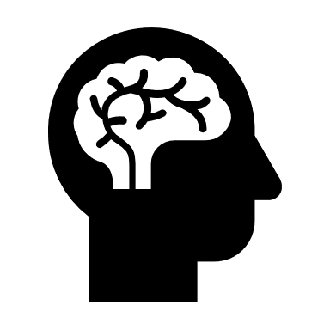
PROBLEM IT SOLVES
Prevents Treatment delay with early stage detection.
Can be operated in remote areas which have scarcity of radiologists.
Reduce healthcare cost to help people who can’t afford MRI scans.
Saves time and effort of the Doctors.
Provides accuracy and is user friendly.

Slide 4
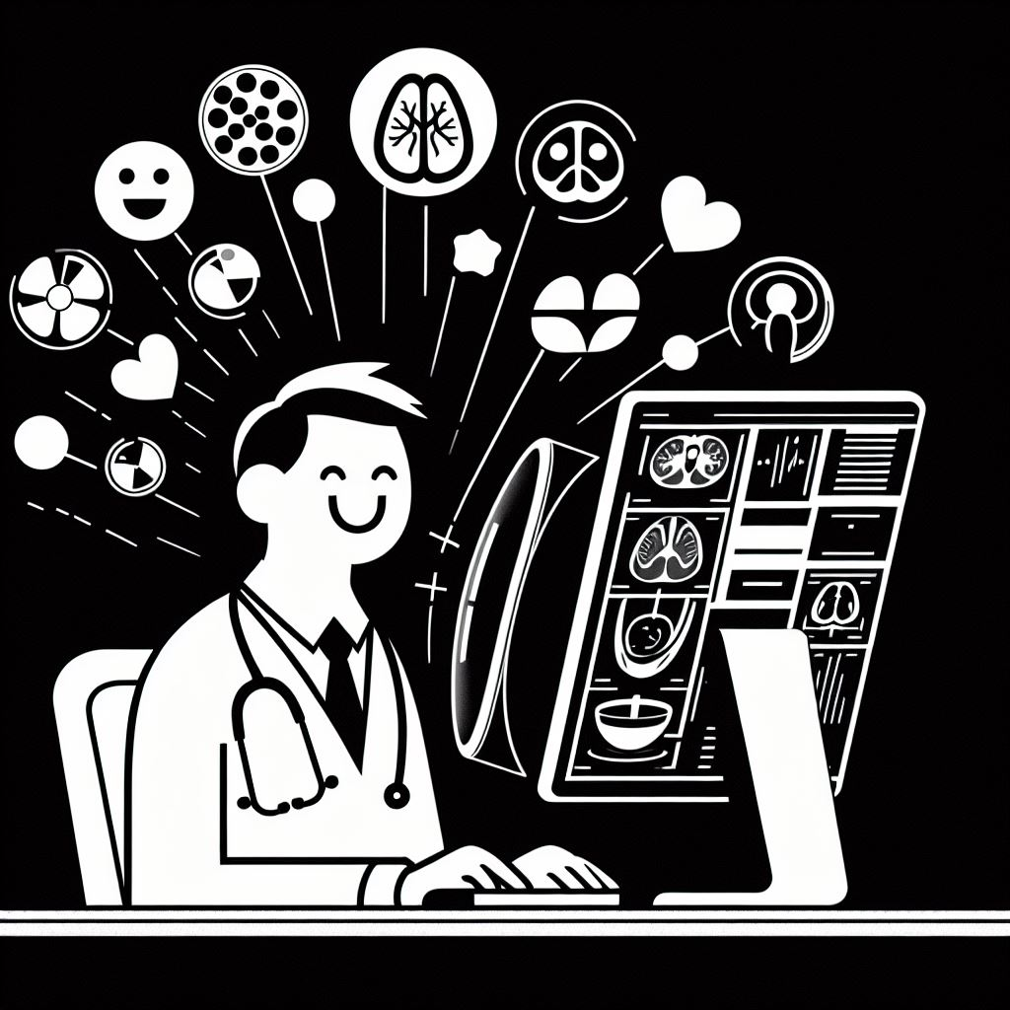
STAKEHOLDERS
Medical professionals may use the app for diagnostic and treatment processes.
Patients may use it to track symptoms, receive information, or communicate with their healthcare providers.
Healthcare institutions may have a stake in the app's development and implementation, especially if it becomes integrated into their diagnostic workflow.
Regulatory bodies may have an interest in ensuring that the app meets safety and efficacy standards.

Slide 5

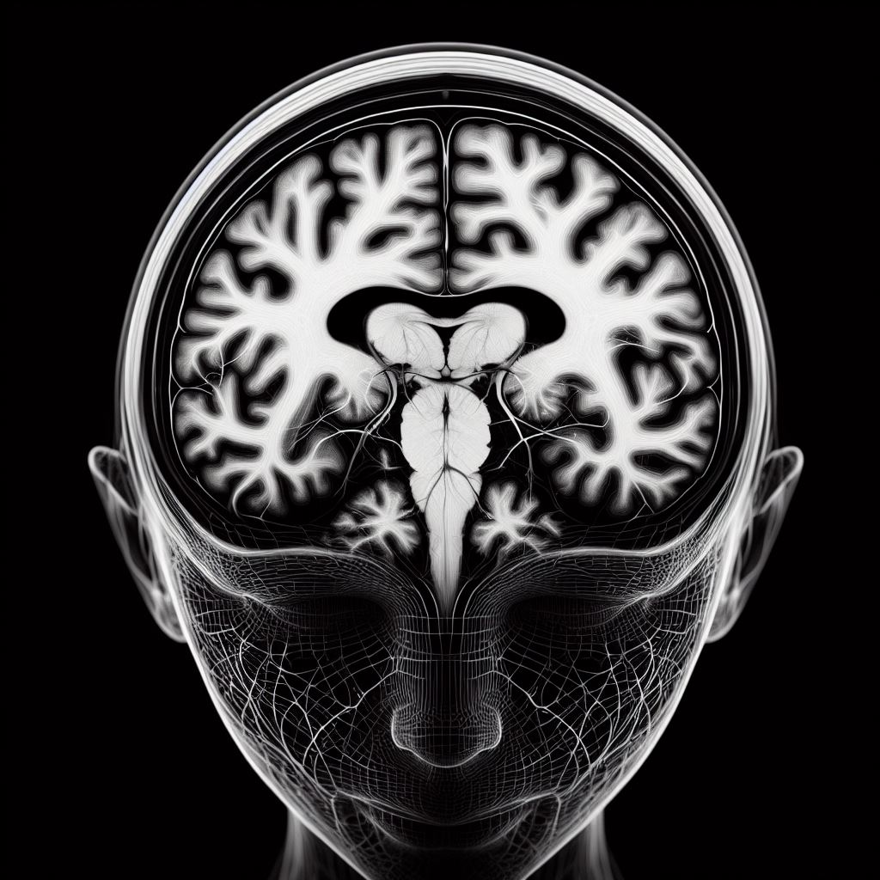
TARGET USERS
Patients suffering from tumor.
Doctors/Radiologists.
Academic Institutions/Medical researchers.

Slide 6


TECH STACK
Programming Languages Used: Python language was used to make this project due its extensive libraries and frameworks in the field of deep learning, including TensorFlow and PyTorch.
IDE: Microsoft Visual Studio was used.
Deep Learning Frameworks: TensorFlow: Leveraged for its scalability, flexibility, and comprehensive ecosystem for building and deploying machine learning models, including neural networks for image classification tasks. PyTorch: Chosen for its dynamic computation graph and ease of use, enabling rapid prototyping and experimentation with neural network architectures.

Slide 7
TECH STACK
Neural Network Architectures: Convolutional Neural Networks (CNNs): Particularly effective for image processing tasks, CNNs are employed for their ability to automatically learn hierarchical features from brain imaging data, aiding in tumor detection and classification.
Data Preprocessing Tools: OpenCV: Utilized for image preprocessing tasks such as resizing, normalization, and augmentation to enhance model performance and generalization.
Visualization and User Interface: HTML/CSS/JavaScript: Frontend web technologies used for building user interfaces, allowing clinicians and users to interact with the application through intuitive dashboards and visualization tools.

Slide 8
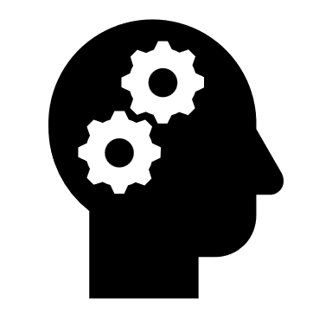
DESIGN
Data Collection and Preprocessing:
The Kaggle website was used to collect brain tumor images along with images of no tumors. It had around 1500 images each.
Data preprocessing was performed using steps such as normalization, resizing, and augmentation to enhance model generalization and robustness.
Model Architecture Selection:
Choose appropriate neural network architectures suited for medical image analysis tasks, such as Convolutional Neural Networks (CNNs) due to their effectiveness in capturing spatial patterns.
Consider advanced architectures like U-Net for semantic segmentation tasks or transfer learning approaches using pre-trained models on large-scale datasets like ImageNet.

Slide 9
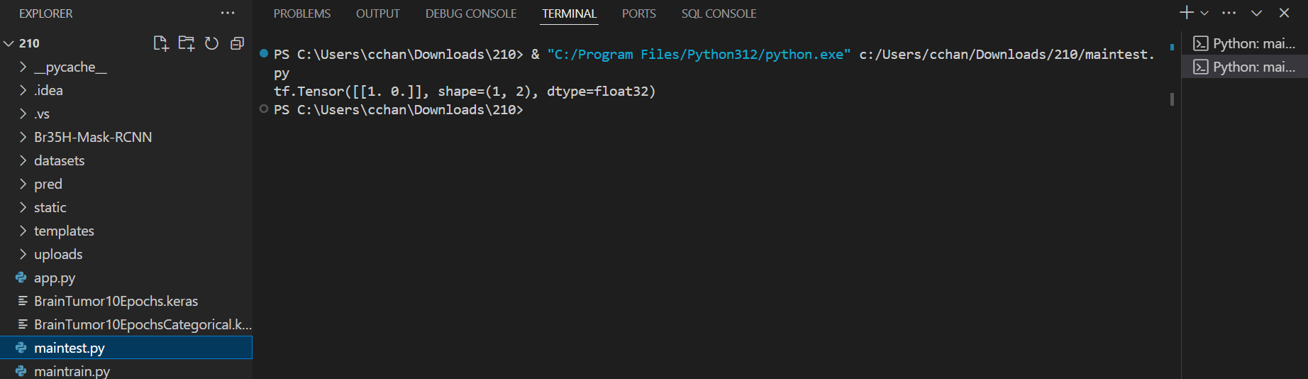
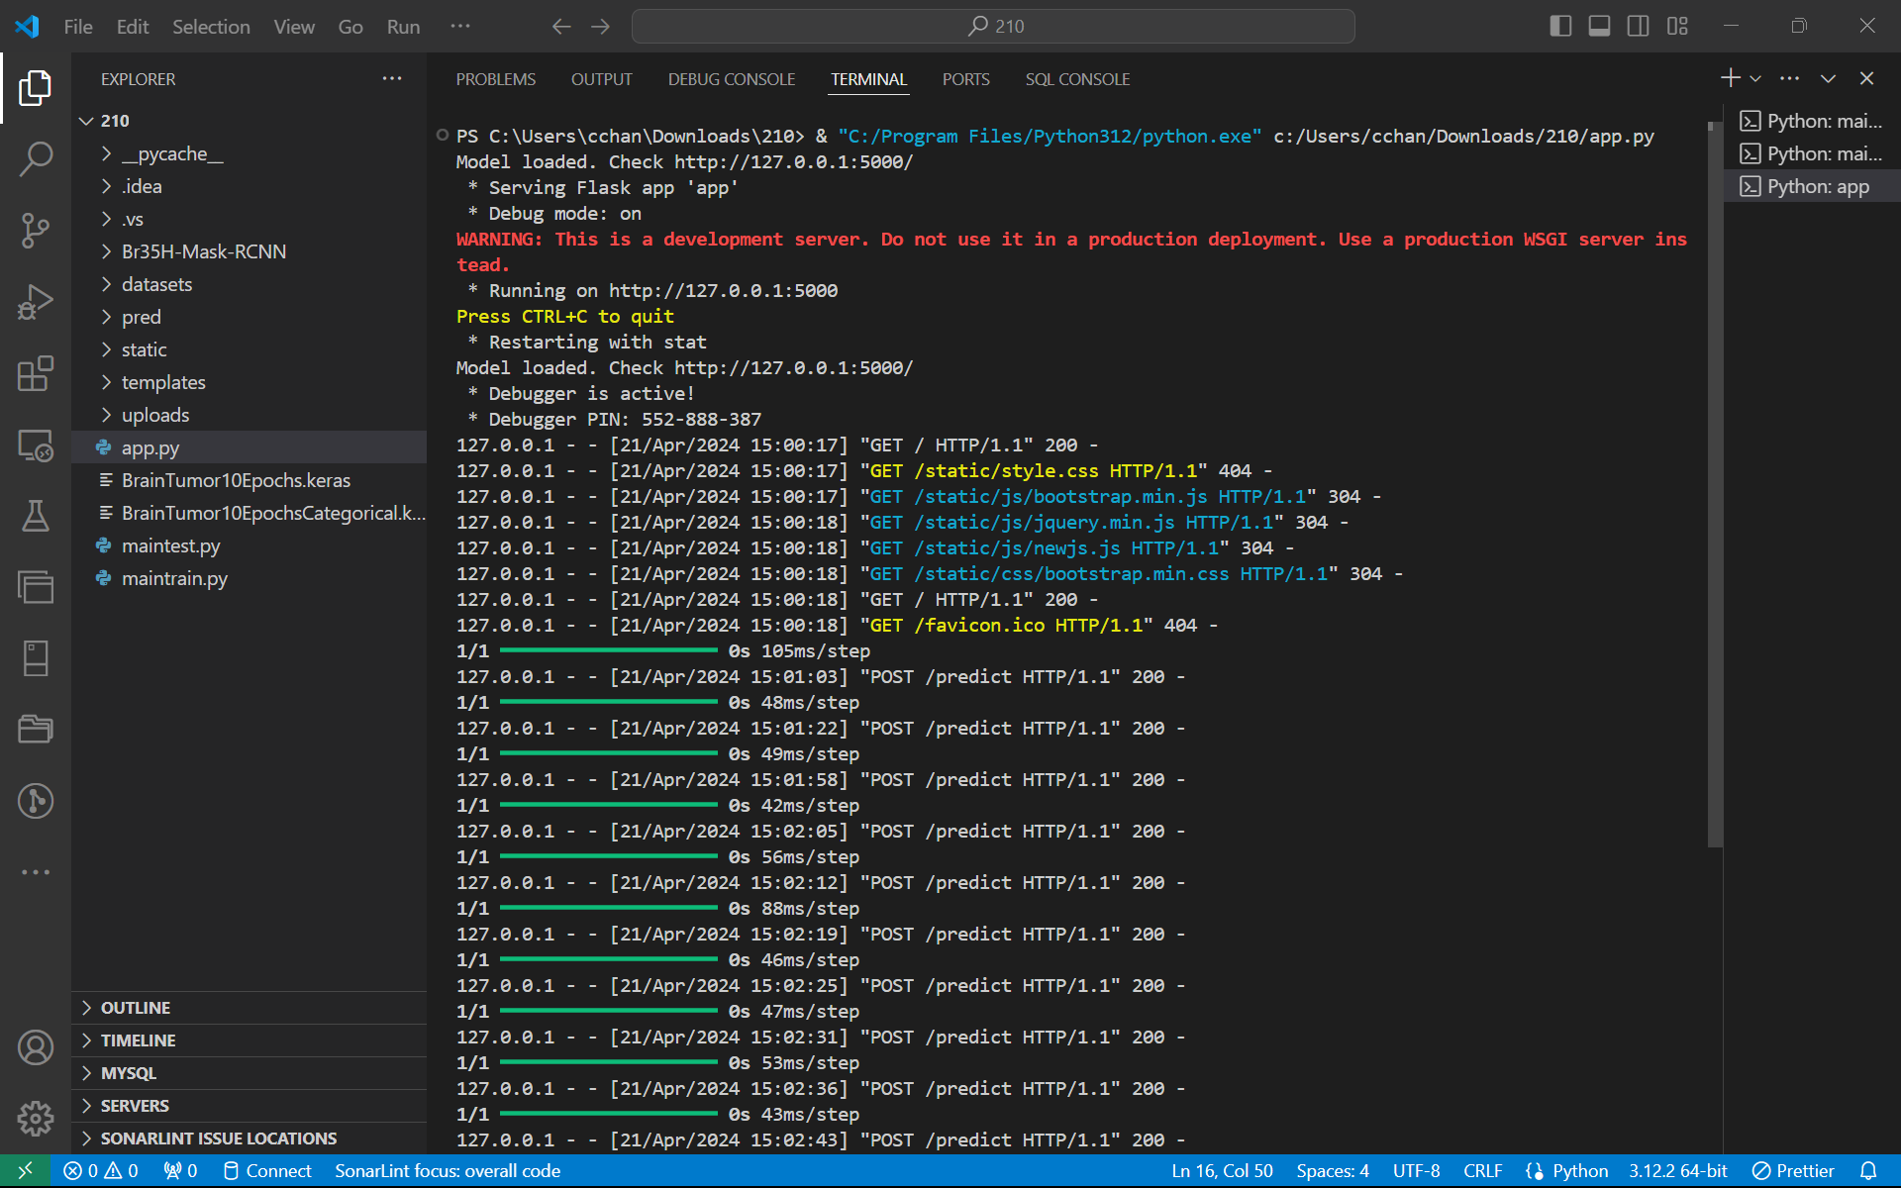
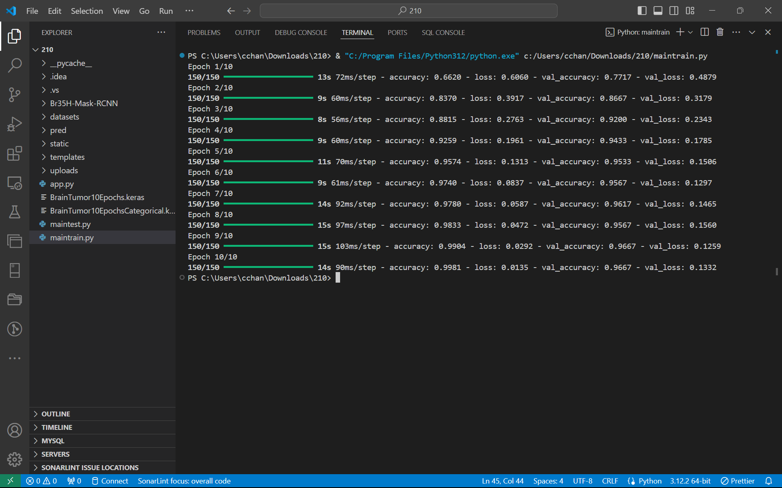
RESULTS
CODE OUTPUT FOR TRAINING MODEL AND APP CODE

Slide 10


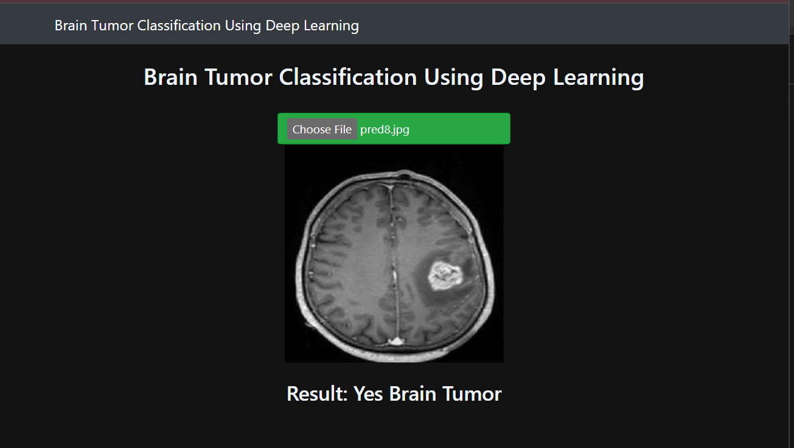
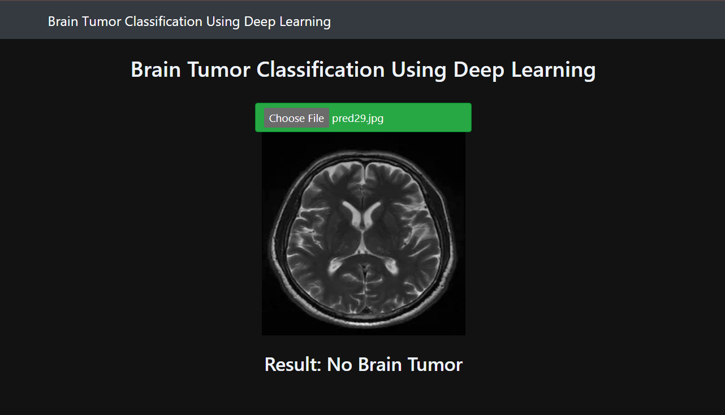
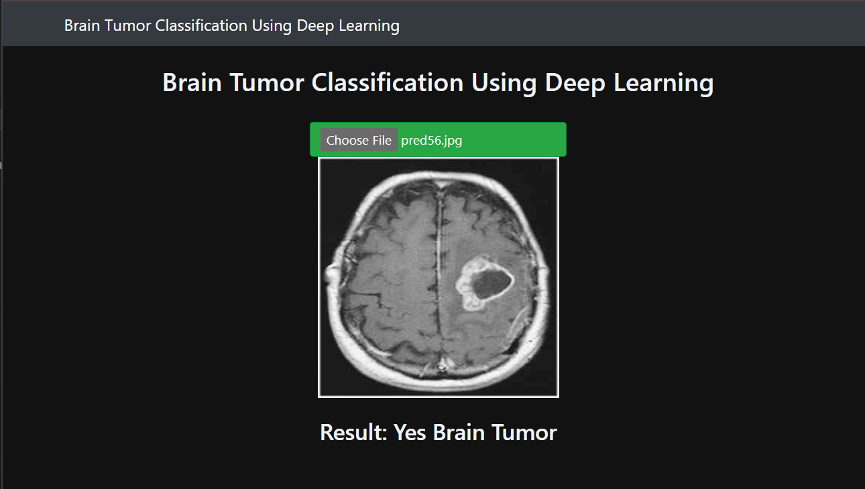
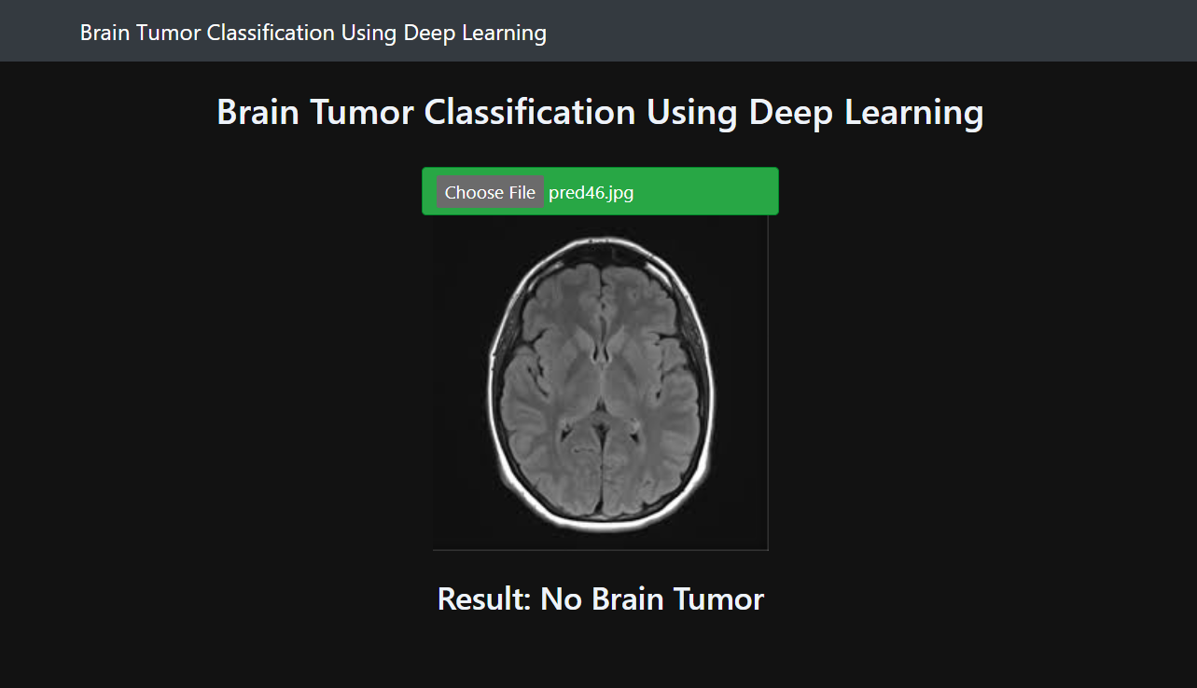
RESULTS

Slide 11
THANK YOU
TEAM MEMBERS
Chandni Gupta (E22CSEU0955)
Jaswanthi Vemuri (E22CSEU0958)
Dakshpreet Singh (E22CSEU0953)
MENTOR NAME
Pratyush Pranany

