Slide 1

Messager
Made by:
Raman Daksh
&
Vaibhav Vats

Slide 2
Objective
The objective of a messaging application developed using Flutter and Firebase can be multifaceted, and it largely depends on the specific goals and requirements of the application
Communication: The primary goal of a messaging app is to facilitate real-time communication between users. It allows users to send text messages & images.
User Engagement: The application seeks to engage users by providing features such as push notifications for new messages, which encourage frequent usage and return visits.
User Experience: A well-designed messaging app offers a user-friendly and enjoyable experience with features like emoji support, message reactions, and customizable profiles.
Privacy and Security: Ensuring the privacy and security of user data is crucial. Features like end-to-end encryption and user authentication contribute to this objective.
Scalability: The app should be scalable to handle a growing user base and increasing message volumes.
Cross-Platform Compatibility: If the app targets a wide audience, ensuring compatibility across multiple platforms (iOS, Android, web) may be an objective.
Brand Awareness: For businesses, the app may serve as a means to enhance brand visibility and engage with customers or clients.

Slide 3
Features
User Authentication: Implement user registration and login using
Google Sign-in using Firebase or another authentication service.
Chat Screens: Create chat screens for individual conversations with
other users. Use a AppBar for the top bar. Allow users to send text, images, and emojis. Implement typing indicators and message read receipts (seen status).
Notifications: Implement push notifications for new messages using
Firebase Cloud Messaging (FCM) or a similar service.
Search Functionality: Add a search bar to find specific chats or messages.
Use the CupertinoSearchTextField for the search bar.
User Profiles: Create user profiles that display profile pictures, status, and other information. Use CupertinoActionSheet for editing profile details.
Online Status: Show online/offline status for users.
Use presence indicators like a green dot next to online users' avatars.
Dark Mode: Implement a dark mode toggle in the settings.
Ensure the app's UI adapts to light and dark modes.
Message Encryption: Implement end-to-end encryption for secure messaging.
Attachments: Allow users to send and receive images.
Message Deletion and Editing: Enable users to delete or edit sent messages if needed.
Emojis and Reactions: Add support for emojis and message reactions.
Profile Customization: Let users customize their profiles with bios, status messages, and display names.

Slide 4
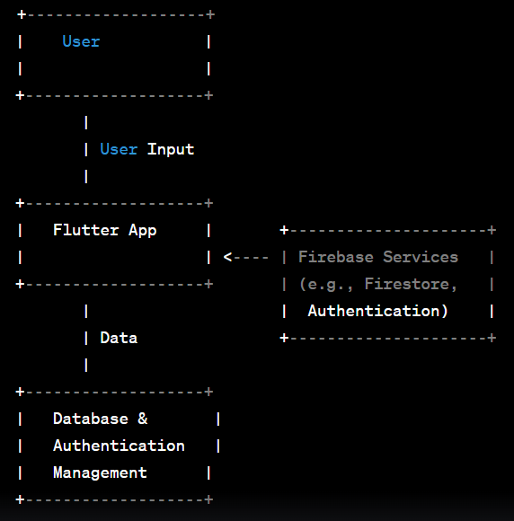
Data Flow Diagram
Level-0
In this simplified DFD:
"User" represents the end-user of the Flutter application.
"Flutter App" is the main component of the application.
Data flows between the user and the Flutter app.
The Flutter app interacts with various Firebase services, such as Firestore for the database and Firebase Authentication for user management.

Slide 5
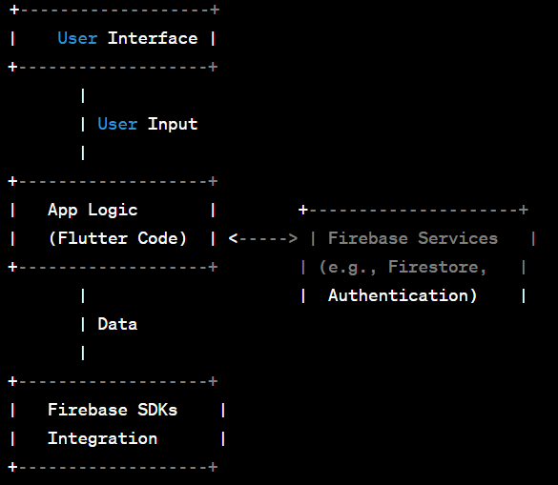
Data Flow Diagram
Level-1
In this level 1 DFD:
"User Interface" handles user input and displays data.
"App Logic" represents the Flutter code responsible for managing data flow, business logic, and interactions with Firebase services.
"Firebase SDKs Integration" illustrates how Firebase SDKs are integrated into the Flutter app to interact with Firebase services.

Slide 6
Activity Diagram
Authentication (Login)
Select Chat (Send or view Messages
Load Chats & User Data
Logout or Exit

Slide 7
Modules
Authentication Module:
Handles user registration, login, and logout.
Manages user sessions using Firebase Authentication.
User Profile Module:
Allows users to view and edit their profiles.
Manages user information, profile pictures, and status.
Chat Module:
Includes components for sending and receiving messages ad Images.
Handles message storage and retrieval from Firebase Firestore.
Notifications Module:
Manages push notifications for new messages and other events.
Integrates with Firebase Cloud Messaging (FCM) or a similar service.
Settings Module:
Provides options for customizing Profile settings.
Contacts Module:
Supports adding, removing, and searching for contacts.
Search Module:
Implements search functionality for finding users.
Local Storage Module:
Manages local storage for caching data, such as chat history or user preferences.
API Integration Module:
Handles interactions with Firebase services, including Firestore for real-time database functionality.
Integrates with Firebase Authentication for user management.
UI Components Module:
Contains reusable UI components and widgets for maintaining a consistent app design.
Utilizes Flutter's widget system, including the Cupertino package for iOS-like UI.
Security Module:
Implements security measures, such as Firebase Security Rules, to protect user data.

Slide 8
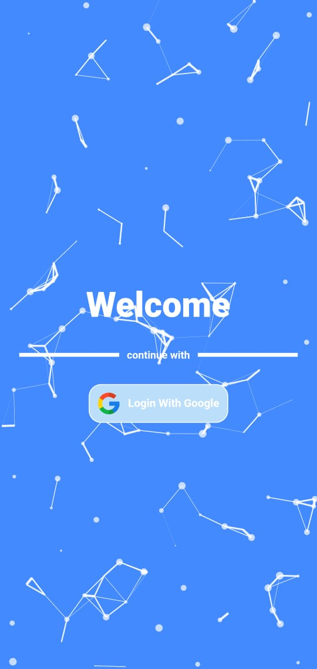
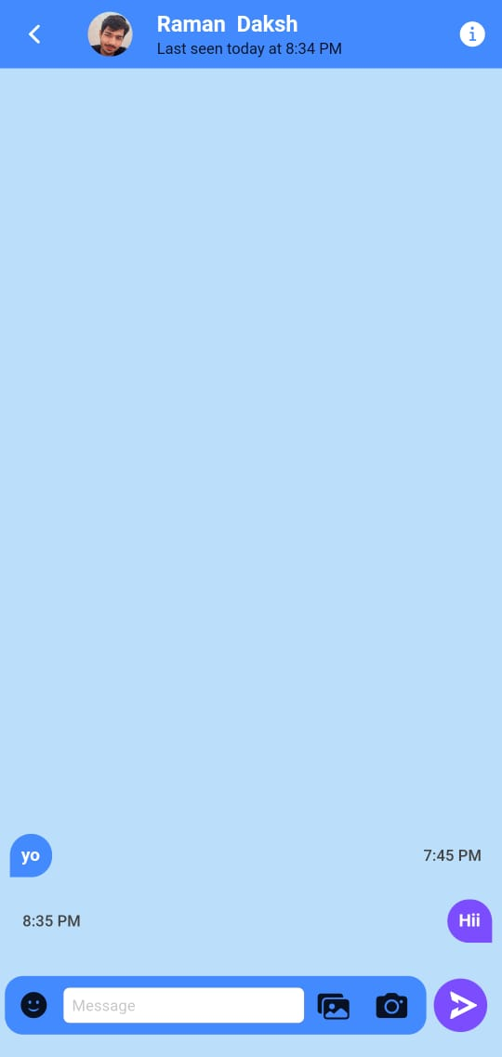
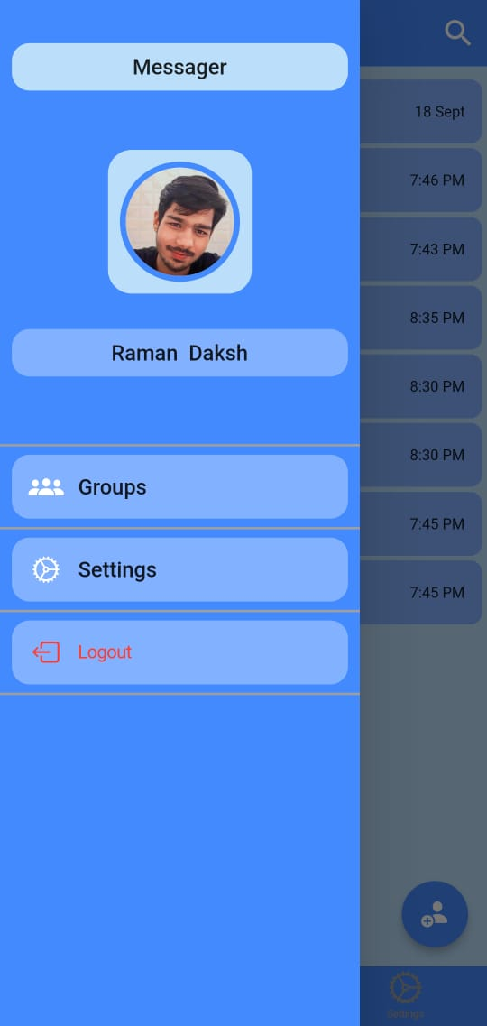
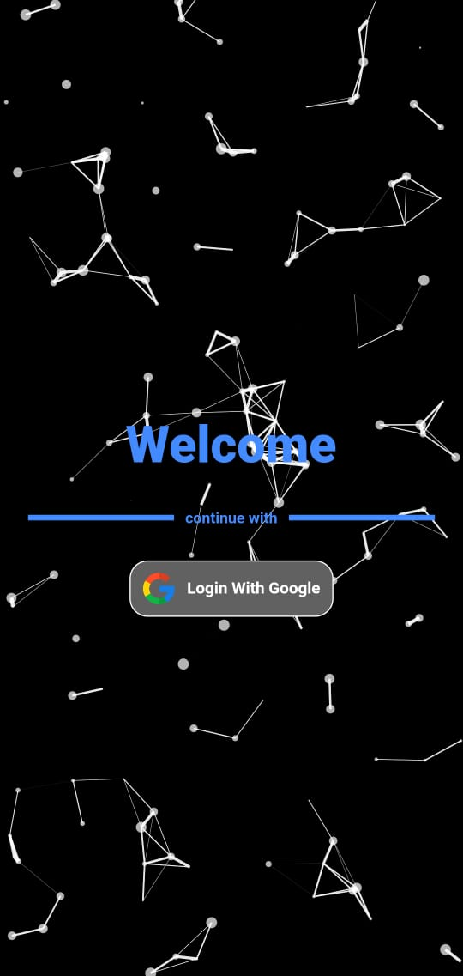
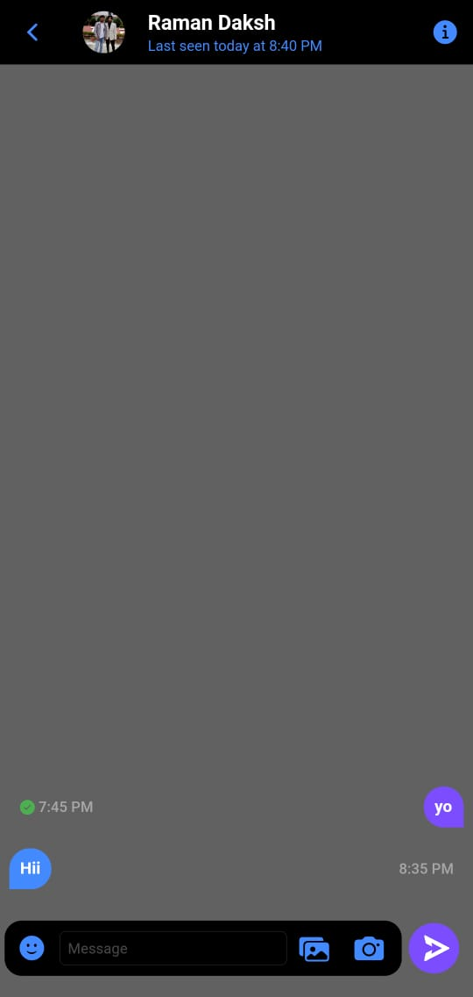
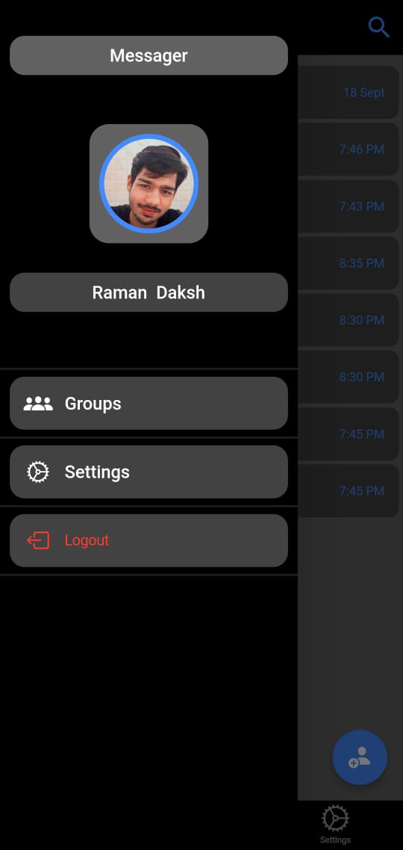
Screenshots

Slide 9
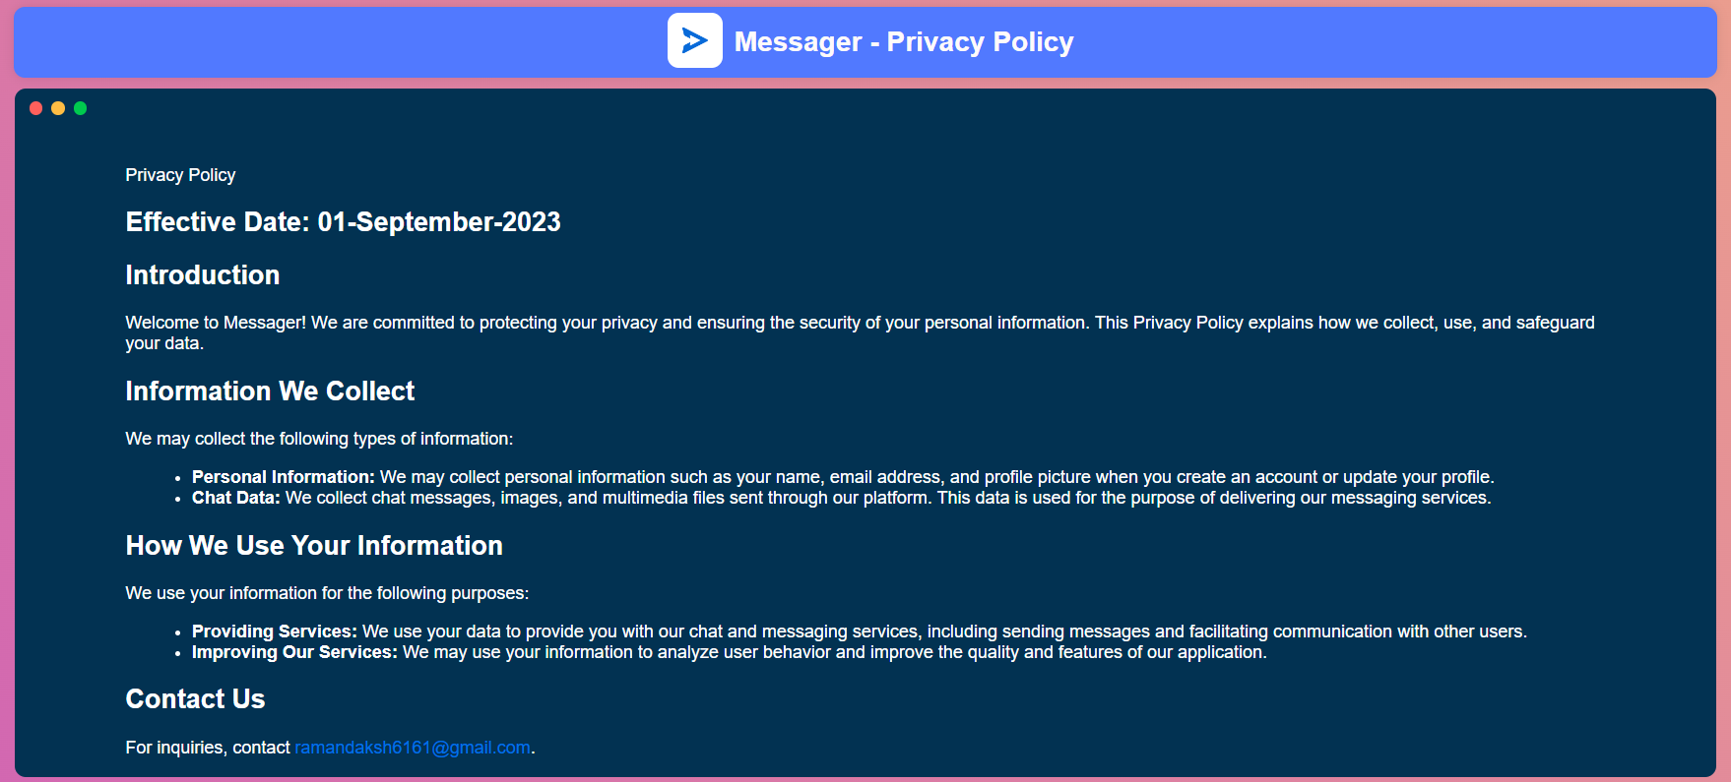

Slide 10
Thank You

