Slide 1

PROJECT NAME
E-VOTING MANAGEMENT SYSTEM
NAME : Daksh Sethi
REG. No. : 19BCE1753

Slide 2
E-Voting
Management System
REQUIREMENTS
TEAM MEMBERS
Oracle APEX
phpMyAdmin
Notepad++
1. Daksh Sethi

Slide 3
E-Voting
Management System
Objectives :
To create an online-platform where people can cast their votes.
Able to manage account details of lakhs of users.
State-wise and constituency wise election wining statistics.
Able to edit/add/delete constituencies.

Slide 4
E-Voting
Management System
ER MODEL →

Slide 5
VOTERS
CANDIDATES
Voter_Id
Name
Age
Const_Id (FK)
Candid_Id
Name
Party_Id (FK)
Age
Const_Id (FK)
N1
Vote
For
N2
Voter_Id
Party_Id (FK)
Candid_Id (FK)
Const_Id (FK)
N
N
Belong
To
Candid_Id
Const_Id (FK)
Have
1
1
PARTIES
CONSISTUENCIES
Party_Id
Name
Const_Id
Name
State

Slide 6



VOTERS :
Voter_Id | Name | Age | Const_Id
VOTES :
Voter_Id | Party_Id | Candid_Id | Const_Id
CANDIDATES :
Candid_Id | Name | Age | Party_Id | Const_Id
CONSTITUENCIES :
Const_Id | Name | State | Total_Votes
PARTIES:
Party_Id | Name

Slide 7
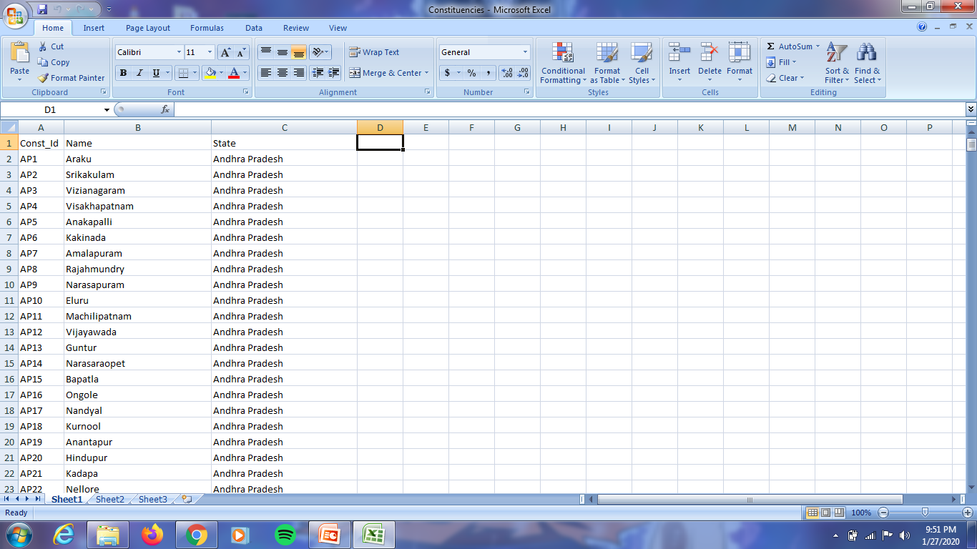
E-Voting
Management System
Work done till now :
Creating databases.

