Slide 1

PROJECT NAME E-VOTING MANAGEMENT SYSTEM
NAME : Daksh Sethi
REG. No. : 19BCE1753

Slide 2
E-Voting Management System
REQUIREMENTS
TEAM MEMBERS
Wampserver
phpMyAdmin
Notepad++
1. Daksh Sethi

Slide 3
E-Voting Management System
Objectives :
To create an online-platform where people can cast their votes.
Able to manage account details of lakhs of users.
State-wise and constituency wise election wining statistics.
Able to edit/add/delete constituencies.

Slide 4
E-Voting Management System
Entities :
Vote
Voter
New Election
Party
Candidates
Constituency
States
Admin

Slide 5
E-Voting Management System
ER MODEL →

Slide 6
VOTERS
CANDIDATES
Voter_Id
Name
Age
Const_Id (FK)
Candid_Id
Name
Party_Id (FK)
Age
Const_Id (FK)
N1
Vote
For
N2
Voter_Id
Party_Id (FK)
Candid_Id (FK)
Const_Id (FK)
N
N
Belong
To
Candid_Id
Const_Id (FK)
Have
1
1
PARTIES
CONSISTUENCIES
Party_Id
Name
Const_Id
Name
State

Slide 7



VOTERS :
Voter_Id | Name | Age | Const_Id
VOTES :
Voter_Id | Party_Id | Candid_Id | Const_Id
CANDIDATES :
Candid_Id | Name | Age | Party_Id | Const_Id
CONSTITUENCIES :
Const_Id | Name | State | Total_Votes
PARTIES:
Party_Id | Name
*However some changes were made later on.

Slide 8
VOTER :
Voter_Id | Password | Name | DOB | Age | Mobile no | Const_id | image | type
VOTE :
Voter_Id | Const_Id | E_name | Party_Id
NEW ELECTION :
Election_Name | State_Id | Date | Type
CANDIDATES :
Candid_Id | Name | Age | Party_Id | Const_Id
PARTY :
Party_Id | Name
CONSTITUENCIES :
Const_Id | Name | Population
STATES :
State_id | Name
ADMIN :
Username | Password | Name
*Those in red are primary key(s) of their respective tables.

Slide 9

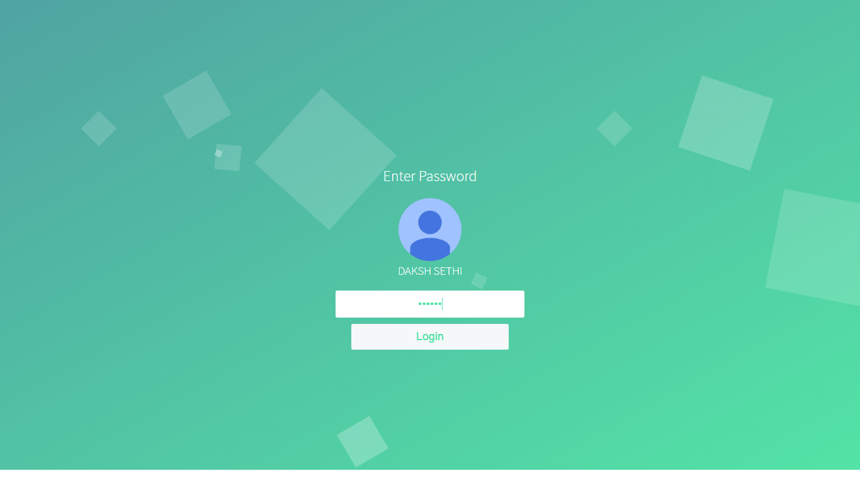
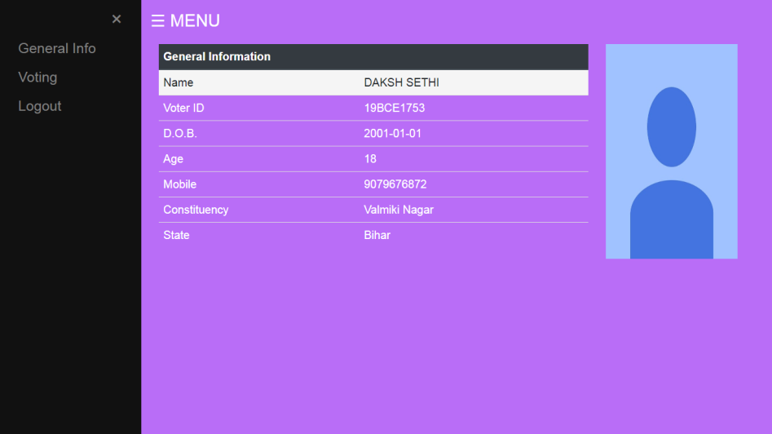
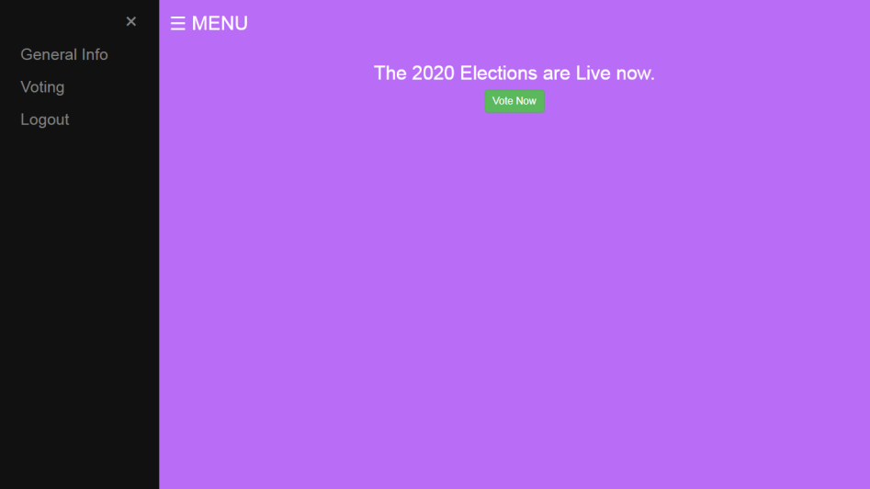
Different Interfaces/Logins/Views
1. Voter

Slide 10
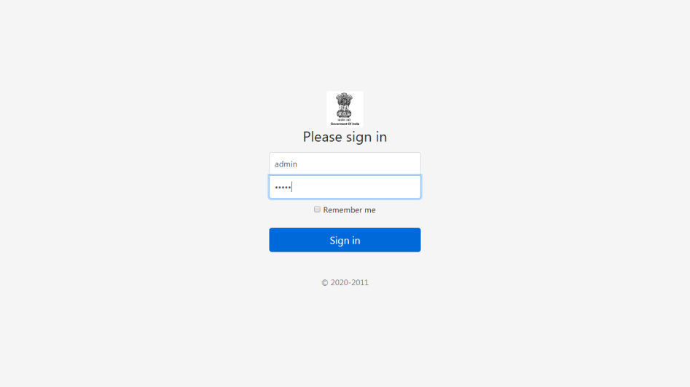
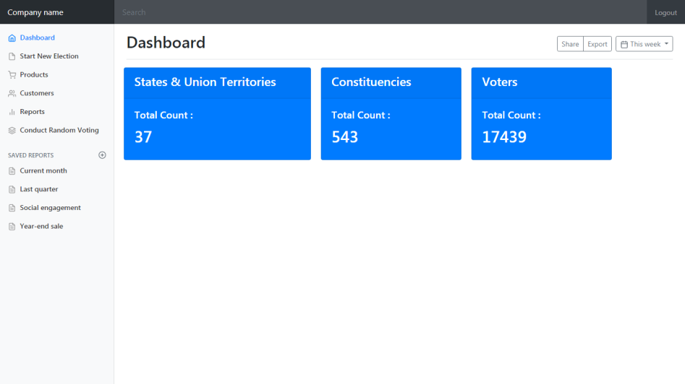
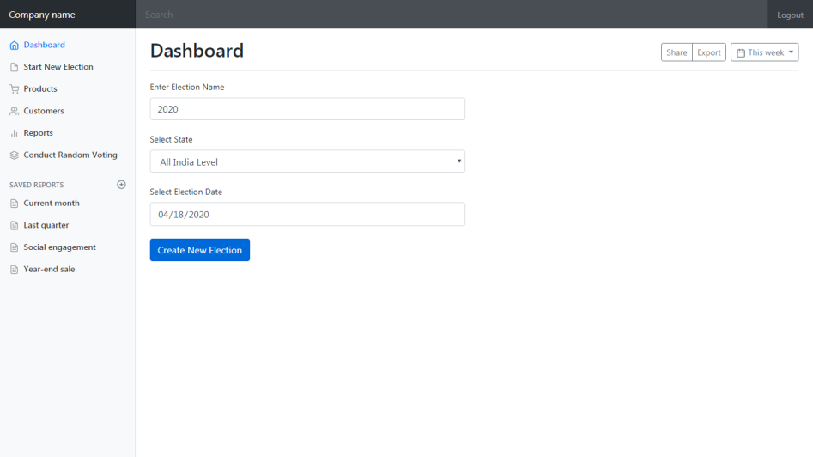
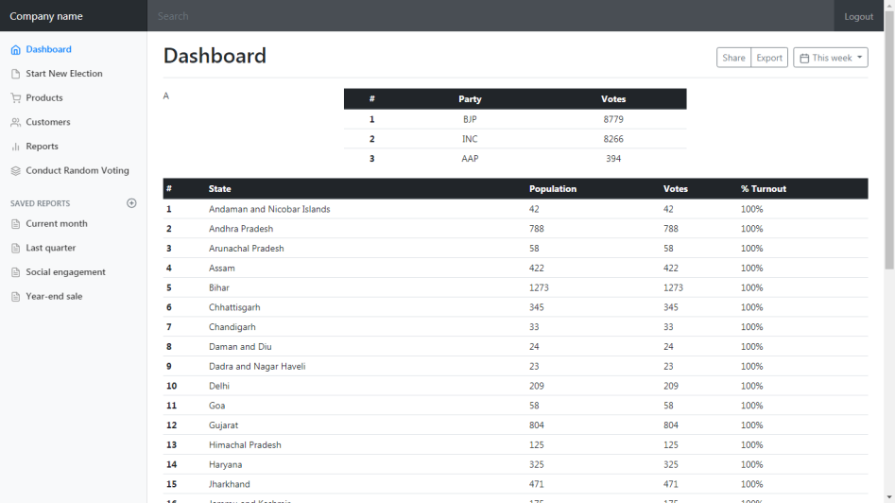
Different Interfaces/Logins/Views
2. Admin

Slide 11
Different Interfaces/Logins/Views
3. E-Mitra
Pages under work!

