Slide 1

Cell Imaging Using Lateral Shearing Interferometer leading to cell characterisation
-Daksh Patel

Slide 2
HOLOGRAPHY
When a light wave encounters an object or an obstacle, it undergoes diffraction. This diffracted wave contains the intensity information as well as the phase information. In conventional photography, we are only able to plot the intensity, whereas the depth information which is carried by the phase distribution is not captured.
Therefore, in order to calculate this change in phase of light wave due to the object, we need a reference wave of light and the interference pattern between these two waves (i.e., The reference wave and the object wave) will provide us with the phase information as well as the intensity. The change in phase by the object is given by the modulation of fringes. This interference pattern is recorded with the help of a photographic plates, CCDs and CMOS.
This recorded pattern of the interference fringes between the reference wave and the scattered wave from the object is known as hologram. Later, this hologram is reconstructed by illuminating the hologram with the help of the same reference beam.
This process of recording a hologram and then reconstructing it is known as holography. It can give us a 3-D image as compared to the 2-D image which is a limitation of conventional photography.

Slide 3
Why did we use holography?
As our main aim was to capture and analyse the biological samples such as human cells, we needed the samples to preserve their original nature.
This was not preserved when we used conventional light microscopy because these samples are sometimes transparent in nature and hence to get a proper picture, chemical dyes are used to stain the sample which can affect the original nature of the sample.
Whereas in holography, we capture the intensity as well as the phase difference which is a function of refractive index. And therefore, there is no need of staining the samples and hence, we can get pure and original data out of our biological samples.

Slide 4
Lateral Shearing Interferometer (LSI)
A Lateral Shearing Interferometer (LSI) is a simple device used to observe interference.
It consists of a shearing glass plate kept at a 45 degree angle from the plane of incident beam. When a laser beam falls onto the surface of this mirror, the beam is reflected two times, i.e., from the front surface of the glass plate as well as from the back surface of the glass plate.
Therefore, the two beams are laterally separated from each other. The term shear represents the separation of the laser beam into two parts. Hence, the name Lateral Shearing Interferometer.
The spacing between the front and the back of the glass plate is of the order of the coherence length of the laser beam and hence the condition for interference is satisfied.
Why Lateral Shearing Interferometer(LSI)?
Both the object and the reference beams travel along the same path and encounter the same set of optical elements.
This leads to high temporal stability compared to the digital holographic microscope using other interferometry setups.
This setup provides sub-nanometer level temporal stability over a period of several minutes, making it ideal for measurement of thickness fluctuations of few nanometers to few tens of nanometers, which normally happens in the case of red blood cells.

Slide 5
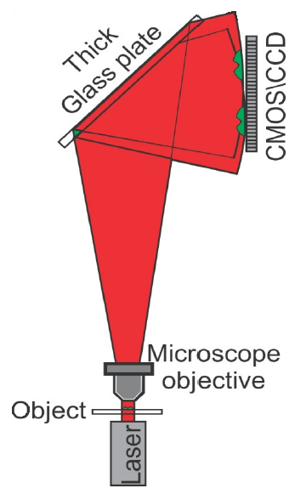
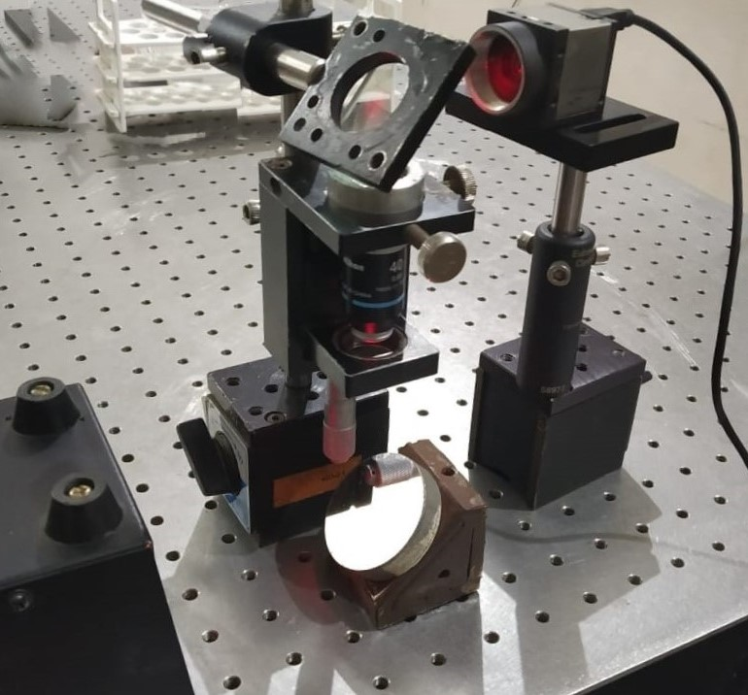
Experimental Setup
CCD
Shearing glass plate
sample
Laser source

Slide 6
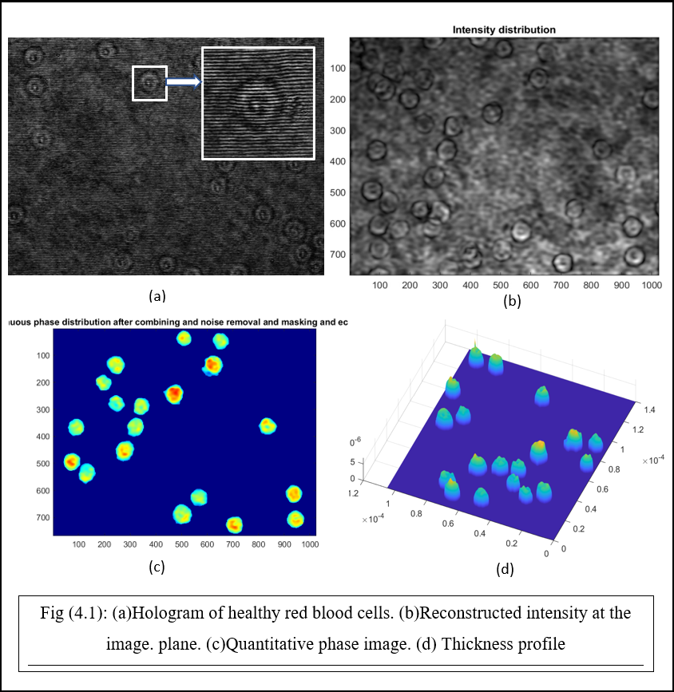
Extraction of cell features
The holograms are numerically processed using ASP, diffraction integral.
The extracted phase provides the cell thickness information.
With the help of the thickness profile obtained as shown in the Fig (4.1)(d), we calculated the various physical parameters pertaining to the cells and also by using multiple frames and tracing, we calculated the mechanical parameters as well.

Slide 7
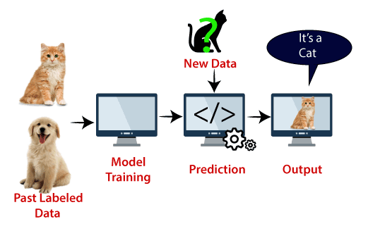
Support Vector Machine
SVM stands for Support Vector Machine and is one of the most widely used Supervised Learning algorithms for Classification and Regression issues. However, it is mostly utilised in Machine Learning for Classification problems.

Slide 8
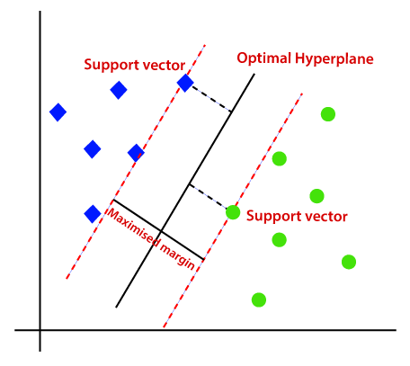
How SVM works?
The SVM algorithm's purpose is to find the optimum line or decision boundary for categorizing n-dimensional space into classes so that additional data points can be readily placed in the correct category in the future. A hyperplane is the name for the optimal choice boundary.

Slide 9
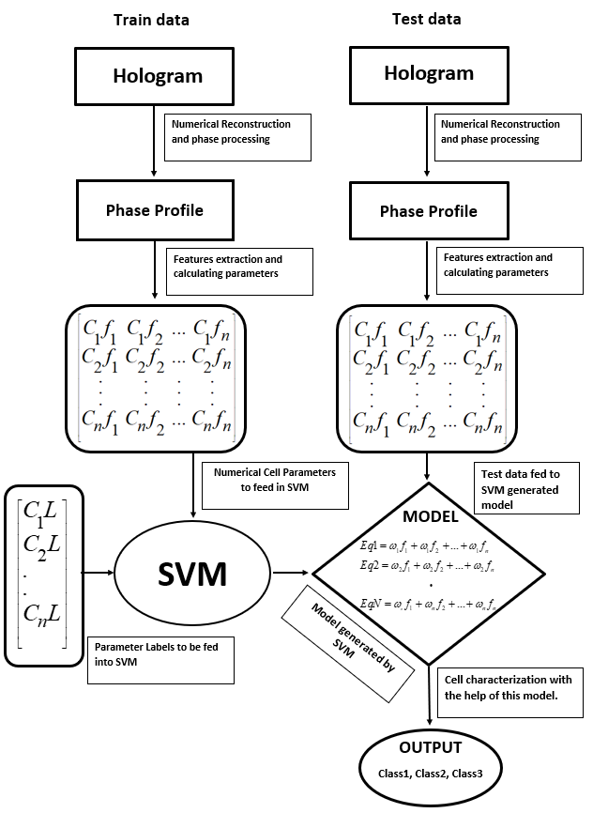
This is how we implemented SVM for cell classification

Slide 10
Results-extracted cell fratures
Physical | Mechanical
Diameter | Optical Path Length
Thickness | Volume change
Area | Frequency fluctuations
Volume | Lateral oscillations
Eccentricity | Membrane stiffness
Sphericity | Dynamic light scattering
Skewness
Kurtosis
We constructed the phase profile of the recorded holograms of cells and extracted physical and mechanical properties pertaining to each cell.

Slide 11
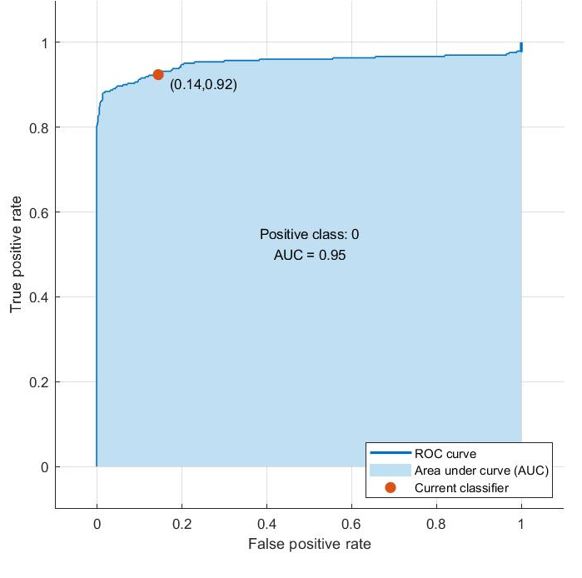
Results – ROC curve
This curve shows the optimum threshold for the proper classification of cells.
The operating point for the SVM model to operate lies on this curve.

Slide 12
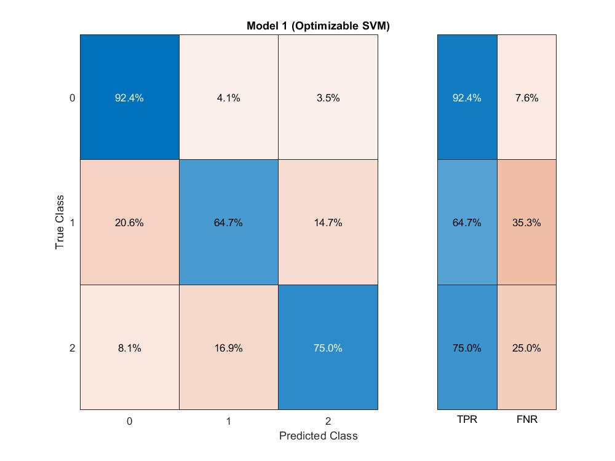
Results – classification accuracy
With the help of SVM algorithm and its generated model, we got the result of the classification of the cells in the form of confusion matrix. The confusion matrix as shown in the above figure is a matrix generated after the classification of the test data was carried out and was cross-checked with the labels. The elements of matrix provide the percentages of true positive rate and the false negative rate.
The overall accuracy calculated for the classification of the cells was found to be 77%.

Slide 13
CONCLUSION
In this study, we did stain-free imaging of healthy and diseased red blood cells using Lateral Shearing Interferometer. Bio-physical and bio-mechanical parameters were extracted for all the cells. SVM classified the cells into healthy, sickle-cell diseased and Thalassemia cells by an accuracy of 77 %. Since all the RBCs are not affected with sickle-cell disease or thalassemia, making group of cells from each disease and then feeding to the algorithm can improve the classification accuracy. Also other algorithms like neural network can be used to classify the cells with better accuracy.

Slide 14
Thank You

