Slide 1
Business Intelligence and Business Analytics
Tutorial
Introducing Tools

Slide 2
Business Intelligence & Business Analytics BIBA
POWER BI
KAGGLE
https://powerbi.microsoft.com/en-us/
https://docs.microsoft.com/en-us/power-bi/guided-learning/
https://docs.microsoft.com/en-us/learn/modules/explore-power-bi-service/
https://www.kaggle.com/

Slide 3
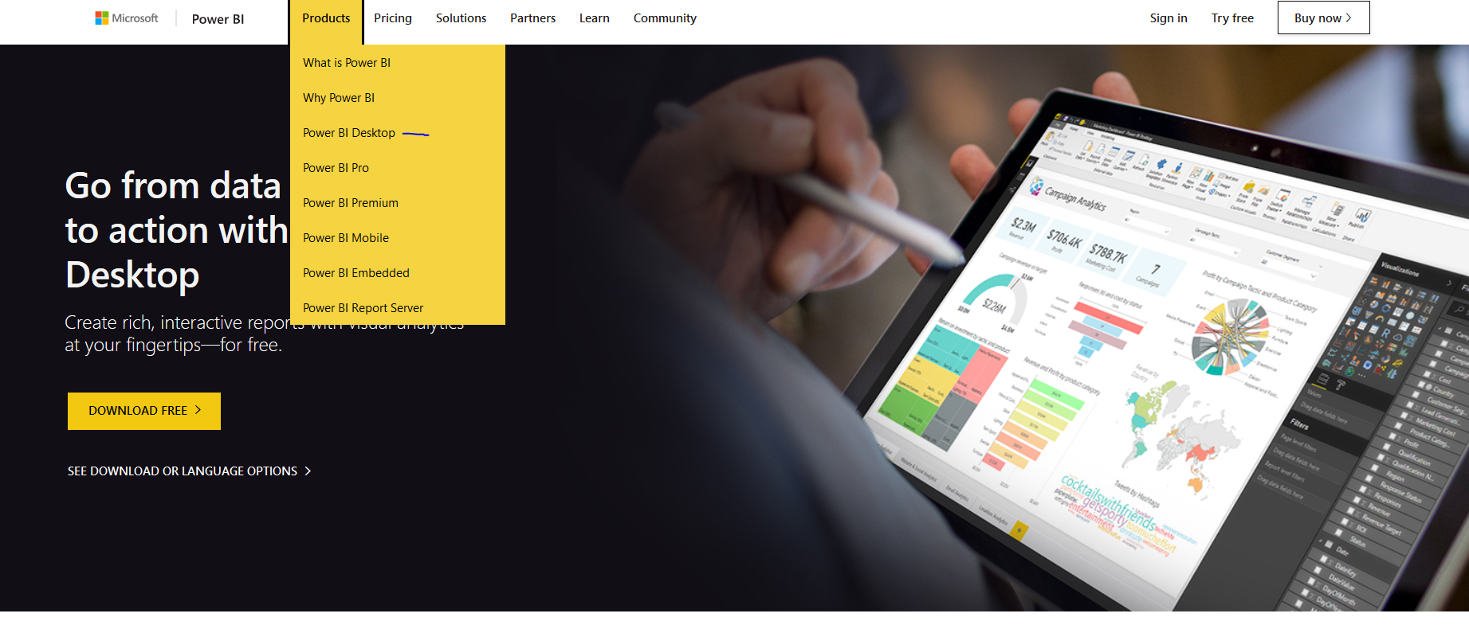
PowerBI Desktop
https://youtu.be/yKTSLffVGbk

Slide 4
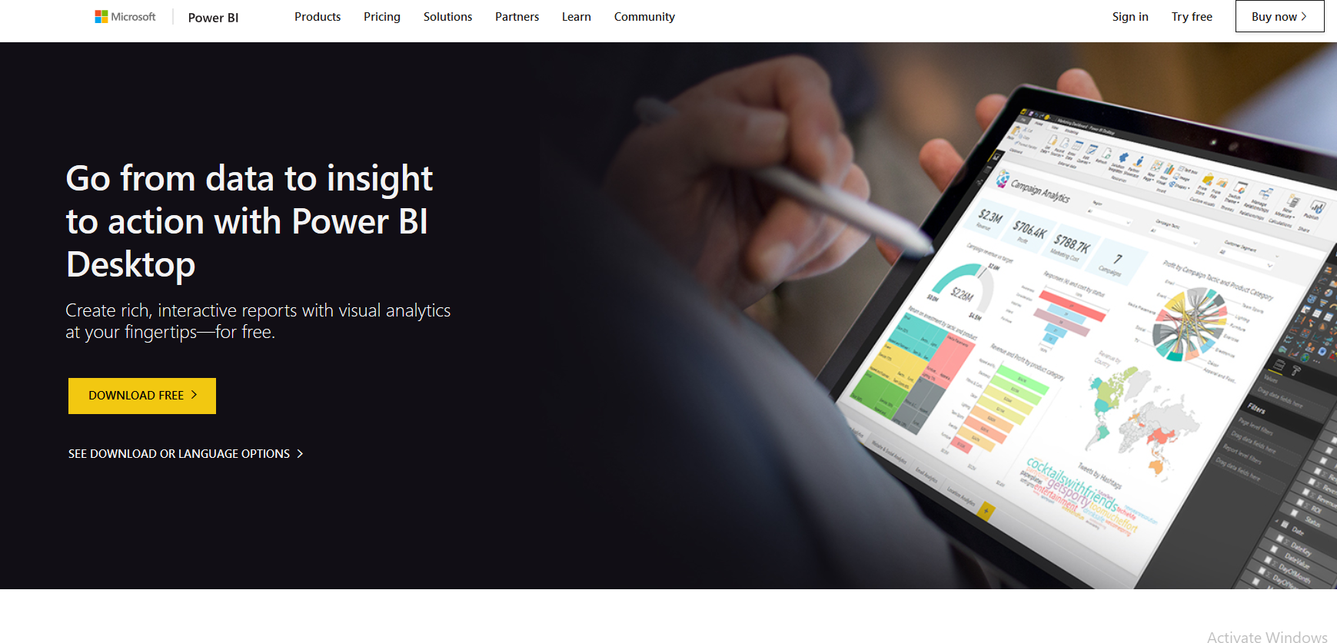
Power BI

Slide 5
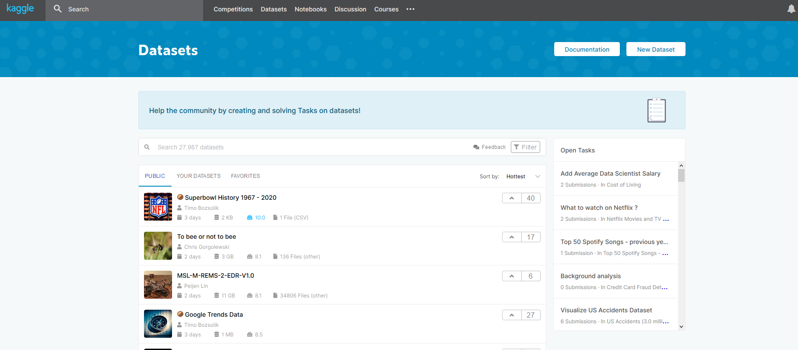
Kaggle
https://www.kaggle.com/
You can register a new account OR
Login with Google Account
You will then have access to various Datasets

