Slide 1
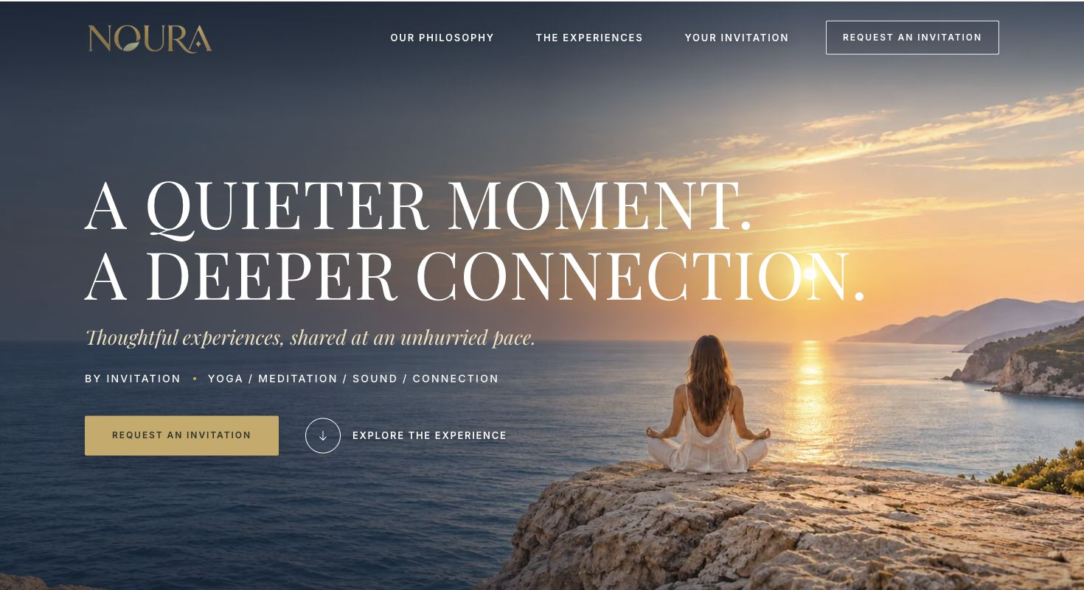
01 Arrival
Notes:
Screenshot of the local NOURA homepage at a 1470 px desktop viewport. Section: Arrival.

Slide 2
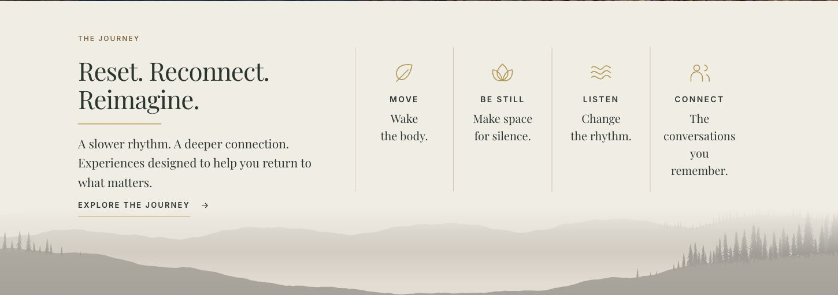
02 The journey
Notes:
Screenshot of the local NOURA homepage at a 1470 px desktop viewport. Section: The journey.

Slide 3
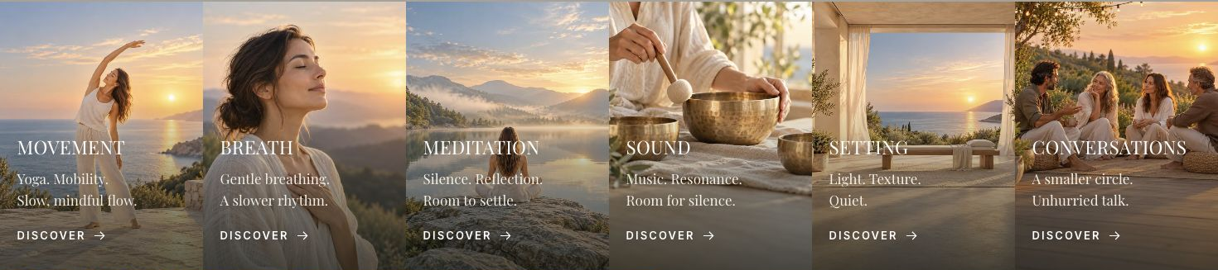
03 Experience index
Notes:
Screenshot of the local NOURA homepage at a 1470 px desktop viewport. Section: Experience index.

Slide 4
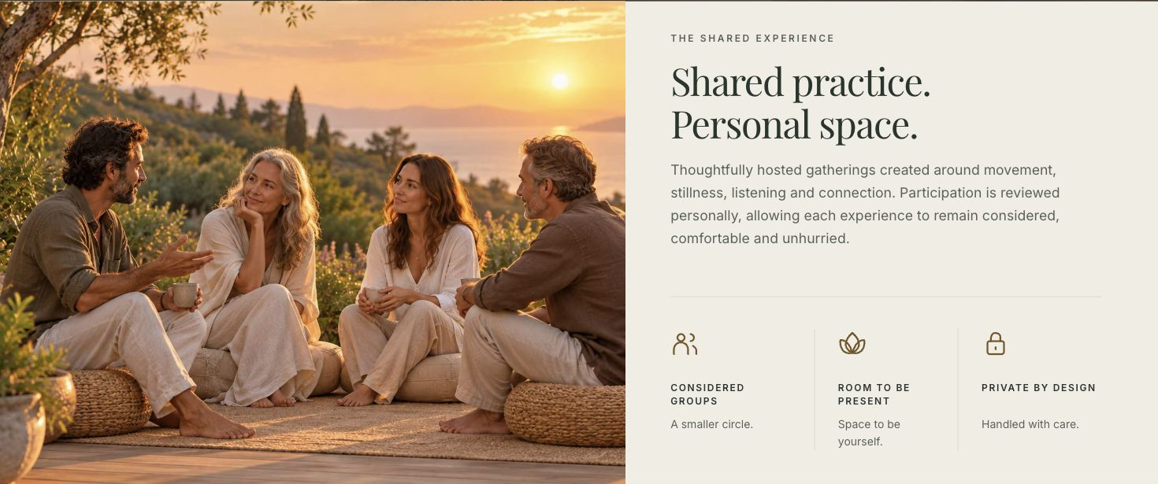
04 Shared experience
Notes:
Screenshot of the local NOURA homepage at a 1470 px desktop viewport. Section: Shared experience.

Slide 5
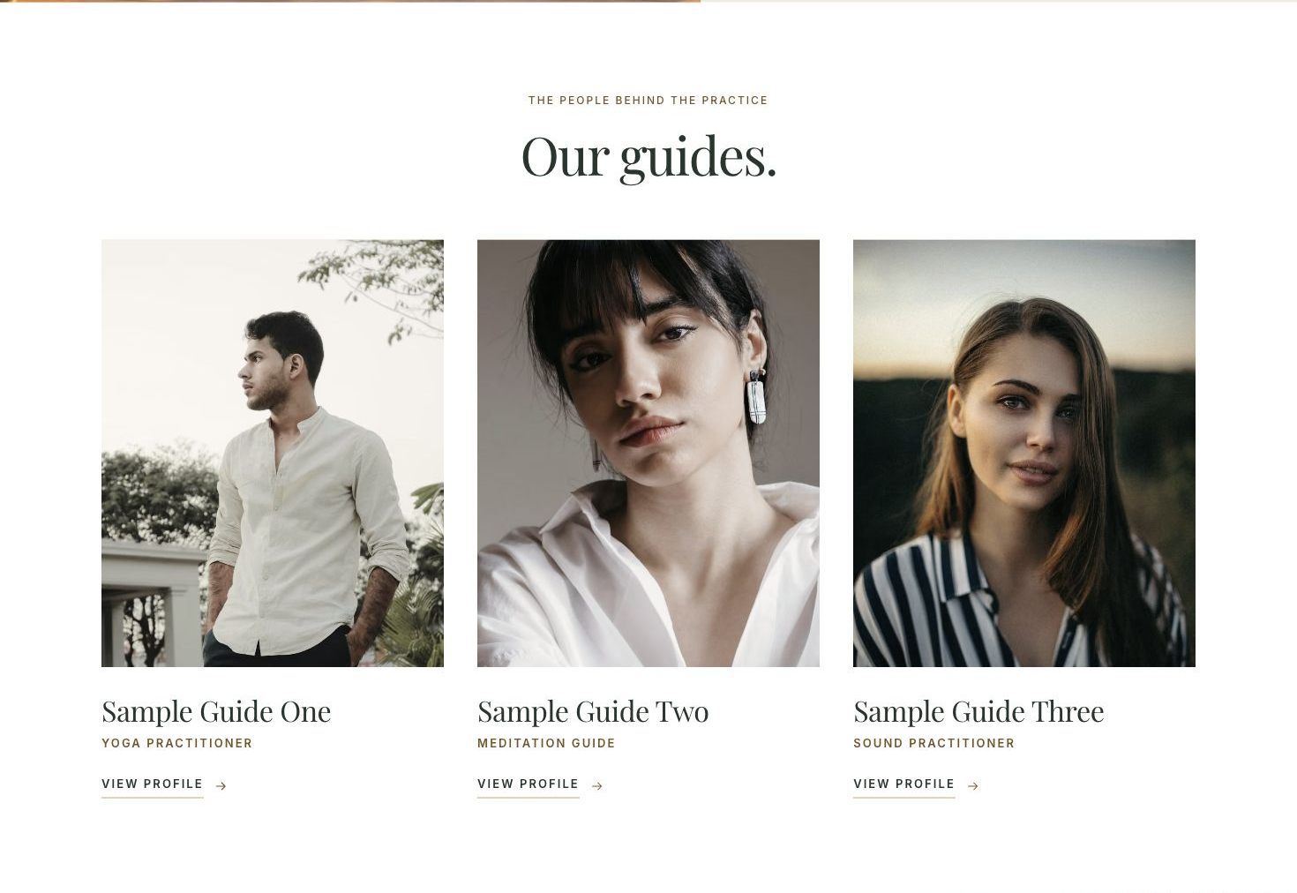
05 Our guides
Notes:
Screenshot of the local NOURA homepage at a 1470 px desktop viewport. Section: Our guides.

Slide 6
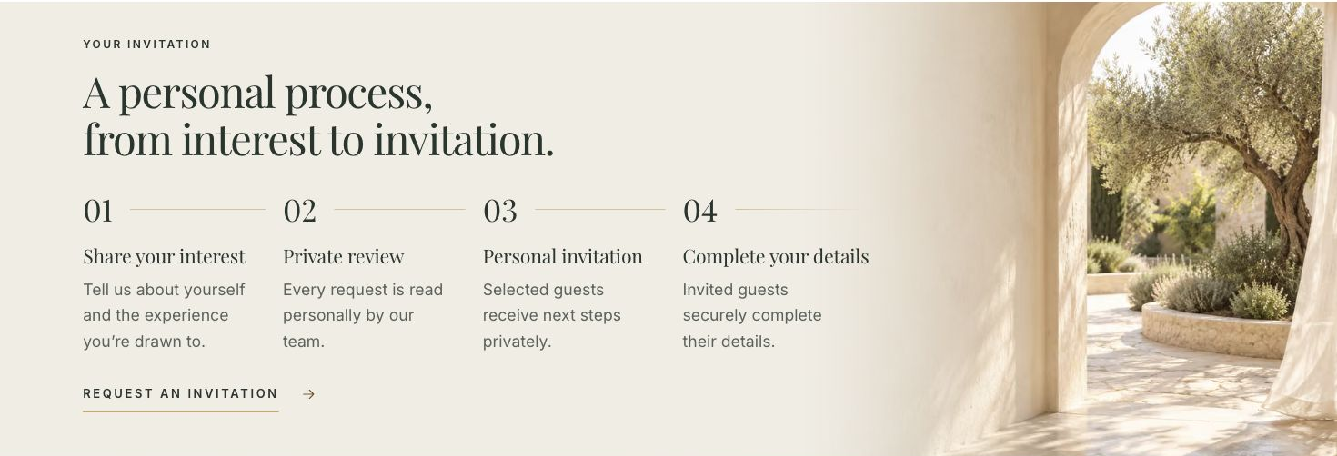
06 Your invitation
Notes:
Screenshot of the local NOURA homepage at a 1470 px desktop viewport. Section: Your invitation.

Slide 7
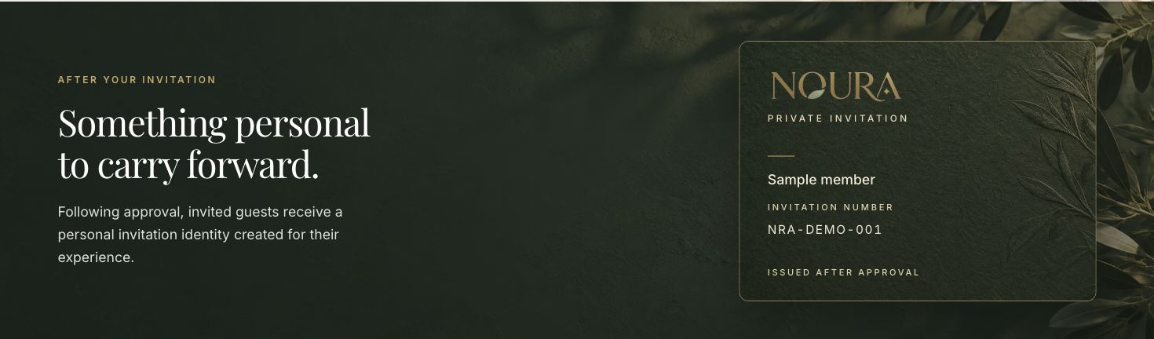
07 Member identity
Notes:
Screenshot of the local NOURA homepage at a 1470 px desktop viewport. Section: Member identity.

Slide 8
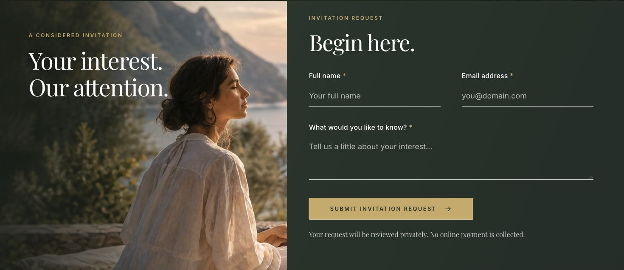
08 Invitation request
Notes:
Screenshot of the local NOURA homepage at a 1470 px desktop viewport. Section: Invitation request.

Slide 9
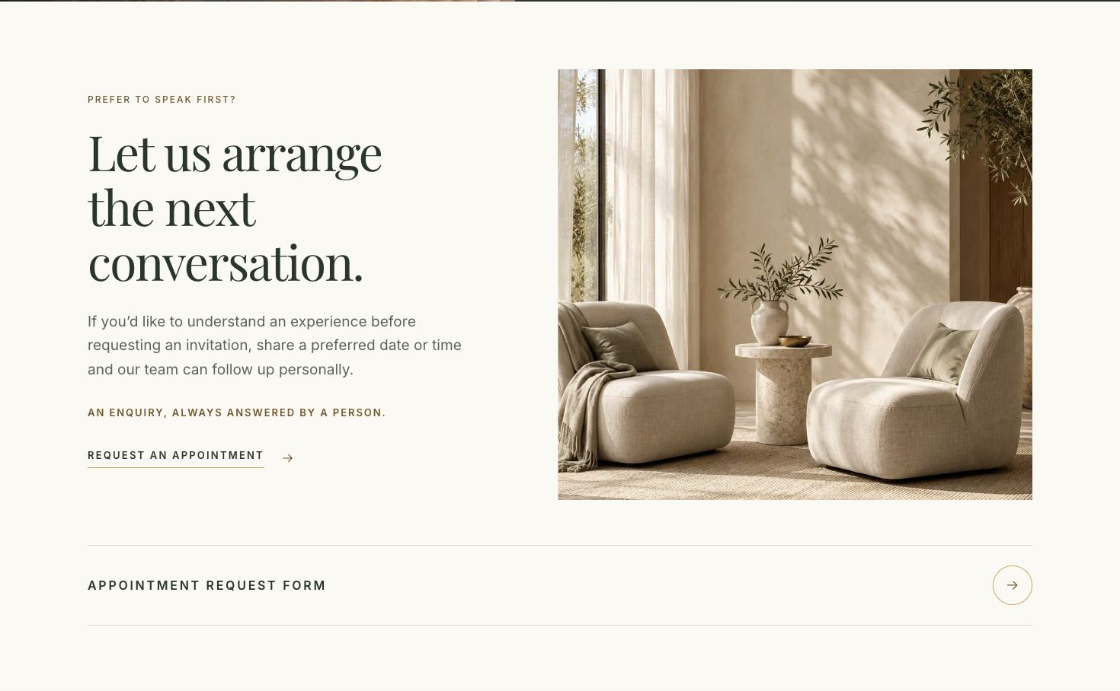
09 Private session
Notes:
Screenshot of the local NOURA homepage at a 1470 px desktop viewport. Section: Private session.

Slide 10
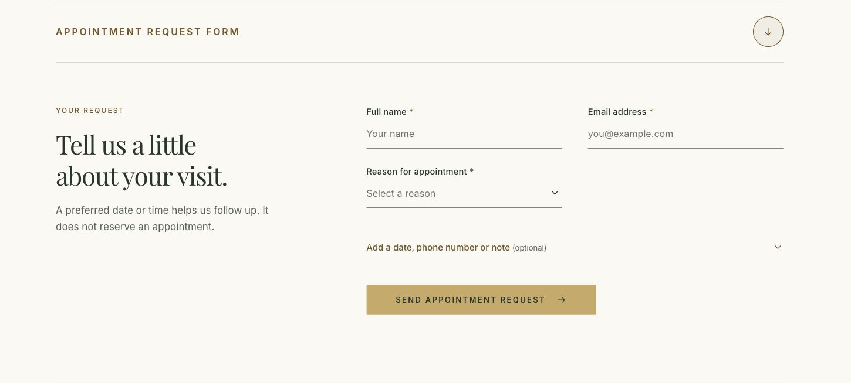
10 Private session request form
Notes:
Screenshot of the local NOURA homepage at a 1470 px desktop viewport. Section: Private session request form.

Slide 11
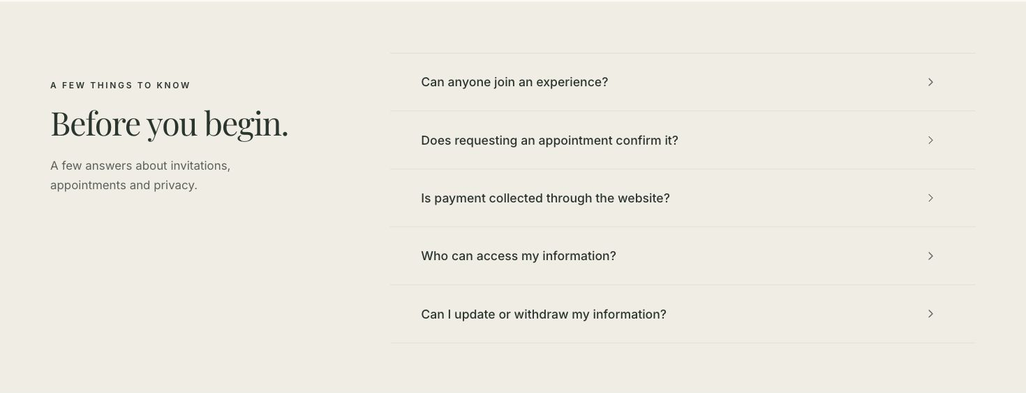
11 Questions
Notes:
Screenshot of the local NOURA homepage at a 1470 px desktop viewport. Section: Questions.

Slide 12
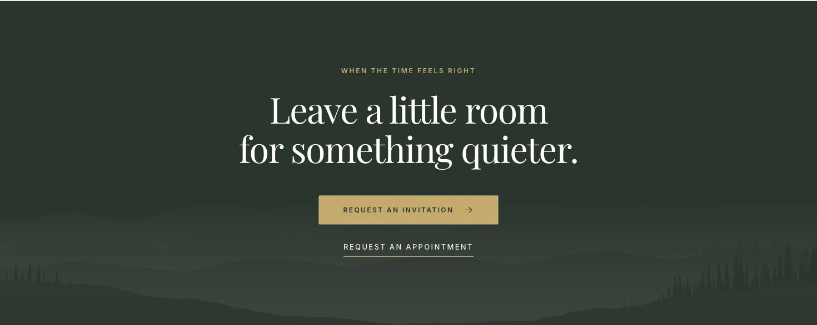
12 Closing invitation
Notes:
Screenshot of the local NOURA homepage at a 1470 px desktop viewport. Section: Closing invitation.

Slide 13
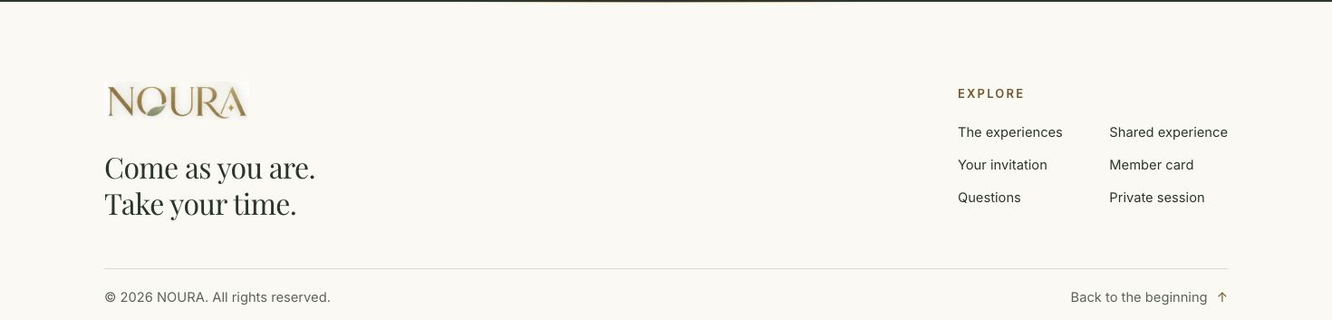
13 Footer
Notes:
Screenshot of the local NOURA homepage at a 1470 px desktop viewport. Section: Footer.

