Slide 1
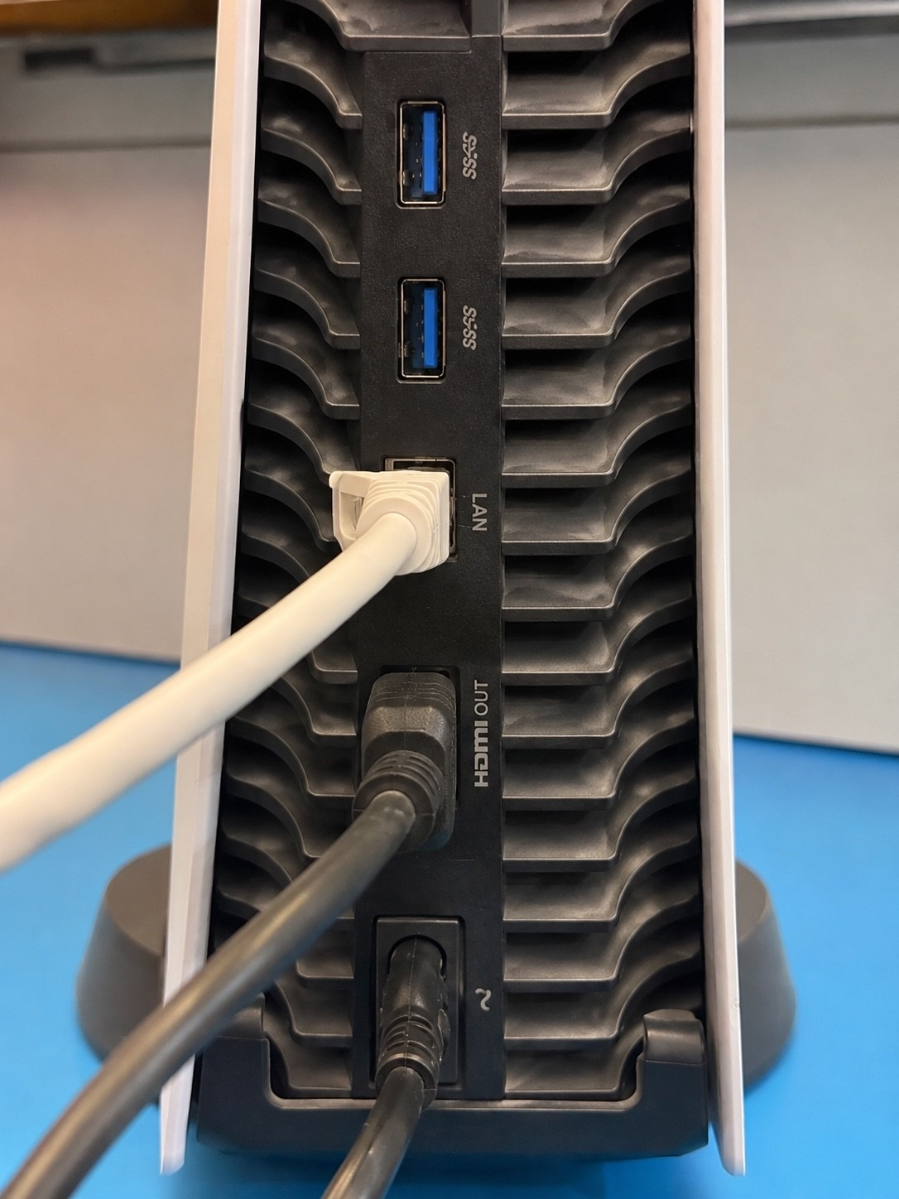
META GLOBAL AI DEVELOPER HACKATHON · PUSH THE FRONTIER
AI can recognise
what it sees.
But can it prove
what's true?
LAN · plug seen by Muse
SAM mask reaches the port ✓
HDMI OUT · plug seen by Muse
no SAM corroboration ?
Introducing ProofCam.
Photo: the author's PlayStation 5. Labels are what a live ProofCam inspection recorded (Muse Spark 1.3 + SAM 3.1).
Notes:
[0:00–0:07 · 7 s] The hook
NARRATION:
AI can recognise what's in a photo. But can it prove what's true?
ON-SCREEN CAPTION (muted viewing):
AI can recognise what it sees. But can it prove what's true?
PRODUCTION:
Slow fade in from black. Hold the real PS5 photo; the two evidence labels are the story in one frame.
ASSET: real photo 4 of inspection insp_92cc… (physical equipment). The two boxes are Muse's recorded port boxes for that photo; the labels state what the policy recorded (LAN: SAM-corroborated; HDMI OUT: Muse only).

Slide 2
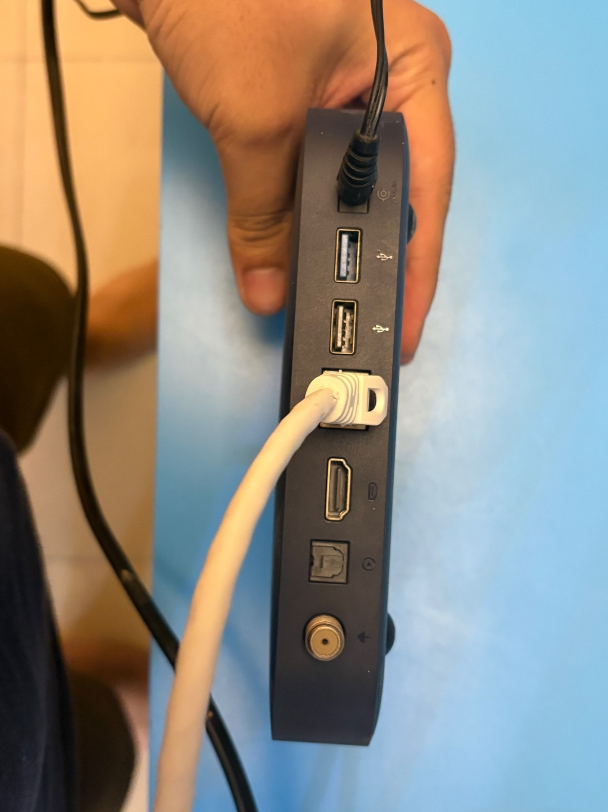

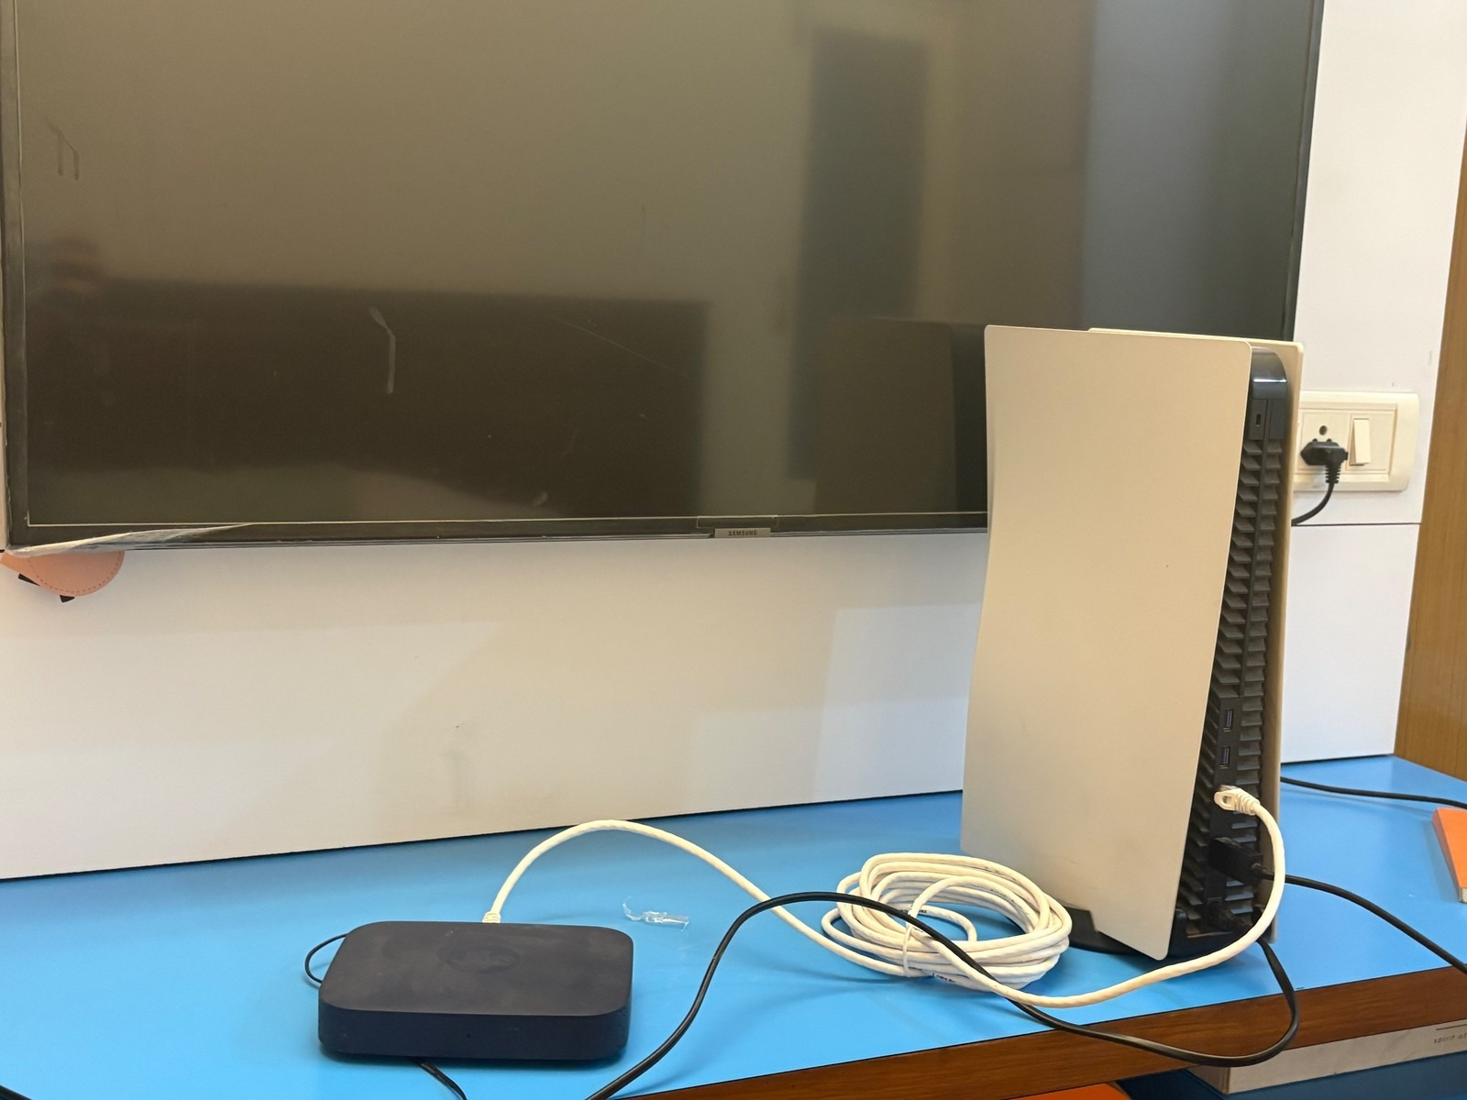

THE PROBLEM
The physical world runs on assumptions.
INSTALLATION CHECKLIST
Router / set-top box installed
Console cabled
TV connected
Signed off
Photos are collected.
Pictures pile up after the work is done, with no link to what they prove.
Checklists are completed.
Ticked by the person who did the work.
Requirements are assumed.
No one can show which photo proves which connection.
A cable is visible in a photo
≠
The required connection is proven
ProofCam
02
Notes:
[0:07–0:18 · 11 s] The real-world problem
NARRATION:
Installations are signed off on photos and checklists. But a cable you can see is not proof that the right two ports are connected.
ON-SCREEN CAPTION (muted viewing):
A cable is visible ≠ the required connection is proven.
PRODUCTION:
Fade. Let the bottom ‘≠’ bar land on the word ‘proof’.
ASSETS: three real photos from the final inspection (physical equipment) as ‘evidence photos’; the checklist is an illustrative generic site checklist (native shapes).

Slide 3
THE INSIGHT
Seeing is not verifying.
TRADITIONAL IMAGE AI
PROOFCAM
“What objects are in this photograph?”
“What evidence establishes that this requirement is satisfied?”
OUTPUT
Labels.
No requirement checked. No gap found.
R1 · set-top box RJ45 → PS5 LAN · Ethernet
television
→
Set-top box RJ45 end
photo 2 · Muse + SAM
game console
PS5 LAN end
photo 4 · Muse + SAM
cable
Same cable at both ends
in no photo · gap stays open
set-top box
OUTPUT
Evidence, the open gap, and the next photo to take.
Illustrative labels on a real photo
From passive recognition to active evidence investigation.
ProofCam
03
Notes:
[0:18–0:28 · 10 s] Seeing is not verifying
NARRATION:
Image AI asks: what's in this picture? ProofCam asks: what evidence establishes this requirement, and what's still missing?
ON-SCREEN CAPTION (muted viewing):
From passive recognition to active evidence investigation.
PRODUCTION:
Fade. Signature slide: left panel = labels, right panel = evidence + gap + next photo (real values).
RIGHT PANEL VALUES: the real state of R1 in the final inspection after photo 4, before the operator's cable statement (both ends established from photos; cable identity shown in no photo, so the gap stayed open until the operator declared it).

Slide 4
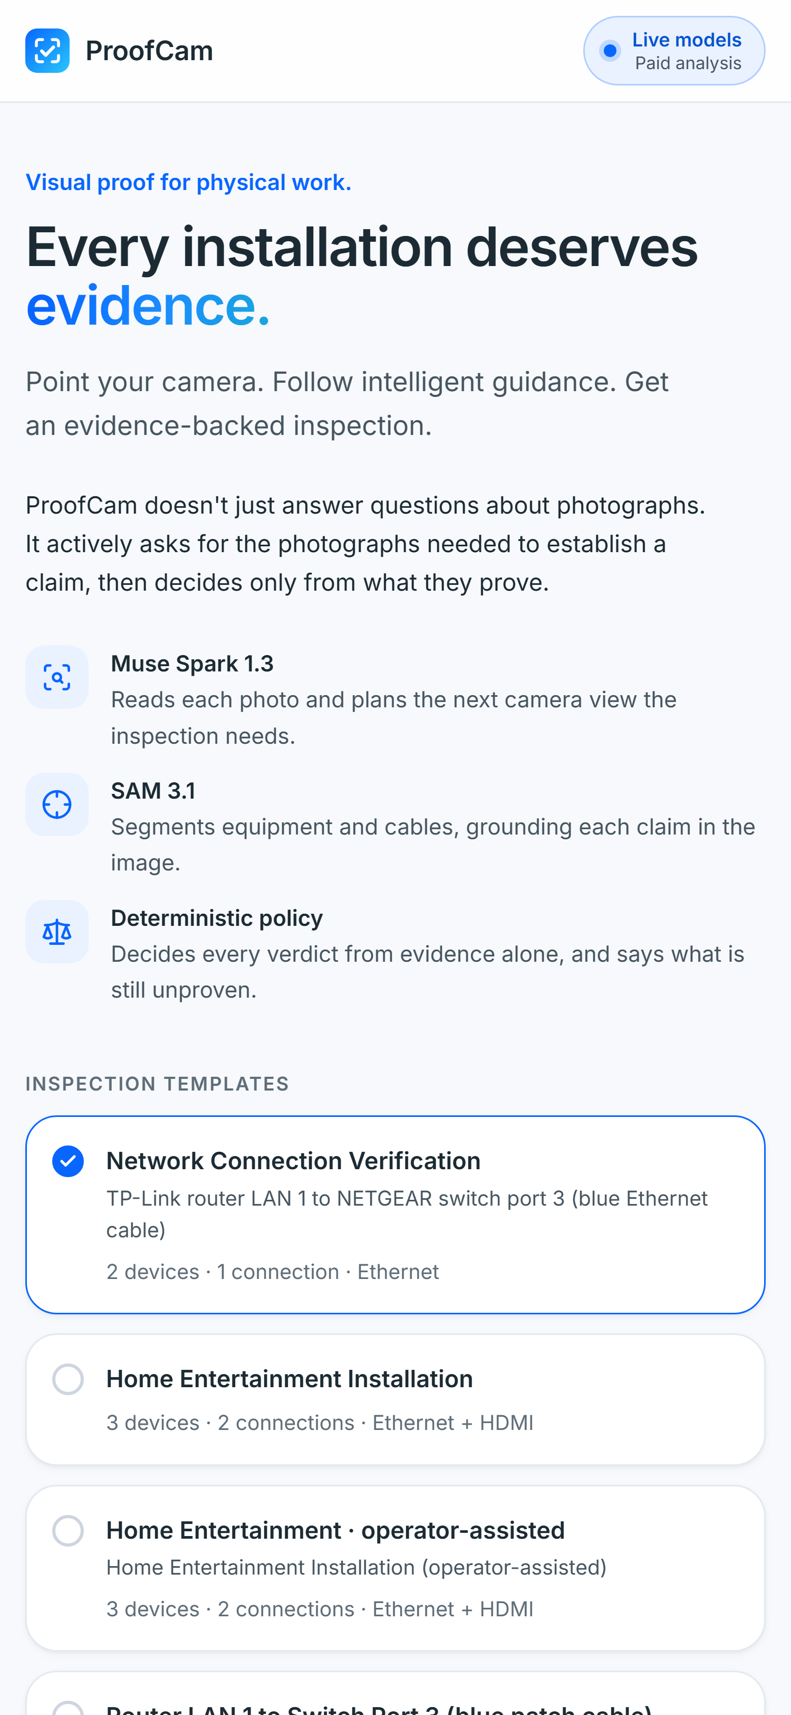
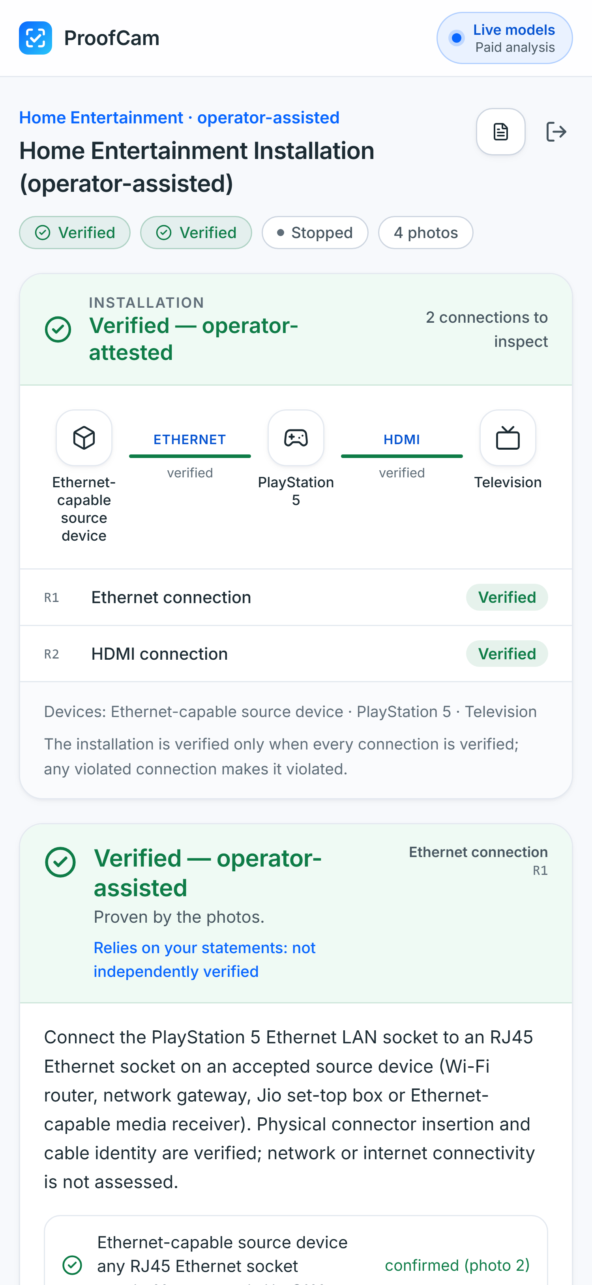




THE PRODUCT
Meet ProofCam.
An AI agent for evidence-driven physical inspections.
Inspect
Photograph the installation with any phone browser.
Reason
Muse Spark reads ports, plugs and labels; SAM 3.1 grounds them.
Request
It asks for the one view that closes the open gap.
Verify
A deterministic policy decides, with an audit trail.
Real app screens (installable PWA) · start screen · completed real inspection
ProofCam
04
Notes:
[0:28–0:37 · 9 s] Meet ProofCam
NARRATION:
This is ProofCam: an AI agent that inspects physical installations, decides what it still needs to see, and asks for that exact view.
ON-SCREEN CAPTION (muted viewing):
Inspect → Reason → Request → Verify.
PRODUCTION:
Fade. Real app screens (landing + the completed real inspection).
ASSETS: headless-Chrome captures of the real app (current build) showing the stored records; no new model calls. Right phone = the final real inspection (VERIFIED — operator-attested).

Slide 5
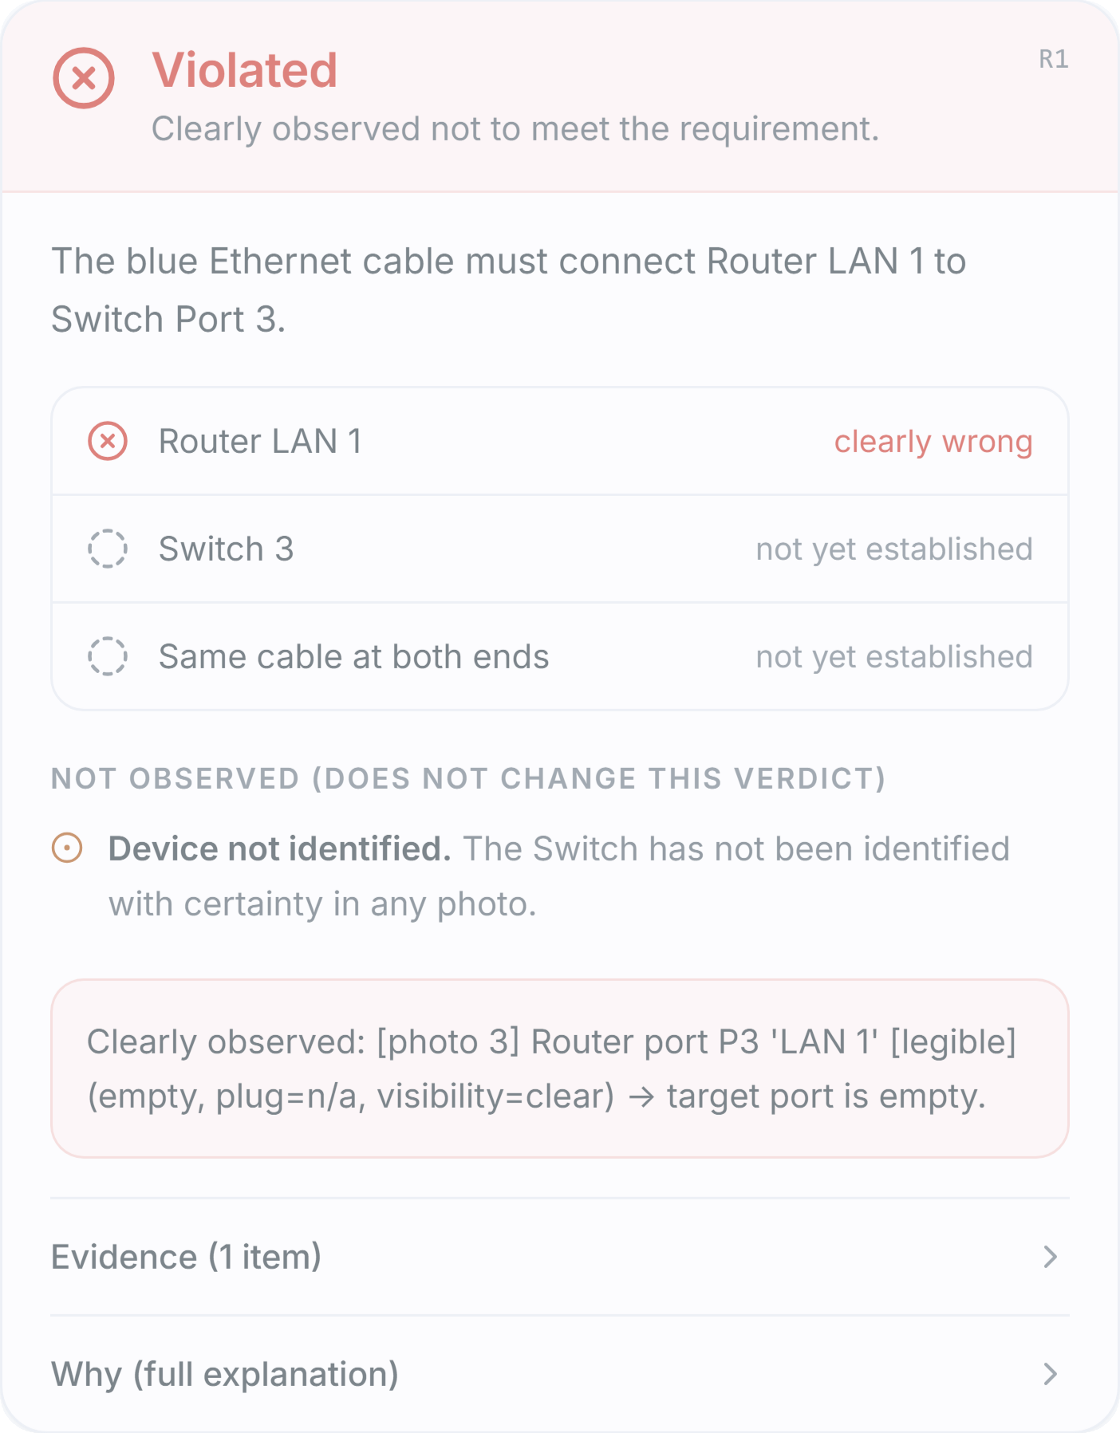
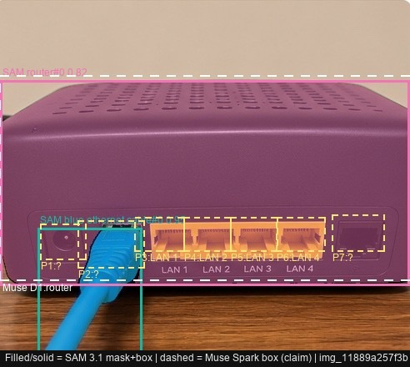
LIVE DEMO · RECORDING A
▶▶ PROCESS ACCELERATED
It doesn't approve everything.
REQUIREMENT
The blue Ethernet cable must connect Router LAN 1 to Switch Port 3.
▶
INSERT
RECORDING A
VIOLATED INSPECTION
iPhone screen recording · portrait
≈20 s · router LAN 1 → switch port 3
Replace this frame: see speaker notes
AI-GENERATED TEST IMAGE
LAN 1
empty
plug
unlabelled socket
“A model's observation is not enough. The requirement must be satisfied.”
Test photos are AI-generated (synthetic) and disclosed · analysed live by Meta Muse Spark 1.3 + SAM 3.1 · 3 photos · 5 model calls
Notes:
[0:37–0:57 · 20 s] Demo A — VIOLATED
NARRATION:
First, a failure case, on AI-generated test photos. The requirement: a blue cable into LAN 1. Muse Spark reads the port labels, SAM grounds the plug, and the policy sees LAN 1 clearly empty. Violated. Not ‘looks plugged in’. Violated.
ON-SCREEN CAPTION (muted viewing):
A model's observation is not enough. The requirement must be satisfied.
PRODUCTION:
RECORDING A in the phone frame. Requirement/start 1.5×; ‘Analysing…’ waits 6–8×; violated card at 1×, hold ≥3 s on ‘Router LAN 1 · clearly wrong’. Keep the ‘AI-generated test images’ disclosure visible.
INSERT RECORDING A (VIOLATED):
1. Select the dashed frame ‘VIDEO PLACEHOLDER · RECORDING A’ (Home → Arrange → Selection Pane).
2. Insert → Video → This Device… → choose the (already sped-up) Recording A file. Drag it onto the frame, then right-click → Size and Position: Lock aspect ratio; height 6.45 in. Delete the dashed frame + label; keep the PHONE FRAME bezel and the PROCESS ACCELERATED pill (Bring to Front).
3. Playback tab: Start = Automatically; Volume = Mute; Trim Video to the strongest 20 s (see DEMO_TIMELINE.md).
4. Transitions → After = 19.5 s (the 20 s slot minus the 0.5 s fade; set a shorter clip accordingly).
CLIP PLAN (final-video time 0:37–0:57): requirement 1.5–2× · ‘Analysing…’ waits 6–8× (keep PROCESS ACCELERATED caption) · violated card 1× and hold ≥3 s.
FACTS: inspection insp_f1bb…, spec router_switch, 3 AI-generated test photos (IMG_6171–6173), 5 live calls (3 Muse, 2 SAM), VIOLATED because photo 3 legibly shows LAN 1 clearly empty; the blue plug sits in an unlabelled socket. The switch was never identified — that does not change the verdict.

Slide 6

HOW IT WORKS · THE ACTIVE INSPECTION LOOP
ProofCam knows what it still needs to see.
01
02
03
04
05
Capture
Observe
Evaluate
Find the gap
Request a view
A photo from the phone camera
Muse Spark: structured claims
SAM 3.1: masks of each concept
Policy re-assesses every requirement over all photos
The most fundamental missing fact
Muse plans the next shot; fixed templates as fallback
repeat until every requirement has a verdict — or stop honestly
FROM THE REAL INSPECTION · REQUEST nv1 · PLANNED BY MUSE SPARK 1.3
FROM THE REAL INSPECTION · REQUEST nv5 · FIXED TEMPLATE
Missing: the set-top box's connection ports have not been seen.
Missing: both HDMI ends show a plug, but no photo shows one cable joining them.
“Walk around to behind the blue table and photograph the rear panel of the dark set-top box on the left…”
“Step back so one photo shows the hdmi cable run between both endpoints, from one device to the other…”
Photo 2 → RJ45 plug seen by Muse, corroborated by SAM ✓
No such photo was taken → the operator declared it instead, and the verdict says so.
ProofCam
06
Notes:
[0:57–1:10 · 13 s] The active inspection loop
NARRATION:
Every photo re-evaluates every requirement. When a fact is missing, like whether one cable joins both ends, ProofCam plans the next camera view to close that gap.
ON-SCREEN CAPTION (muted viewing):
ProofCam knows what it still needs to see.
PRODUCTION:
Fade. Loop diagram, then the two real requests from the final inspection (nv1 by Muse, nv5 template).
REAL REQUEST TEXTS: nv1 and nv5 of inspection insp_92cc… (copied verbatim, shortened with …). nv5 was issued from the fixed templates after the operator statements; the HDMI cable identity was then declared by the operator rather than shown in a photo.

Slide 7
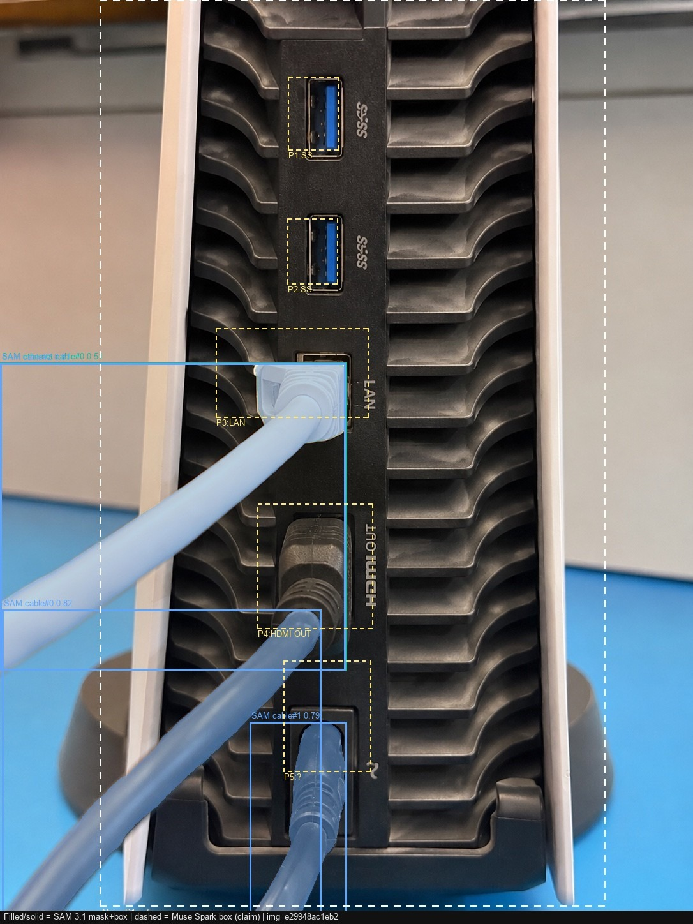


META AI MODELS
Two Meta models. One verification system.
MUSE SPARK 1.3 · REASONS
Reads each photo into structured claims (devices, ports, labels, plugs, cables, certainty) and plans the next camera view for the open gap.
structured JSON output · vision · next-view planning
SAM 3.1 · GROUNDS
Segments each named cable and device concept on the same image. A plug claim counts only where a real mask reaches that port.
concept segmentation · independent spatial check
DETERMINISTIC POLICY · VERIFIES
Fuses every photo against the specification. It alone sets VERIFIED, VIOLATED or INSUFFICIENT EVIDENCE, with the provenance of each claim.
no model output is ever a verdict
filled · SAM 3.1 mask
dashed · Muse claim
Not one ‘looks connected’ prompt: 22 model calls across 4 photos, each claim checked.
Photo 4, stored overlay · LAN: Muse + SAM ✓ · HDMI OUT: Muse only
ProofCam
07
Notes:
[1:10–1:24 · 14 s] Two Meta models, one system
NARRATION:
Two Meta models, one system. Muse Spark reasons: photos become structured claims and next-view plans. SAM 3.1 grounds those claims in real pixels. A deterministic policy decides.
ON-SCREEN CAPTION (muted viewing):
Muse reasons. SAM grounds. Policy verifies.
PRODUCTION:
Fade. Real stored overlay of photo 4 (SAM masks + Muse boxes) on the right.
WHY THIS IS MORE THAN ONE VISION CALL: Muse produces schema-validated claims and plans views; SAM independently segments named concepts; the policy only accepts a plug where both agree and the spec's rules hold. SAM confirms a region, never cable identity or connector type on its own (disclosed in reports). Call counts from the trace of insp_92cc….

Slide 8
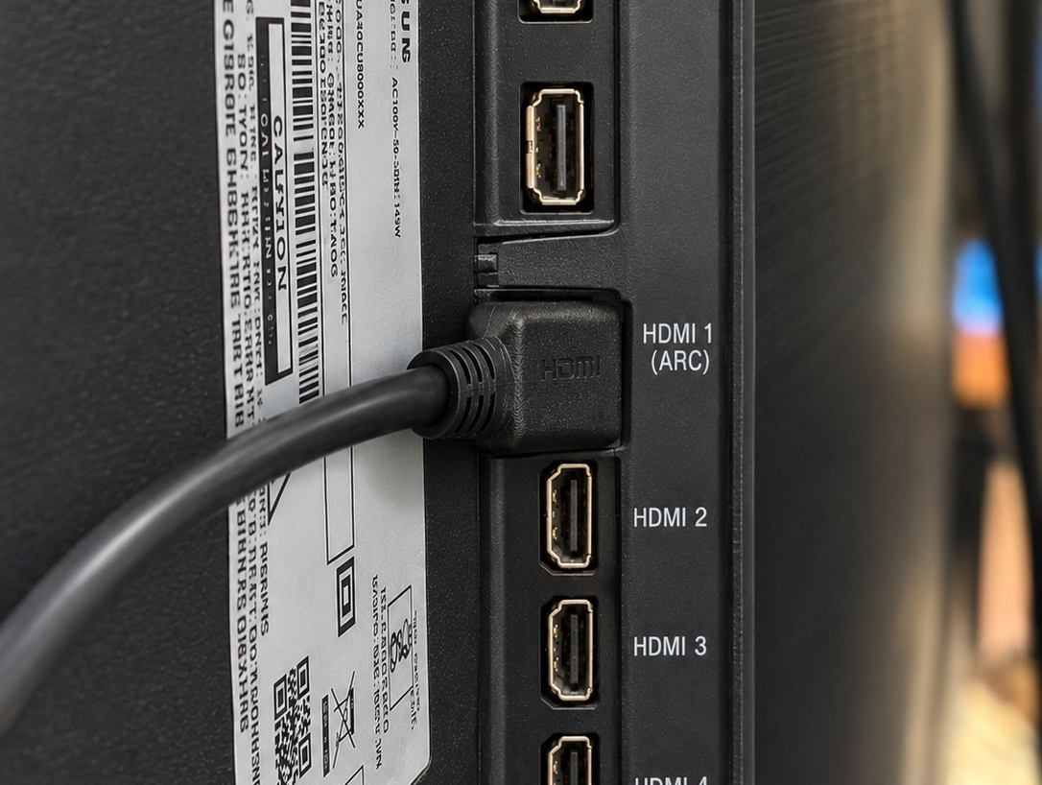
LIVE DEMO · RECORDING B
▶▶ PROCESS ACCELERATED
Watch the evidence accumulate.
PHOTO 1 · OVERVIEW
TV, PlayStation 5 and Jio set-top box identified
▶
INSERT
RECORDING B
REAL EQUIPMENT · 4 PHOTOS
iPhone screen recording · portrait
≈25 s · photos 1→4 and results
Replace this frame: see speaker notes
set-top box ports not visible → first next-view request
PHOTO 2 · REQUESTED VIEW
Set-top box rear: RJ45 plug clearly inserted
Muse ✓ · SAM ✓ (generic ‘cable’ mask) · end established
PHOTO 3 · REQUESTED VIEW
TV panel: plug in HDMI 1 (ARC)
Muse ✓ · SAM ✓ (generic ‘cable’ mask) · end established
PHOTO 4 · REQUESTED VIEW
PS5 rear: LAN plug and HDMI OUT plug
LAN: Muse ✓ SAM ✓ · HDMI OUT: Muse only (SAM found no HDMI cable)
Real equipment · 4 photos · 22 live Meta model calls (8 Muse Spark 1.3, 14 SAM 3.1) · model waits sped up in the recording
Notes:
[1:24–1:49 · 25 s] Demo B — evidence accumulates
NARRATION:
Now my real setup: a Jio set-top box, a PlayStation 5 and a TV. Four photos. Each time, Muse observes, SAM segments, and the policy re-checks both connections. Three plug ends are established from photos. One HDMI plug Muse saw, but SAM could not confirm.
ON-SCREEN CAPTION (muted viewing):
Real equipment · 4 photos · every requirement re-checked after each photo.
PRODUCTION:
RECORDING B (part 1) in the phone frame: photos 1→4 with their result cards. Waits 6–8× with ‘PROCESS ACCELERATED’ visible; each ‘Next view’ card 1–1.5×, readable for ≥2 s.
INSERT RECORDING B — PART 1 (photos 1→4):
1. Select ‘VIDEO PLACEHOLDER · RECORDING B’ in the Selection Pane; Insert → Video → This Device… → the sped-up clip of photos 1–4; size to height 6.45 in over the frame; delete the dashed frame + label, keep the PHONE FRAME bezel and the PROCESS ACCELERATED pill on top (Arrange → Bring to Front).
2. Playback: Start Automatically · Mute · Trim to 25 s. Transitions → After = 24.5 s (25 s slot minus the 0.5 s fade).
CLIP PLAN (final-video time 1:24–1:49): see DEMO_TIMELINE.md — waits 6–8×, each Next-view card readable ≥2 s at 1–1.5×.
FACTS: inspection insp_92cc…, spec ps5_home_setup_assisted (operator-assisted template), physical equipment, 4 photos, 22 live calls. Ends established from photos: set-top box RJ45 (photo 2), TV HDMI 1 (ARC) (photo 3), PS5 LAN (photo 4). PS5 HDMI OUT: Muse saw the plug; SAM's ‘hdmi cable’ found nothing and the generic ‘cable’ mask did not corroborate it.

Slide 9
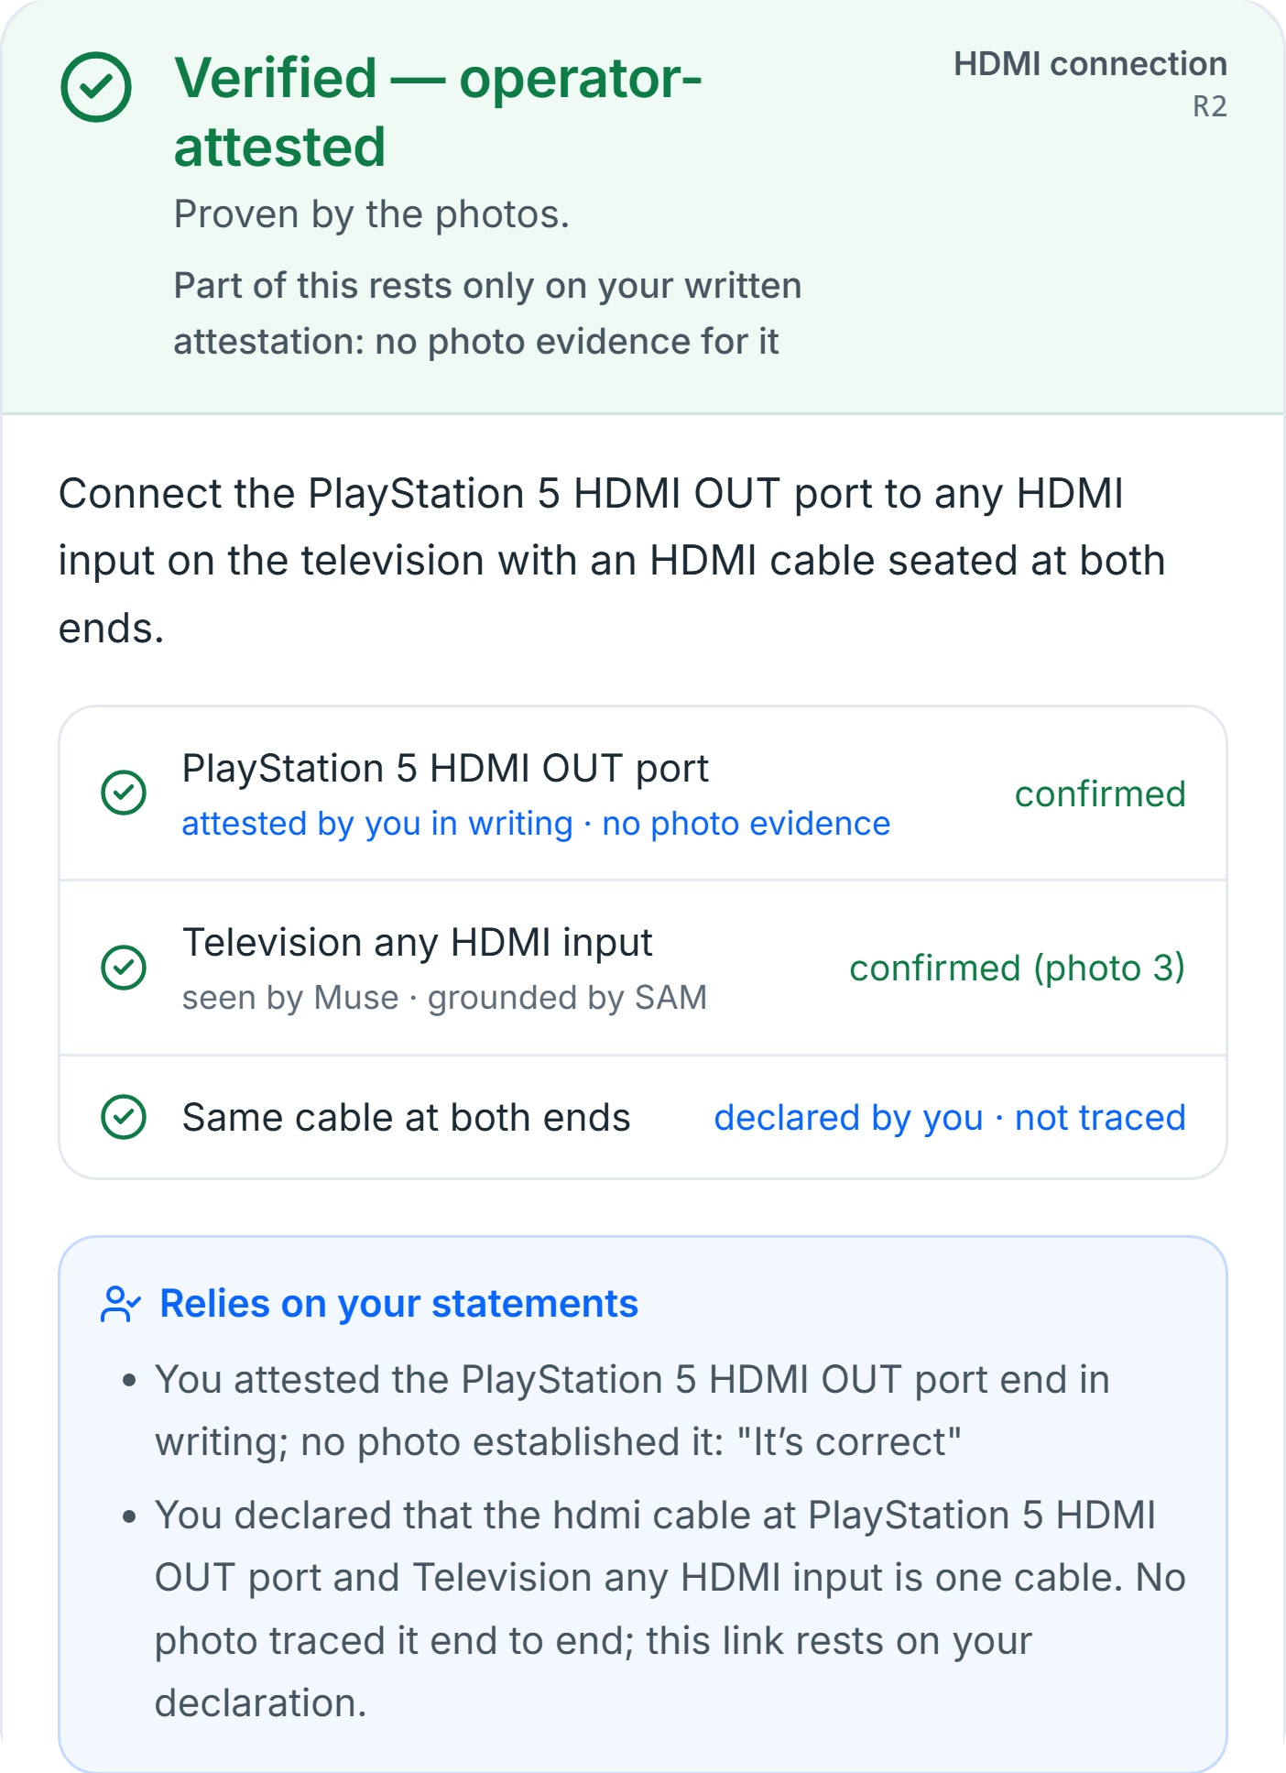

ASSURANCE · HUMAN IN THE LOOP
When the camera can't prove it, ProofCam says so.
ESTABLISHED FROM PHOTOS
CONFIRMED BY THE OPERATOR
Muse observed · SAM corroborated · policy accepted
Recorded verbatim · time-stamped · labelled in the verdict
Set-top box RJ45 plug
Ethernet run is one cable
photo 2
declared · no photo traced it
PlayStation 5 LAN plug
HDMI run is one cable
photo 4
declared · no photo traced it
TV HDMI input plug
PS5 HDMI OUT plug
photo 3
attested in writing · Muse saw it, SAM did not corroborate
When visual evidence runs out, ProofCam doesn't invent certainty. It records exactly what the human confirmed.
ProofCam
09
Notes:
[1:49–2:03 · 14 s] Human-in-the-loop assurance
NARRATION:
That is where ProofCam stays honest. When the camera can't prove something, it says so, and records exactly what I confirmed, labelled as human, not as vision.
ON-SCREEN CAPTION (muted viewing):
When the camera can't prove it, ProofCam says so.
PRODUCTION:
Fade. Static, readable split (photos vs operator). Optional: 3–4 s of Recording B at 1× showing the confirmation sheet.
EXACT RECORD (insp_92cc…): od1 cable_identity R1 (00:13:49), od2 endpoint_attestation R2 PS5 HDMI OUT (00:14:10, note “It’s correct”), od3 cable_identity R2 (00:14:19). R1 = VERIFIED operator-assisted; R2 = VERIFIED operator-attested. The right image is the real R2 card from the app.

Slide 10
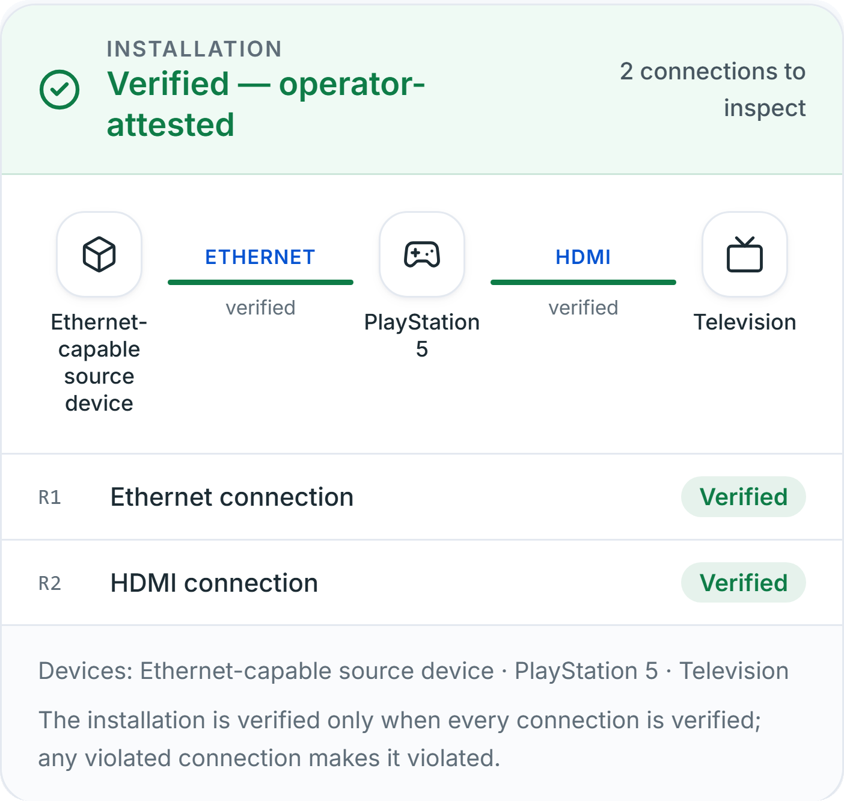
THE RESULT
Every verdict has an evidence trail.
GENERATED REPORT · EXCERPT (CONDENSED)
OVERALL VERIFIED — OPERATOR-ATTESTED, NOT VISUALLY ESTABLISHED
R1 Ethernet VERIFIED — OPERATOR-ASSISTED
photo 2 set-top box RJ45 Muse + SAM (generic) + shape
photo 4 PS5 LAN Muse + SAM
00:13:49 operator: Ethernet run is one cable
R2 HDMI VERIFIED — OPERATOR-ATTESTED
photo 3 TV HDMI 1 (ARC) Muse + SAM (generic) + shape
00:14:10 operator: PS5 HDMI OUT end attested in writing
00:14:19 operator: HDMI run is one cable
2 / 2 requirements verified
3 of 4 connection ends from photos
3 operator statements, time-stamped
22 live Meta model calls · ≈ $0.13
ProofCam
10
Notes:
[2:03–2:14 · 11 s] The result
NARRATION:
The result: verified, operator-attested. Every claim links to a photo, a model output or a time-stamped statement.
ON-SCREEN CAPTION (muted viewing):
VERIFIED — OPERATOR-ATTESTED: every claim has an evidence trail.
PRODUCTION:
Fade. Real installation card + condensed lines from the generated report. Do not call this ‘independently verified’.
IMPORTANT: the overall label is VERIFIED — OPERATOR-ATTESTED (R2's PS5 HDMI OUT end rests on a written attestation), not ‘independently verified’ and not merely ‘operator-assisted’. The excerpt condenses real lines of the generated Markdown report (supporting items, provenance and statement times). Cost is the app's list-price estimate from the trace.

Slide 11

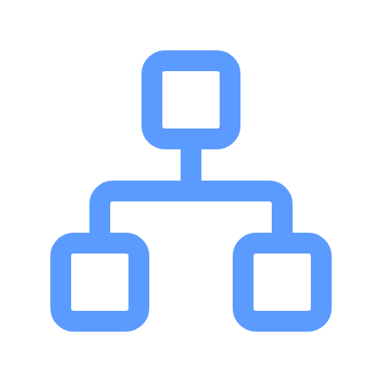


ENGINEERING
Built for evidence, not just predictions.
Phone camera · PWA
FastAPI service
Meta Model API
Structured observations
React 19 · TypeScript · Vite · Tailwind
Python · Pydantic · one photo = one step
Muse Spark 1.3 · SAM 3.1 (streamed)
schema-validated claims: devices, ports, plugs
Auditable report
SQLite inspection record
Deterministic policy
Grounding
JSON + Markdown · provenance per claim
append-only evidence · resumable
verdicts · gaps · assurance
SAM masks ↔ Muse boxes, per port
Call budget reserved before every request
Idempotent, resumable captures
Contradictions surfaced, never resolved silently
Operator statements append-only
499 backend + 57 frontend automated tests
Tests use mocked models: regression, not accuracy
≈6,300 lines of Python engine · ≈4,100 lines of TypeScript UI · built 30 Oct – 4 Nov 2026
ProofCam
11
Notes:
[2:14–2:25 · 11 s] Technical depth
NARRATION:
Under the hood: structured model outputs, policy-only verdicts, an append-only evidence store, call budgets, and over five hundred automated tests.
ON-SCREEN CAPTION (muted viewing):
Built for evidence, not just predictions.
PRODUCTION:
Fade. Architecture snake; tests are mocked-model regression tests, not accuracy benchmarks (say nothing more).
VERIFIED FACTS (5 Nov 2026): backend pytest 499 passed (1 live test deselected); frontend vitest 57 passed; tsc clean; production build OK. Tests run against mocked Meta responses and recorded fixtures: they are regression tests for policy correctness and failure cases, not accuracy benchmarks. Line counts: backend/proofcam/*.py and frontend/src (TS/TSX).

Slide 12





THE BIGGER OPPORTUNITY
Today, cables. Tomorrow, infrastructure.
PRODUCT VISION · POTENTIAL APPLICATIONS, NOT CURRENT DEPLOYMENTS
Data centres
Telecom
Factories
Energy
Field service
Is every server patched to the port in the drawing?
Is each feed on the right port of the right radio?
Is the sensor installed and cabled as specified?
Are string connectors where the design says?
Was the part replaced, and can we show it?
Physical requirement
Evidence
Verification
Audit trail
Same loop. Different specifications.
ProofCam
12
Notes:
[2:25–2:38 · 13 s] The bigger opportunity
NARRATION:
Today it's cables. But the same loop, requirement, evidence, verification, audit trail, could serve data centres, telecom, factories, energy and field maintenance.
ON-SCREEN CAPTION (muted viewing):
Today, cables. Tomorrow, infrastructure. (Vision — not current deployments.)
PRODUCTION:
Fade. Keep the ‘potential applications, not current deployments’ tag on screen.
Say ‘could’ — these are illustrative questions for a product vision. ProofCam today inspects cable connections between devices from phone photos; nothing here has been deployed or measured in these settings.

Slide 13


WHY THIS MATTERS
What if every physical installation could explain why it was trusted?
Verifiable observations
Clear uncertainty
Traceable decisions
Human accountability
Every claim is tied to a photo and a model output.
Unknown stays unknown. ‘Insufficient evidence’ is an answer.
A deterministic policy, not a model's opinion, sets the verdict.
When people vouch, their words are recorded and labelled.
The value isn't naming objects. It's deciding what observable evidence supports a physical requirement.
ProofCam
13
Notes:
[2:38–2:47 · 9 s] Why this matters
NARRATION:
What if every physical installation could explain why it was trusted?
ON-SCREEN CAPTION (muted viewing):
What if every physical installation could explain why it was trusted?
PRODUCTION:
Fade. Let the question breathe; no extra narration.

Slide 14

PROOFCAM
The verification layer for the physical world.
AI that doesn't just see the physical world. It asks for the evidence needed to verify it.
Built with Meta Muse Spark 1.3 and SAM 3.1
github.com/dakshvatss/proofcam
Daksh Vats · Indie Developer Track · Push the Frontier
Independent project, not affiliated with or endorsed by Meta.
Notes:
[2:47–2:55 · 8 s] Close
NARRATION:
ProofCam. Muse reasons. SAM grounds. Policy verifies.
ON-SCREEN CAPTION (muted viewing):
PROOFCAM — the verification layer for the physical world.
PRODUCTION:
Fade through black. End card holds the GitHub URL for the full 8 s.
Hold the URL on screen for the whole 8 s. Before exporting: the repository must be PUBLIC and pushed (see SUBMISSION_FINAL_CHECKLIST.md).

Slide 15
APPENDIX · ORIGINALITY
What I built during the hackathon
30–31 Oct
2 Nov
3 Nov
4 Nov
4–5 Nov
M0
M1–M2.2
M2.3–M3.3
M3.4–M3.9
Demos
Inspection loop, deterministic policy, Meta API client; live Muse + SAM validation on five reference scenarios
Resumable agent state, SQLite store, FastAPI service; verdict hardening; next-view guidance and contradictions
Grounding geometry; mobile camera PWA; private access and spending cap; live-inference readiness
Three devices / two connections; view relevance; evidence provenance; operator-assisted inspections
Live VIOLATED run (synthetic test photos) and live VERIFIED run on the real home setup
BUILT IN THIS REPOSITORY
• Agent loop: gap selection, next-view requests, attempt ceilings
• Deterministic verification policy and evidence provenance
• Muse/SAM orchestration, grounding geometry, SAM fallback
• SQLite persistence, budgets, idempotent captures, FastAPI
• Mobile PWA, reports, operator statements, test suites
USED, NOT BUILT
• Meta Muse Spark 1.3 and SAM 3.1 via the Meta Model API
• React, Vite, Tailwind CSS, Lucide icons
• FastAPI, Pydantic, SQLite, Pillow, NumPy
• Meta's official SAM output parser (meta_sam_parser)
• All 18 commits dated 30 Oct – 4 Nov 2026 (repository created 30 Oct)
ProofCam
15
Notes:
Facts from git history and docs/PROGRESS.md. The first commit (30 Oct 09:36 IST) adds only .gitattributes; the Milestone 0 code commit follows at 10:03. Work after the last commit (assisted-template and attestation changes) must be committed and pushed before submission.

Slide 16
APPENDIX · EVIDENCE MODEL
How ProofCam labels what it knows
GROUNDED
Muse claim + SAM mask at the port + spec rules
Counts as evidence
SEEN BY MUSE ONLY
Every check met except SAM corroboration
Recorded, never counted
OPERATOR-CONFIRMED
Plug seated · device identity · one cable (spec-permitted)
Counts; verdict marked operator-assisted
OPERATOR-ATTESTED
A written statement where no photo establishes the end
Counts; verdict marked operator-attested
UNRESOLVED / CONTRADICTED
Missing, ambiguous or conflicting observations
Blocks verification; review if contradictory
Verdicts: VERIFIED · VIOLATED · INSUFFICIENT EVIDENCE — set only by the deterministic policy.
Assurance on a verdict: visual · spec assumption · operator-assisted · operator-attested. Statements never override a contradicting photo.
ProofCam
16
Notes:
Source: backend/proofcam/policy.py and evidence.py (RequirementAssessment.assurance, EndpointAssessment.candidates, OperatorDeclaration). Operator statements are available only in the operator-assisted template.

Slide 17
APPENDIX · HONEST LIMITS
What ProofCam does not claim
Not certification
Synthetic data is disclosed
Visually observable conditions only: no electrical safety, network connectivity, signal or regulatory claims.
Recording A uses AI-generated test photos. Recording B uses photos of real equipment.
SAM recall is imperfect
Cable identity across photos
In recorded live runs SAM's ‘hdmi cable’ concept found nothing in 12 of 12 photos; a bounded generic ‘cable’ fallback is disclosed when used.
Similar cables in different photos are never joined. Without a single-photo trace, identity needs a declared, labelled statement.
Static installations
Tests ≠ accuracy
All photos are assumed to show one unchanged configuration; physical changes must be declared.
Automated tests check policy behaviour with mocked models; no accuracy benchmark has been run.
ProofCam
17
Notes:
Sources: README/report disclaimer; docs/META_API_FACTS.md (SAM recall counts); docs/DECISIONS.md D39–D40.

Slide 18
ALTERNATE LAYOUT (HIDDEN) · USE IF RECORDING A IS LANDSCAPE
It doesn't approve everything.
▶
INSERT RECORDING A (16:9)
Unhide this slide and hide the portrait version
Notes:
Use only if Recording A is landscape (e.g. a laptop screen capture). Slide Show → Hide Slide toggles visibility. Copy the narration/timing from main slide 5.

Slide 19
ALTERNATE LAYOUT (HIDDEN) · USE IF RECORDING B IS LANDSCAPE
Watch the evidence accumulate.
▶
INSERT RECORDING B (16:9)
Unhide this slide and hide the portrait version
Notes:
Use only if Recording B is landscape (e.g. a laptop screen capture). Slide Show → Hide Slide toggles visibility. Copy the narration/timing from main slide 8.

