Slide 1

Lab Prereqs

Slide 2
Agenda
Install cloud foundry CLI
Install cURL tool

Slide 3
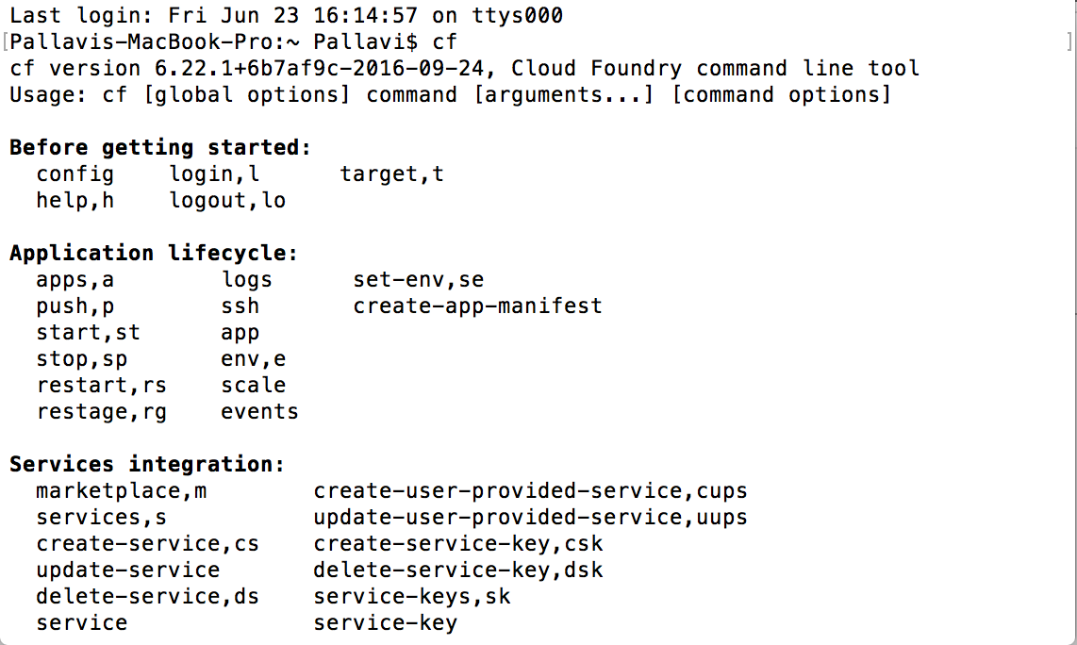
Install Cloud foundry CLI
Visit http://docs.cloudfoundry.org/cf-cli/install-go-cli.html
Download the installable under the section ii
Follow instructions under the section
Test using cf command in the command prompt window, If you see an output similar to the one in the screen shot below. You have installed successfully.
Notes:
Concepts details: Concepts that are detected typically have an associated link to a DBpedia resource.
Entities example: “Paris Hilton stayed in a Hilton Hotel in Paris, France” identifies that “Paris Hilton” is a person, “Hilton Hotel” is a facility, the second mention of “Paris” is a city, and “France” is a country.
Keywords details: Keyword phrases are organized by relevance in the results.
Categories example: “Leonardo DiCaprio won an Oscar” returns “/art and entertainment/movies and tv/movies” as the most confident classification.
Sentiment details: Sentiment information can be returned for detected entities, keywords or user-specified target phrases found in the text.

Slide 4
Install cURL tool
Visit https://bintray.com/vszakats/generic/curl/7.43.0 (for Windows)
Under downloads section find curl-7.43.0-win64-mingw.zip and download the zip
Unzip the folder
Traverse to that directory in the terminal window
Try the command CURL –version. If you get th eversion 7.43 in the output, you have the CURL utility in your system
Notes:
Concepts details: Concepts that are detected typically have an associated link to a DBpedia resource.
Entities example: “Paris Hilton stayed in a Hilton Hotel in Paris, France” identifies that “Paris Hilton” is a person, “Hilton Hotel” is a facility, the second mention of “Paris” is a city, and “France” is a country.
Keywords details: Keyword phrases are organized by relevance in the results.
Categories example: “Leonardo DiCaprio won an Oscar” returns “/art and entertainment/movies and tv/movies” as the most confident classification.
Sentiment details: Sentiment information can be returned for detected entities, keywords or user-specified target phrases found in the text.

