Slide 1

Watson Natural Language Classifier

Slide 2
Agenda
Natural Language Classifier Introduction
Key concepts, Usecases
Hands on

Slide 3

IBM Watson Natural Language Classifier
The Natural Language Classifier service applies cognitive computing techniques to return best matching predefined classes for short text inputs, such as a sentence or phrase..
Unlike traditional APIs, many cognitive services require being trained first before they can be used; the Watson Natural Language Classifier (NLC) service is one of those services that must be trained before using.
IBM Watson Natural Language Understanding

Slide 4
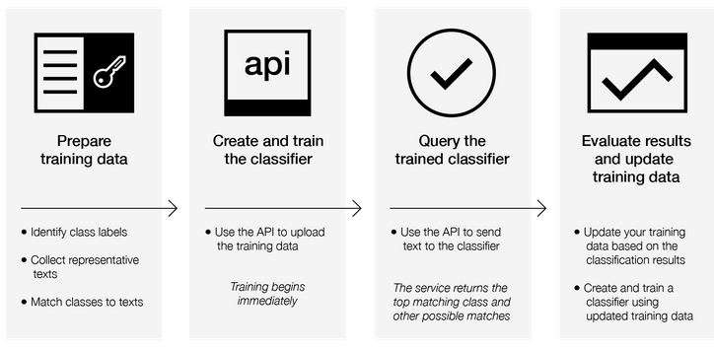
Training the classifier – How does it work?

Slide 5
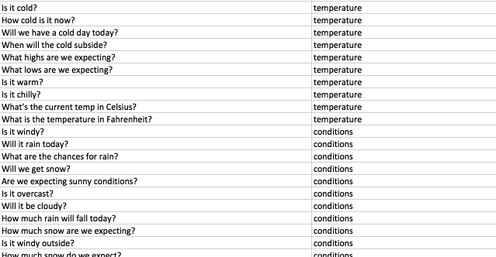
What kind of data and What kind of classification?

Slide 6
Usecases : NLC is used in combination with other services
Chatbot with Long Tail Search
Use images from a manufacturing setting to make sure products are being positioned correctly on an assembly line
Visual Auditing: Look for visual compliance or deterioration in a fleet of trucks, planes, or windmills out in the field, train custom classifiers to understand what defects look like
Insurance: Rapidly process claims by using images to classify claims into different categories.
Social listening: Use images from your product line or your logo to track buzz about your company on social media
Notes:
Concepts details: Concepts that are detected typically have an associated link to a DBpedia resource.
Entities example: “Paris Hilton stayed in a Hilton Hotel in Paris, France” identifies that “Paris Hilton” is a person, “Hilton Hotel” is a facility, the second mention of “Paris” is a city, and “France” is a country.
Keywords details: Keyword phrases are organized by relevance in the results.
Categories example: “Leonardo DiCaprio won an Oscar” returns “/art and entertainment/movies and tv/movies” as the most confident classification.
Sentiment details: Sentiment information can be returned for detected entities, keywords or user-specified target phrases found in the text.

Slide 7
IBM Watson Natural Language Understanding
Usecases
Social commerce: Use an image of a plated dish to find out which restaurant serves it and find reviews, use a travel photo to find vacation suggestions based on similar experiences, use a house image to find similar homes that are for sale
Retail: Take a photo of a favorite outfit to find stores with those clothes in stock or on sale, use a travel image to find retail suggestions in that area
Education: Create image-based applications to educate about taxonomies, use pictures to find educational material on similar subjects
Notes:
Emotion details: Emotion information can be returned for detected entities, keywords or user-specified target phrases found in the text.
Relations example: You can identify an “awardedTo” relation between an award and its recipient.

Slide 8
Lets get HANDS on… CREATING SERVICE INSTANCE and ACCESSING THE SERVICE CREDENTIALS
Step 1 : Visit http://console.ng.bluemix.net/ and login using bluemix userid and pwd
Step 2: Go to the three bars on the left hand side and click services
Step 3: Pick Watson on the left navigation bar -> click “Create Watson Service” ->Select ”Natural Language Classifier”
Step 4 : In the following screen click “Create” on the bottom right hand corner
Step 5 : Click on the “service credentials” on the left navigation bar
Step 6 : Click on ”view credentials” on under the actions tab. Make a note of the userid and pwd. You will need this to make the API calls
Notes:
Concepts details: Concepts that are detected typically have an associated link to a DBpedia resource.
Entities example: “Paris Hilton stayed in a Hilton Hotel in Paris, France” identifies that “Paris Hilton” is a person, “Hilton Hotel” is a facility, the second mention of “Paris” is a city, and “France” is a country.
Keywords details: Keyword phrases are organized by relevance in the results.
Categories example: “Leonardo DiCaprio won an Oscar” returns “/art and entertainment/movies and tv/movies” as the most confident classification.
Sentiment details: Sentiment information can be returned for detected entities, keywords or user-specified target phrases found in the text.

Slide 9
Lets get HANDS on… TRAIN YOUR CLASSIFIER
Step 1 : In the terminal window, traverse to the path where the training file is kept
<root>/Manila-Training-Material/3_Session/Lab3-Student-kit
Step 2 : Train the classifer with the following CURL command
curl -i --user "{username}":"{password}" -F training_data=./weather_data_train.csv -F training_metadata="{\"language\":\"en\",\"name\":\"TutorialClassifier\"}" "https://gateway.watsonplatform.net/natural-language-classifier/api/v1/classifiers"
Make a note of the classifier ID that appears in the response of this CURL request
Step 3 : Check the readiness of the classifier using the following CURL command
curl --user "{username}":"{password}" "https://gateway.watsonplatform.net/natural-language-classifier/api/v1/classifiers/{classifier_id}"
Notes:
Concepts details: Concepts that are detected typically have an associated link to a DBpedia resource.
Entities example: “Paris Hilton stayed in a Hilton Hotel in Paris, France” identifies that “Paris Hilton” is a person, “Hilton Hotel” is a facility, the second mention of “Paris” is a city, and “France” is a country.
Keywords details: Keyword phrases are organized by relevance in the results.
Categories example: “Leonardo DiCaprio won an Oscar” returns “/art and entertainment/movies and tv/movies” as the most confident classification.
Sentiment details: Sentiment information can be returned for detected entities, keywords or user-specified target phrases found in the text.

Slide 10
Lets get HANDS on… TEST YOUR CLASSIFIER
Once the classifier is trained. You will see a message – “The classifier instance is now available and ready to take classifier requests”
Run the following command
Step 4: Classify Text
curl -G --user "{username}":"{password}" "https://gateway.watsonplatform.net/natural-language-classifier/api/v1/classifiers/{classifier_id}/classify" --data-urlencode "text=How hot will it be today?”
Analyze the Response......
Step 5: Classify Text ( For the term not used in training - foggy)
curl -G --user "{username}":"{password}" "https://gateway.watsonplatform.net/natural-language-classifier/api/v1/classifiers/{classifier_id}/classify" --data-urlencode "text=Will it be foggy tomorrow morning?”
Analyze the Response......
Notes:
Concepts details: Concepts that are detected typically have an associated link to a DBpedia resource.
Entities example: “Paris Hilton stayed in a Hilton Hotel in Paris, France” identifies that “Paris Hilton” is a person, “Hilton Hotel” is a facility, the second mention of “Paris” is a city, and “France” is a country.
Keywords details: Keyword phrases are organized by relevance in the results.
Categories example: “Leonardo DiCaprio won an Oscar” returns “/art and entertainment/movies and tv/movies” as the most confident classification.
Sentiment details: Sentiment information can be returned for detected entities, keywords or user-specified target phrases found in the text.

Slide 11
Learn more…
Create classifier:
https://www.ibm.com/watson/developercloud/natural-language-classifier/api/v1/#c
reate_classifier
Using your own data to train the Natural Language Classifier:
https://www.ibm.com/watson/developercloud/doc/natural-language-classifier/using
-your-data.html
Videos:
https://www.youtube.com/watch?v=KP3RS-ugYus
Notes:
Concepts details: Concepts that are detected typically have an associated link to a DBpedia resource.
Entities example: “Paris Hilton stayed in a Hilton Hotel in Paris, France” identifies that “Paris Hilton” is a person, “Hilton Hotel” is a facility, the second mention of “Paris” is a city, and “France” is a country.
Keywords details: Keyword phrases are organized by relevance in the results.
Categories example: “Leonardo DiCaprio won an Oscar” returns “/art and entertainment/movies and tv/movies” as the most confident classification.
Sentiment details: Sentiment information can be returned for detected entities, keywords or user-specified target phrases found in the text.

